Slide 1
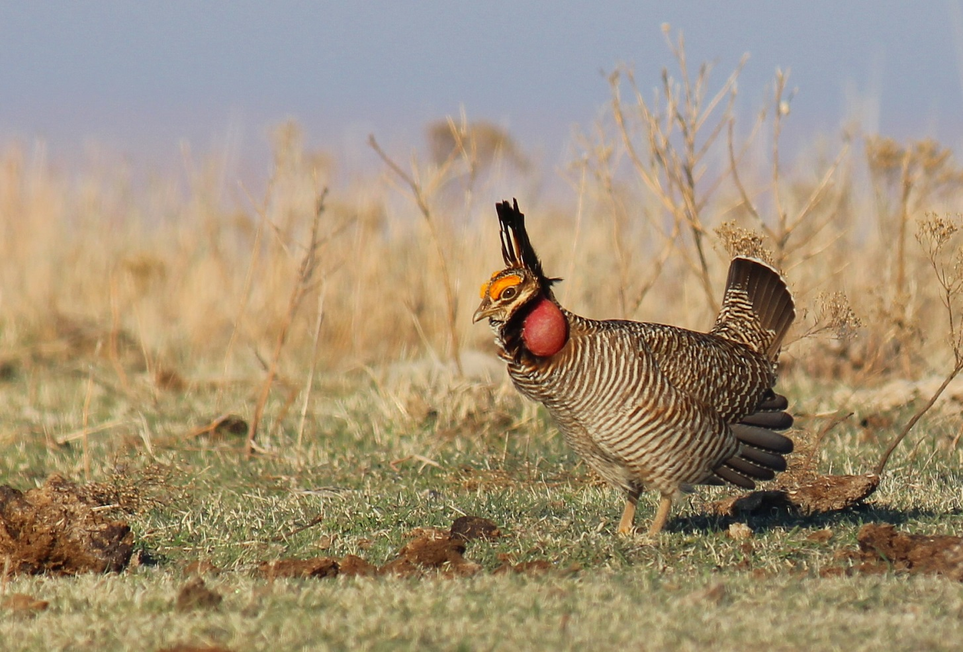
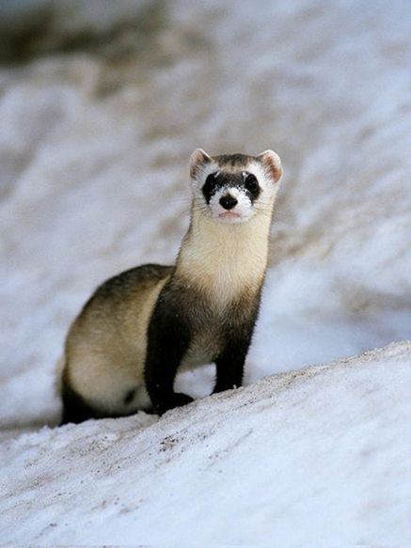
Wildlife Policy Issues for 2015
Endangered Species
Clean Water Act

Slide 2
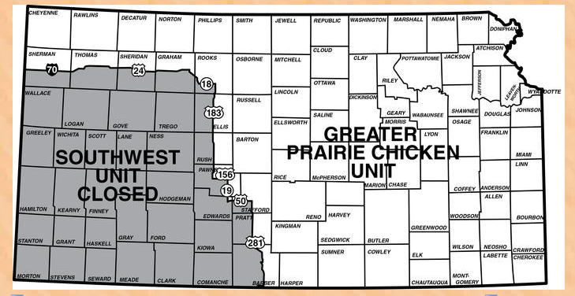
Lesser Prairie Chicken

Slide 4
Black-footed ferret

Slide 5
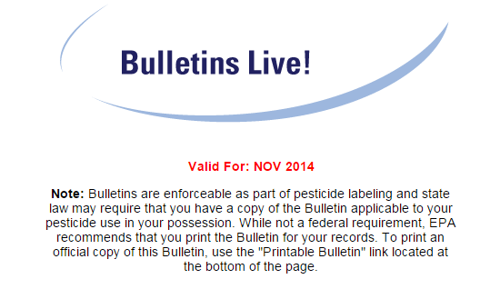
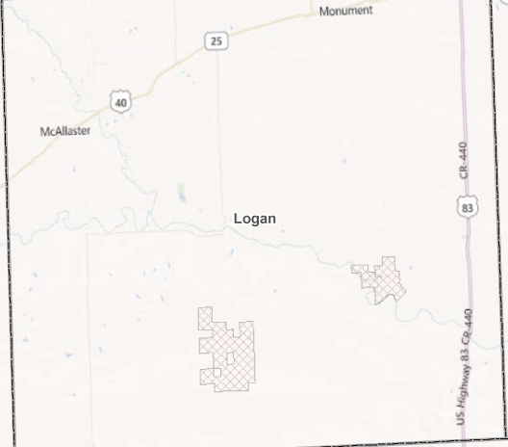

Slide 6
Definitions
“Endangered” means a species is in danger of extinction throughout all or a significant portion of its range. “Threatened” means a species is likely to become endangered within the foreseeable future.
As of August 11, 2014
1,287 species of animals
882 species of plants

Slide 7
History
1973 President Nixon signed the Endangered Species Act (ESA)
1975 Kansas Nongame and Endangered Species Conservation Act
The ESA prohibits harassing, harming, pursuing, hunting, shooting, wounding, killing, trapping, capturing and collecting listed species, unless specifically permitted, or attempting to engage in such activities within the United States
U.S. Supreme Court found that "the plain intent of Congress in enacting" the ESA "was to halt and reverse the trend toward species extinction, whatever the cost.

Slide 8
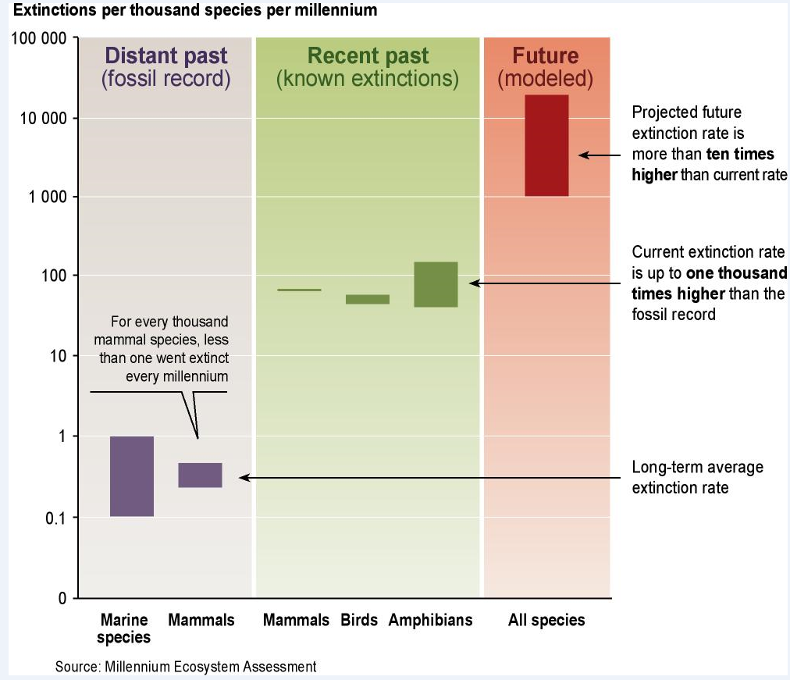
Causes of endangerment
Habitat destruction and degradation
Competition(exotic invasive species)
Pollution
Overexploitation

Slide 9
Petition and listing
1. There is the present or threatened destruction, modification, or curtailment of its habitat or range.
2. An over-utilization for commercial, recreational, scientific, or educational purposes.
3. The species is declining due to disease or predation.
4. There is an inadequacy of existing regulatory mechanisms.
5. There are other natural or manmade factors affecting its continued existence.

Slide 10
Kansas Threatened and Endangered Species (60 species)
Threatened
Mammals
EASTERN SPOTTED SKUNK
Fish
BLACKSIDE DARTER
CHESTNUT LAMPREY
FLATHEAD CHUB
HORNYHEAD CHUB
NEOSHO MADTOM
PLAINS MINNOW
ARKANSAS DARTER
REDSPOT CHUB
SHOAL CHUB
SILVERBAND SHINER
STURGEON CHUB
TOPEKA SHINER
WESTERN SILVERY MINNOW
Birds
PIPING PLOVER
SNOWY PLOVER
Invertebrates
BUTTERFLY MUSSEL
DELTA HYDROBE
FLUTEDSHELL MUSSEL
OUACHITA KIDNEYSHELL MUSSEL
ROCK POCKETBOOK MUSSEL
SHARP HORNSNAIL
Amphibians
EASTERN NARROWMOUTH TOAD
EASTERN NEWT
GREEN FROG
GREEN TOAD
LONGTAIL SALAMANDER
SPRING PEEPER
STRECKER'S CHORUS FROG
Reptiles
BROADHEAD SKINK
CHECKERED GARTER SNAKE
LONGNOSE SNAKE
REDBELLY SNAKE
SMOOTH EARTH SNAKE
TEXAS BLIND SNAKE (NEW MEXICO BLIND SNAKE)
Chelonia
COMMON MAP TURTLE
Endangered
Mammals
GRAY MYOTIS
BLACK-FOOTED FERRET
Fish
PALLID STURGEON
ARKANSAS RIVER SPECKLED CHUB (PEPPERED CHUB)
ARKANSAS RIVER SHINER
SICKLEFIN CHUB
SILVER CHUB
Birds
ESKIMO CURLEW
LEAST TERN
BLACK-CAPPED VIREO
WHOOPING CRANE
Invertebrates
AMERICAN BURYING BEETLE
ELKTOE MUSSEL
ELLIPSE MUSSEL
FLAT FLOATER MUSSEL
MUCKET MUSSEL
NEOSHO MUCKET MUSSEL
OPTIOSERVUS RIFFLE BEETLE
RABBITSFOOT MUSSEL
SLENDER WALKER SNAIL
WESTERN FANSHELL MUSSEL
Amphibians
CAVE SALAMANDER
GROTTO SALAMANDER
MANY-RIBBED SALAMANDER

Slide 11
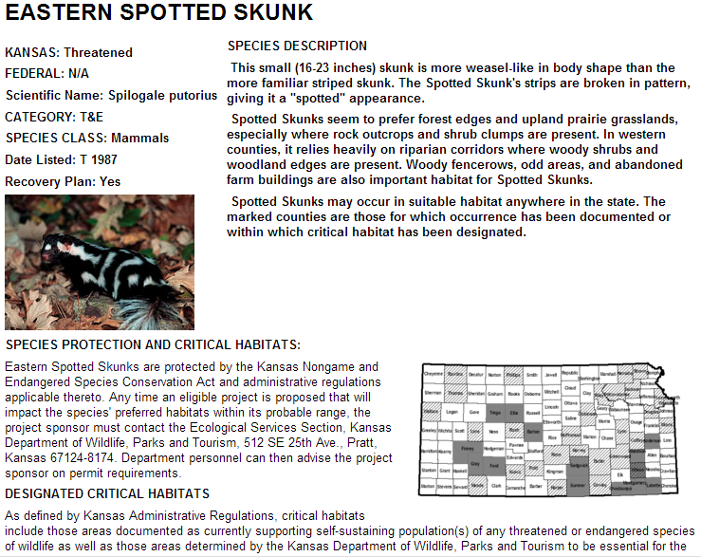
ESA and the 1975 Kansas Nongame and Endangered Species Conservation Act
ESA requires Federal agencies to insure that any action authorized, funded or carried out by them is not likely to jeopardize existence
KDWPT Review required for
Publicly funded projects
KDHE Notice of Intent
DWR or COE permits
Review about 2000/yr.
“action” on about 50

Slide 12
Reviews that require action
Avoidance
Minimize
Mitigation
Compensation

Slide 13
Required mitigation
The goal of a mitigation plan should be to compensate with the same kind of habitat that is lost (i.e. in-kind) and result in 100% replacement of the functional habitat value lost. Compensation will work toward establishing and/or improving permanent habitat. It will be designed to provide maximum benefit to all wildlife species associated with the habitat changed.

Slide 14
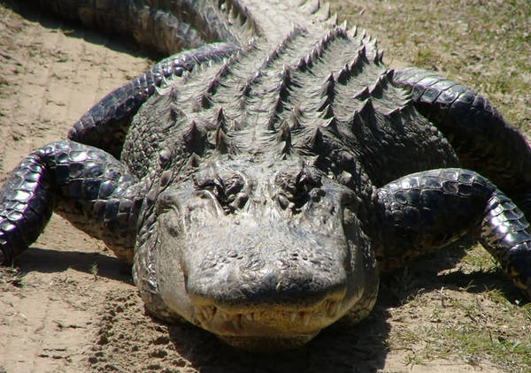
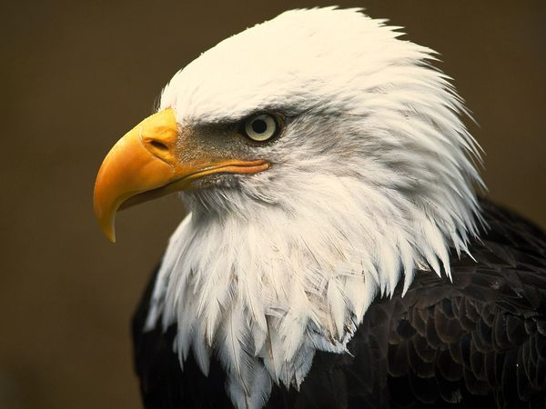
Are species protection and restoration working?
58 U.S. and foreign species have been delisted
30 due to recovery
10 due to extinction
7 for taxonomic revisions
11 for legislative changes
However 35 species reclassified from endangered to threatened

Slide 15
Private property and Fifth amendment takings
Although the supreme court has tried to define which government actions effect a ‘taking” its largely failed
Generally only when a permanent physical occupation of private property or through regulation a total elimination of its economic use and value
If partial elimination
Economic impact
Extent it interferes with reasonable investment expectations
The “character” of the government action

Slide 16
ESA funding
FWS FY2014 request
$255,019,000
All agencies combined spend > $1.7 B

Slide 17
Is the law popular?
(73%) agree with the statement, “Wildlife that is threatened and endangered in Kansas yet abundant in other states should still be protected in Kansas.”
(72%) agree with the statement, “Although only threatened and endangered wildlife are currently protected in Kansas, threatened and endangered plant life should also be protected.”
Nationwide 5% want ESA revoked, 49% want it strengthened.

Slide 18
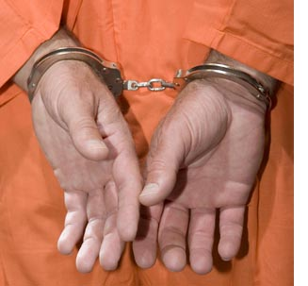
Penalties
$50,000 and one year of jail
126 violations resulted in 86 criminal and 40 civil cases.
Fines up to $50,000 in 59 cases and jail time up to 1,170 days in 18 instances. Probation in 33 cases.

Slide 19
How to fix ESA
Incentives rather than commands
Bison vs cattle
Define “harm” so that it is death or injury to listed species
Funding for compensation comes from where?
Recovery costs must include compensation for landowners loss of land value or loss of income
“Rare mineral/land value increases; rare bird/land value decreases”
Models to follow CRP and WRP
If people who bear the cost of living with wildlife are able to benefit from it, then they will conserve it.

Slide 20
Summary
Desert tortoise and spotted owl-large scale land retirement actions species still declining
Failure can be a success if you learn from it
House passed 4 bills this summer to change ESA
Transparency
Gray literature as science
Limit lawyer pay to <$125/hr on ESA cases
Require FWS to state true costs of implementing

