Slide 1
Drought Concerns for Cattle Producers
Larry C. Hollis, D.V.M., M.Ag.
Extension Beef Veterinarian
Kansas State University

Slide 2
Drought Effects
Water
Quantity
Quality
Feed
Quantity
Quality

Slide 3
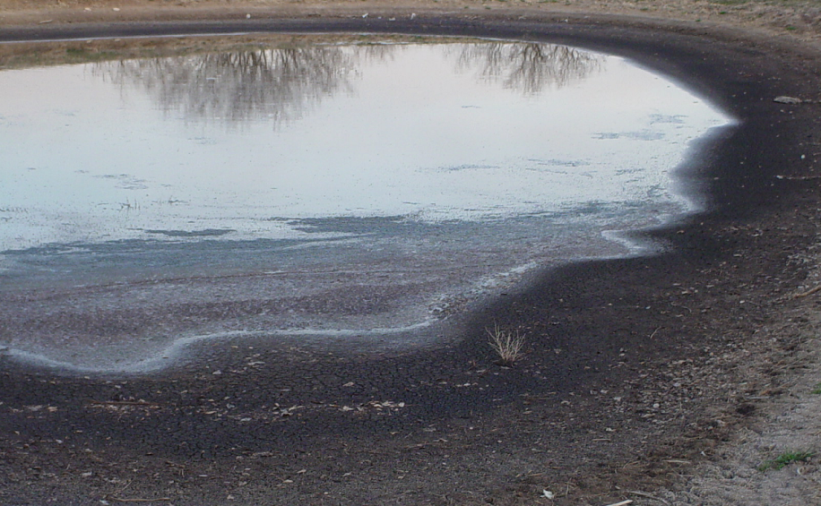
Drought Effects: Water
Reduced quantity and quality

Slide 4
Drought Effects
Concentration of non-volatile toxins:
Salts
Nitrates/nitrites
Toxic runoff or point-source components

Slide 5
Total Dissolved Solids
< 3000 ppm
3000-5000 ppm
5000-7000 ppm
7000-10,000 ppm
Satisfactory
Poor FE; loose stools
Unsafe for pregnant or lactating animals
May cause brain damage or death

Slide 6
Remember
Water = first limiting nutrient
Water intake drives feed intake

Slide 7
Major Livestock Concerns
Loss of performance due to lack of water
Decreased milk production
Decreased gain
Decreased BCS
Increased urinary calculi

Slide 8
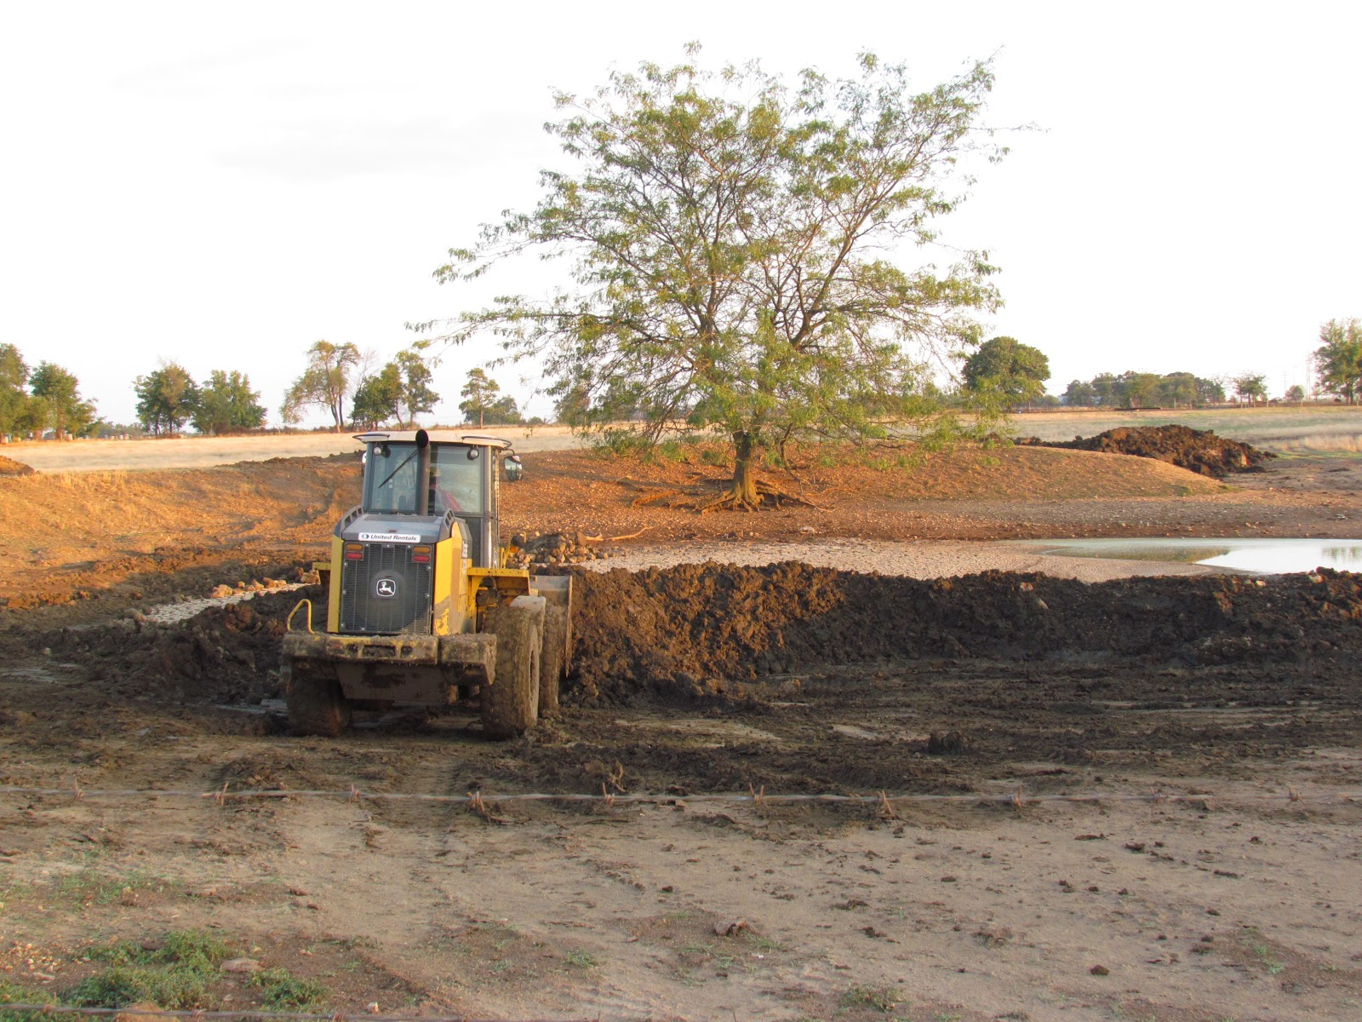

Slide 9
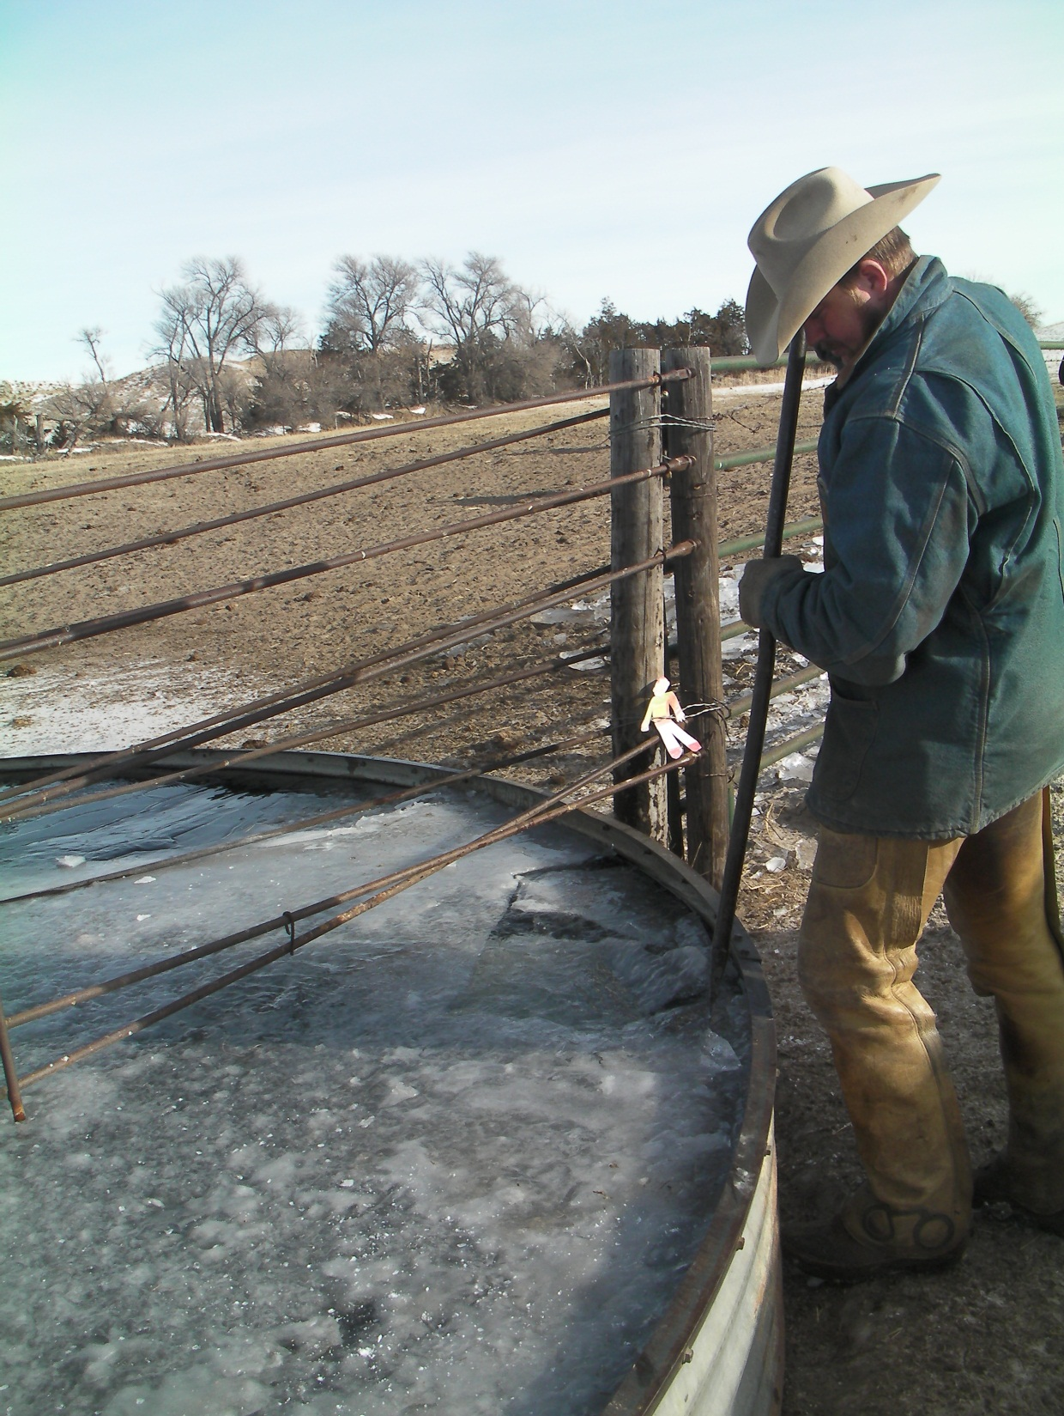

Slide 10
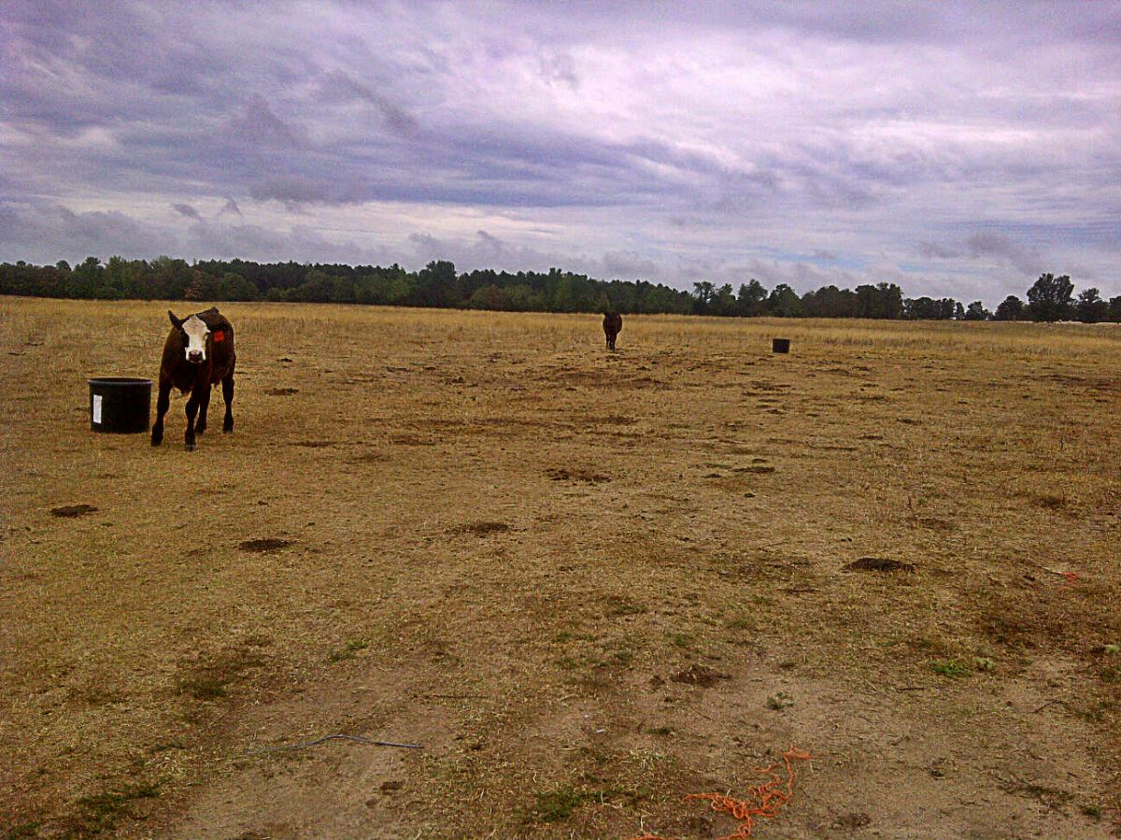
Drought Effects: Feed
Reduced quantity and quality

Slide 11
Drought Effects
Decreased rangeland productivity
Decreased livestock productivity

Slide 12
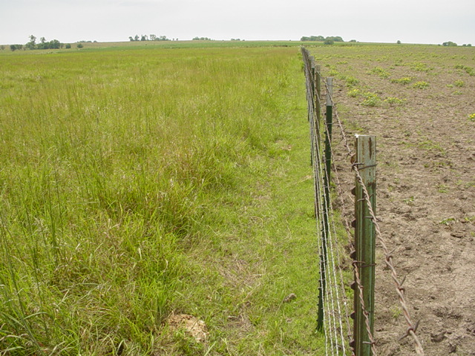
Drought Effects
Decreased crop productivity
Increased plant toxin accumulation
Nitrates
Prussic acid
Aflatoxins

Slide 13
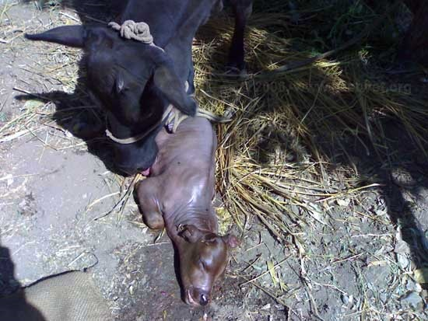
Nitrate Toxicity
Problem primarily in ruminants
Rumen microflora convert nitrate (NO3) to nitrite (NO2)
Reduces Fe in hemoglobin to form methemoglobin (chocolate brown blood)
NO2 shuts down O2-carrying capacity of hemoglobin
Asphyxiation
Abortion in sub-lethal doses

Slide 14
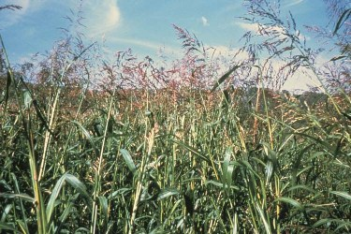
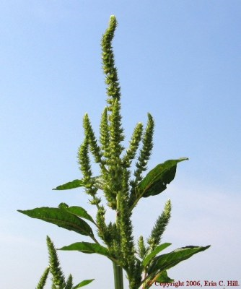
Nitrate Accumulators
Sorghum
Sudangrasses
Forage Sorghums
Grain Sorghums
Johnsongrass
Pearl Millet
Pigweed
Corn (volunteer)

Slide 15
Nitrate Levels
Vary by location in the plant
Stalks > Leaves >> Grain
Vary by age of plant
Young/actively growing > maturing/mature
Vary with soil moisture levels
Drought-stressed
Drought ending rain
Vary with fertilization

Slide 16
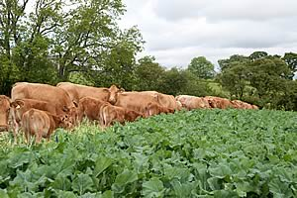
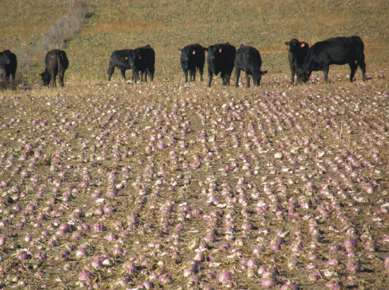
Nitrate Accumulators
Cover crops
Turnips
Radishes

Slide 17
Nitrate Levels
Can increase with cloudy, overcast days
Does not dissipate when harvested as hay

Slide 18
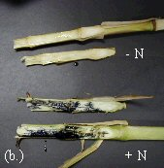
Managing Toxicity
Test plants before grazing or harvesting
Diphenylamine spot test – qualitative
Quantitative testing
Notes:
Talk about corners of fields “border effect”

Slide 19
Testing Labs
Agronomy Dept
SDK – Hutchinson
ServiTech – Dodge City, Hastings, Amarillo

Slide 20
Interpretation of Forage Nitrate Test
ppm NO3 (dry matter basis)
0-3,000
3,000-5,000
5,000-10,000
>10,000
Interpretation
Generally safe for all cattle.
Generally safe for non-pregnant beef cattle. Low risk or reduced breeding performance and early term abortions.
Some risk for all cattle. May cause mid to late term abortions and weak newborn calves. May decrease growth and milk production.
Potentially toxic for all cattle. Can cause abortions, acute toxicity symptoms, and death.

Slide 21
Managing Toxicity
Test plants before grazing or harvesting
Don’t graze or harvest “hot spots”
Raise cutter bar when harvesting
Ensiling will reduce NO3 ≈ 20-50%
Control weedy accumulator species
Do not turn hungry cattle in on suspect forages
Cattle can partially adapt over time
Notes:
Talk about corners of fields “border effect”

Slide 22
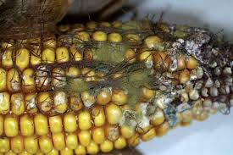
Fungal (Myco)toxins
Fungus:
Aspergillus flavus
Fusarium graminearum
Fusarium spp.
Aspergillus & Penicillium spp
Fusarium verticillioides
Toxin:
Aflatoxins
Trichothecenes
Vomitoxin (DON)
T-2
Zearalenone
Ochratoxin
Fumonisins
Notes:
Deoxynivalenol

Slide 23
Mycotoxins
Dose-dependent response
Death
Sudden
Gradual onset
Organ damage
Performance loss
Reduced feed intake
Performance loss
Young animals most susceptible

Slide 24
Mycotoxin effects
Hepatotoxic
Nephrotoxic
Impaired protein synthesis
Carcinogenic
Embryotoxic
Impaired immune function
Pulmonary edema
Ovarian dysfunction

Slide 25
Aflatoxin
FDA guidelines for acceptable aflatoxin level in corn based on intended use (www.fda.gov).
Intended use Max. legal aflatoxin level
Milk (dairy calf feed) None detected
Corn of unknown destination <20 ppb
Corn for young animals <20 ppb
Corn for dairy cattle <20 ppb
Corn for breeding beef cattle, swine, <100 ppb
and mature poultry
Corn for finishing swine <200 ppb
Corn for finishing cattle <300 ppb

Slide 26
Fumonisin
Equine Leukoencephalomalacia
“Moldy corn poisoning”
TVMDL - Amarillo
ces.purdue.edu
Notes:
Floor sweepings

Slide 27
Toxic Plants
Lack of available forage will force cattle to eat toxic plants that they would normally ignore.

Slide 28
Drought Effects: Summary
Water
Quantity
Quality
Feed
Quantity
Quality

