Slide 1
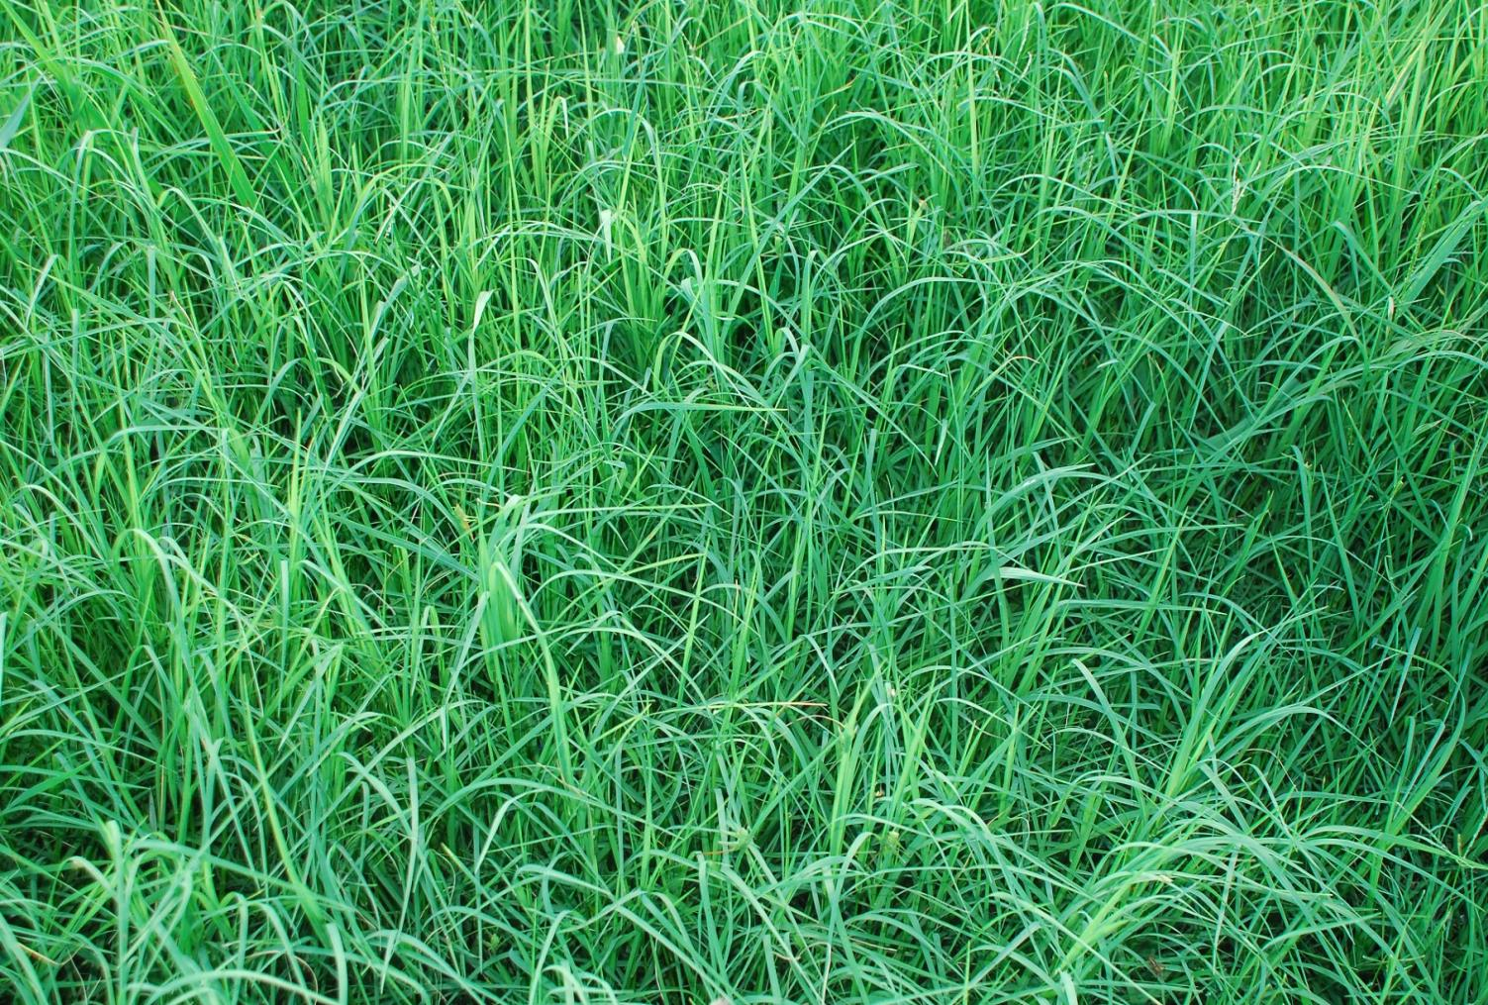
Bermudagrass Project
Keith Martin, Josh Coltrain and Jeri Geren
Meeting - Producer Relationships - Results

Slide 2
Parsons Silt Loam Soil
Trial site

Slide 3
Treatment List - 2013
TRT# | Treatments | N rate (lbs/a) | Rep1 | Rep2 | Rep3
1 | NH4 | 0 | 101 | 203 | 304 | 17' by 60' long
2 | NH4 | 60 | 102 | 201 | 303
3 | NH4 | 120 | 103 | 204 | 301
4 | NH4 | 180 | 104 | 202 | 302
5 | Urea | 0 | 105 | 208 | 306 | 10' by 50' long
6 | Urea | 60 | 106 | 205 | 308
7 | Urea | 120 | 107 | 206 | 307
8 | Urea | 180 | 108 | 207 | 305
9 | AmmNit | 0 | 109 | 211 | 310 | 10' by 50' long
10 | AmmNit | 60 | 110 | 210 | 312
11 | AmmNit | 120 | 111 | 212 | 309
12 | AmmNit | 180 | 112 | 209 | 311
13 | Urea+Agrotain | 0 | 113 | 214 | 316 | 10' by 50' long
14 | Urea+Agrotain | 60 | 114 | 215 | 314
15 | Urea+Agrotain | 120 | 115 | 213 | 315
16 | Urea+Agrotain | 180 | 116 | 216 | 313

Slide 4
Treatment Map 2013

Slide 5
Treatment Map - 2015
 | 17' wide |  |  |  |  | 10' wide
70' long | 104 | 112 | 204 | 212 | 304 | 312
 |  | 111 |  | 211 |  | 311
 | 103 | 110 | 203 | 210 | 303 | 310
 |  | 109 |  | 209 |  | 309
 | 102 | 108 | 202 | 208 | 302 | 308
 |  | 107 |  | 207 |  | 307
 | 101 | 106 | 201 | 206 | 301 | 306
 |  | 105 |  | 205 |  | 305
NH4 | Urea + A | NH4 | Urea | NH4 | Urea + A
 | Urea + A |  | Urea |  | Urea + A
NH4 | Urea + A | NH4 | Urea | NH4 | Urea + A
 | Urea + A |  | Urea |  | Urea + A
NH4 | Urea | NH4 | Urea + A | NH4 | Urea
 | Urea |  | Urea + A |  | Urea
NH4 | Urea | NH4 | Urea + A | NH4 | Urea
 | Urea |  | Urea + A |  | Urea

Slide 6
Trial Procedures
Producer apply NH4 in strips north and south where designated in the Treatment Map
Researchers will apply the Urea, AmNit, and Urea+Agrotain soon after NH4 application
Researchers will supply enclosure fencing
Solar electric fence
Forage measurements
Tonnage
Protein and quality

Slide 7
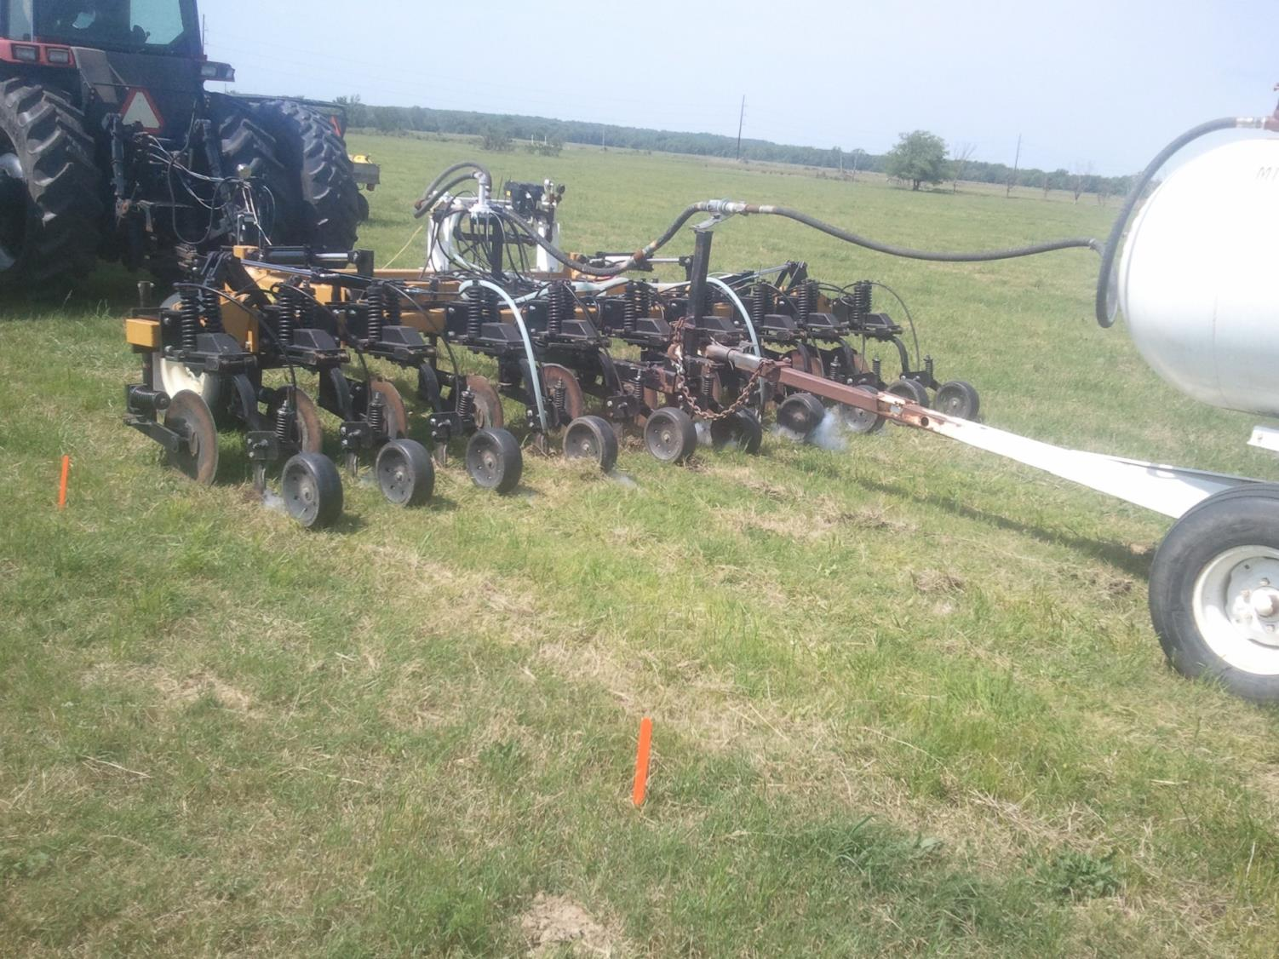

Slide 8
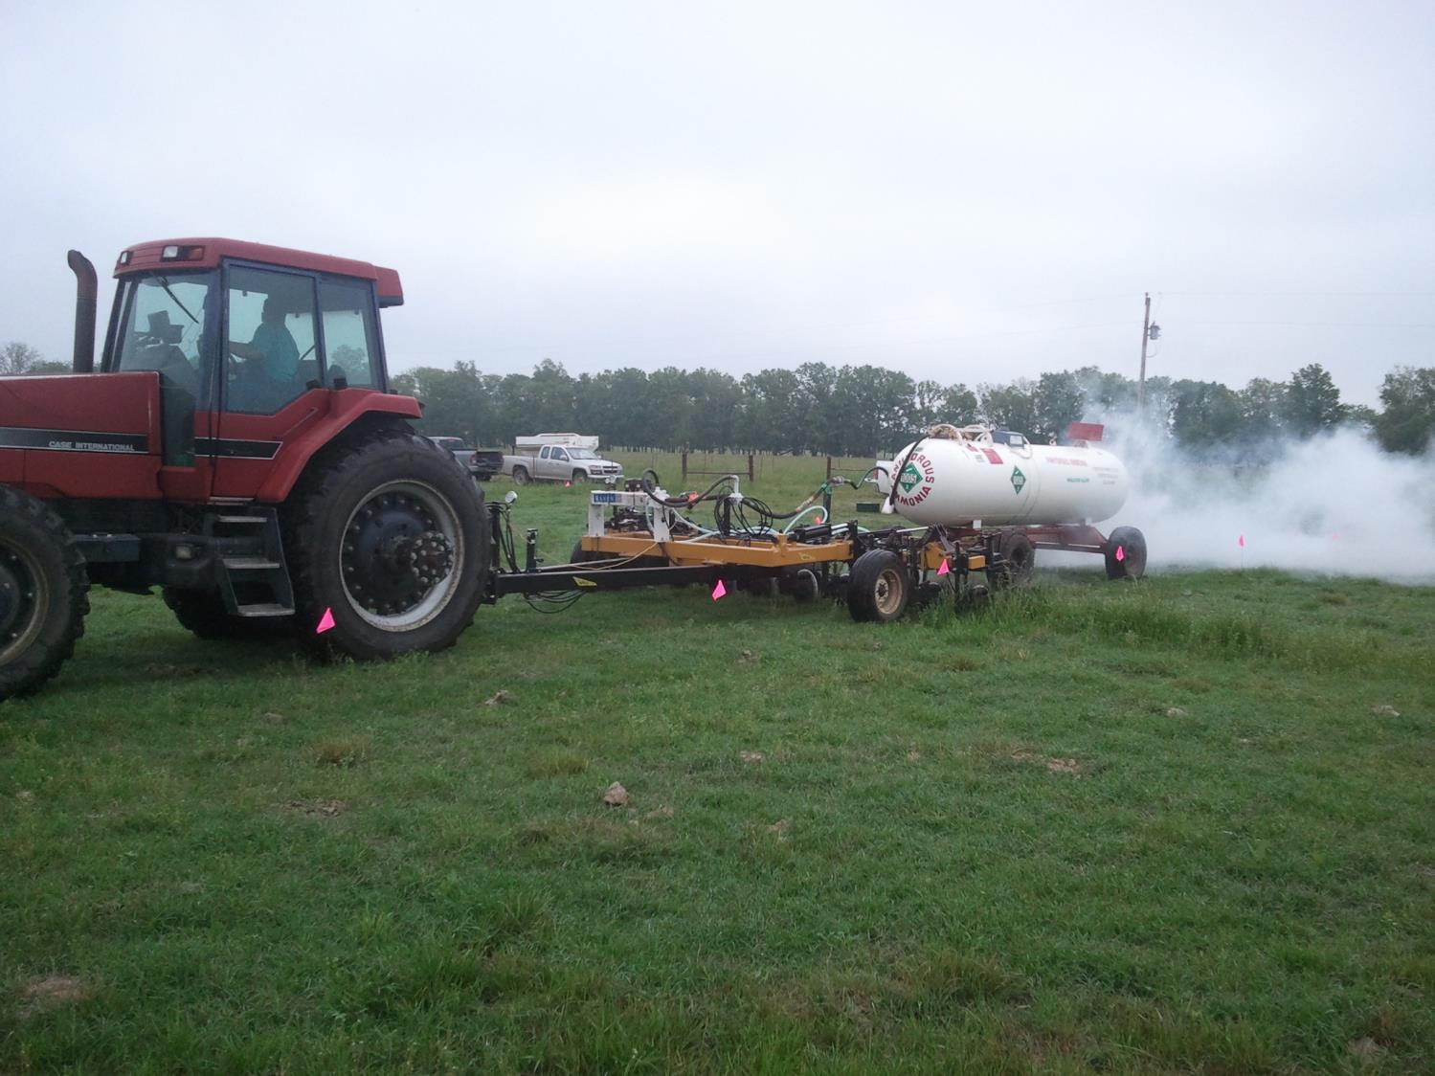

Slide 9
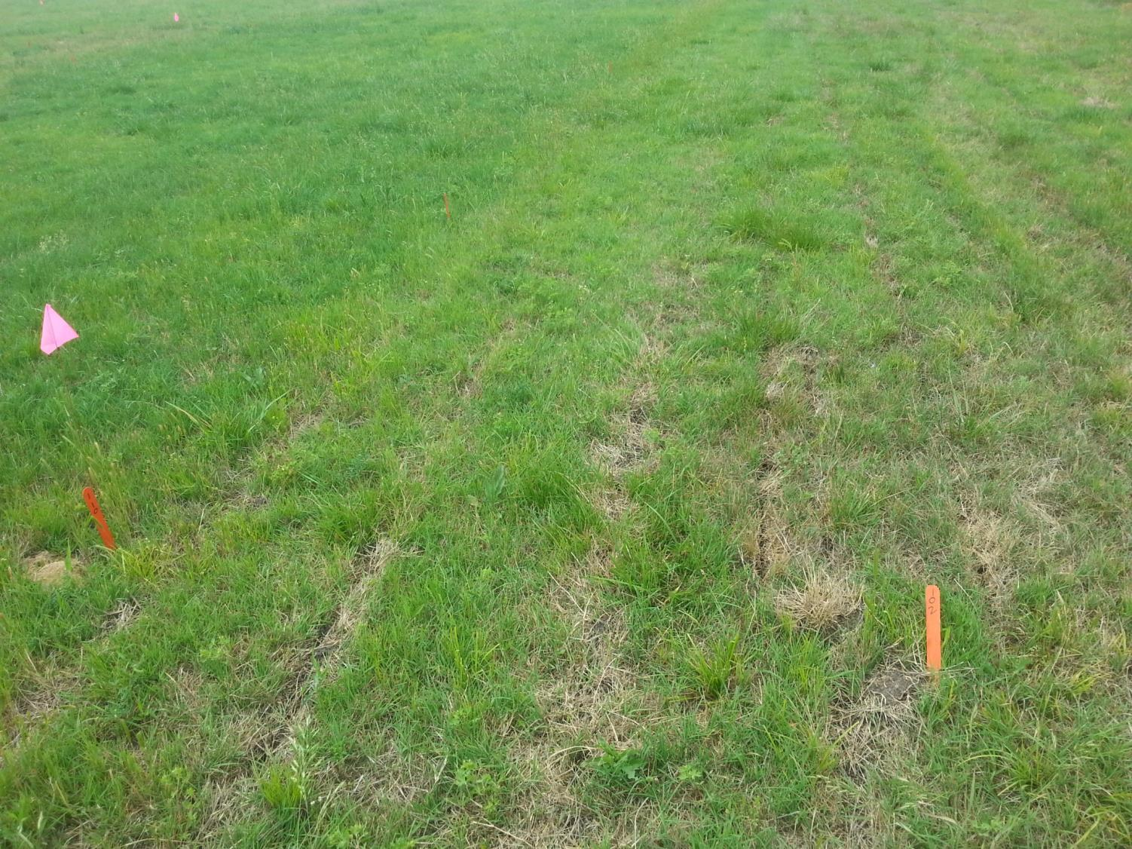

Slide 10
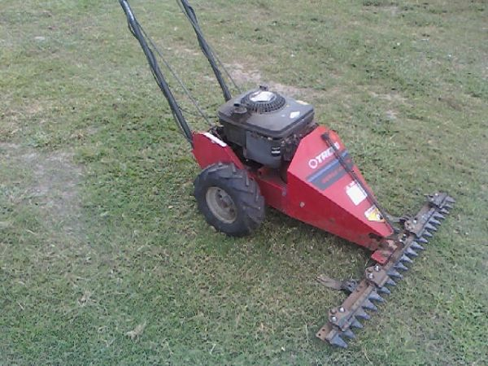
Harvest

Slide 11
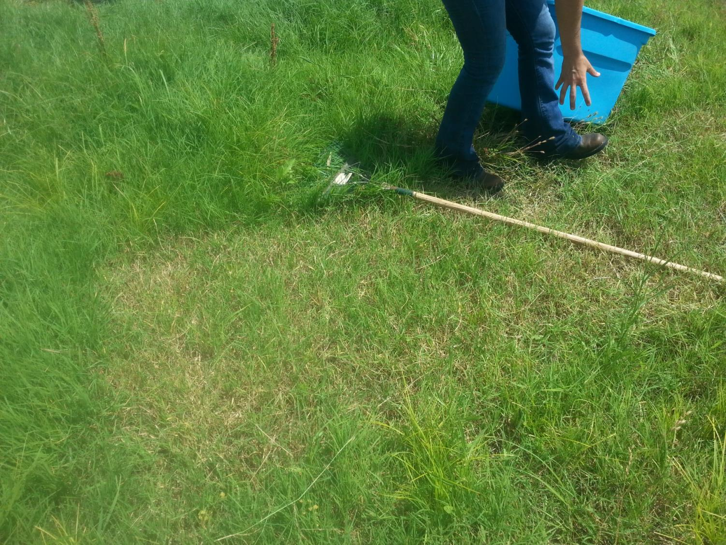

Slide 12
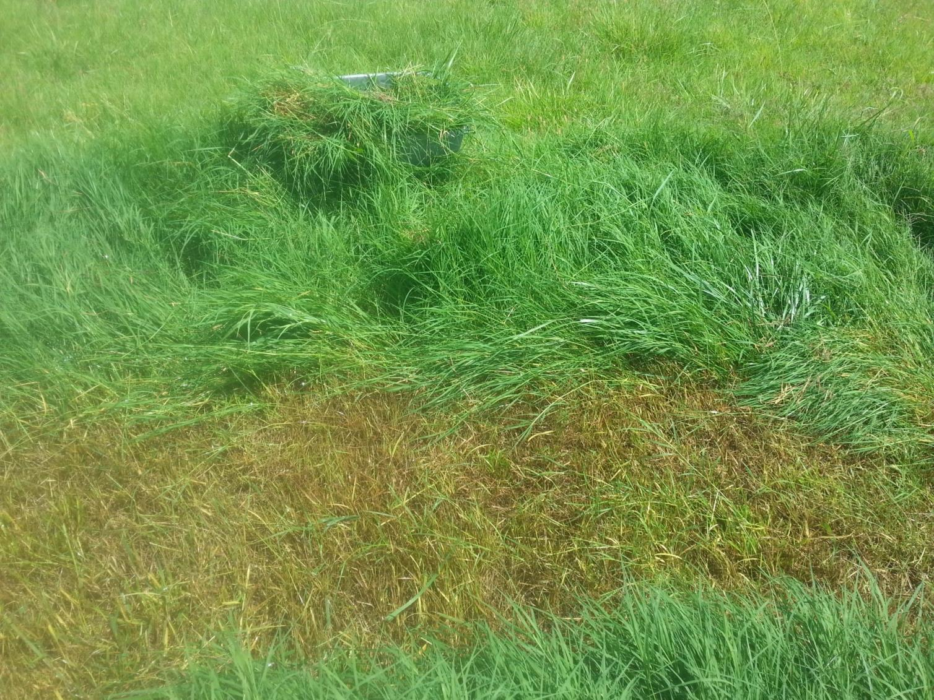

Slide 13
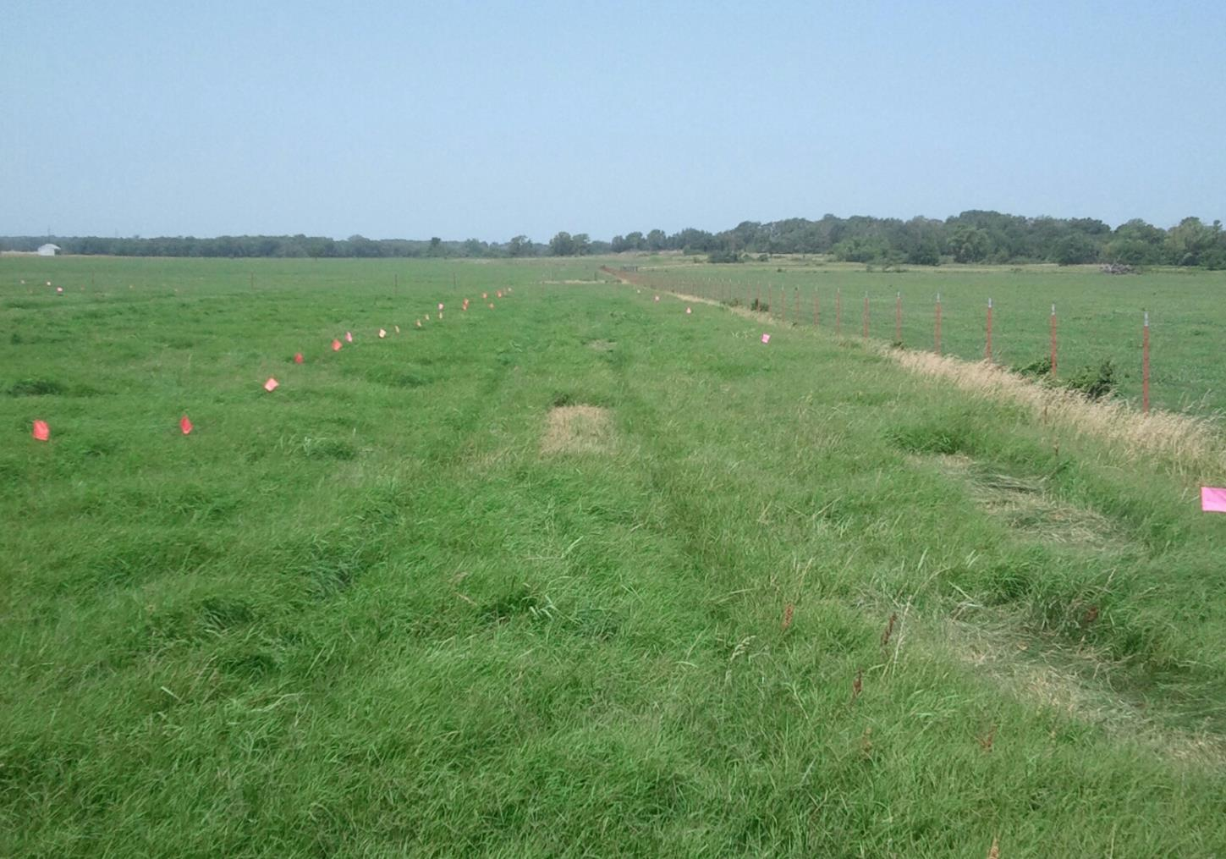

Slide 14
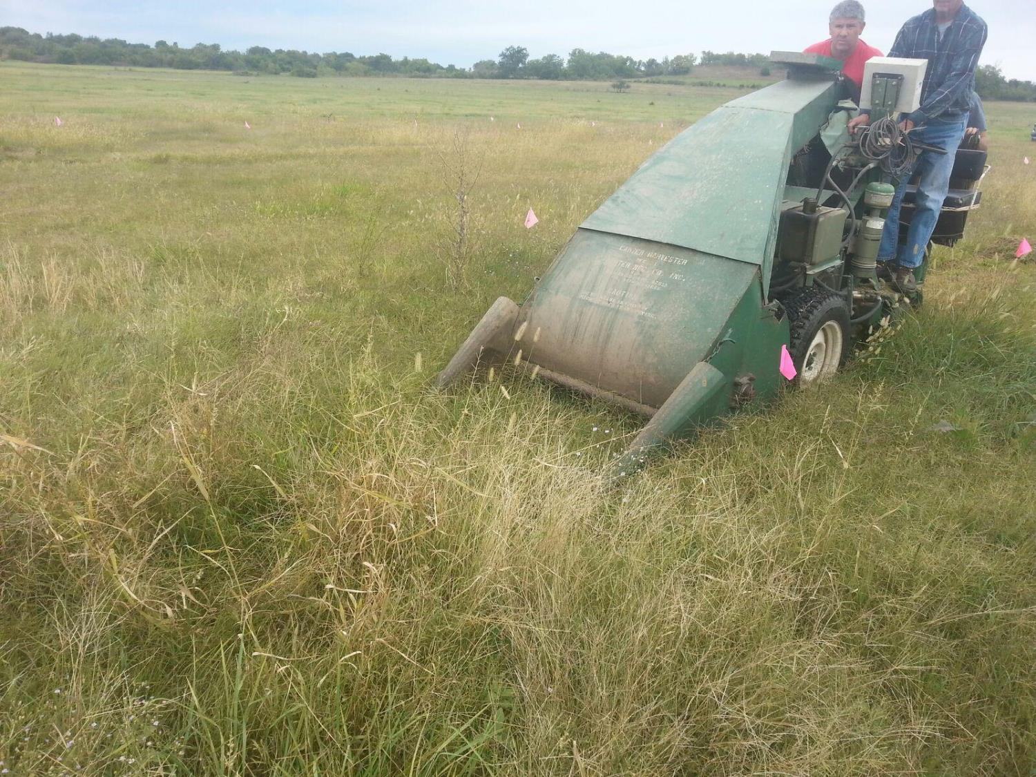

Slide 15
Results

Slide 16
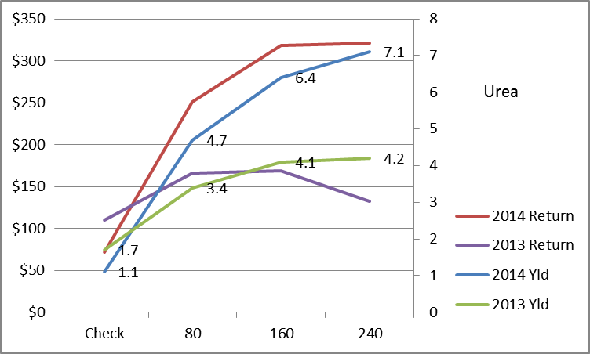

Slide 17
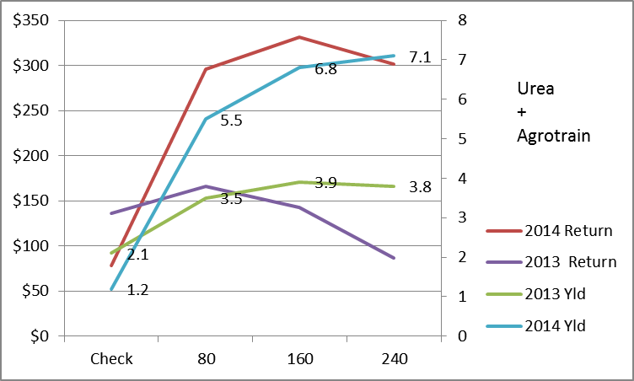

Slide 18
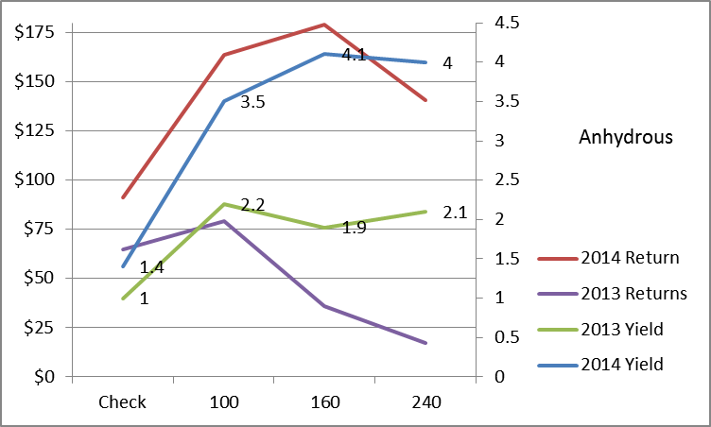

Slide 20
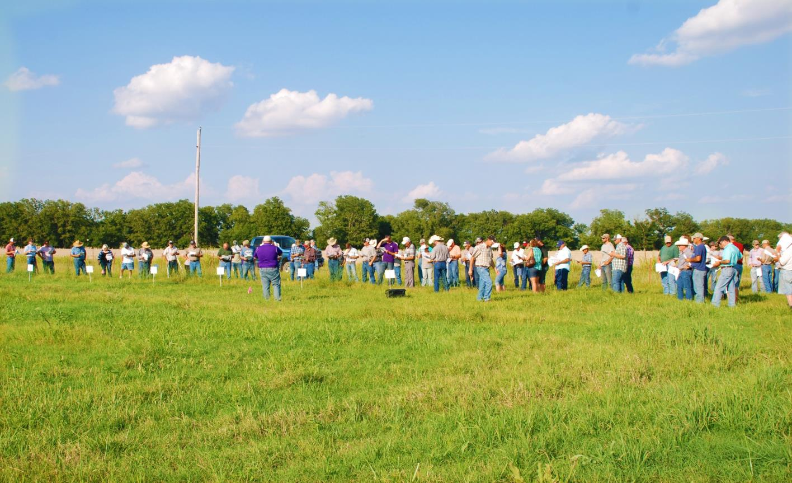

Slide 21
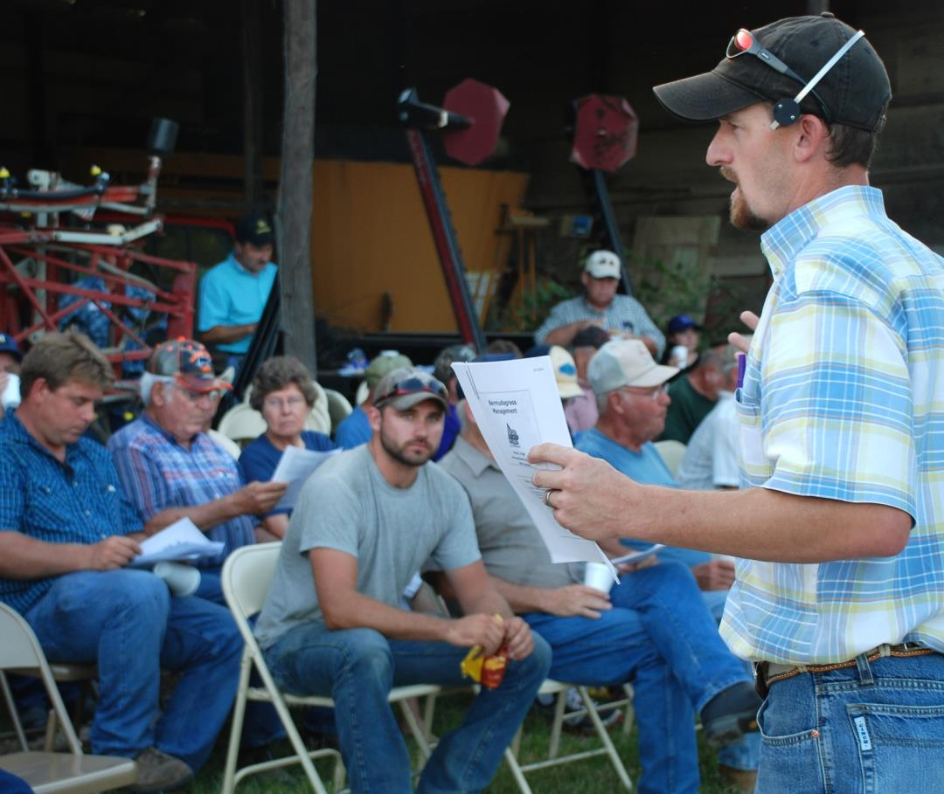

Slide 22
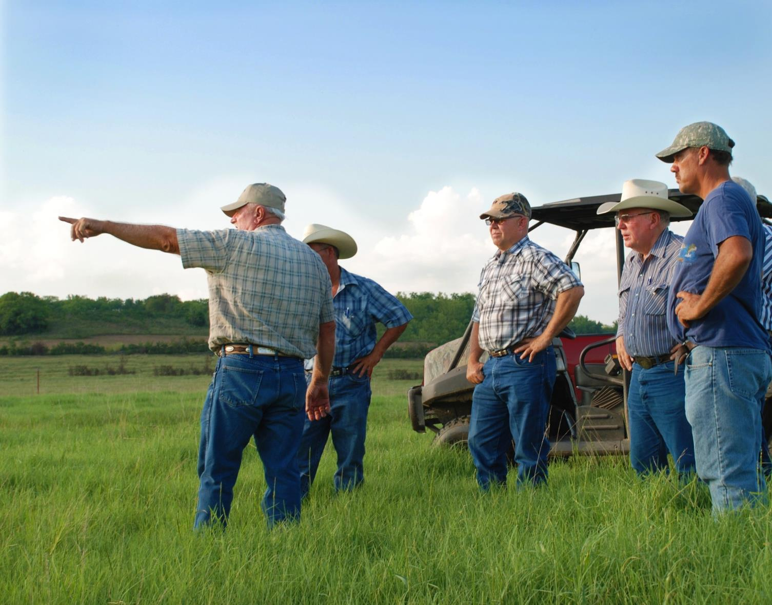

Slide 24
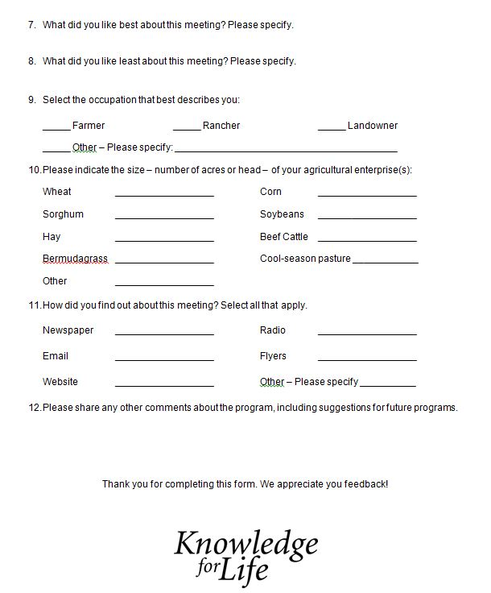

Slide 25
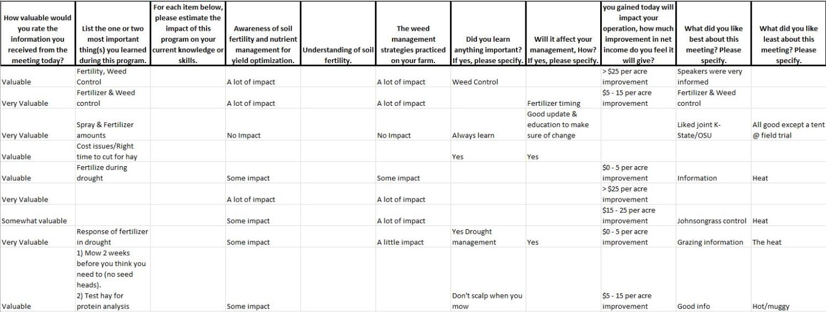
Sample KPICS Data Compilation

Slide 26
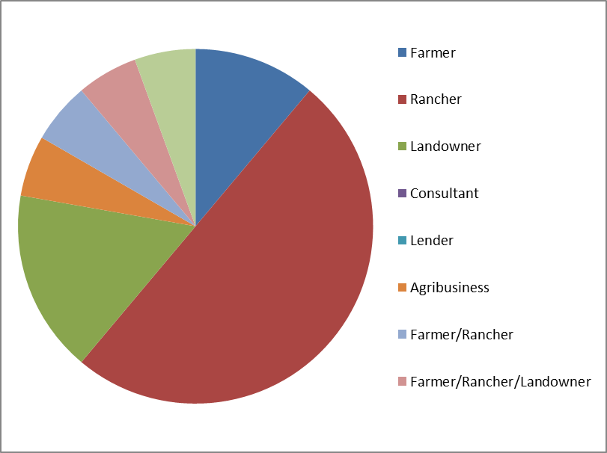
Audience

Slide 27
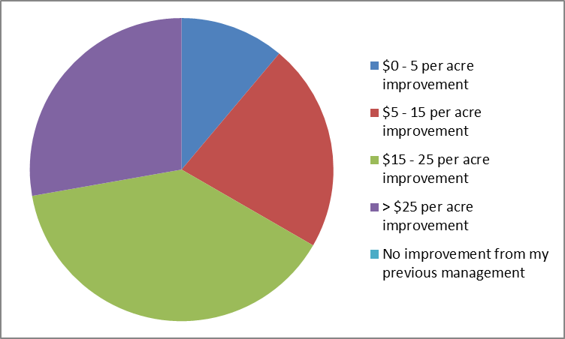
Improvement in Net Income Per Acre

Slide 28
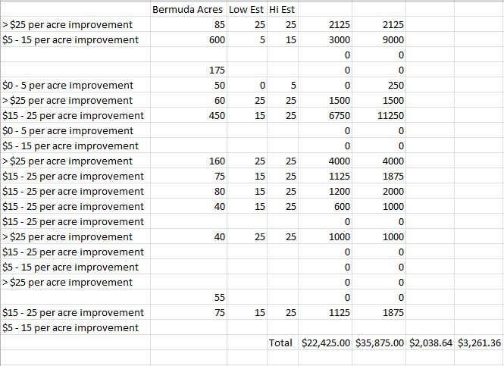
Data Results

Slide 29
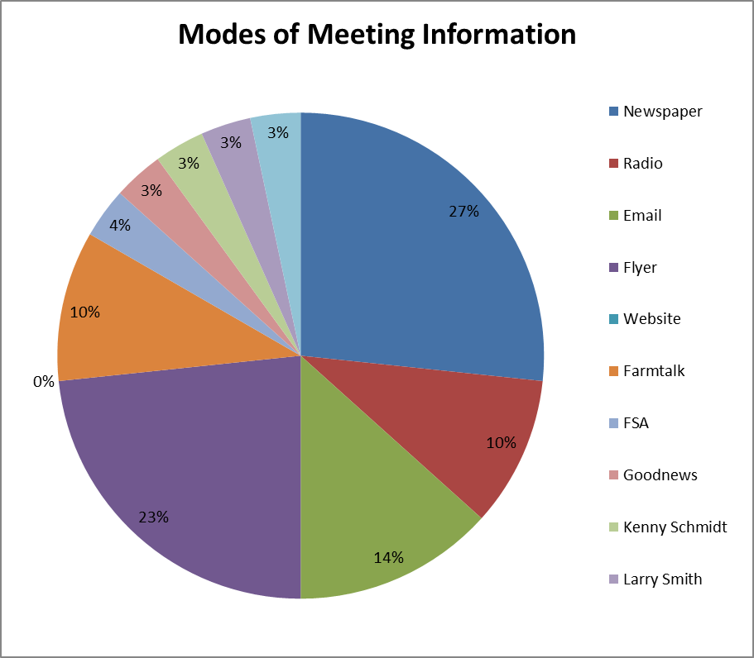

Slide 30
Questions

