Slide 1
Prussic acid
(name)
Kansas State University

Slide 2
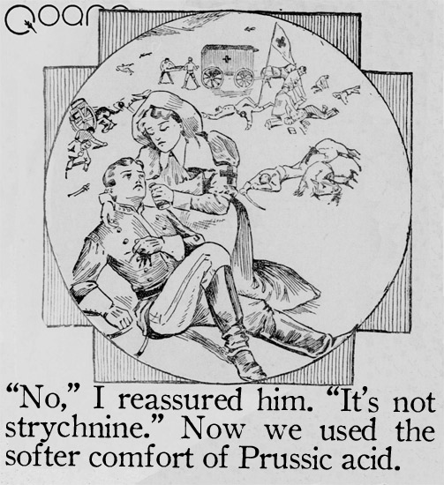
Mode of action
Aka hydrocyanic acid poisoning or cyanide poisoning
Occurs when consuming cyanogenic glycosides
Cyanogenic glycosides are in the epidermal cells of plants
http://qoana.com/blog/?p=1487

Slide 3
Mode of action
Mastication mixes enzymes and dhurrin leaving aglycone from which HCN is released
HCN is absorbed in rumen wall
Cattle will then have rapid, then labored slow breathing, muscle spasms, and dilated pupils
Death occurs in 15 minutes up to 2 hours after ingestion
Asphyxiation
Blood color is “cherry red”
Overabundance of oxygen in blood but cells can’t use it
If cattle live past 2 hours then recovery is likely

Slide 4
Testing and Treatment
2 mg/pound of body weight per hour will kill an animal
0.02% prussic acid considered dangerous
Treatment:
Sodium nitrate (1.2%) and sodium thiosulfate (7.4%) in a 125-250 cc dose
Before the heart stops – you may save the animal
Make sure diagnosis is correct – nitrate toxicity symptoms same as prussic acid except:
Blood is “chocolate brown”
Symptoms manifest hours after consumption

Slide 5
Important note
Nitrate toxicity and prussic acid poisoning are NOT related
Notes:
We often talk about prussic acid and nitrates in the same sentence but these are two independent disorders that often occur within the same plants and can be caused by similar weather and fertility issues. Management practices are different for each disorder so make sure you are correctly managing for the disorder of interest with your grazing and harvesting methods.

Slide 6
Managing for prussic acid
Identify periods when prussic acid will be high and avoid grazing
Identify plants that have prussic acid potential
Develop grazing management plan
Heavier stocking is better (4-6 AU/acre)
Improper soil fertility can increase prussic acid issues:
Found to a higher degree in soils with high N and deficient in P and potash
Split N application reduce risk of both nitrates and prussic acid

Slide 7
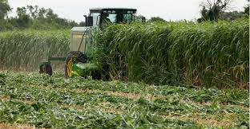
Managing for prussic acid
Process of haying or ensiling will completely remove all issues with prussic acid
Damaging the epidermal layers will allow the cyanide to evaporate
Still do not consume until after 10 days of curing or ensiling
Prussic acid will be high
immediately following harvest

Slide 8
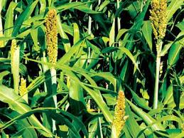
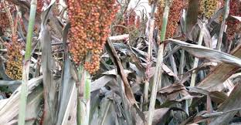
Managing for prussic acid
Periods when prussic acid is high
Drought
Drought-breaking rain
Immature plants
Sprouts
Killing freeze
Severe damage to plant
Hail
Herbicide

Slide 9
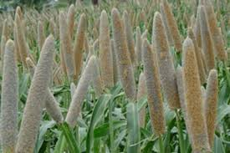
Managing for prussic acid
Susceptible plants
Safe
Sorghums
Millets
Johnsongrass
Sudan grass
Sorghum-sudans
Common milkweed
Many stone fruits
Wild cherry
Black nightshade
Horsenettle
Pearl millet
Foxtail millet
Corn

Slide 10
Managing for prussic acid
Grazing management plans will be different based on which annual forage
Sorghums, Johnsongrass
Wait to graze until plants are taller than 24 inches
Rotational or strip grazing is the best option
If you are rotationally grazing make sure to leave ~8 inches for re-growth
Want to consume the paddock within 10 days to prevent grazing of re-growth
Takes ~25 days before growing back to 24 inch

Slide 11
Managing for prussic acid
Grazing management plans will be different based on which annual forage
Sudangrass, sorghum-sudan, millets
Wait to graze until plants are taller than 18 inches
Rotational or strip grazing is the best option
If you are rotationally grazing make sure to leave ~8 inches for re-growth
Want to consume the paddock within 10 days to prevent grazing of re-growth
Takes ~21 days before growing back to 18 inch

Slide 12
Managing for prussic acid
Process of haying or ensiling will completely remove all issues with prussic acid
Damaging the epidermal layers will allow the cyanide to evaporate
Still do not consume until after 10 days of curing or ensiling
Prussic acid will be high
immediately following harvest

Slide 13
Managing for prussic acid
Wait at least 10 days after killing freeze before grazing milo stalks, standing sorghums/millets, etc
This allows enough time for the cyanide to evaporate
After hay harvest you can graze the regrowth, just make sure it is either:
Taller than 24 inches if sorhgum, 18 inches if millet
Has been killed by freeze at least 10 days ago

Slide 14
Managing for prussic acid
Drought breaking rain
The plants will immediately go to growing, generating new sprouts possibly
Fast growth in susceptible plants will result in high levels
Wait to graze until has met height rule
Wait a minimum of a week after drought breaking rain (DO NOT graze within 4 days of drought breaking rain)

Slide 15
Managing for prussic acid
Prussic acid is very concerning with the fact it kills so rapidly
Management practices can drastically reduce risk of toxicity
Planning is important with grazing of prussic acid plants
Haying and ensiling are a safe way to feed prussic acid susceptible plants

Slide 16
Questions?

