Slide 1
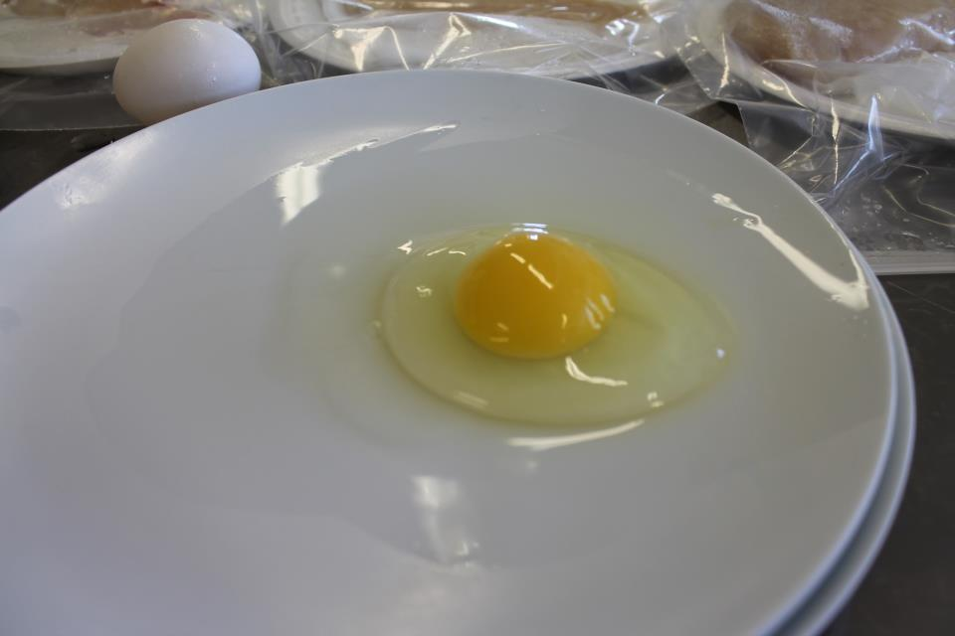
Indicate the USDA grade for this broken out egg.
1

Slide 2
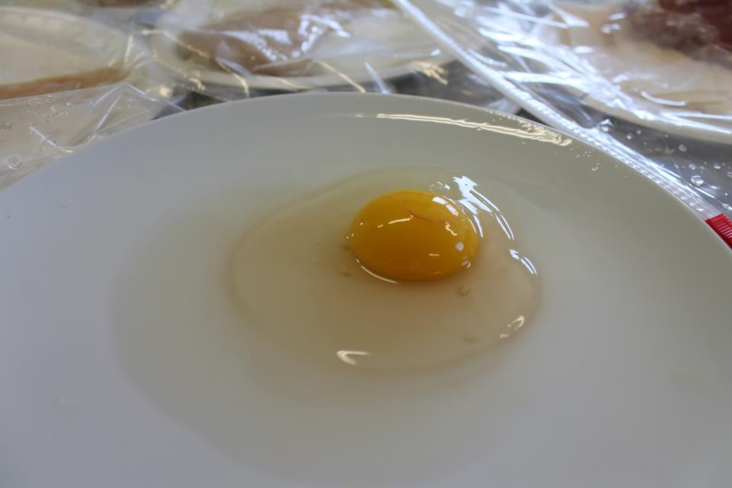
Indicate the USDA grade for this broken out egg.
2

Slide 3
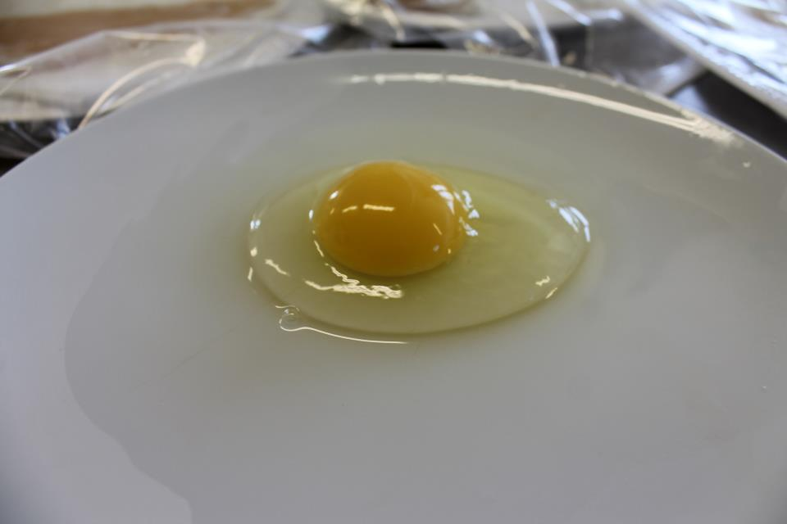
Indicate the USDA grade for this broken out egg.
3

Slide 4
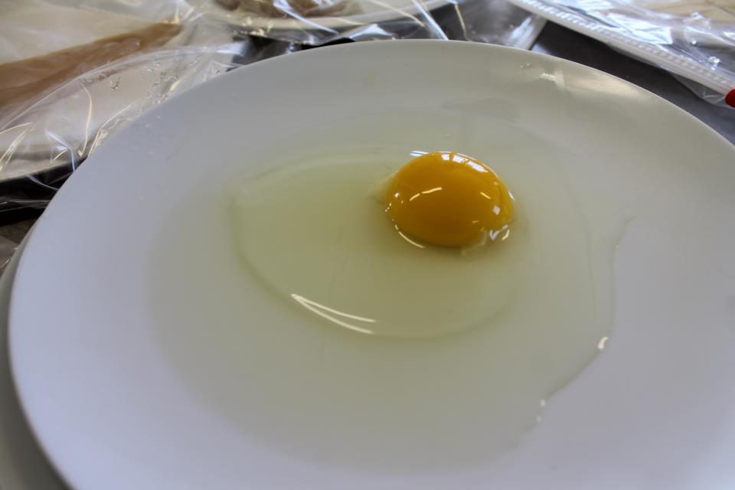
Indicate the USDA grade for this broken out egg.
4

Slide 5
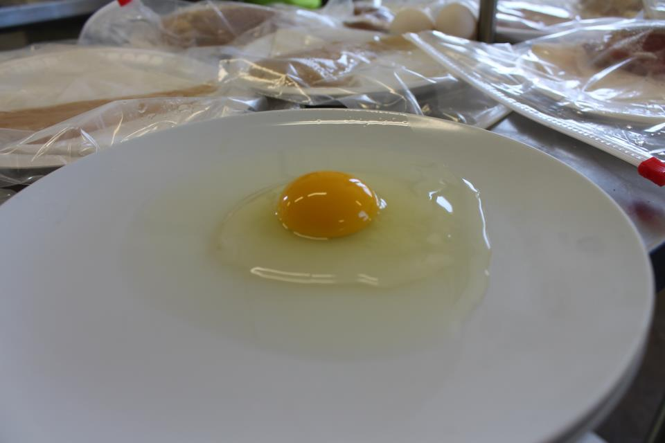
Indicate the USDA grade for this broken out egg.
5

Slide 6
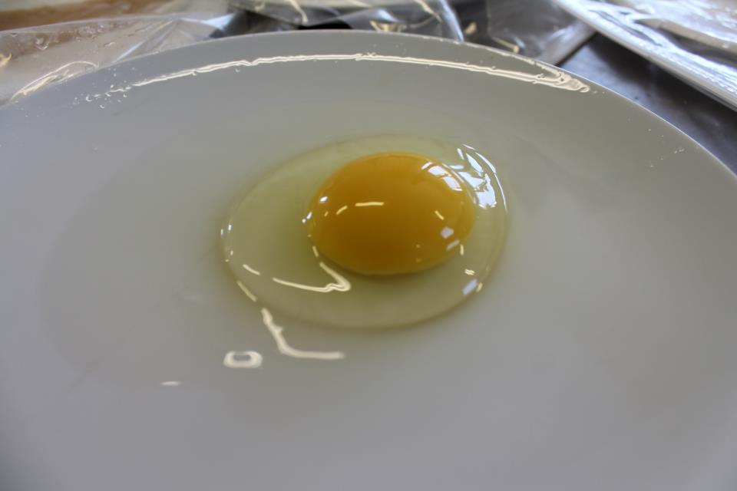
Indicate the USDA grade for this broken out egg.
6

Slide 7
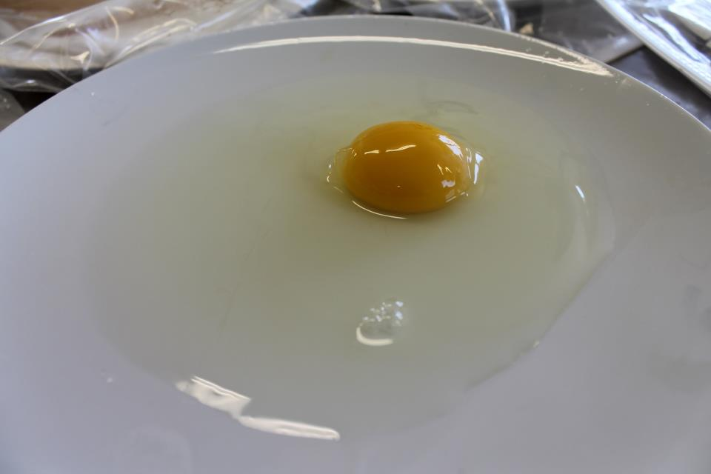
Indicate the USDA grade for this broken out egg.
7

Slide 8
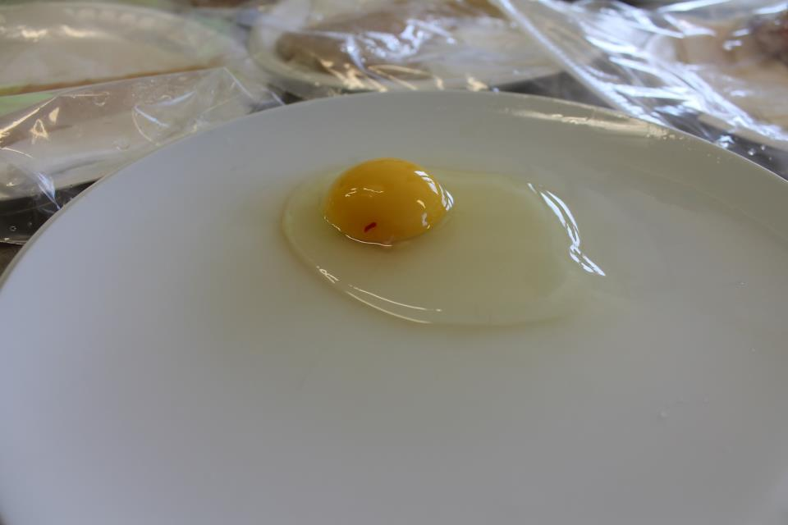
Indicate the USDA grade for this broken out egg.
8

Slide 9
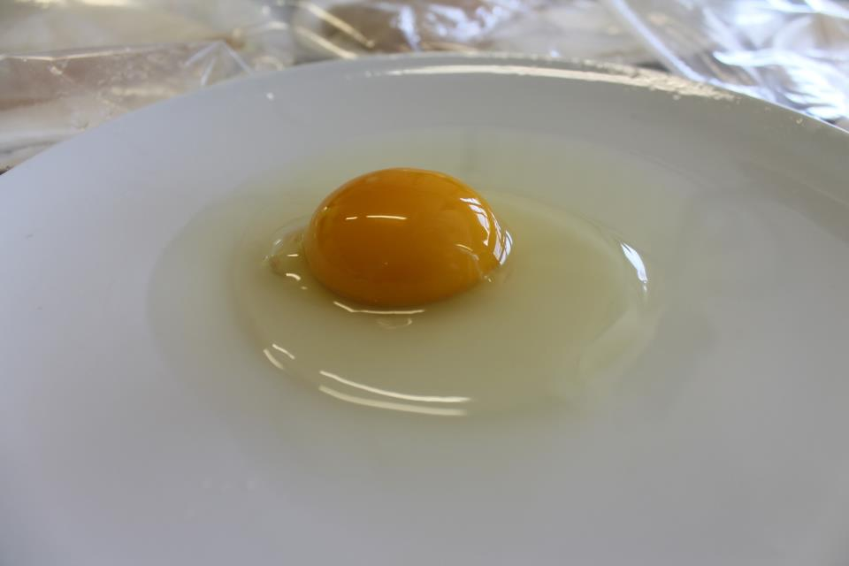
Indicate the USDA grade for this broken out egg.
9

Slide 10
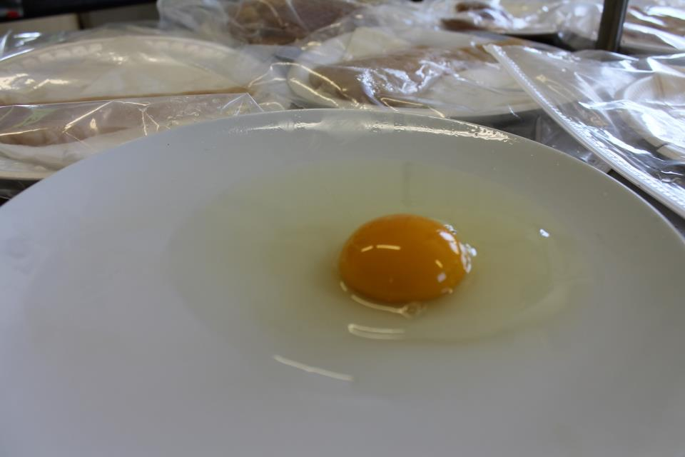
Indicate the USDA grade for this broken out egg.
10

Slide 11
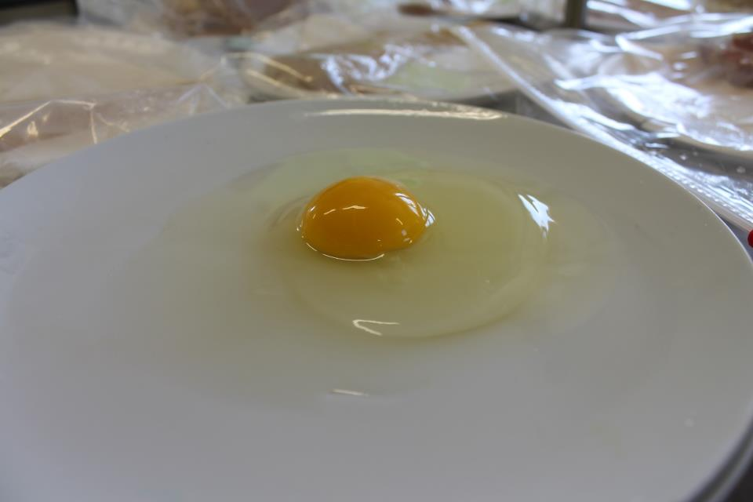
Indicate the USDA grade for this broken out egg.
11

Slide 12
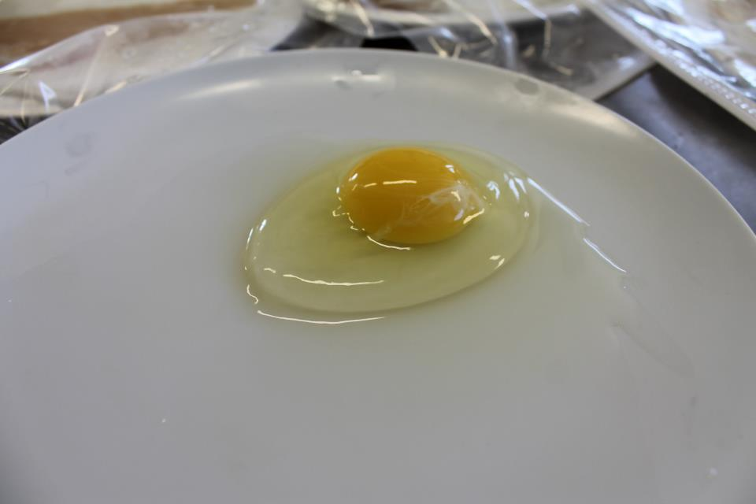
Indicate the USDA grade for this broken out egg.
12

Slide 13
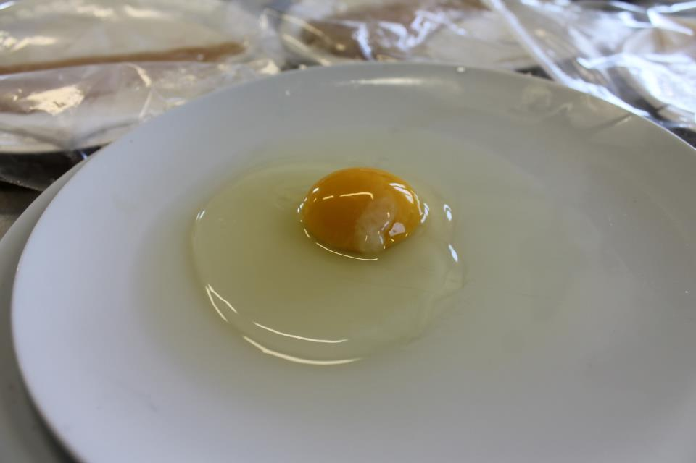
Indicate the USDA grade for this broken out egg.
13

Slide 14
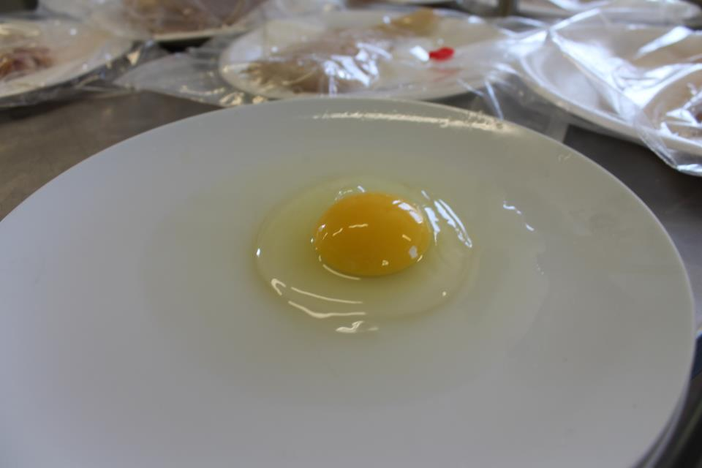
Indicate the USDA grade for this broken out egg.
14

Slide 15
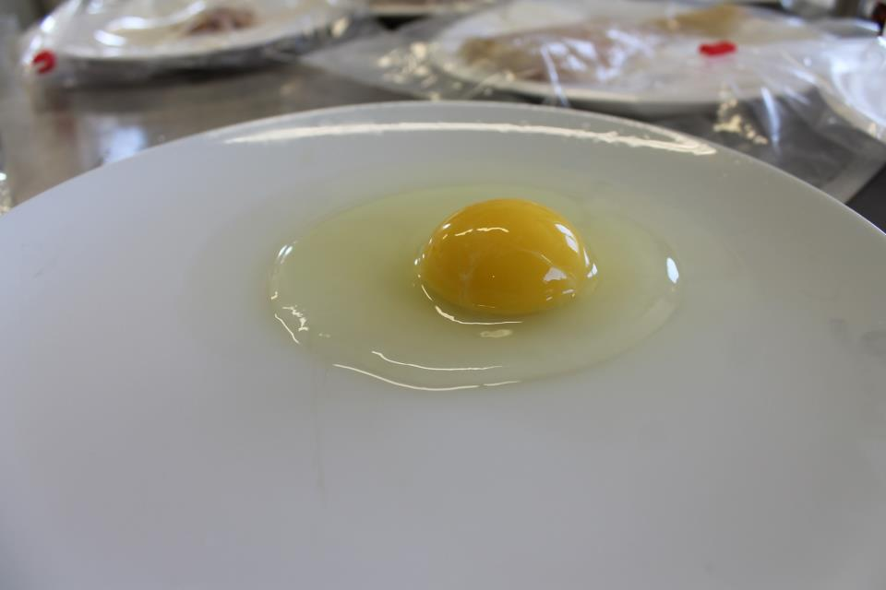
Indicate the USDA grade for this broken out egg.
15

