Slide 1
Cutting Through the Bull…
Practical Beef Sire Selection
Bob Weaber, Ph.D.
Cow-Calf Extension Specialist
Associate Professor
Dept. of Animal Sciences and Industry
bweaber@k-state.edu

Slide 2

Systematic Sire Selection
Set Goals
Assess Cow Herd
Assess Resources
Breed Selection
Bull Selection
  Reproduction
  Structure
  Performance
  Visual Appraisal
http://www.nbcec.org/producers/sire.html

Slide 3
The Dreaded/Celebrated
Sale Catalog
Catalog arrives in the mail…are you?
  Excited
  Fearful
  Overwhelmed by data overload
  Confident?

Slide 4
Why so much stuff?

Slide 5

Video and Supplement Sheet

Slide 6
Practical Pre-Purchase Advice…
Do your homework!
  Set a budget (you get what you pay for)
  Get current percentile table
  Review sale offering: EPDs and Pedigree
  Make preliminary ‘short list’ of bulls to consider
Arrive at sale site early to inspect bulls
Shorten ‘short list’ based on phenotype or other updated data
Selection: Do what’s easy or what’s profitable?

Slide 7
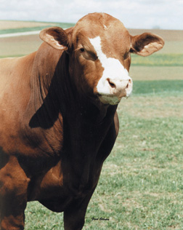
Sire Selection in Two Steps
Pick the right breed(s)
    PLANNED Crossbreeding
    Breeding objectives
    Considerations
Chose right individual in that breed
    EPDs
    Genetic risk management
    Selection indexes

Slide 8
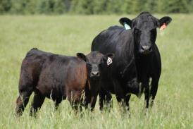
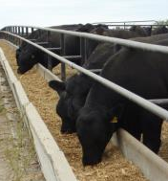
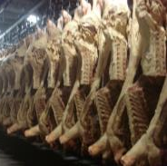
Revisiting the Breeding Objective(s)

Slide 9
Do You Have a
Breeding Objective??
Our objective is to breed cattle that breed as yearlings, calve unassisted and rear a good calf for sale at weaning every year. We aim to breed functional cattle that flesh easily and can forage on the hills over winter but must have the temperament and soundness to be farmed intensively during calving and the breeding season.

Slide 10
Do You Have a
Breeding Objective??
Our objective is to breed cattle that breed as yearlings, calve unassisted and rear a good calf for sale at weaning every year. We aim to breed functional cattle that flesh easily and can forage on the hills over winter but must have the temperament and soundness to be farmed intensively during calving and the breeding season.
Missing: How do they replace females in herd?

Slide 11
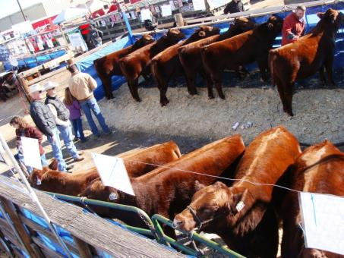
Sire Selection:
Systems and Tools

Slide 12
Crux of Straight-breeding
Do the benefits of selection for economically important/convenience traits within breed (straight-breeding) outweigh the improvement of lowly heritable traits via heterosis (especially maternal)?
Selection should be for BOTH additive and non-additive genetic merit.

Slide 13
Sire Selection Tools:
DNA Markers
EPD
Ratios
Adjusted weights
Raw Weights
Visual Appraisal
Ability to generate response to selection
Cost

Slide 14

EPDs-One Tool in the Tool Box
Selection is challenging
Not all economically important traits have EPD
  Fertility
  Disease resistance
  Heat Tollerance/fescue fitness
  Conformation traits
  Mature weight
Use the right tool for job!
Multiple trait selection

Slide 15
EPD’s Work…
7-9 times more effective generating response to selection than phenotypic selection
Can be used to:
  Increase performance
  Decrease performance
  Optimize performance
Do not select for maximum genetic expression w/o regard to other factors
  Nutritional conditions

Slide 16
Yearling Weight Phenotypic and Genetic Trend
Data Source: 2009 Am. Angus Sire Evaluation Report; Phenotypic and Genetic Trends

Slide 17
EPDs Work—Selection for increased growth
YW_{Pheno} = 910 + 3.38*YW_{EPD}
R² = 0.96
Data Source: 2009 Am. Angus Sire Evaluation Report; Phenotypic and Genetic Trends

Slide 18
Birth Weight Phenotypic and Genetic Trend
Data Source: 2009 Am. Angus Sire Evaluation Report; Phenotypic and Genetic Trends

Slide 19
EPDs Work—Selection for Birth Weight
BW_{Pheno} = 75 + 2.68*BW_{EPD}
R² = 0.95
Data Source: 2009 Am. Angus Sire Evaluation Report; Phenotypic and Genetic Trends

Slide 20

The Role of Economically Relevant Traits
A trait that has a direct cost or return associated with it is an Economically Relevant Trait (ERT).
Traits that are correlated to ERTs are indicator traits.
Example: Is Birth Weight or Calving Ease the ERT? Why??
Weaning Weight or Yearling Weight?

Slide 21
Relative Economic Weights for Integrated Beef Firm
Reproduction:Growth:End Product
2:1:1
(Melton, 1995)

Slide 22
Relative Economic Weights for Traditional Beef Firm
Reproduction:Growth:End Product
10:5:1
(Melton, 1995)

Slide 23
What’s a Selection Index?
$W - One number to use in selection that summarizes five
Appropriately weights each trait for its influence of profit
Selection on ‘aggregate merit’ (Hazel, 1943)
Value of each trait - increase in satisfaction with one unit change in a trait, all others held constant
Selection index is formal statement of trade-offs among traits used to evaluate selection candidates (MacNeil et al., 1997)

Slide 24
Using Selection Indexes
Use your marketing endpoint to guide you to ‘right’ index
Apply independent culling levels to EPDs you know limit production in your environment (CED, MILK)
Limit use of other EPDs in selection criteria (decreases selection pressure)
Use $Index to guide you to the bull with the most optimal combination of traits
Use $Index just like other EPDs

Slide 25
You get what you sow…
If you use terminal traits and terminal indexes in selection, what do you get?
You get response in terminal traits!
If maternal traits are important to you, put pressure on maternal traits
  Think ‘optimization’
  Traits: CE, CEM, DOC, HP, Stay (rebreeding), MW, ME, replacement indexes

Slide 26
Individual
Bull
Selection
Bob Weaber, Ph.D.
Cow-Calf Extension Specialist
Assistant Professor
Dept. of Animal Sciences and Industry
bweaber@k-state.edu

Slide 27
Individual Bull Selection
Once you get the breed(s) right, focus on:
  Trait emphasis-where to put selection pressure
  Genetic merit of sire prospect
    EPDs
    Convenience/economic traits
  Phenotypic considerations
  Breeding soundness

Slide 28
Trait Emphasis
Align traits used in selection with those that are economically relevant!!
EASIEST: Use a selection index aligned with the production system/marketing endpoint
  $ B (TI, CHB, TSI, MTI, GridMaster) if you retain ownership
  $W (API, HerdBuilder, etc.) if you sell weaned calves

Slide 29
Simple Trait Selection
Sell calves at weaning and …
  purchase crossbred replacement heifers
    think ‘Terminal Sire’, moderate calving ease, high growth
  raise your own replacements
    think ‘Balance’, calving ease, easy fleshing, moderate milk and moderate growth
    AVOID CARCASS TRAIT LOSERS!!

Slide 30
Simple Trait Selection
Retain ownership and sell calves in the beef and …
  purchase crossbred replacement heifers
    think ‘Terminal Sire’, high growth (carcass wt), balance of quality and yield traits
  raise your own replacements
    think ‘Balance’, calving ease, easy fleshing, moderate milk and moderate growth, balance of quality and yield.
MANAGE MARKET RISK WITH
BALANCED CARCASS TRAITS !!

Slide 31

Across Breed EPD Worksheet www.ksubeef.org
www.ksubeef.org

Slide 32

Beef Genomics
Future

Slide 33
Should you use genomic tools in your operation?
YES!!!!
Any questions?

Slide 34
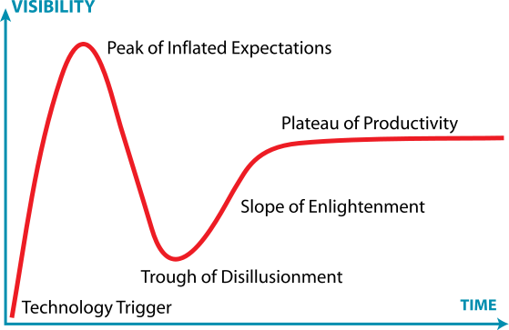
Genomic Technology Adoption in Beef Industry
Gartner Hype Cycle

Slide 35
Integrated Information
EPD (index or interim)
GE-EPD
MBV (correlated indicator trait)
If you know how to use EPDs,
you know how to use GE-EPDs!
Spangler, 2011

Slide 36
Genomic Tools Much Better
2015 NALF Training Results
Trait | %GV explained by Panel | Regression of EPD on MBV
CED | 0.6271 | 1.0173
BW | 0.7055 | 0.9527
WW | 0.4239 | 0.8143
YW | 0.6390 | 0.9498
MILK | 0.5447 | 1.0933
CEM | 0.5922 | 1.0900
CWT | 0.6573 | 1.0714
REA | 0.6321 | 1.0487
MARB | 0.8359 | 1.0234
FT | 0.7073 | 0.8902

Slide 38
Current Status
Breed | No. Anim | LD Impute | Provider | Method
Angus | 160,000 | Y | GS, Z | CORR
Red Angus | 13,700 | Y | GS, Z | BLEND
Hereford | 15,780 | Y | GS | BLEND-Ext.
Simmental | 10.800 | Y | GS | BLEND
Limousin | 5,660 | Y | GS | BLEND
Gelbvieh | 3,880 | Y | GS | BLEND
Charolais | 2,136 | N | GS | CORR
Santa Gertrudis | 3,160 | N | GS | SS-GBLUP
Brangus | 3,909 | Y | GS, Z | SS-GBLUP
Spangler, 2014

Slide 39
Thank You!
Questions?

Slide 40
Panel %GV = 33%
%GV=
33%
$h_{}^{2}$=40%
$$σ_{p}^{2}$$

Slide 41
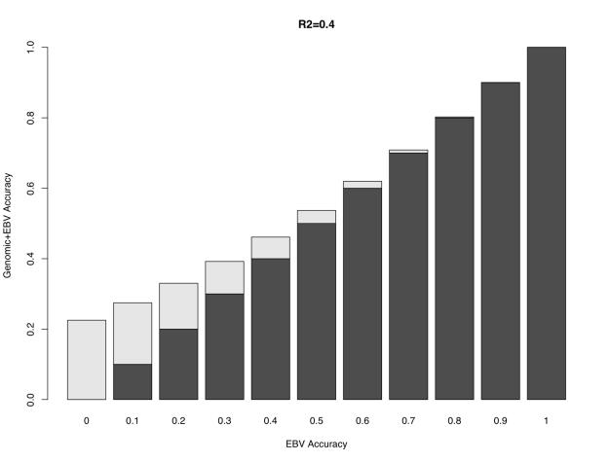
Impact on Accuracy--%GV=40%
Spangler, 2011

Slide 42
Increased Accuracy-Benefits
Mitigation of risk
Faster genetic progress
Increased accuracy does not mean higher or lower EPDs!
  Increased information can make EPDs go up or down

Slide 43
Imputation
Sire (HD)
…..TCACCGCTGAG…..
…..CAGATAGGATT…..
Offspring (LD)
Offspring (Imputed)
…..??G??????A??….
….CAGATAGGATT…..
…..??T??????T??…..
…..??T??????T??…..
Source: Spangler, 2014 NBCEC Brown Bagger

Slide 44
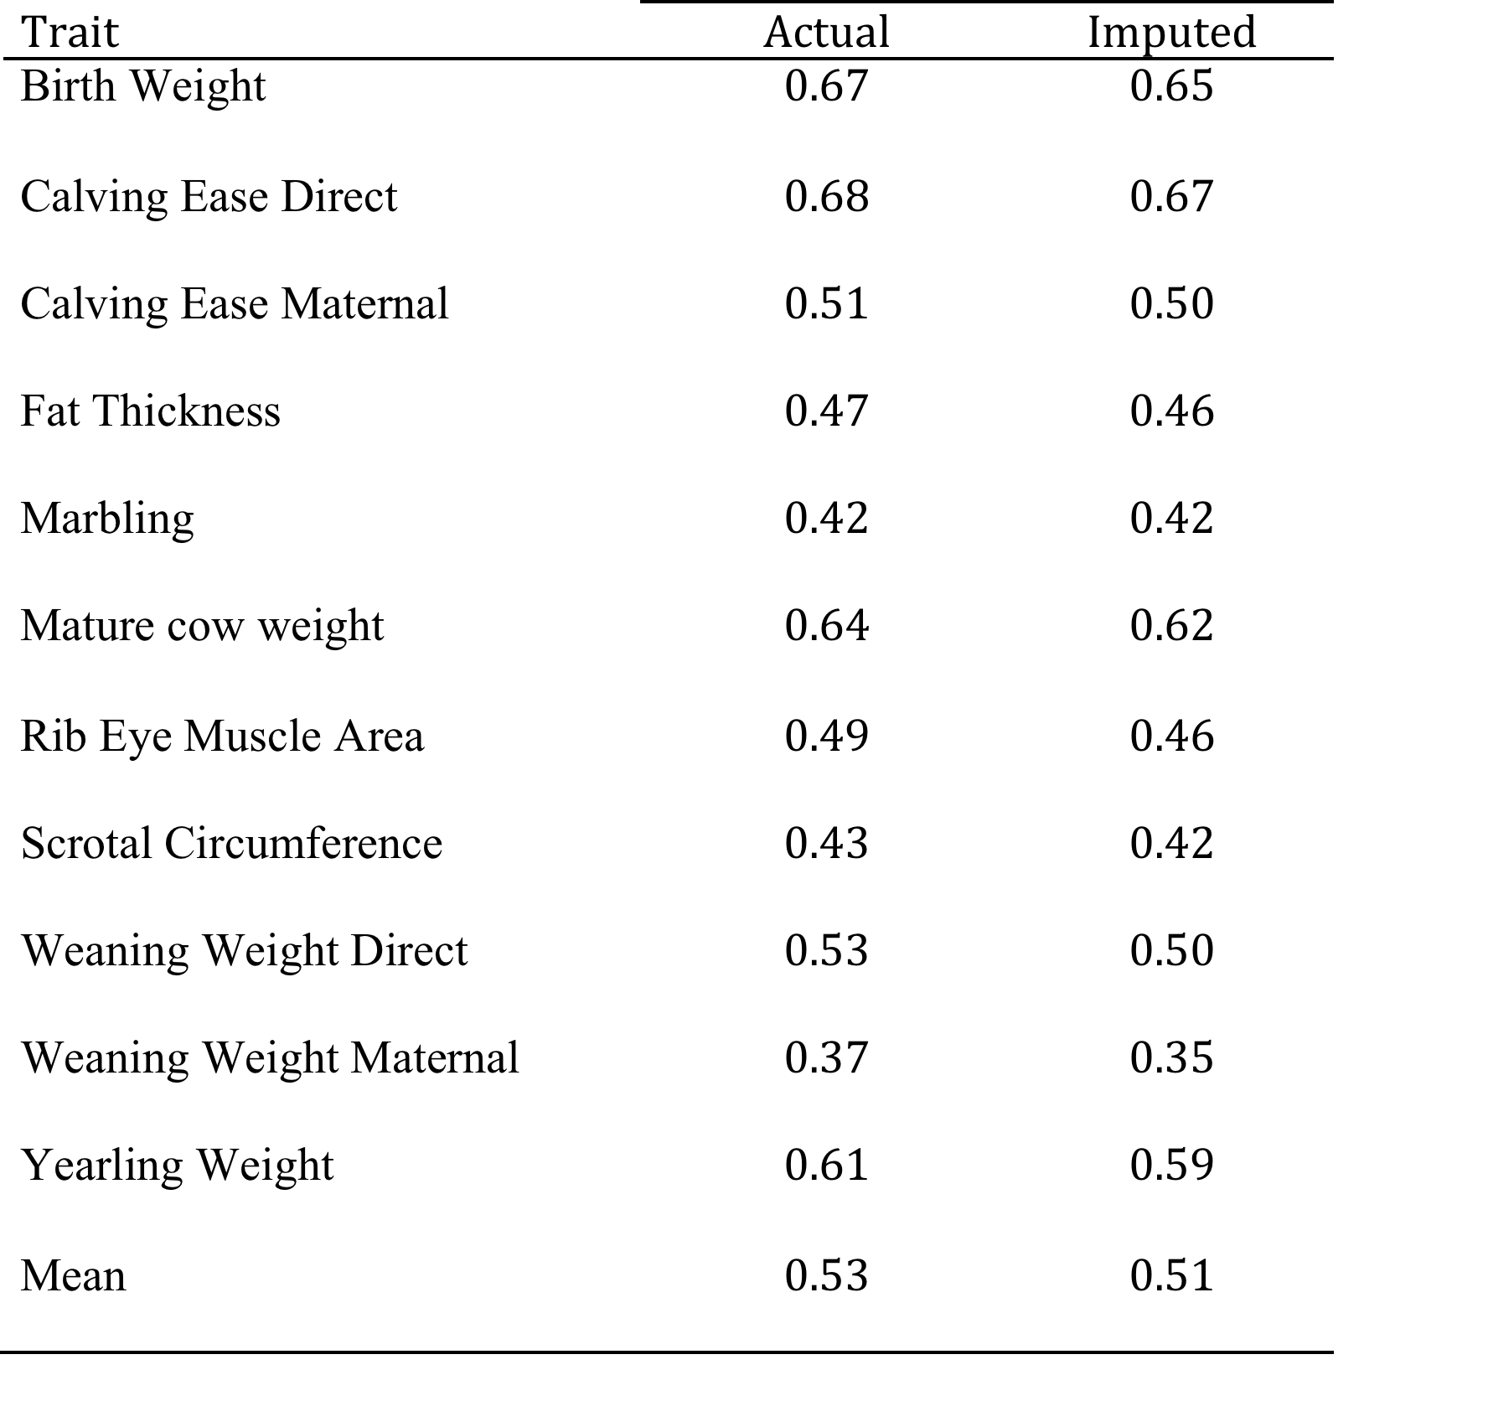
Lower Density Panels
Actual = 50k
Imputed = 10k
(from GGP-LD)
AHA Predictive Accuracy 2,980 6-fold
Source: Garrick, BIF GPW 2013

Slide 45
Heterosis Effects on Economically Relevant Traits
Improves Calving Rate – 6% ª
Improves Calf Survival to Weaning – 4% ª
Improves WW -- 8% ª
Improves YW – 4% ª
Improves Carcass Traits – 0-2% ª
Significant improvement in traits with low h²
Improves Weaning Wt. Per Cow Exposed – 23% ^{b}
Animal disease resistance: BRD and Pinkeye
PLUS: Breed Complementarity
ª Kress and Nelsen (1998)
^{b} Gregory and Cundiff (1980)

Slide 46
The Dollars of Heterosis
100 cows, 80% Weaning Rate, 575 avg. weaning weight, 10 year horizon
Calf Survival to Weaning (6%) = 60 hd.
Weaning wt. (4%) = +19,780 lb.
Weaning wt. per cow exposed (23%) = +105,800 lb.
  …or the equivalent of 18 more 575 lb. calves/year
  Heterosis is worth ~$150/cow/year

Slide 47
Mating System Goals
Optimize the utilization of calf and maternal heterosis.
Utilize breed complementarity to match cows to their environment and their progeny to market targets.
Minimize variation in progeny phenotypes by stabilizing breed inputs.

Slide 48
Selection Tools for Beef Cattle Improvement

Slide 49
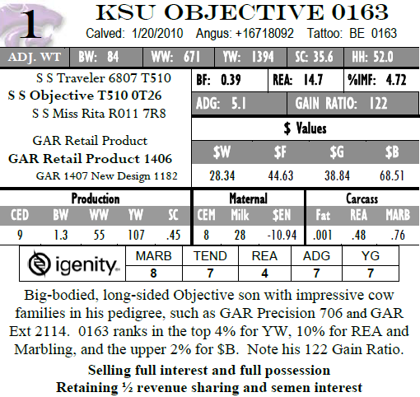

Slide 50
EPDs Defined
Expected
  Future, average, mean
Progeny
  Offspring
Difference
  Implies comparison between animals
  NOT phenotypic performance
Measure of relative merit among individuals
Estimate of average effect of animal as parent
Estimate of average gamete genetic merit

Slide 51
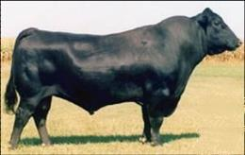
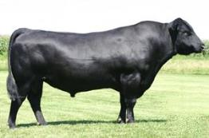
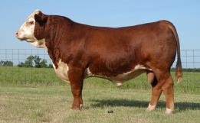
Using EPDs
Bon View New Design 878
S A F Strategy 9015
KCF Bennett 3008 M326

Slide 52
Percentile Rank
Spring 2012 American Angus Association
Percentile Breakdown
Non-Parent Cows
 | Production |  |  |  | Maternal
Top Pct | CED | WW | YW | Doc | CEM | Milk
5% | 11 | 60 | 106 | 24 | 12 | 31
10% | 10 | 57 | 102 | 21 | 11 | 29
15% | 9 | 56 | 99 | 19 | 10 | 27
20% | 9 | 54 | 97 | 18 | 10 | 26
25% | 8 | 53 | 94 | 16 | 9 | 26
30% | 7 | 52 | 93 | 15 | 9 | 25
35% | 7 | 50 | 91 | 14 | 9 | 24
40% | 6 | 49 | 89 | 13 | 8 | 24
45% | 6 | 48 | 87 | 12 | 8 | 23
50% | 6 | 47 | 86 | 11 | 8 | 22
60% | 5 | 45 | 82 | 9 | 7 | 21
70% | 3 | 43 | 78 | 6 | 6 | 20
80% | 2 | 40 | 73 | 3 | 5 | 18
90% | 0 | 35 | 66 | -2 | 4 | 16
Avg | 5 | 47 | 85 | 10 | 8 | 22

Slide 53
Calving Ease EPDs
Why focus on Calving Ease?
  CE is economically relevant, BW is indicator trait
EPDs
  CED = direct measure of percent sire’s calves born unassisted
  CEM = maternal measure of percentage of sire’s daughters that calve unassisted

Slide 54
Calving Ease EPD Model
Multiple trait model
  CE threshold trait,
  BW linear
  CED h² = 0.20 (0.18); Angus (Simmental)
  CEM h² = 0.12 (0.19)

Slide 55
Calving Ease EPD Model
Multiple trait model
  Genetic correlation of CED & BW = -0.69 (-0.41)
    CE is polygenic
    Some genes effect both BW and CE (pleiotropy)
  Genetic correlation between CED & CEM
    Angus doesn’t fit (previously estimated at -0.30), Gelbvieh, Simmental ~= -0.13

Slide 56


Using CE EPDs
Bon View New Design 878
S A F Strategy 9015

Slide 57
Making the tools work together…

Slide 58
Angus Selection Indexes
$W = Weaning Value ($ per head)
  BW, WW, Milk, Mature Wt.
$F = Feedlot Value ($ per head)
  WW, YW and correlations
$G = Grid Value ($ per head)
  Grade and yield components
$B = Beef Value ($ per head)
  $F and $G adjusted for weight and costs
$EN = Cow Energy (savings/cow/year)
  Milk and Mature Wt. as they relate to maintenance energy requirements

Slide 59
Independent culling levels
CED = 2.1 WW = 43 MM = 18 SC = 0.9 IMF = 0.04
 | CED | WW | MM | SC | IMF | $BMI
1 | 2.5 | 55 | 20 | 1.0 | 0.10 | 20.16
2 | 5.0 | 50 | 25 | 1.2 | -0.10 | 19.55
3 | 4.0 | 45 | 20 | 1.0 | 0.25 | 20.35
4 | 1.6 | 62 | 19 | 1.0 | 0.20 | 21.64
Moser, 2005

Slide 60
Types of Heterosis
Direct heterosis
  The advantage of a crossbred calf
Maternal heterosis
  The advantage of a crossbred cow
  Biggest heterosis impact on cow/calf productivity
  Two-thirds of economic benefit
  “Don’t brag to me if you only have crossbred calves!!”

Slide 61

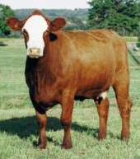
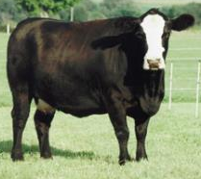
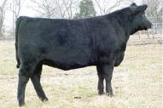
Origins of Heterosis
X
=
X
=

Slide 62
Heritability and Heterosis: Inversely Related
Trait
Reproduction
(fertility)
Production
(growth)
Product
(carcass)
Heritability Heterosis
Low High
Moderate Moderate
High Low

Slide 63
Angus Selection Indexes
Index Name | Progeny Endpoint | Breeding System | Index Type
$W (Weaning) | weaned feeder calves | T | G
$EN (Maintenance Energy) | replacement heifers | M | G
$F (Feedlot) | live fed cattle | T | G
$G (Grid) | beef carcasses sold on grid | T | G
$B (Beef) | beef carcasses from retained ownership sold on grid | T | G

Slide 64
Hereford Selection Indexes
Index Name | Progeny Endpoint | Breeding System | Index Type
BMI$ (Baldy Maternal Index) | beef carcass sold on grid; replacement heifers retained | A | G
BII$ (Brahman Influence Index) | beef carcass sold on grid; replacement heifers retained | A | G
CHB$ (Certified Hereford Beef Index) | beef carcass sold on CHB grid | T | G
CEZ$ (Calving Ease Index) | matings to replacement heifers | M | G

Slide 65
Charolais, Gelbvieh, Limousin, Simmental Selection Indexes
Index Name | Progeny Endpoint | Breeding System | Index Type
TSPI (Terminal Sire Profitability Index) | beef carcass sold on grid | T | C
CV (Carcass Value) | beef carcass sold on grid | T | G
FM (Feedlot Merit) | live fed cattle | T | G
MTI (Mainstream Terminal Index) | beef carcasses sold on grid | T | G
API (All Purpose Index) | beef carcasses sold on grid; replacements retained | A | G
TI (Terminal Index) | beef carcasses sold on grid | T | G

Slide 66
Selection Index Limitations
EPD not available on all ERTs or Indicators
Most indexes revenue focused; cost information difficult to obtain
General Indexes representative of industry vs. Custom Index representative of individual firm
Relative Economic Values used in generalized index may not be reflective of your operation
Linear vs. Non-linear Profit Functions
  Diminishing returns (i.e. Carcass Wt., Mature Size)
Managerial differences can cause contraction or expansion of phenotypic variation
Still better than ‘seat of pants’ approach that most of us apply

