Slide 1
Veterinary Antimicrobial Use Regulations
An Environment of Change
Brian Lubbers, DVM, PhD, DACVCP
Director of Clinical Microbiology

Slide 2
Changing Regulations
Cephalosporin Extralabel Use Restriction
FDA Guidance 209
FDA Guidance 213
Veterinary Feed Directive

Slide 3
Why?
Increasing antimicrobial resistance
Antimicrobial Exposure
Agricultural Use Human Use
80% 20%

Slide 4
Cephalosporin Extralabel Use Restriction
“Extralabel”
  Any use that is not on the label
  Different animal species
  Different disease
  Different dose
  Different route
  Different frequency or duration of administration
Any extralabel use of any drug requires the supervision of a veterinarian

Slide 5
Cephalosporin Extralabel Use Restriction
April 2012
FDA issued prohibition of extralabel uses of cephalosporins
  Cattle, swine, chickens, turkeys
  For disease prevention
    Excede® label indication is NOT RESTRICTED
  At unapproved doses, frequencies, duration or routes of administration
  For species / production classes not indicated on the label
  Exceptions:
    Approved cephapirin products
    Treatment / Control of an extralabel indication when label dose regimen is used
    Use in minor species

Slide 6
What was the evidence?
Violative residue investigations
  Poor / nonexistant animal treatment records
  Inadequate animal ID
  Lack of animal owner knowledge regarding withdrawal times
  Drug product administered by extralabel route
  Drug product administered at extralabel [increased] dose
  Drug product administered to animal class not approved (veal)

Slide 7
What was the evidence?
FDA hatchery inspections
  Ceftiofur use in unapproved doses / methods of administration
Biobullets
FDA farm / veterinary hospital inspection
  Use of human-approved cephalosporins (cephalexin) in cattle
Increasing cephalosporin resistance in Salmonella - NARMS

Slide 8
How does this impact veterinarians / producers?
Minimal direct impacts
  Increased familiarity with product labels
Indirect impacts
  ENORMOUS
  “However, the Agency [FDA] believes that it is not limited to making risk determinations based solely on documented scientific information, but may use other suitable information as appropriate.”

Slide 9
How does this impact antimicrobial use?
Likely minimal
  Extralabel use only part of the violative residue issue
    Production system / Management / Training bigger issues
  Cephalosporins not widely used in veterinary medicine
SALES DATA (kg) | Veterinary (2012)
Cephalosporins | 27,654
Human (2011) | % Used in Veterinary
496,910 | 5%

Slide 10
FDA Guidance 209
The Judicious Use of Medically Important Antimicrobial Drugs in Food-Producing Animals
  Dec 2013

Slide 11
What was the evidence?
Recent Peer-Reviewed Scientific Literature
Governmental / Professional Reports

Slide 12
What was the evidence?
Recent Peer-Reviewed Scientific Literature
Alali (2008) Longitudinal study of antimicrobial resistance among E. coli isolates from integrated multisite cohorts of humans and swine.
Sharma (2008) Diversity and distribution of commensal fecal E. coli bacteria in beef cattle administered selected subtherapeutic antimicrobials in a feedlot setting.
Alexander (2008) Effect of subtherapeutic administration of antibiotics on the prevalence of antibiotic-resistant E. coli bacteria in feedlot cattle.
Harvey (2009) A metagenomic approach for determining prevalence of tetracycline resistance genes in the fecal flora of conventionally raised feedlot steers and feedlot steers raised without antimicrobials.
Vieira (2009) Association between tetracycline consumption and tetracycline resistance in E. coli from healthy Danish slaughter pigs.
Varga (2009) Associations between reported on-farm antimicrobial use practices and observed antimicrobial resistance in generic fecal E. coli isolated from Alberta finishing swine farms.
Alexander (2010) Farm-to-fork characterization of E. coli associated with feedlot cattle with a known history of antimicrobial use.
Sapkota (2011) Lower prevalence of antibiotic-resistant Enterococci on US conventional poultry farms that transitioned to organic practices.
Vieira (2011) Association between antimicrobial resistance in E. coli isolates from food animals and blood stream isolates from humans in Europe: an ecological study.
Mirzaagha (2011) Distribution and characterization of ampicillin- and tetracycline-resistant E coli from feedlot cattle fed subtherapeutic antimicrobials.
Looft (2012) In-feed antibiotic effects on the swine intestinal microbiome.

Slide 13
What was the evidence?
Governmental / Professional Reports
1969 Report of the Joint Committee on the Use of Antibiotics in Animal Husbandry and Veterinary Medicine “Swann Report”
1970 FDA Task Force Report “The Use of Antibiotics in Animal Feed”
1980 NAS Report “The Effects on Human Health of Subtherapeutic Use of Antimicrobial Drugs in Animal Feeds”
1984 Seattle-King County Study: “Surveillance of the Flow of Salmonella and Campylobacter in a Community”
1988 Institute of Medicine Report: “Human Health Risks with the Subtherapeutic Use of Penicillin or Tetracyclines in Animal Feed”
1997 WHO Report, “The Medical Impact of Antimicrobial Use in Food Animals”
1999 NRC Report: “The Use of Drugs in Food Animals – Benefits and Risks”
1999 US GAO Report – “Food Safety: The Agricultural Use of Antibiotics and Its Implications for Human Health”
1999 European Commission Report, “Opinion of the Scientific Steering Committee on Antimicrobial Resistance”
2000 WHO Expert Consultation: “WHO Global Principles for the Containment of Antimicrobial Resistance in Animals Intended for Food”
2003 Report “Joint FAO/OIE/WHO Expert Workshop on Non-Human Antimicrobial Usage and Antimicrobial Resistance: Scientific assessment”
2003 IOM Report, “Microbial Threats to Health: Emergence, Detection and Response”
2004 Report, “Second Joint FAO/OIE/WHO Expert Workshop on Non-Human Antimicrobial Usage and Antimicrobial Resistance: Management Options”
2004 US GAO Report – “Antibiotic Resistance: Federal Agencies Need to Better Focus Efforts to Address Risks to Humans from Antibiotic Use in Animals”
2005 Codex, “Code of Practice to Minimize and Contain Antimicrobial Resistance”
2006 Antimicrobial Resistance: Implications for the Food System, Comprehensive Reviews in Food Science and Food Safety
2009 American Academy of Microbiology. Antibiotic Resistance: An Ecological Perspective on an Old Problem
2011 WHO Report: Tackling antibiotic resistance from a food safety perspective in Europe

Slide 14
Literature and Report Summary
Use of antimicrobials is associated with the development of resistant bacteria
Pathogens (and their resistance elements) move from animals to people through the food chain
Quantitative risk assessments are needed to determine level of risk
?

Slide 15
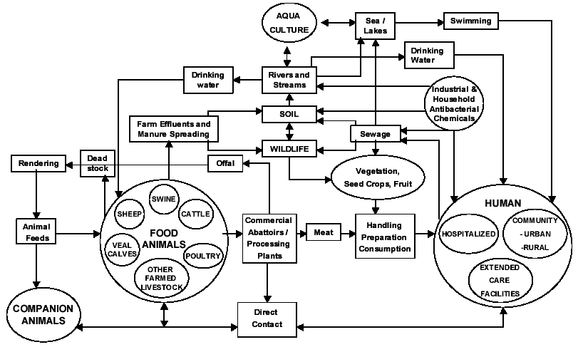
Image from: Health Canada

Slide 16
In the absence of quantitative risk……
Increasing antimicrobial resistance
Antimicrobial Exposure
Agricultural Use Human Use
80% 20%

Slide 17
Literature and Report Summary
(continued)
Increased surveillance for:
  Resistant bacteria
  Antimicrobial consumption
Develop strategies to limit the need for antimicrobials (husbandry)
New modalities for prevention and treatment should be researched
Eliminate the use of medically important antimicrobials as growth promoters
Increase veterinary oversight of antimicrobial use

Slide 18
How does this impact veterinarians / producers?
The Judicious Use of Medically Important Antimicrobial Drugs in Food-Producing Animals
  Principle 1:
    The use of medically important antimicrobial drugs in food-producing animals should be limited to those uses that are considered necessary for assuring animal health.
    FDA Guidance 213
  Principle 2:
    The use of medially important antimicrobial drugs in food-producing animals should be limited to those uses that include veterinary oversight or consultation.
    Veterinary Feed Directive

Slide 19
FDA Guidance 213
New Animal Drugs and New Animal Drug Combination Products Administered in or on Medicated Feed or Drinking Water of Food-Producing Animals: Recommendations for Drug Sponsors for Voluntarily Aligning Product Use Conditions with GFI 209
  Dec 2013
  Provides Animal Health Companies with Direction for Removing Non-Therapy Label Indications

Slide 20
FDA Guidance 213
Applies to:
  Medically important antimicrobials
  Used in or on medicated feed or water of food producing animals
  For production purposes

Slide 21
Medically important antimicrobials…
Does not include
  Ionophores – monensin (Rumensin ®), lasalocid (Bovatec ®)
  Bacitracin
  Bambermycins – Flavomycin®
  Pleuromutilins – tiamulin (Denagard®)
    Not listed in FDA 152, but is on the WHO medically important list

Slide 22
Medically important antimicrobials with food animal indications
Aminoglycosides
  Neomix® 325
Lincosamides
  LS 50
Macrolides
  Tylan 100®
Penicillins
Florfenicol
  Nuflor ®
Streptogramins
Sulfonamides
Tetracyclines
  Aureomycin®
 | Veterinary (2012) | Percent Total Veterinary Use
Aminoglycosides | 273,536 | 2%
Lincosamides | 218,140 | 2%
Macrolides | 616,274 | 4%
Penicillins | 965,196 | 7%
Sulfas | 493,514 | 3%
Tetracyclines | 5,954,361 | 41%
NIR / Other | 1,495,959 | 10%

Slide 23
For Production Purposes
Treatment / Prevention / Control labels NOT affected
“increased rate of weight gain”
“improved feed efficiency”
Aureomycin®
  Control of active infection of anaplasmosis caused by Anaplasma marginale susceptible to chlortetracycline
  Increased weight gain

Slide 24
Where are we with Guidance 213?
December 2013
  3 month period for drug sponsors to indicate compliance
  26 drug sponsors
  283 drug products affected
July 1 2014
  All sponsors committed to comply
  31 labels withdrawn
  2 label changes approved
    1 added requirement for veterinary oversight
    1 production indication dropped
3 year window for full implementation

Slide 25
How does this impact veterinarians / producers?
Minimal
  Guidance 213 impacts drug sponsors
  Many of the withdrawn labels were for products that were not actively being marketed

Slide 26
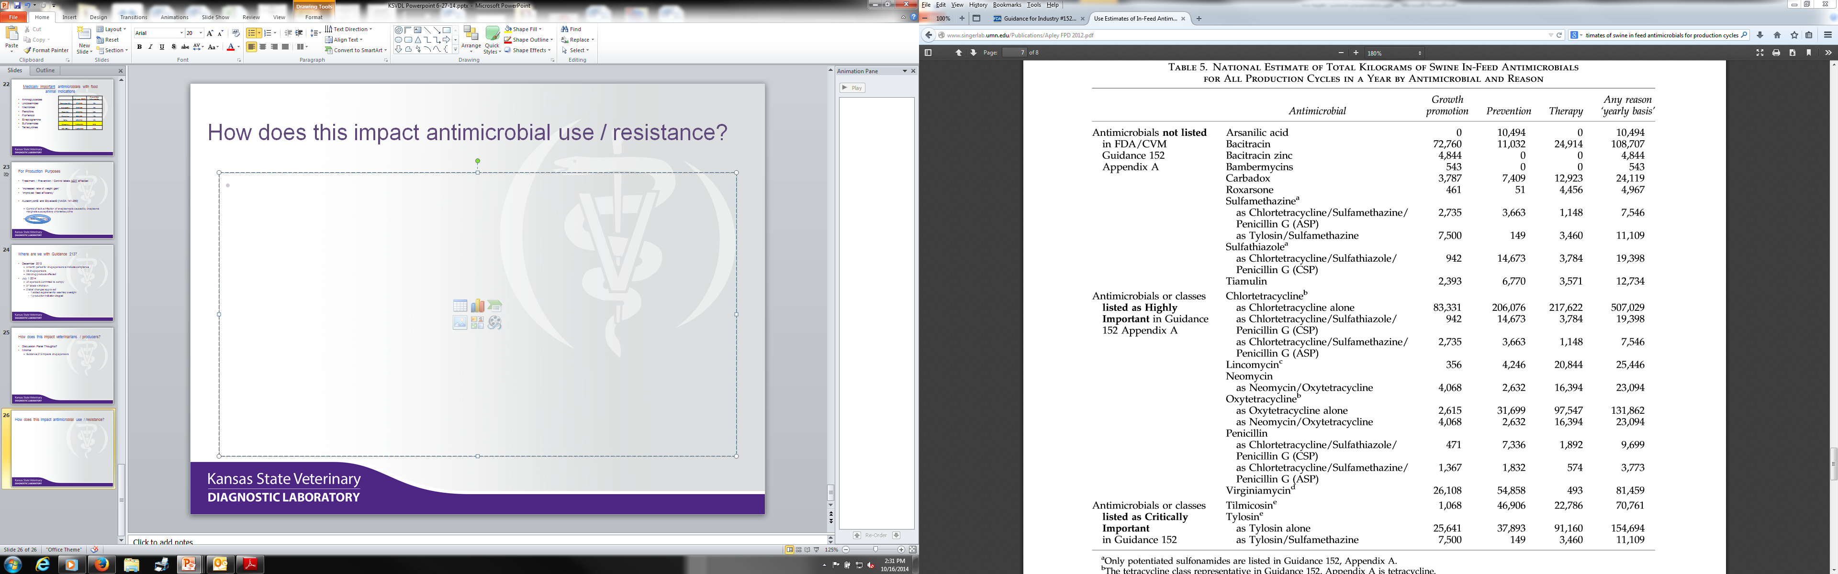
How does this impact antimicrobial use?
16%
2%
32%
1.5%
16%
160,270
15%
1,068,964
Apley (2012) Foodborne Pathogens and Disease

Slide 27
How does this impact antimicrobial use?
?
?
Apley (2012) Foodborne Pathogens and Disease

Slide 28
Veterinary Feed Directive
FDA Guidance 120
  Questions and Answers concerning VFDs

Slide 29
Where are we with VFDs?
Final revisions not yet available
Addressing concerns with original VFD language / logistics
  Limited experience with VFD process
    Only 3 products currently under VFD regulations [1 is not currently marketed]
  Administrative burdens
    Proposed record keeping reduction from 2 years to 1 year
  Veterinary workforce limitations
    Revised VCPR language
    VCPR requirements now fall to the states
  Impacts on feed industry
    Eliminate reclassification of VFD drugs to Category II

Slide 30
How will this impact veterinarians / producers?
Huge Impacts
  Veterinarians & producers will now be responsible and accountable for antimicrobial use in food animals
  Documentation is going to extend well beyond VFD
    Treatment protocols
    Treatment records
    Training records

Slide 31
How will this impact antimicrobial use?
Minimal
  Isn’t intended to reduce appropriate use

Slide 32
QUESTIONS?

