Slide 1

US & Kansas Dairy Industry Trends
Eastern KS Animal Science Extension Update
November 18, 2014
Mike Brouk mbrouk@ksu.edu

Slide 2
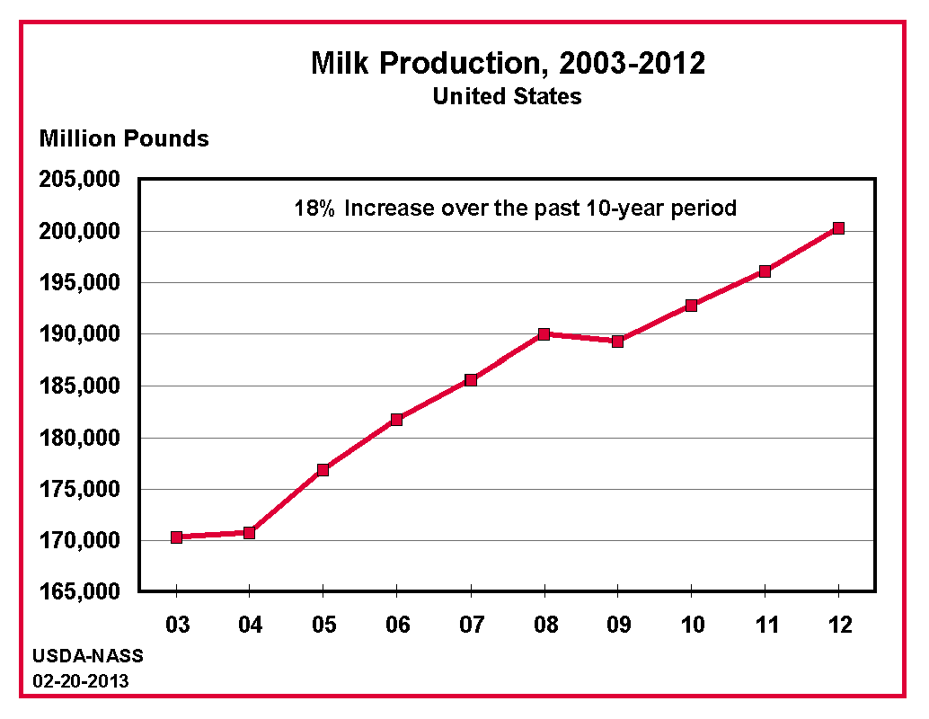

Slide 3
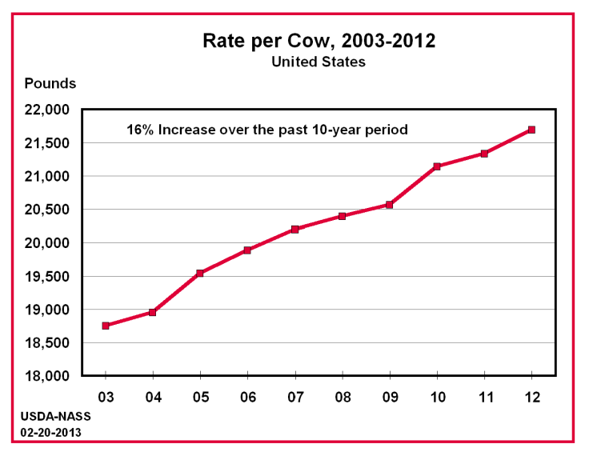

Slide 4
Average US Milk Production per Cow and Milk Fat Percent from 1925 to 2013
1945 - 25 million cows
119,828 million lbs
2013 - 9.22 million cows
  201,218 million lbs
36.9% of cows
1.68 times the amount of milk
Compiled from: USDA Statistical Bulletin 303, 430
USDA Statistical Bulletin Entitled Milk: Final Estimates for Various Issues.

Slide 5
Changes in KS Milk Cow Numbers
2013 – 134,000 cows

Slide 6
Changes in KS Milk Production
2013 - 2,930 million pounds

Slide 7
Changes in KS Milk Production per Cow
2013 – 21,881 lb per cow

Slide 8
KS Dairy Industry Trends
Data Source: NASS Quick Stats

Slide 9
KS Dairy Industry Trends
Data Source: NASS Quick Stats

Slide 10
KS Dairy Industry Trends
Data Source: NASS Quick Stats

Slide 11
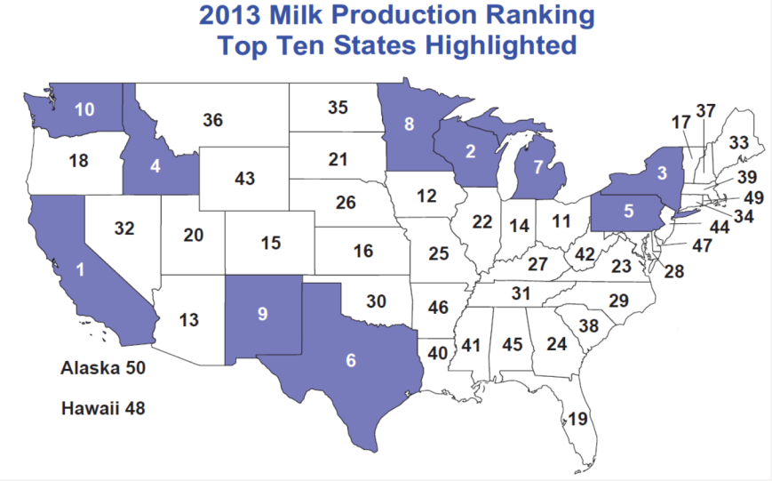
Source: Federal Milk Market Administrator – Central Order

Slide 12
Source: Federal Milk Market Administrator – Central Order

Slide 13
Source: Federal Milk Market Administrator – Central Order

Slide 14
Source: Federal Milk Market Administrator – Central Order

Slide 15
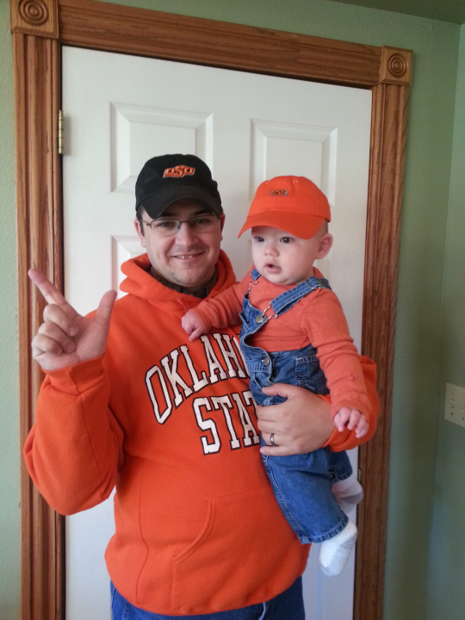

Slide 16
www.fmmacentral.com

Slide 17
Kansas Dairy Farms by County - 2013
Chart courtesy of Federal Milk Market Administrator, Central Order 32.

Slide 18
Destination of KS Milk in May, 2013
Arkansas, Colorado, Georgia, Iowa, Kansas, Kentucky, Louisiana, Minnesota, Missouri, North Carolina, Nebraska, New Mexico, Oklahoma, Tennessee, and Texas
75% of KS May 2013 milk shipped out of KS
46 Different Plants
Source: Federal Milk Market Administrator Central Order – May 2013 FO32 data

Slide 19
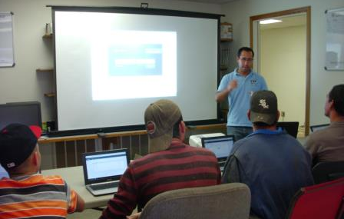


K-State Dairy Employee Training and Development
Luís G. D. Mendonça
Assistant Professor and Dairy Extension Specialist
Kansas State University

Slide 20
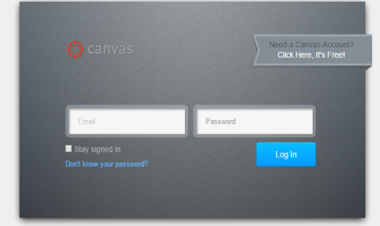
K-State Dairy Employee Training and Development
Training sessions focused:
  Animal welfare and animal handling
Keep track of employees’ trainings
Future training sessions in several areas
https://canvas.instructure.com/login

Slide 21
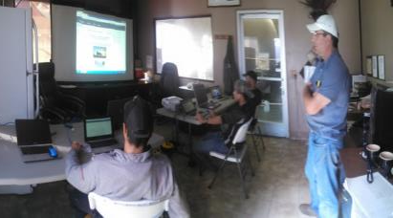
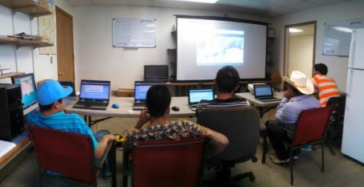
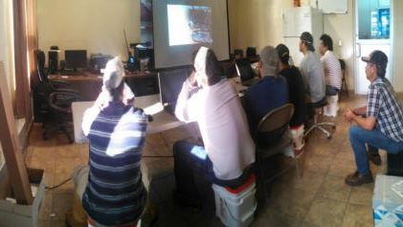
Training Sessions
10/13/2014 – 10/16/2014
Total: 80 employees trained
Groups of 6
Training sessions: 25 – 40 min

Slide 22
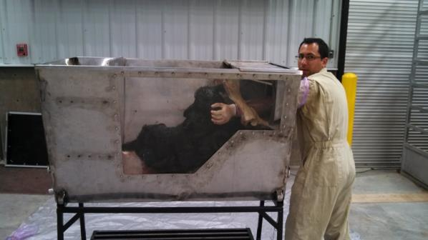
Calving Schools - 2015
January 14, 2015 – Salina
January 20, 2015 – Manhattan (date to be confirmed)
January, 2015 - Dighton

Slide 23

Milk Price Protection Program
Robin Reid
December 5 signup deadline
Back to top
Dairy Program Resources
Title | Date | Author | Download
Frequently Asked Questions: MPP Dairy | 9/18/14 | Robin Reid | View
MPP Dairy Fact Sheet | August, 2014 | USDA FSA | View
Highlights of the FSA Final Rule on the MPP-Dairy Program for Dairy Producers | 8/29/14 | Andew Novakovic DMaP | View
Web-based MPP Decision Tool | September, 2014 | DMaP | View Tool Instructions Brochure
Spreadsheet Tool for Calculating Milk Production History | September, 2014 | DMaP | View
Dairy Markets and Policy Website (DMaP) | Updated frequently | DMaP | View
LGM Dairy Resources | Updated frequently | University of Wisconsin | View
http://www.agmanager.info/events/Webinars/default_Dairy.asp

Slide 24
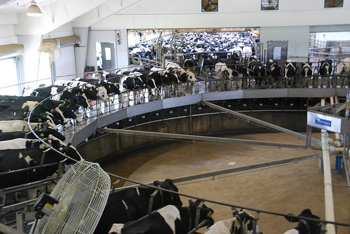
Adaption of Technology

Slide 25
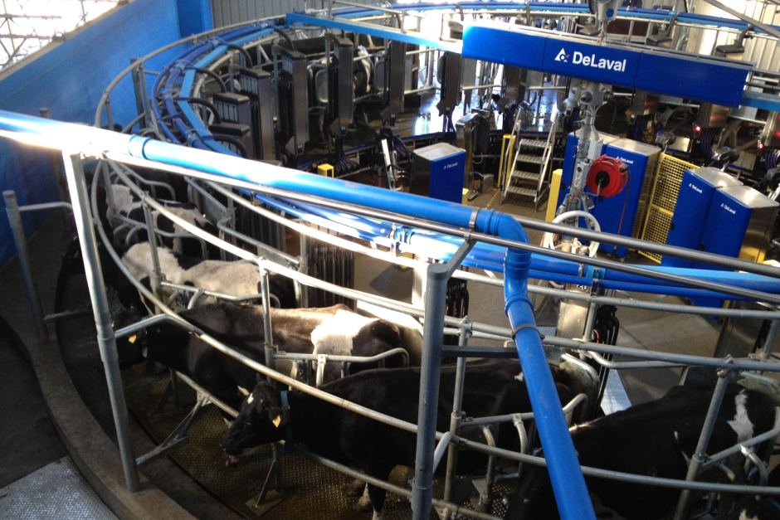
Robotic Milking Systems

Slide 26
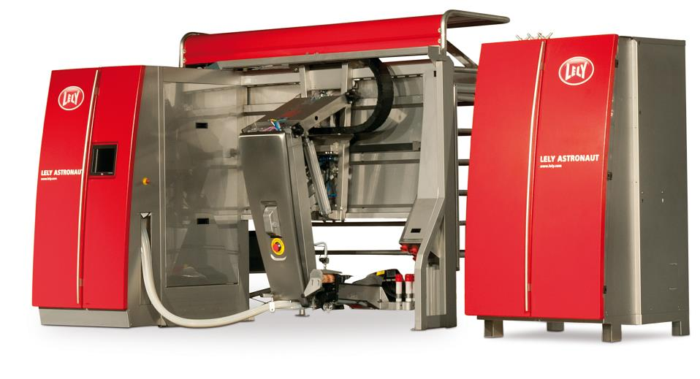
Robotic Milking Machine

Slide 27
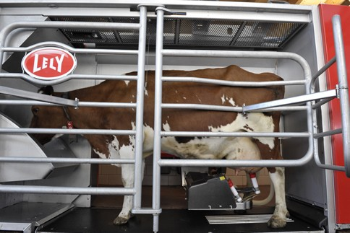
More than a milking machine

Slide 28
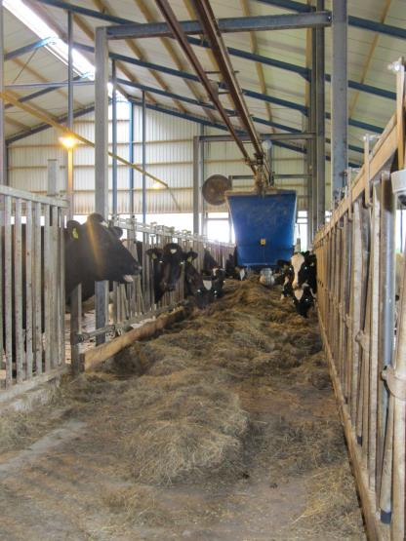
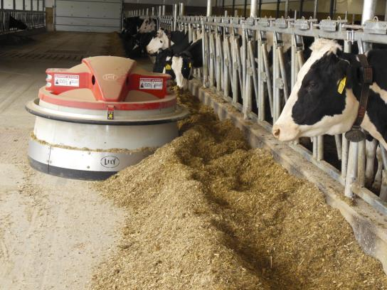
Computerized Feeding Systems

Slide 29
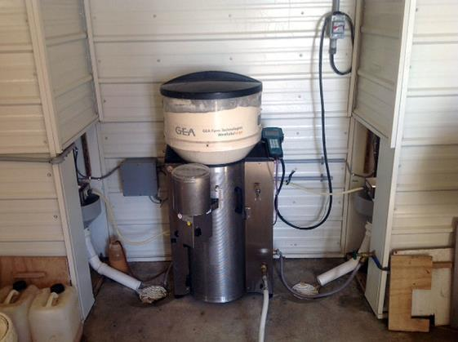
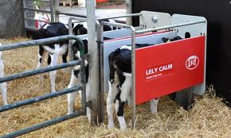
Computer Calf Feeders

Slide 30
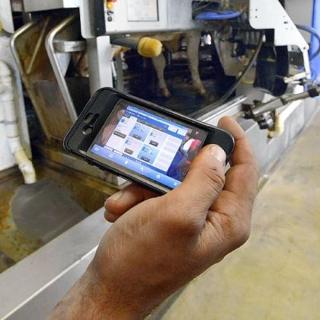
Get connected with your cows and systems

Slide 31
Summary
Positive Growth in KS Dairy Industry
Bright Future for KS
Technology Brings Opportunities
  Global Leadership
  Industry Training
  Owner Training
  Employee Training
  Connect with Consumers

