Slide 1
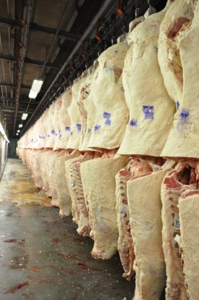
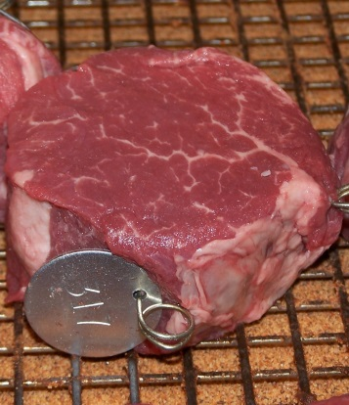
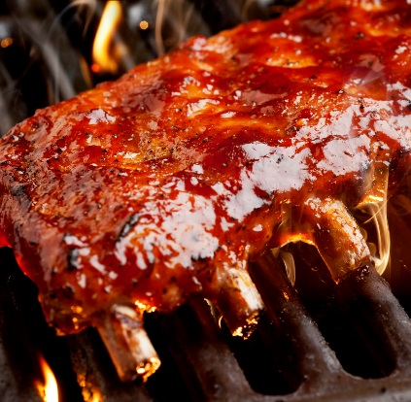
Fresh Meat Extension
Programming Opportunities
Travis O’Quinn, Ph.D.
November 2014

Slide 2
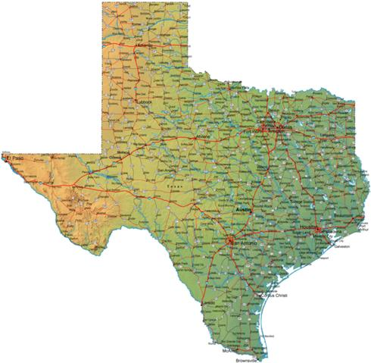

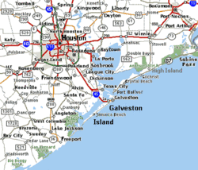
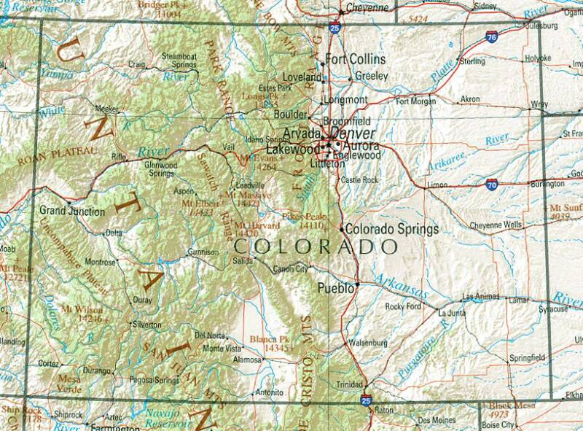

BACKGROUND
Grew up in League City, TX
Texas Tech University
Bachelors of Science, Animal Science,
Meat Science Option; Summa Cum Laude
Texas Tech University
Masters of Science, Meat Science
Major Professor – Dr. Mark Miller
Thesis - Consumer assessment of beef strip
loin steaks of varying fat levels
Colorado State University
Doctorate of Philosophy, Meat Science
Major Professors – Dr. Keith Belk and
Dr. Daryl Tatum
Dissertation - Identifying consumer
preferences for specific beef flavor
characteristics

Slide 3
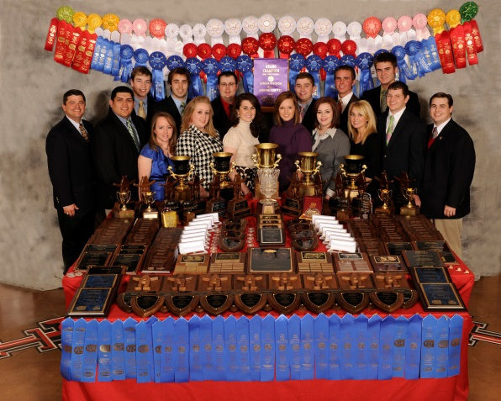
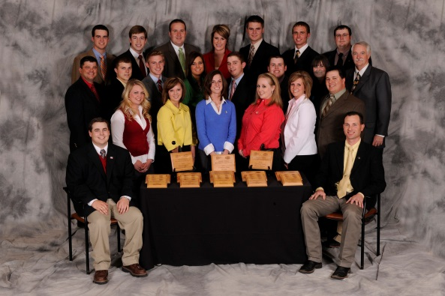
BACKGROUND
Meat Judging Teams
2006 Reserve National Champion Team
2009 National Champion Team
2010 Reserve National Champion Team
Meat Animal Evaluation Teams
2007 National Champion Team
2008 National Champion Team
2009 National Champion Team
2010 National Champion Team
2013 National Champion Team
Meat Science Quiz Bowl Teams
2007 National Champion Team
2009 National Champion Team
Coached or Member of 10 National or Reserve National Champion Teams

Slide 4

BACKGROUND
Current Position:
Assistant Professor, Meats Extension Specialist
60% Extension, 40% Research Appointment
Started in July 2014

Slide 5
Meats Extension Programming

Slide 6


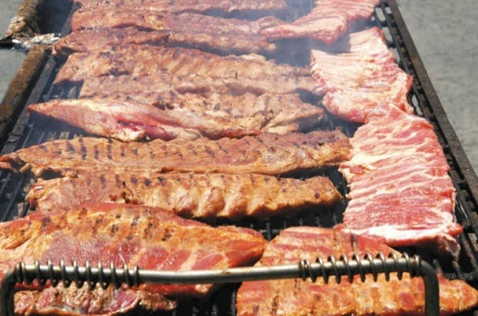
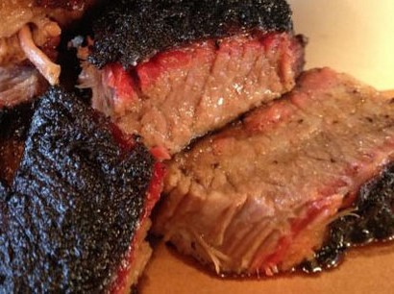
BBQ 101
BBQ 101
All day program focusing on teaching consumers about all things BBQ
Targeting consumers who have an interest in learning more about BBQ and are looking to learn different techniques, about different meats, different products etc.
Will focus on how to create great backyard BBQ for friends and family
Will touch on competitive BBQing, but will not be the major focus
Hands-on demonstrations, taste testing of different products, etc.

Slide 7
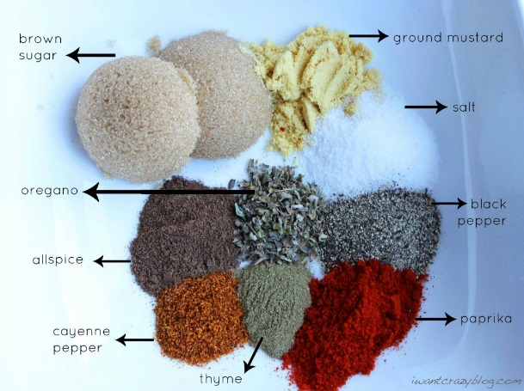
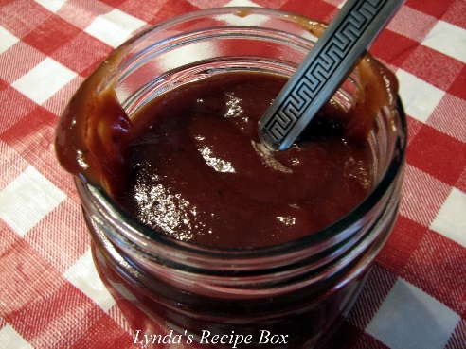
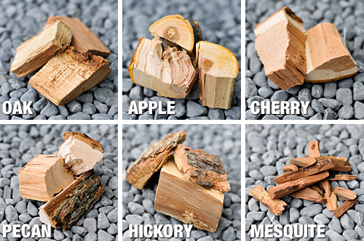
BBQ 101
Topics:
Types and uses of different grills/smokers
Spices, rubs, marinades, and sauces
Regional differences in BBQ
Different flavors of woods
Demonstration and discussion of common and less common meat cuts used for BBQ
Meat Selection and Preparation
Food Safety
Degrees of doneness for different meats
Taste testing of different sauces, meats cooked with different woods, wrapped vs unwrapped product
Provide every participant with a book containing lots of different recipes and BBQing tips with all presentations included

Slide 8
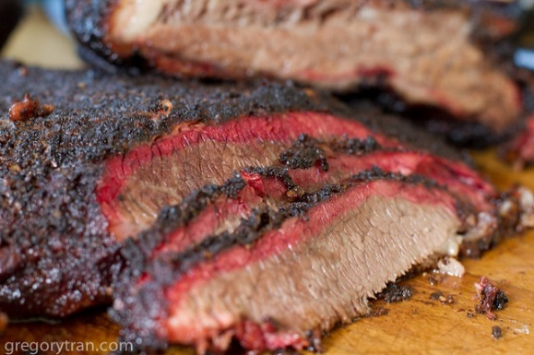
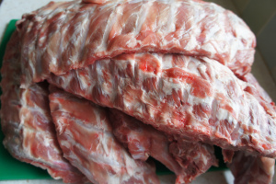
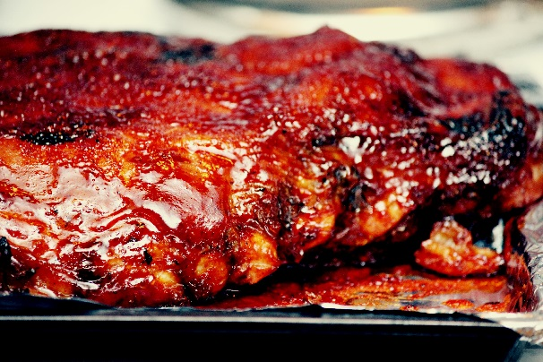
BBQ 101
Timeline:
Would like to do 4 of these in late spring before grilling season starts to heat up; May
One in Manhattan, One at KSU Olathe Campus, looking for two more locations in Western KS
If lots of interest, may do an additional one in the fall
60 – 80 people at each event
Looking for potential speakers on any of the topics listed
Looking for potential sponsorship

Slide 9
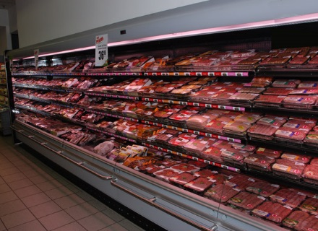
CONSUMER TOPICS

Slide 10



CONSUMER TOPICS
Fact Sheets and Programs
Confusing meat marketing / labeling terminology
- Meat product labeling and marketing - what do all those words really mean?
Differences between Grass vs Grain Fed Beef
New cut names with pictures and cooking information
Ground Beef 101
Right cut for the right cooking method – maximizing value and taste
Meat selection basics
How and why to use a meat thermometer when cooking meat
What’s in a grade? – All about meat grading
In addition to the fact sheet, most of these topics would have a ready made PowerPoint and evaluation for simple programing at the county level

Slide 11

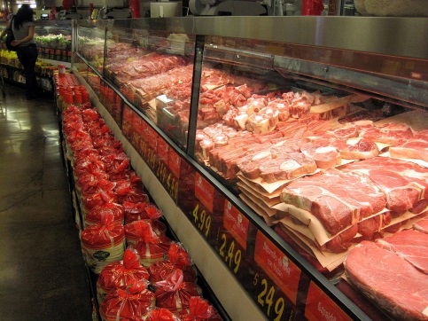
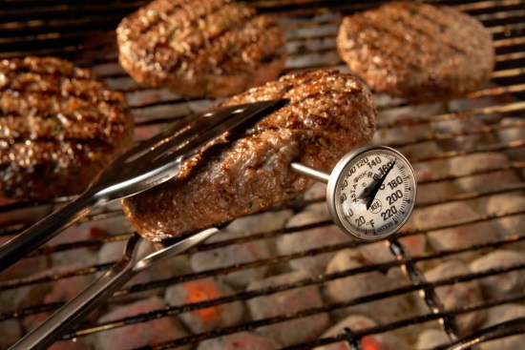
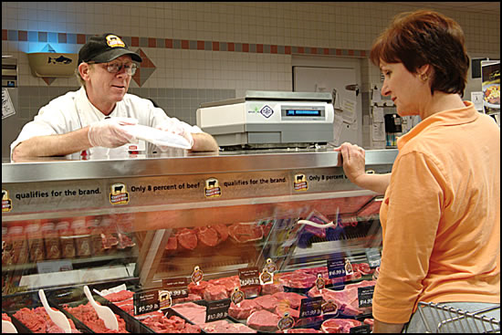
CONSUMER TOPICS
Meat 101
Focused on current consumer issues concerning meat and meat products
Focused on helping educate consumers about meat
Potentially in the fall of next year
Topics would include:
  Safe meat handling
  Meat cookery
  Meat selection and purchasing
  Meat production
  Meat labeling and marketing
  Meat nutrition
  Producer panel
  Tasting of different types of beef

Slide 12

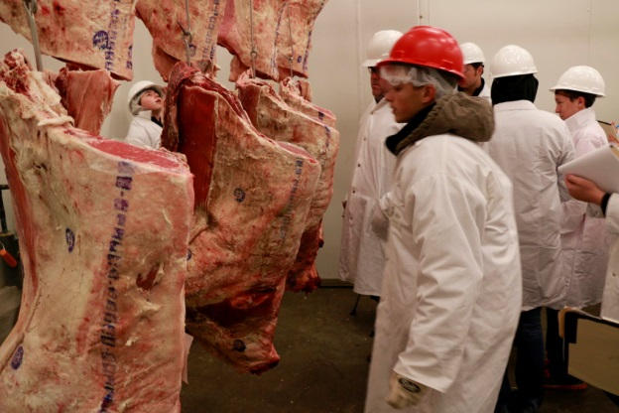
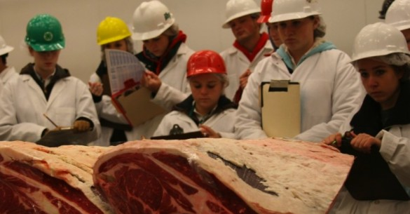
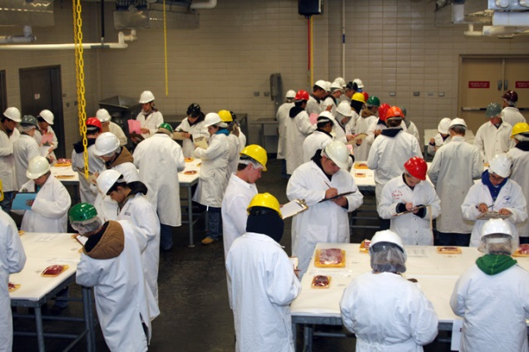
4-H MEAT JUDGING
Future Plans
Provide more resources for coaches
Provide opportunities for teams to get “cooler time”
Planning on developing a website with information and training resources for teams. Will have pictures, videos, terminology, sample classes, reasons, how-to instruction, etc.
Planning on hosting a one day meat judging clinic in the spring allowing teams to come to KSU and practice on several different classes, retail ID, instructional times from K-State meat judging team members
Potential regional meat judging workshops

Slide 13
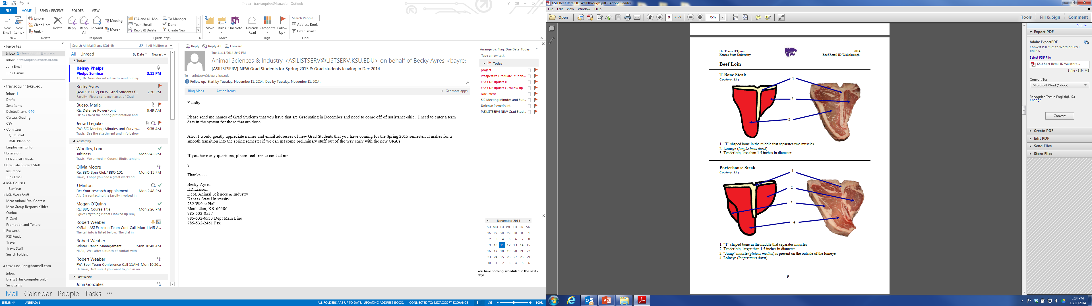
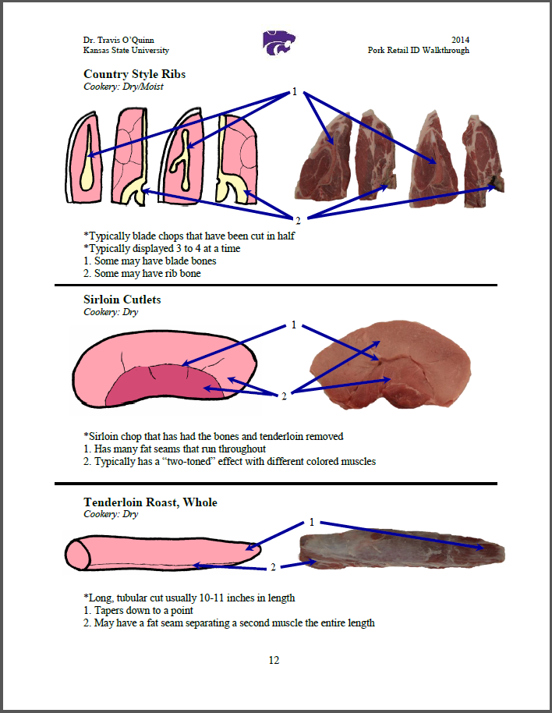
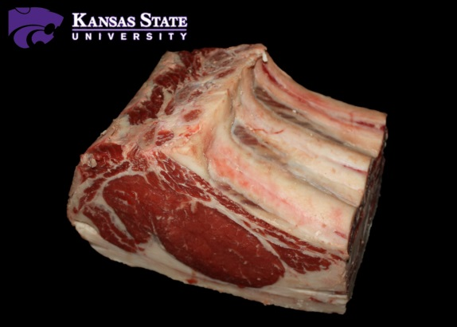
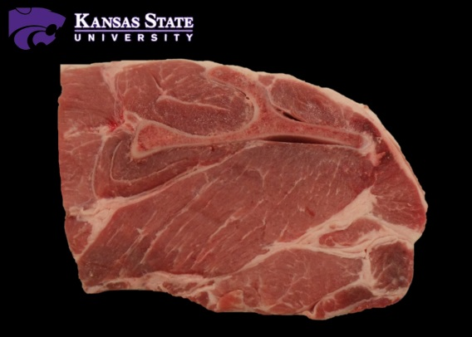
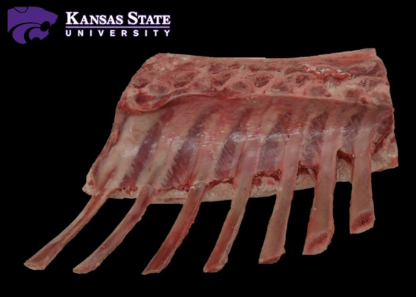
4-H MEAT JUDGING

Slide 14
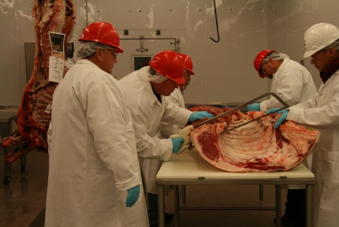
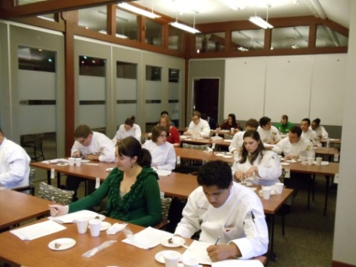
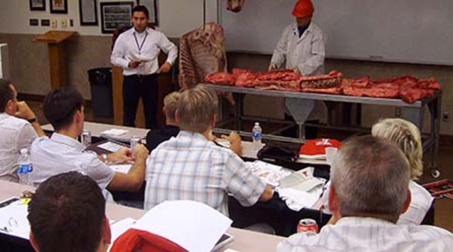
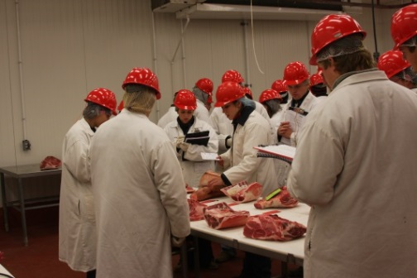
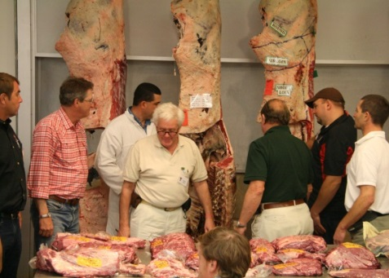
ADDITIONAL PROGRAMING
Other Possibilities
Carcass contests associated with livestock shows
Meat cutting and processing demonstrations
Beef 706 program – producer and feeder focused
Fed-Beef Challenge
Specific meat-related issues programing
Any meat related programing that may be needed

Slide 15
Questions?
Travis O’Quinn
travisoquinn@ksu.edu
785-532-3469

