Slide 1
Understanding Nitrate Toxicity for Cattle and Management Practices
(agent)
(title)

Slide 2
Overview
What is nitrate toxicity
Physiology of disorder
Symptoms
What increases nitrate issues in forages
How do we manage for nitrate toxicity in cattle
Harvesting plans
Feeding plans
Testing

Slide 3
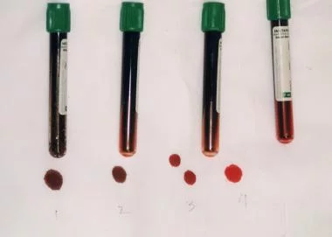
What is nitrate toxicity
Over-accumulation of nitrite in the rumen that leads to absorption into blood and decreases oxygen carrying capacity
Symptoms include:
Bluish/chocolate brown mucus membranes
Rapid/difficult breathing
Noisy breathing
Rapid pulse (150+/min)
Salivation
Bloat
Tremors
Staggering
Weakness
Dark “chocolate-colored” blood
Coma
Death
Abortions
In tubes 1 and 2, methemoglobin fraction is 70%; in tube 3, 20%; and in tube 4, normal. https://emedicine.medscape.com/article/204178-overview

Slide 4
Nitrate Toxicity
Physiology of disorder
O₂
O₂
O₂
O₂
Nitrate
Nitrite
Ammonia
Notes:
This is a multi-animation slide. When talking about this slide one begin by saying that the normal nitrate cycle is this: nitrate is consumed by the ruminant animal (click) the rumen microbes that convert nitrate to nitrite are very fast and efficient, thus (click) leading to a high level of nitrite in the rumen (click). In a perfect world the rumen microbes can convert nitrite to ammonia to be utilized by the animal or other microbes. However, (click) when consuming a high dosage of nitrate (click) those very efficient microbes rapidly (click) convert nitrate to nitrite (click) and the lower and less efficient microbes (click) can’t convert nitrite to ammonia. This over-accumulation of nitrite in the rumen (click) then gets absorbed into the blood stream where (click) it binds to the hemoglobin molecules to make methemoglobin. As you are familiar, hemoglobin is the oxygen carrying molecules of the blood. When the nitrite is bound the blood is not able to carry oxygen and thus leads to the classic symptoms of dark chocolate blood, trouble breathing, abortions, and potentially death.

Slide 5
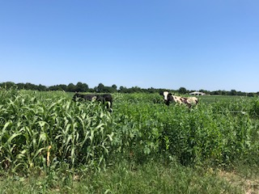
Sources of nitrate
Even though nitrite is the cause of symptoms we test for nitrate
Nitrite is 10X more toxic than nitrate
Sources include:
Plant species
Agronomic factors
Water
Fertilizer
Notes:
Acute nitrate poisoning may occur if livestock consume nitrate fertilizer. Avoid grazing immediately after spreading fertilizer. Areas where the fertilizer spreader turns or areas where filling (and consequently spilling) take place may have excessive quantities of nitrate freely available to animals.

Slide 6
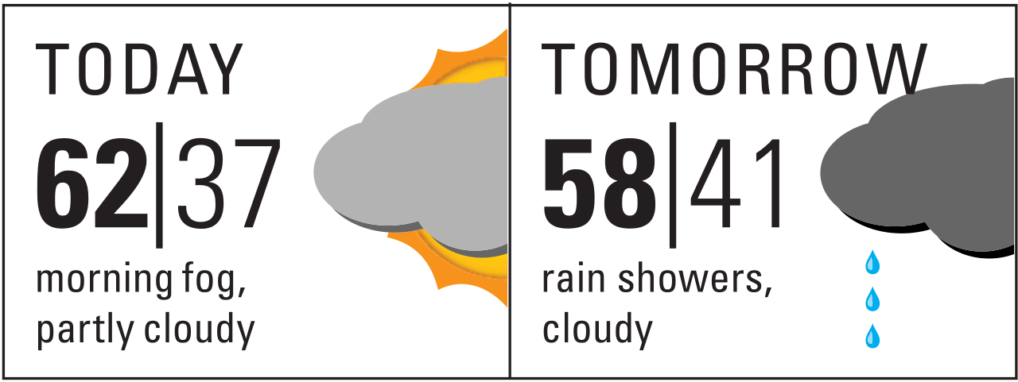
Factors affecting nitrate levels
Specific plants
Fertility
Weather

Slide 7
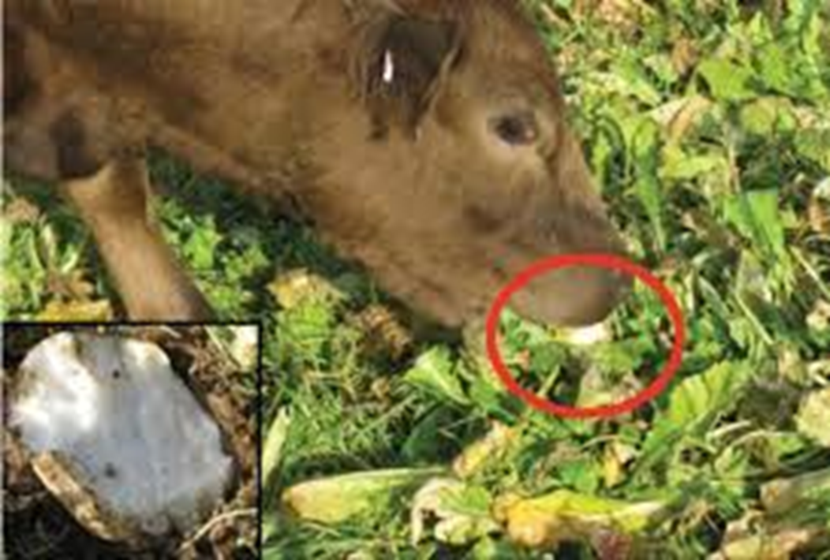
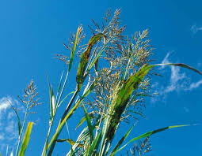
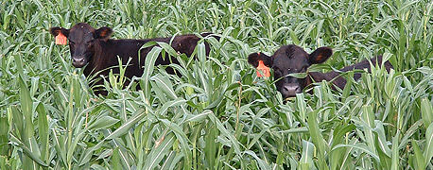
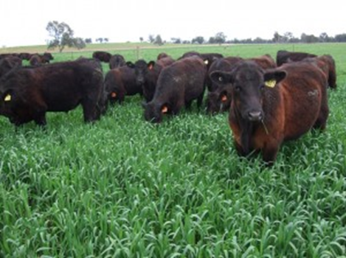
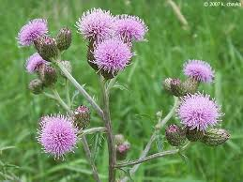
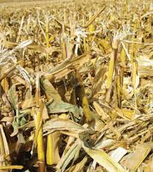
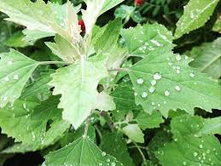
Common plants known to accumulate nitrate
Crops
Weeds
Barley
Corn
Flax
Millet
Oats
Radishes
Rape
Rye
Soybean
Sorghum
Sudangrass
Sugar beets
Sweetclover
Turnips
Wheat
Canada Thistle
Dock
Jimsonweed
Johnson Grass
Kochia
Lambsquarter
Nightshade
Pigweed
Russian Thistle
Smartweed
Wild Sunflower

Slide 8
Plant fertility effects on nitrate accumulation
Factors that increase nitrate in plants
Greater nitrogen application
Higher residual nitrogen in field
Deficiencies in soil:
Acidity
Sulfur
Phosphorus
Low molybdenum
Molybdenum converts nitrate-nitrogen to organic nitrogen or amino acids in plants

Slide 9
Weather conditions
Drought
But not all drought conditions (must have some moisture for plant to absorb nitrogen from soil and accumulate nitrate)
If all the nitrates are at the surface of soil but not roots, then very little is absorbed
Drought-breaking rain
Nitrates will be high in plants that survive the drought and have a rain (3-4 days after rain event)
Re-growth after drought breaking rain

Slide 10
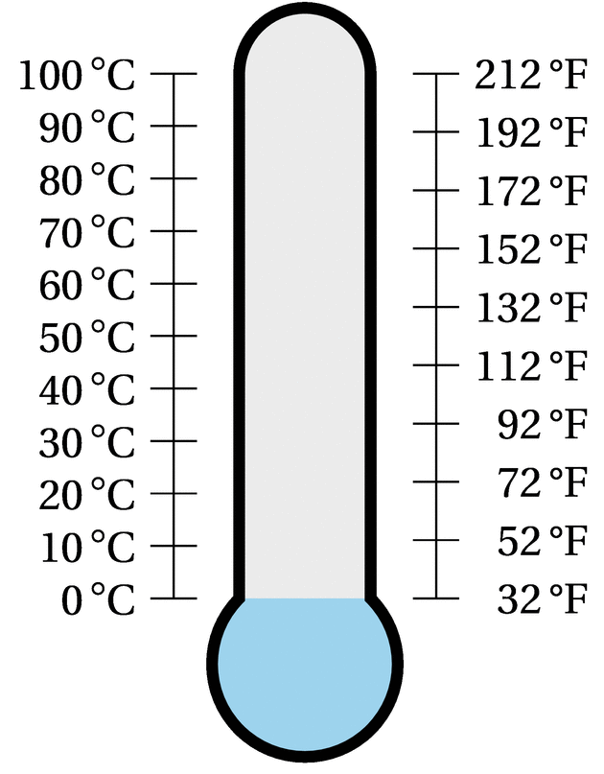
Weather conditions
Frost, hail, and low temperatures
Interfere with normal plant growth
Can damage, reduce, or destroy leaf area of plant
Impede photosynthesis so accumulate nitrates in stem or stalk and not converted to usable proteins in leaf
Need at least 55°F for active growth and photosynthesis
Nitrates can be absorbed quickly at lower temperatures but need warm temp for these to be converted to amino acids and proteins

Slide 11
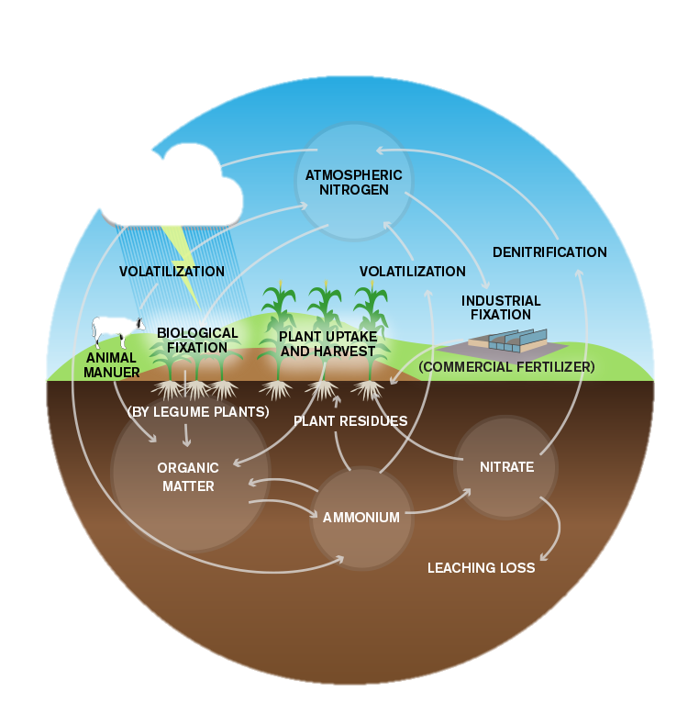
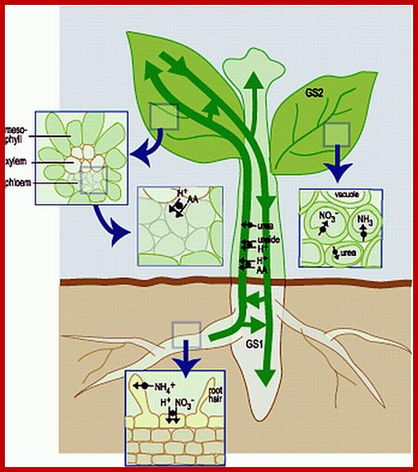
Weather conditions
https://plantcellbiology.masters.grkraj.org/html/Plant_Cell_Biochemistry_And_Metabolism4-Nitrogen_Metabolism.htm
Anything that disrupts
Nitrogen cycle can increase
nitrates in plants
IPNI
Notes:
Nitrogen cycle and nitrogen metabolism in plants

Slide 12
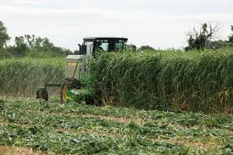
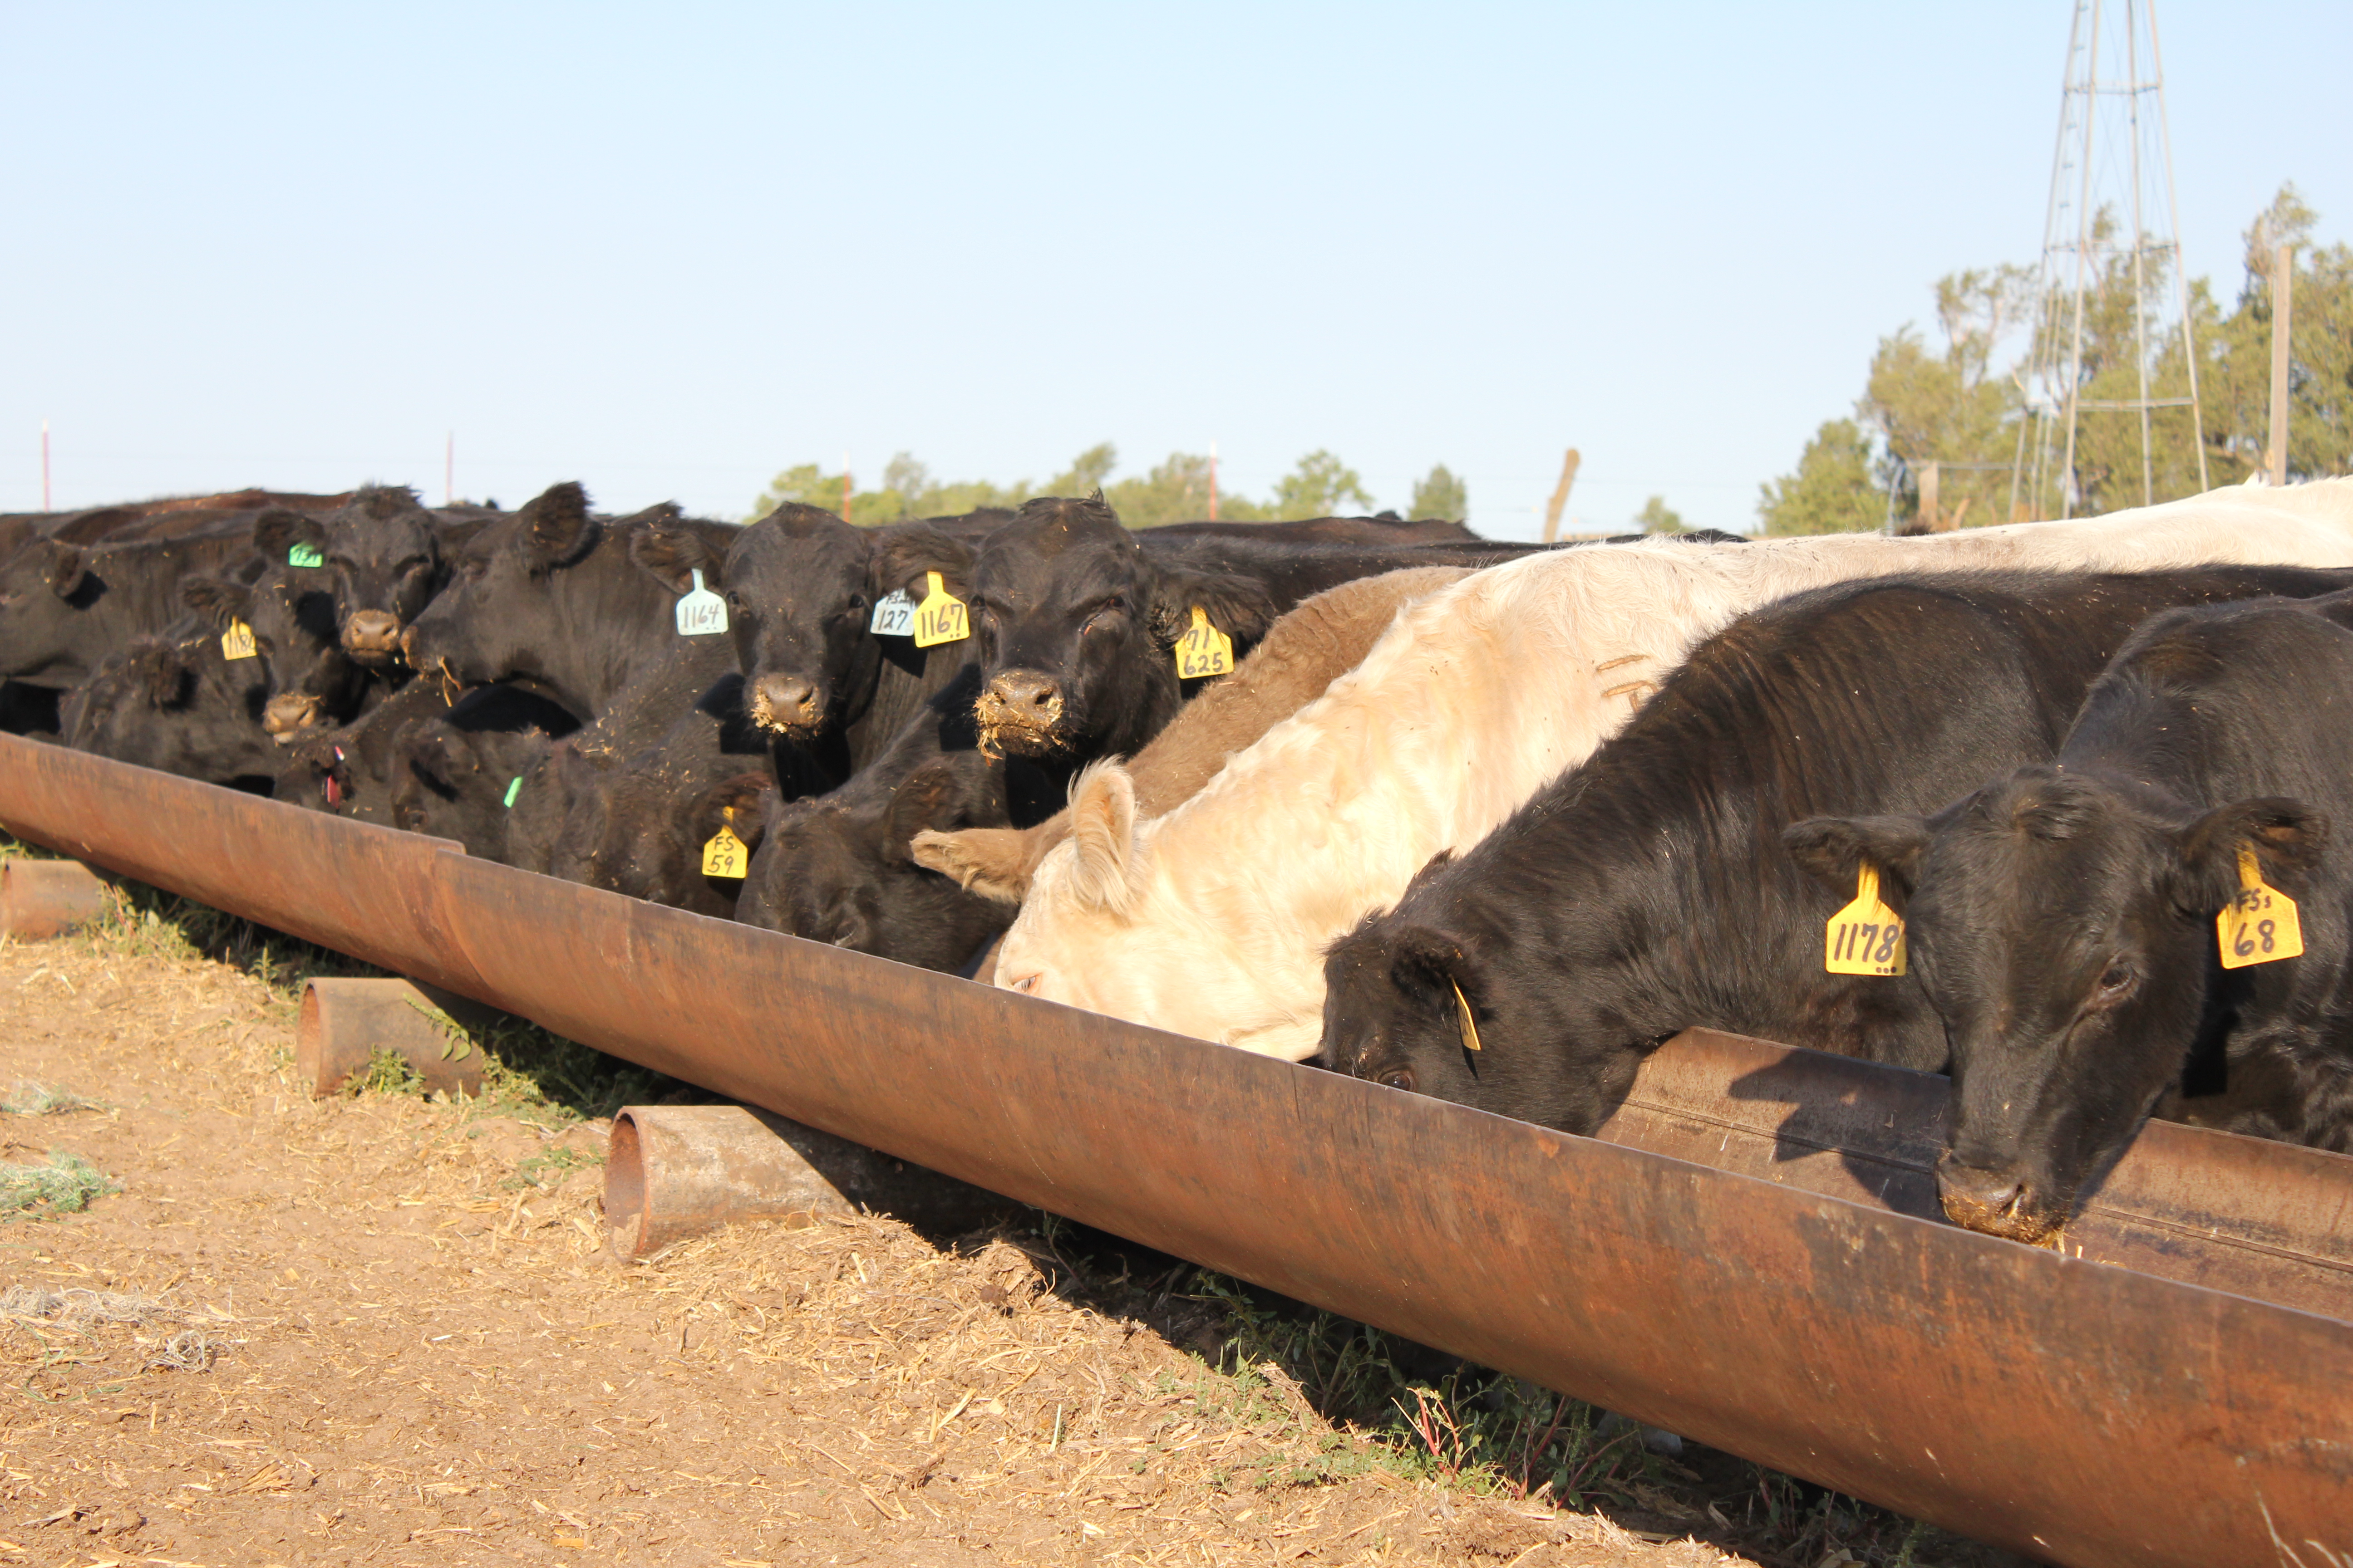
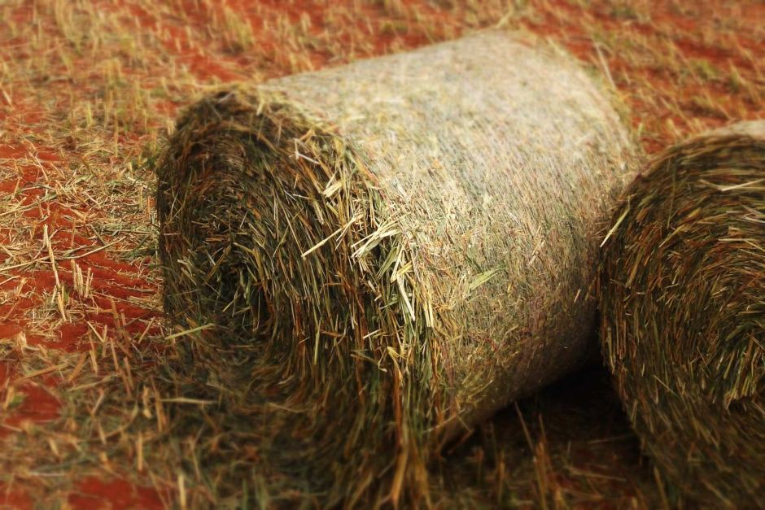
Managing for nitrate toxicity
Harvesting
Feeding

Slide 13
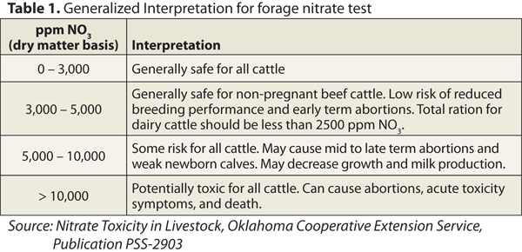
Nitrates
Levels/recommendations

Slide 14
Plant parts and plant maturity
Stalks and stems closest to the ground have highest nitrate values
Bottom 1/3 highest nitrate
Seed (grain) and flower usually little to no nitrate
More mature plants less nitrate than young
Except…..
Notes:
Mature vs young except when environmental and soil conditions are favorable.

Slide 15
Harvesting high nitrate forage
If concerned about high nitrate values
Sample field prior to harvesting
Options:
Allow plant to mature longer
Raise cutter bar (minimum of 6 inches)
Make into silage (if still moisture less than 40%)

Slide 16
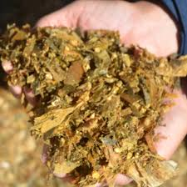
Harvesting high nitrate forage
Ensiling process can reduce nitrates 40-60%
IF DONE properly
Still need to test prior to feeding for nitrate values
Do not feed as green chop – unless feeding immediately
Any heating will cause nitrate to convert to nitrite and is 10x more toxic to cattle

Slide 17
Nitrates
Levels/recommendations

Slide 18
Dilution is the solution to nitrate pollution

Slide 19
Management methods
Always provide good clean water
Make sure water isn’t contributing nitrates
Provide dry/other sources of feed
Dilute to safe feeding levels based on class of cattle
Generally feed highest nitrate hays to growing cattle
Graze during day not at night during 1st week
Higher nitrate values when dark outside because of reduced photosynthesis

Slide 20
Management methods
Provide additional energy/protein to shuttle nitrite to ammonia
More soluble sugars provide additional efficiency of microbes to convert nitrite to ammonia
Make sure proper mineral is supplied
Sulfur in particular
Higher sulfur feeds provide needed sulfur atoms for microbes to more efficiently convert nitrite to ammonia
Adapt cattle to high nitrate feeds over time

Slide 21
How much is testing costing me?
Each nitrate test is ~$15
Times to test
Pre-harvest (x2)
Post-harvest
Pre-feeding
Total cost is ~$60
What is the cost
of not testing??

Slide 22
Testing methods
Best method is to send sample to accredited laboratory for analysis
Currently only method that has been proven to be quantitative
Some field tests
Test strips
Diphenylamine test

Slide 23
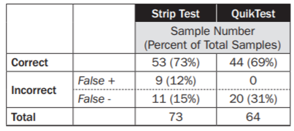
Testing methods
Field tests have use, but should not be used primarily to develop diets
Use of field test
Test various spots along stalk to determine cutting height
Quick test to answer YES/NO whether nitrate present
Error with field test

Slide 24
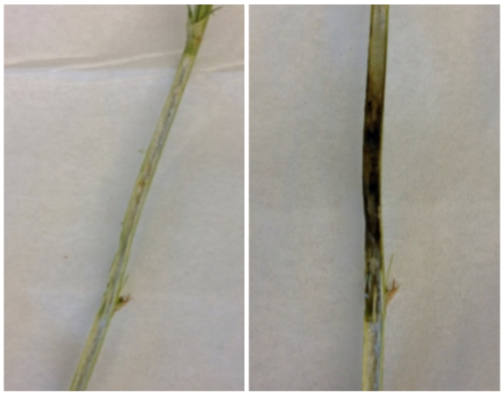
Testing methods
Diphenylamine nitrate test
file:///C:/Users/Livestock%20Specialist/Documents/Programs/Agent%20resources/Nitrate/Forage%20Nitrate%20Analysis%20MG.pdf

Slide 25
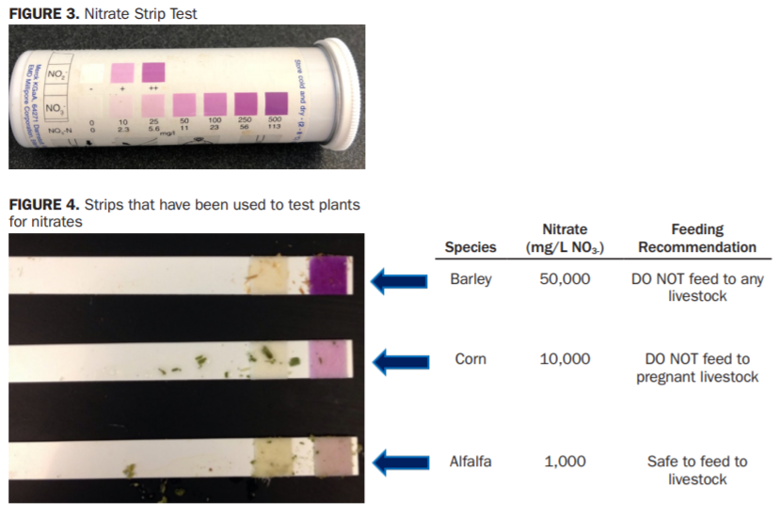
Testing methods
Nitrate test strips
file:///C:/Users/Livestock%20Specialist/Documents/Programs/Agent%20resources/Nitrate/Forage%20Nitrate%20Analysis%20MG.pdf

Slide 26
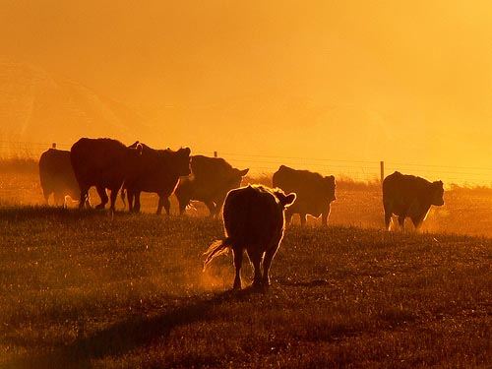
Thanks!!
Questions

