Slide 1
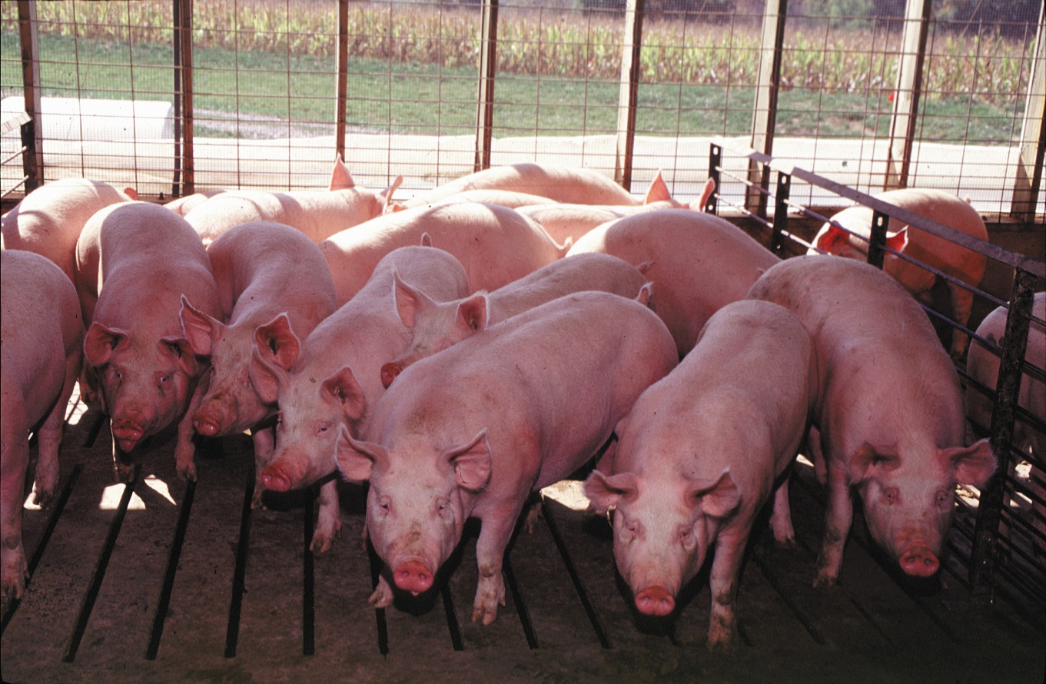
Swine Industry Update
www.KSUswine.org

Slide 2
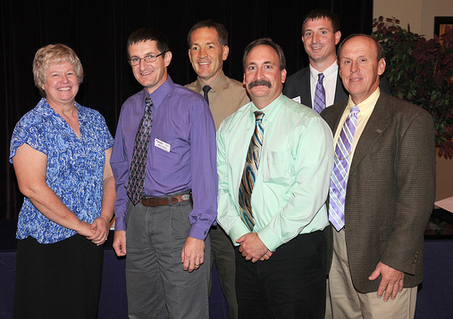
KSU ASI Swine Extension Team
1.4 Extension tenths in Swine
  Joel DeRouchey (20%)
  Bob Goodband (20%)
  Jim Nelssen (40%)
  Mike Tokach (60%)
  Steve Dritz (Vet Med)
  Lois Schreiner

Slide 3
Other KSU Faculty working with swine
Animal Sciences and Industry
  Duane Davis (Reproduction, physiology)
  Joe Hancock (Nutrition)
  Travis O’Quinn, Terry Houser, John Gonzalez (meats)
  Hilary Hawkins (Youth)
Grain Sciences and Industry
  Charles Stark and Cassie Jones (Feed processing, everything feed mills)

Slide 4
Other KSU Faculty working with swine
Ag Engineering
  Pat Murphy
Ag Economics
  Glynn Tonser
Veterinary Medicine
    Dick Hesse, Bob Rowland, Jurgen Richt, Jerome Nietfeld, etc

Slide 5
Source: USDA/FAS

Slide 6
Pork: 37% of the world’s meat consumption
Source: UN Food & Agriculture Organization
Notes:
Pork beats chicken and beef. Pork accounts for 37% of the world’s consumption of meat. Farmers have also worked very hard to make pork a better meat and it’s paying off here at home with increasing sales and through record exports to countries like Japan. Sales to Japan during 2013 totaled $1.9 billion.
(Source: UN Food & Agriculture Organization – Statistical Bulletin 2013)

Slide 7
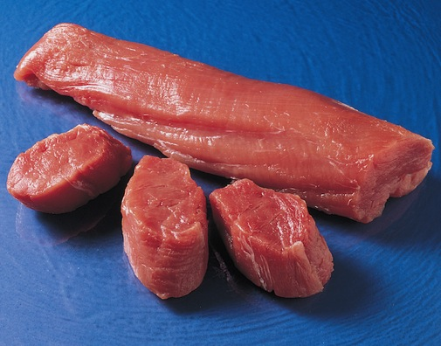

USDA Study Shows
  Pork tenderloin lean as skinless chicken breast.
  7 common pork cuts 16% leaner than 25 years ago.
  Saturated fat down 27%.
Notes:
A USDA study shows:
Ounce for ounce, pork tenderloin is just as lean as a skinless chicken breast
The 7 most common pork cuts are, on average, 16 percent leaner than 25 years ago, and
Saturated fat has dropped 27 percent
(Source - Study conducted by: USDA in conjunction with the University of Wisconsin-Madison and the University of Maryland)

Slide 8

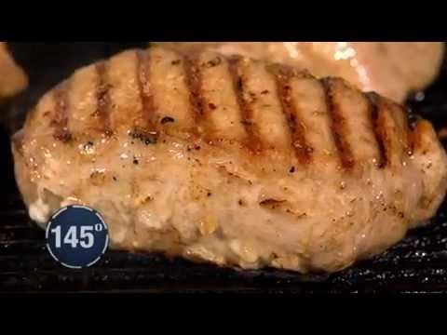
Leaner Pork = Less Cooking
USDA guidelines updated for whole pork cuts.
Notes:
Leaner pork also means less cooking and so for some, it helps to think about cooking fresh pork cuts just like you do steaks.
Years ago pork was often overcooked due to our fear of trichinosis; which is now virtually nonexistent because of today’s modern farming practices.
USDA guidelines have been updated for safely cooking whole cuts of pork such as chops, roasts and tenderloins to a medium rare internal temperature of 145 degrees Fahrenheit with a resting time of three minutes before carving or eating. Those cuts will slightly pink on the inside. To achieve medium doneness, cook whole pork cuts to 160 degrees Fahrenheit.
Ground pork, like all ground meats, should be cooked to 160 degrees.
Pre-cooked ham can be reheated to 140° F. or enjoyed cold.

Slide 10
Average U.S. Hog Carcass Weight

Slide 11
Annual U.S. Pork Production Per Sow
1930-80 growth rate: 2.0%
1980-13 growth rate 2.8%

Slide 12
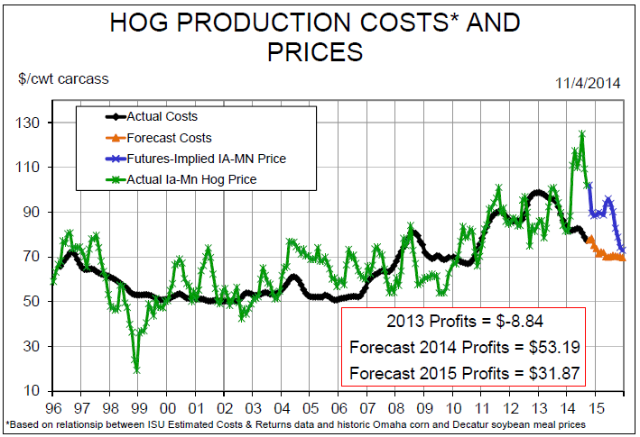

Slide 13
Recent Swine Industry History
Volatility
Profit to 1998 - 30+years
LOSS to 2000
Profit to 2002
Loss to 2004
PROFIT to 2007
LOSS to 2010
Profit for 2011
Loss to 2013
PROFIT for 2014 and 2015

Slide 14
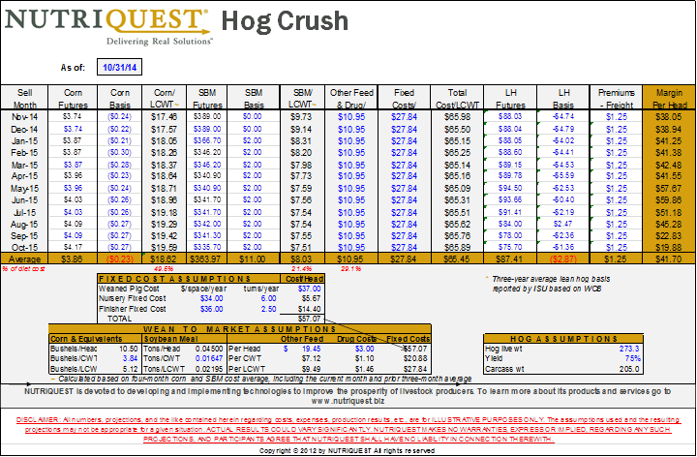
12 month projection is VERY Profitable

Slide 15
Porcine Epidemic Diarrhea Virus (PEDv) information
Porcine coronaviruses do not affect people
PEDv and deltacoronavirus are not food safety concerns
They do not affect other species, just pigs
PEDv is NOT a new virus - Europe and Asia for some years; delta also previously known
  Cross-protection is limited or absent
There are no effective vaccines or treatments
Clearly some portal or fomite is open into the US, globalizing these swine diseases

Slide 16
Pathology of PEDv
Highly infectious and pathogenic, brief incubation period ~24 hours
Destroys the mature enterocytes lining the small intestine -> severe watery diarrhea and dehydration
All ages of pigs are affected, adults become immune, temporarily, after recovery
Death loss of ~100% in nursing pigs; little death loss in weaned and older pigs but morbidity, suffering, weight loss

Slide 17
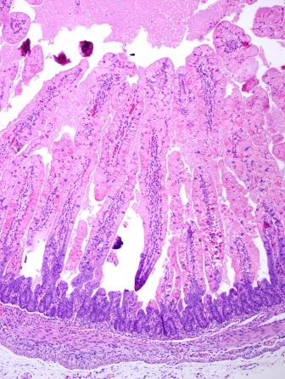
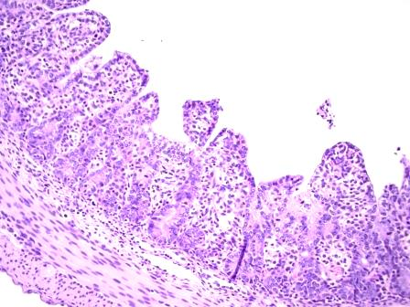
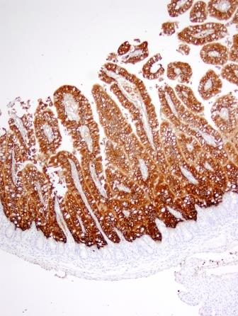
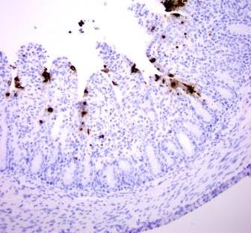
Immunohistochemistry (IHC)
1
3
2
Late PEDv infection (~36 hrs PI): Severe villus atrophy & loss of absorptive epithelium
4
Normal neonatal pig: Healthy, long intestinal villi
Early PEDv infection (~8 hrs PI): Infected cells (brown stain) line the villi
Late PEDv infection (~36 hrs PI): Few infected cells remain (brown stain) & absorptive cells destroyed
Source: Schwartz, Madson, Magstad et al.

Slide 18
Impact of acute infection
Farrowing – infection spreads rapidly, death within 24 hours for baby pigs; <3wks of age nearly all die
Farrowing – 100% of piglets continue die for 3 weeks and then slow improvement as recovered, immune sows begin to farrow.
Survival back to roughly normal levels in 5 weeks
Some abortions and a few sow death losses
To estimate losses – roughly 5 weeks of piglets or 10% of annual production

Slide 19
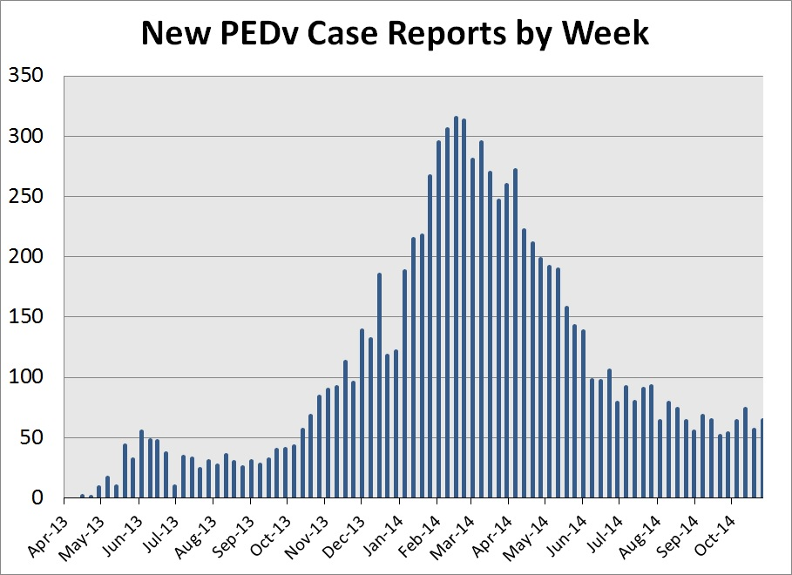

Slide 20
PEDv – Educational information
www.aasv.org Porcine Epidemic Diarrhea Information section
For reference from web site:
  Exhibition Recommendations
  Disinfectants
  Market Biosecurity
  Transportation Biosecurity
  Manure Hauling Biosecurity Guidelines

Slide 21
PEDv – Educational information
National Pork Board has developed factsheets on PEDv and youth swine projects.
www.pork.org/pedv
  Swine Health Recommendations: Exhibitors of All Pigs Going to Exhibits or Sales
  Swine Health Recommendations: Organizers of Exhibitions and Sales
  Swine Health Recommendations: Biosecurity for Organizers of Weigh-in or Tagging Events

Slide 22
Kansas swine industry future
Volatility
  Great profitability potential in 2014-2015.
  Fear of massive losses in fall 2016
    Run out of packing space due to current/future expansion.
Future Challenges
  PEDv
  Sow housing
  Antibiotic use
  Castration and tail docking

Slide 23
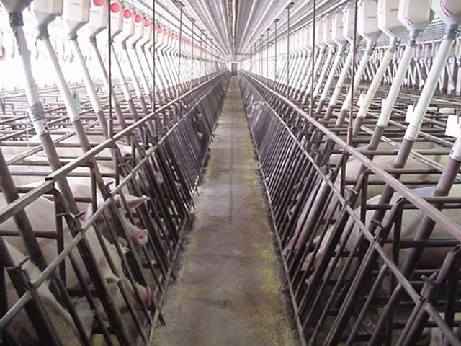

Slide 24
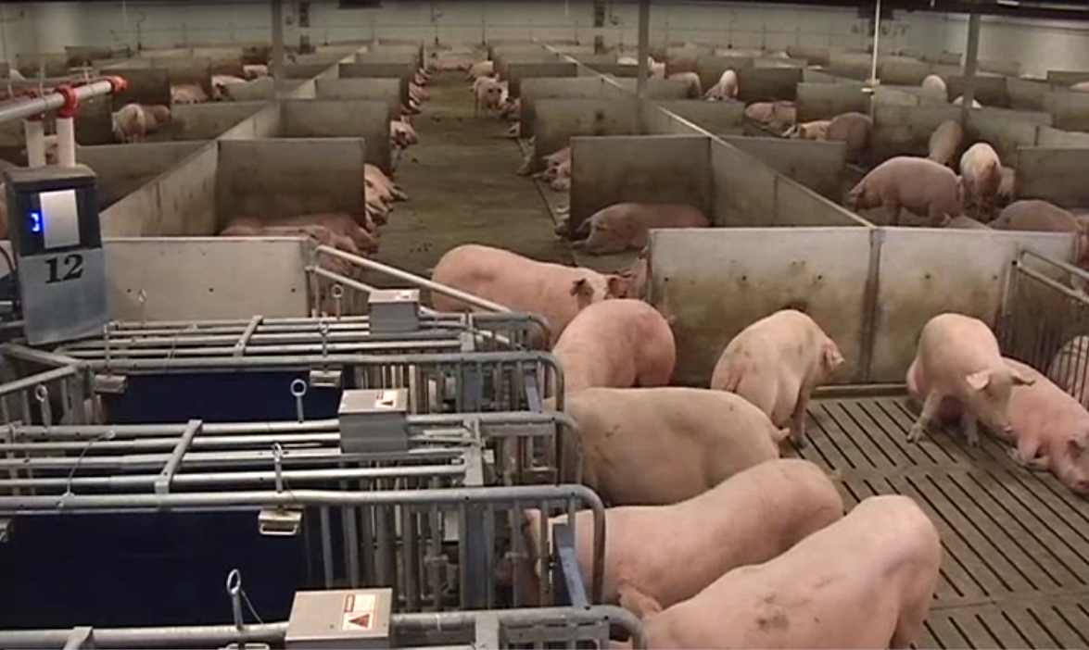

Slide 25

K-State Swine Industry Day
Thursday, November 20, 2014
www.KSUswine.org
Notes:
1

Slide 26
National Junior Swine Association Regional Leadership Conference
To be held December 6, 2014, Manhattan
Held in various locations around the US each year, 1st time in KS
Focused on youth 12-18 years old and adults
Wide variety of show and industry related topics.
Registration deadline November 16th, 2014

Slide 27
Junior Swine Producer Day
To be held February 28, 2015
  Held every other year in Manhattan
  350 - 400 youth and adults attend
Focused on the basics of swine projects
  Buying the right pig, daily care, nutrition, showing, youth PQA+, etc..
More information to come
  We greatly appreciate your promotion and support of this event

Slide 28
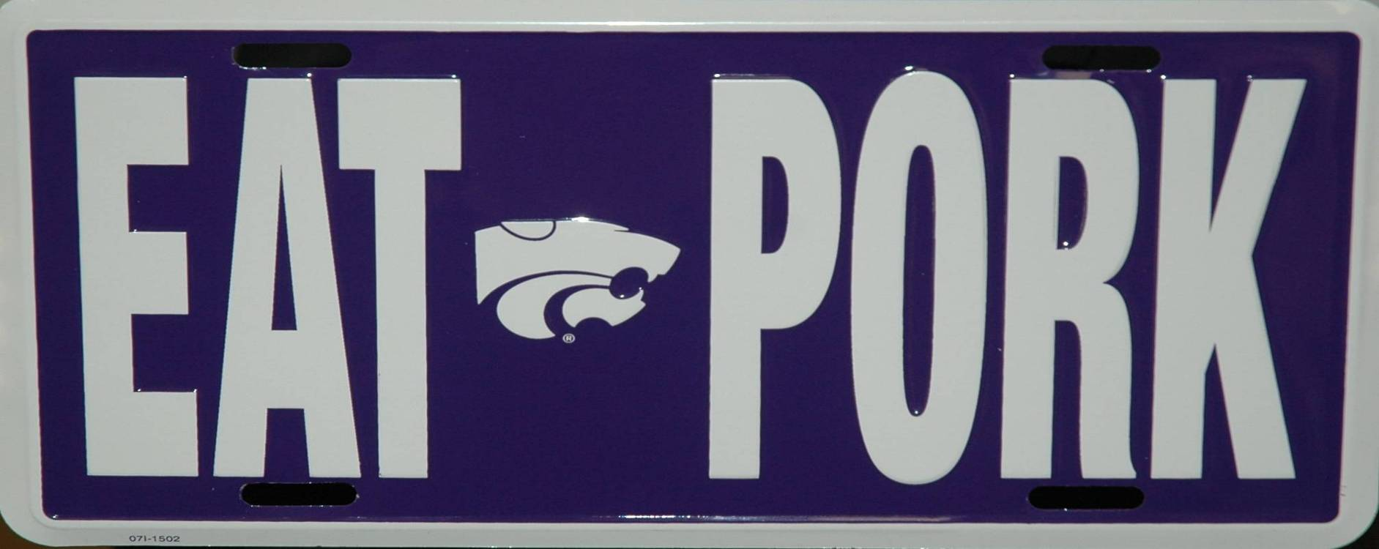
Thank you!
www.KSUswine.org

Slide 29
Questions on Youth Livestock
Sweepstakes:
  Changes to speed up awards
  When to hold?

Slide 30

KJLS
Football

Slide 31

Labor Day weekend
State fair
State fair

