Slide 1


Food, Agriculture and Veterinary Response
What we have learned through planning, training and exercise activities

Slide 2
Key Points
Incident Command WILL be used by all responding and supporting agencies – we have an Incident Management Teams (IMT)
The STATE has statutory authority for Food, Agriculture and Veterinary response within the state
  Feds when Interstate
  Locals = No Authority
States, locals and federal agencies are working to ensure a collaborative effort
KDA has been actively exercising plans for years
  Federal agencies participate, but very few (if any) complex exercises have been initiated at the federal level
For a complex FAVR event – Federal, State and LOCAL

Slide 3

Kansas is a member of the largest and most active consortia of states
The Southern Area Alliance consists of Hurricane States and the New England also has a recently formed group
States have good day to day working relationships for Food, Animal Health and Plant events
Notes:
Colorado AH personnel join MSP on our conference calls and have been very engaged with us in our planning efforts. California is also very active on many workgroups and USDA projects.

Slide 4
Why is it always FMD?
Foot and Mouth Disease seems to be the most devastating agriculture event we can imagine
There are some complex feed and food scenarios that would also be crippling
The assumption that we depend on is that if we can set up systems to deal with FMD, we would use the same mechanisms to respond to other diseases and agriculture events

Slide 5
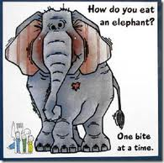
New concept for Animal Health Planners - Since the UK outbreak of FMD in 2001 State and Federal Officials had been eating the whole elephant – Which was necessary
Once we had those initial FAD Plans in place, Kansas started looking at what might NOT work and began with the issue of STOPPING Movement

Slide 6
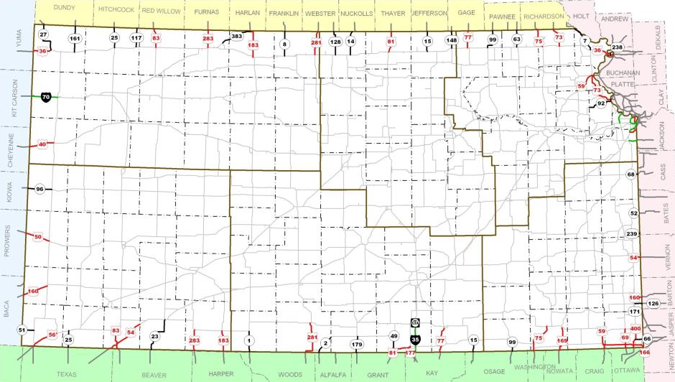
Interstate vs. Intrastate
Notes:
Map of Kansas highlighting the state and federal highways that cross borders. All traffic will be directed to checkpoints that will be set up at these locations. Goal is to share these with the border states to maximize the use of limited resources.

Slide 7
Pilot Project resulted in 2 Exercises
The whole elephant approach led to some discoveries
  Things we had planned weren’t possible
    Logistically
    Safety Issues
    Practicality
  Our efforts to “save” industry might destroy it
  Planning, Training and Exercising became the focus – One bite at a time

Slide 8
SAMS K
Stop Animal Movement Statewide KS/OK
October 22, 2009

Slide 9
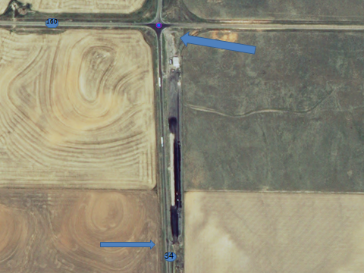

Slide 10
Exercise Overview
Who Played?
  State
    Kansas Animal Health Department
    Oklahoma Department of Agriculture, Food, and Forestry
    Kansas/Oklahoma Department of Transportation
    Kansas/OK State Emergency Management
    Kansas National Guard (SEOC Only)
    Kansas/Oklahoma Highway Patrol
    Kansas Department of Agriculture
  Federal
    USDA (APHIS/FSIS)
    FBI

Slide 11
Exercise Overview
Local Players
  Kansas Counties: Stevens, Meade, Clark, and Morton
  Oklahoma Counties: Beaver, Harper, and Texas
  Industry Associations and Academia
Who is helping?
  Contractor – SES inc, Merriam, KS
  MultiState Partnership for Security in Agriculture
    Wisconsin (5) (HS, AG, Local, LE)
    Missouri ( 7) (AG and Academia)
    Nebraska (5) (AG and Roads)
    Michigan (4) (AG, LE)
    Minnesota (1) (AG)

Slide 12
Objectives
Evaluate the functionality and implementation of each state’s plan for a stop movement order.
Evaluate interstate and intrastate coordination and communication related to a stop movement order.
Determine resource needs and requirements for a stop movement order.
Achieve consensus from border-states on the most practical and effective methods for routing livestock-related transports during outbreaks affecting non-border states.

Slide 13
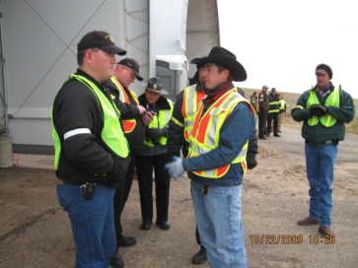
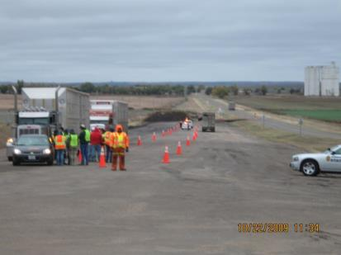
What did we learn?
Need a system to track emergency permits
  Piled up in trooper cars
  No situational awareness regarding border state checkpoints
Movement order took to long to write and distribute
Mixing strip and shared border concept worked very well – it was POSSIBLE

Slide 14
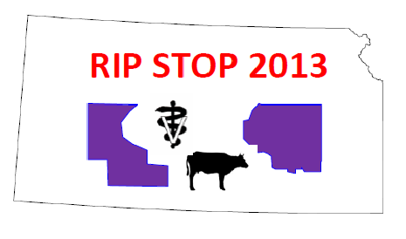

Slide 15
Participants
Kansas Department of Agriculture (KDA)
Kansas Governor’s Office
Kansas Highway Patrol (KHP)
Kansas Division of Emergency Management (KDEM)
Kansas Department of Transportation (KDOT)
Kansas State University (KSU)
Kansas Department of Wildlife, Parks and Tourism (KDWPT)
Kansas Department of Health and Environment (KDHE)
Riley County (RI CO)
City of Manhattan
Pottawatomie County (PT CO)
Livestock Marketing Association (LMA)
Midwest Dairy Association
Kansas Pork Association (KPA)
Kansas Livestock Association (KLA)
Kansas Veterinary Medical Association
Sedgwick County Zoo
Kansas National Guard (KSNG)
Colorado Department of Agriculture (CDA)
Nebraska Department of Agriculture (NDA)
Missouri Department of Agriculture (MDA)
Midwest Card
Kansas Forest Service (KFS)
Iowa State University
Iowa Department of Homeland Security and Emergency Management
Michigan Department of Agriculture
Texas Board of Animal Health
Oklahoma State University
New Mexico Department of Agriculture

Slide 16
Scenario
Day 1 – Real Time Play
  Outbreak in Alabama
    Practice Traffic Control and new permit management system
    Practice the response of the KDA Incident Management Team
  Outbreak at the CVM
    FADD Dispatched
    New objectives for the IMT – surveillance, disease control, JIT, additional incident command posts
Day 2 - 41 Hour Time Jump
  Transition from Stop Movement to Permitted Movement
  Additional Kansas Cases identified
  Engagement of Riley and Pottawatomie Counties
  Coordination with University, other states, SEOC

Slide 17
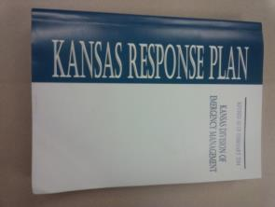

What did we learn?
      We are well trained
      Our plans are valid
        Vet School
        Animal Science & Industry
        KDA and KDEM
FMD is a highly complex event
  Traditional response doesn’t work – too widespread and different authorities
We can do it without immediate federal assistance

Slide 18
What did we learn?
Information Sharing is a challenge
  Many entities need information to make decisions
  Complex network at the University
Movement control is confusing – terminology needs to be clear and consistent
Situational awareness needs to be improved
Most participants want more opportunities for realistic practice
We need more team members to replace the veterinarians who are currently assigned roles in the IMT – Veterinarians will be in the field

Slide 19
Improvement Planning
KDA 3 year training and exercise plan
  Quarterly drills for IMT members
  Annual exercises with partners
  More drills and training opportunities for team members
  Will include stakeholders in all of our training and exercise activities
Situation Reports – will be developed and shared with all stakeholders
Movement Control – policy decision, change in terminology, clear – concise messaging

Slide 20
Improvement Planning
SOG’s and Plans need to be more specific
  Include checklists that can be delegated
  Movement order needs to be in clear language
    Cervids? Camelids? Products? No vet speak
KDA and KDEM will continue to work on resource request process to ensure counties understand – may need a specific checklist
KDA will participate in regional exercises

Slide 21


Slide 22
Invisible Fire 2014
NE/NC Region
  September 24, 2014
  KDA Set up IMT in MHK
  Counties:
    Riley
    Pottawatomie
    Lyon
    Clay
South Central Region
  October 22, 2014
  KDA Simulated Play in Wichita
  Counties:
    Butler
    Sedgwick
    Reno
    McPherson
    Sumner
    Harvey

Slide 23
Invisible Fire 2014
Lessons Learned
  More training is needed for locals
  KDA should prepare specific information for School Districts
  Division Supervisor Concept works
  “Fixes” made since RIP STOP were effective
    Situation Report
    Use of WebEOC
  Counties want an SME with them – can’t be KDA

Slide 24
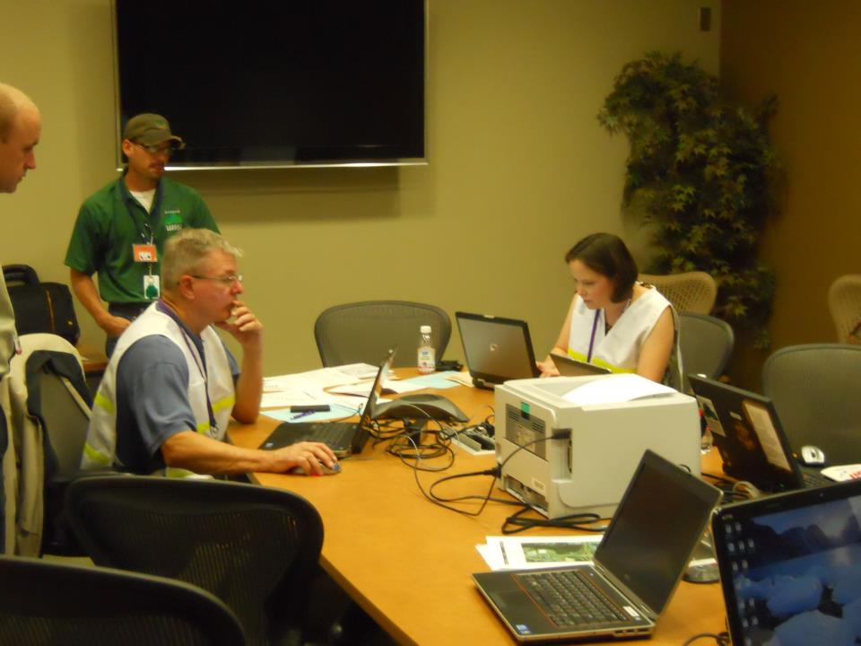
Incident Command and Policy Group

Slide 25
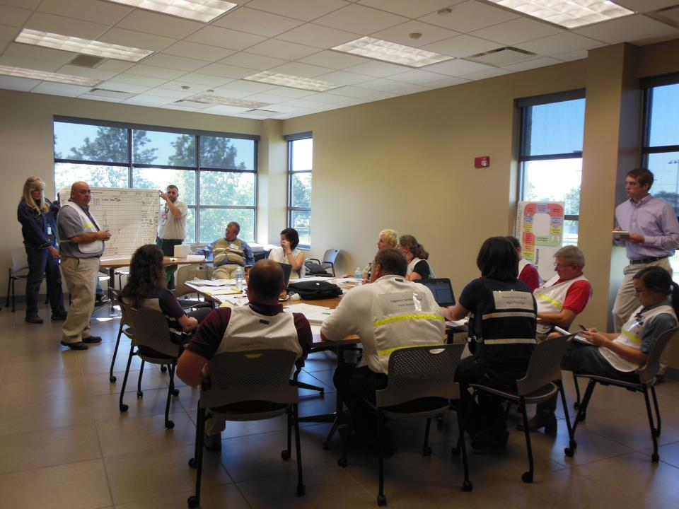
PLANNING MEETING

Slide 26
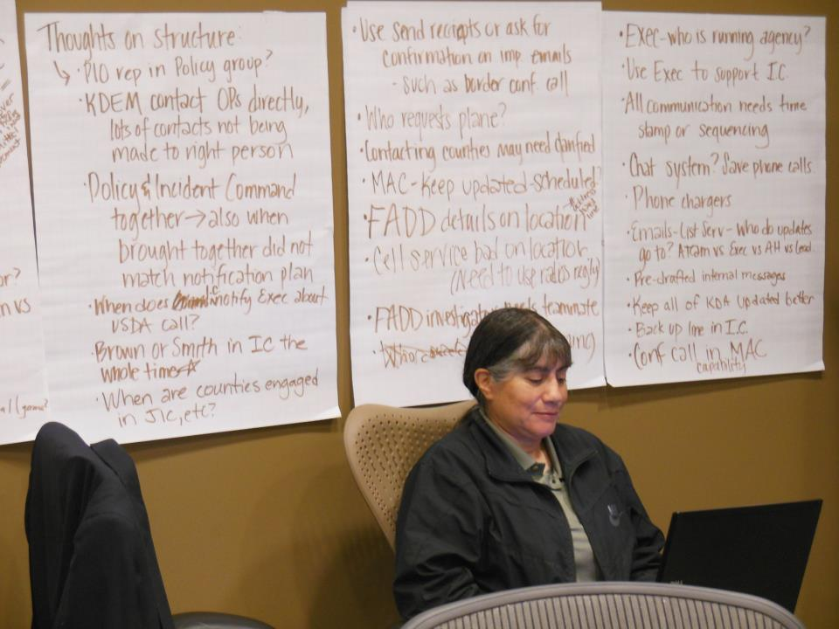

Slide 27
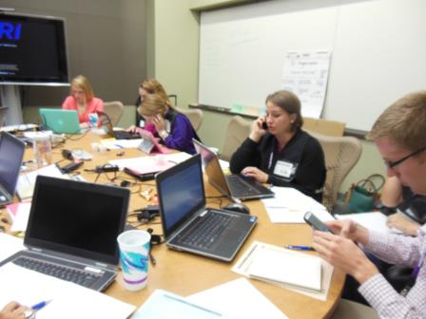
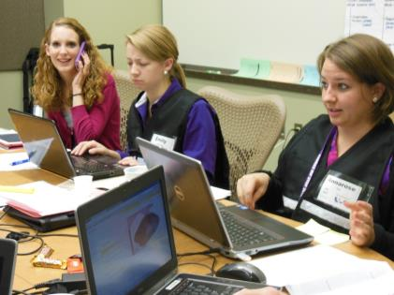
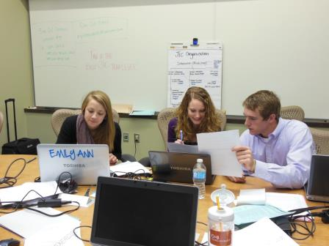
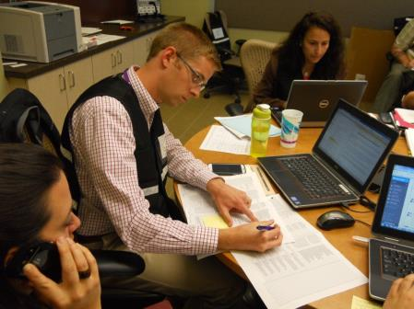
JOINT INFORMATION CENTER

Slide 28
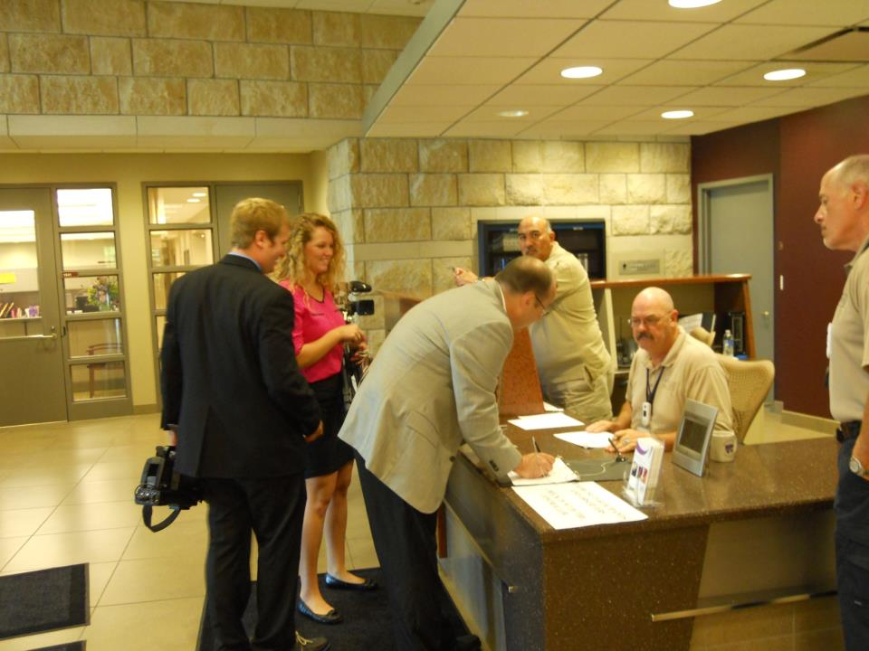


Slide 29
Next Bites?
Continue efforts with quarantine management and control area enforcement
  Resource Intensive
  May be needed for months
  Significant local role
Secure Supply Plans
  Eggs, Milk, Pork
  KS volunteer to assist with Development of Secure Beef (KDA/KSU)
Continue to engage with regional and national leadership

Slide 30
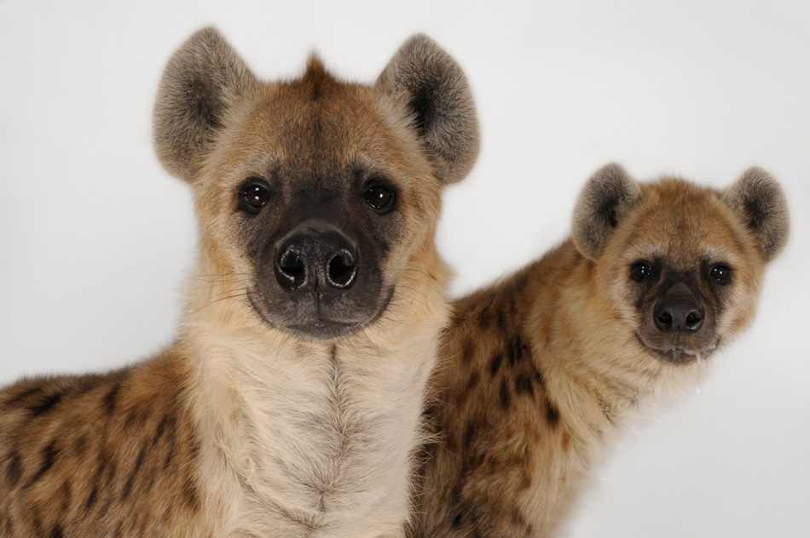

Sandy Johnson
Sandy.johnson@kda.ks.gov
785-564-6608
Notes:
Spotted hyenas – Sunset Zoo

