Slide 1
Veterinary Feed Directive
Gregg A. Hanzlicek, DVM, PAS, PhD
Director, Production Animal Field Disease Investigations
Kansas State Veterinary Diagnostic Laboratory
College of Veterinary Medicine
Kansas State University

Slide 2
What is a VFD?
Written authorization for an animal owner/caretaker to obtain and use a VFD drug or combination to treat the animals within accordance for use approved by FDA

Slide 3
the veterinarian’s name, address, and telephone number;
• the client’s name, business or home address, and telephone number;
• the premises at which the animals specified in the VFD are located;
• the date of VFD issuance;
• the expiration date of the VFD;
• the name of the VFD drug(s);
• the species and production class of animals to be fed the VFD feed;
• the approximate number of animals to be fed the VFD feed by the expiration date of the VFD;
• the indication for which the VFD is issued;
• the level of VFD drug in the feed and duration of use;
• the withdrawal time, special instructions, and cautionary statements necessary for use of the drug in conformance with the approval;
• the number of reorders (refills) authorized, if permitted by the drug approval, conditional approval, or index listing;
• the statement: “Use of feed containing this veterinary feed directive (VFD) drug in a manner other than as directed on the labeling (extra label use), is not permitted”;
• an affirmation of intent for combination VFD drugs as described in 21 CFR 558.6(b)(6); and • the veterinarian’s electronic or written signature.
Information required for each VFD

Slide 4
What is a VFD drug?
A "VFD drug” is a drug intended for use in or on animal feed that is limited to use under the professional supervision of a licensed veterinarian.
All VFD drugs will contain this statement on the label:
"Caution: Federal law restricts medicated feed containing this veterinary feed directive (VFD) drug to use by or on the order of a licensed veterinarian."

Slide 5
Who will be under VFD rules?
All production animal industries
  Beef
  Dairy
  Swine
  Sheep
  Goats
  Poultry
  Aquaculture
  Honey production (apiarist)

Slide 6
Why was the VFD program initiated?
To prevent further antibiotic resistance observed in human medicine
  By reducing the use of “medically important” antibiotics by production agriculture
Allows for “veterinary oversight”
Encourages “judicious antimicrobial use”

Slide 7
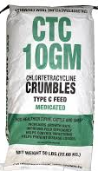
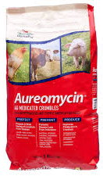
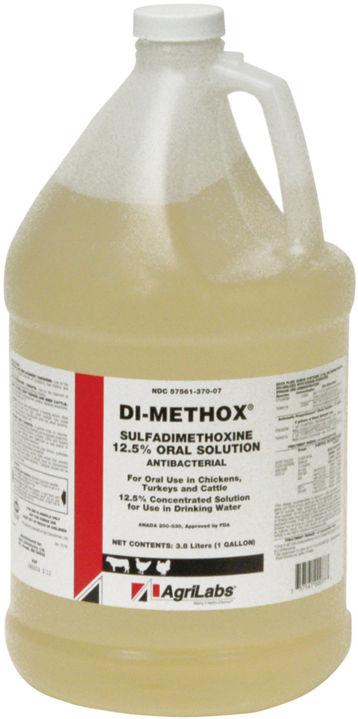
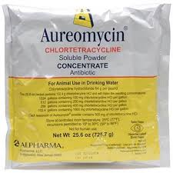
VFD
Only impacts:
  FEED grade antibiotics
  Presently over-the-counter (OTC)
  Used in or on feed or in water
That are……
“Medically important” in human medicine

Slide 8
VFD
Does NOT include:
  Injectable antibiotics
  Bolus antibiotics
  Dewormers
  Fly control products
  Anti-inflammatory products: Banamine™
  Implants
  MGA
  Intramammary antibiotics
  Synchronization products

Slide 9
VFD
Does NOT include*:
  Ionophore
    Rumensin™, Bovatec™
  Coccidiostat
    Decoxx™
  Coccidiostat / coccidiocidal
    Corid™
  Bacitracin
    BMD 60™
  Are not medically important in human medicine
*Unless they are fed with VFD designated antibiotic

Slide 10
Need a VFD: scenarios
Rumensin in the feed by itself
  Can use and do NOT need VFD
Rumensin in feed with Tylan™
  Do need VFD because Tylosin requires VFD
Chlortetracycline in feed for BRD treatment
  Need a VFD
Medicated milk replacers
  Need a VFD

Slide 11
All products
Will NO longer be legal to use for:
“increased weight gain”
“improve feed efficiency”

Slide 12
Extra label use
Extra label use is NOT permitted under any circumstance
Extra label use =
  Different dose (higher or lower)
  Different length of time
  Different class or species of animal not on the label
  Different disease than on the label
  Different reason for use: prevention vs. control

Slide 13
Extra label use is NOT permitted under any circumstance for feed grade antibiotics
This is law today:
  Cannot use feed grade antibiotics for:
    Pinkeye
    Footrot
    Anaplasmosis prevention/chemosterilization
      “for the control of active infection”

Slide 14
What products will be included?
http://www.fda.gov/AnimalVeterinary/SafetyHealth/AntimicrobialResistance/JudiciousUseofAntimicrobials/ucm390429.htm

Slide 15
Currently there are 3 products with VFD labels
  Pulmotil™
  Florivo™
  Kavault™

Slide 16
As the VFD moves forward
By the end of 2016, every medically important drug used in livestock feed will require a VFD label
  ALL antibiotics destined to be VFD products will become VFD products in DECEMBER 2016.
  Until then it is business as usual.
  After January 2017—all will be VFD

Slide 17
Client responsibilities
Must establish a valid client patient relationship with a licensed veterinarian
Feed VFD feed or combination to animals by no later than the expiration date
Provide a copy of the VFD to the distributor if the issuing veterinarian sends the distributor’s copy through the client
Maintain a copy of the VFD for 2 years
Provide VFD orders for inspection by FDA upon request

Slide 18
Must follow two important dates
Expiration
How many days the producer has to acquire and use the VFD drug
No expiration date longer than 6 months
Duration
Number of days the VFD is to be fed
Pulmotil™: Feed for 14 days
Pulmotil™
45 day expiration
14 feeding duration

Slide 19
Veterinarian requirements
Licensed in the state where the product is used/animals housed
Has a valid client patient relationship
  1) engage with the client to assume responsibility for making clinical judgments about patient health;
  2) have sufficient knowledge of the patient by virtue of patient examination and/or visits to the facility where patient is managed
  3) provide for any necessary follow-up evaluation or care

Slide 20
Veterinarian requirements
Provide a copy of the VFD to both client and distributor
can ask the client to deliver a hard copy to distributor
Maintain original VFD for two years
Provide VFD orders for inspection by FDA upon request

Slide 21
Client discusses with veterinarian the need to feed a particular antibiotic
Veterinarian agrees the need fits the label indications for use
Veterinarian completes VFD
Vet sends electronic/fax/hard copy to both client and distributor…
Or, provides hard copy to client who then delivers to distributor

Slide 22

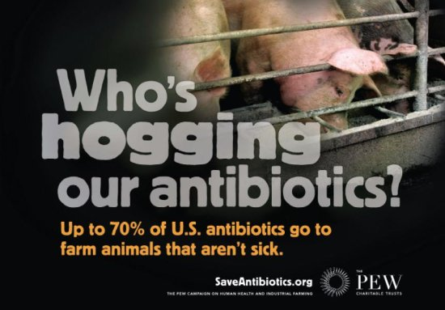

Slide 23
Thank you
Gregg A. Hanzlicek
785-532-4853
gahanz@vet.k-state.edu

