Slide 1
Understanding Ionophores for Ruminants
Dale A. Blasi
Eastern Kansas Agent Update
November 6, 2012

Slide 2
Presentation Outline
Introduction
Mode of Action
Coccidiostat
Ionophores for growing cattle
Ionophores for beef and dairy cows
Toxicity

Slide 3
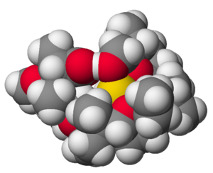
What are Ionophores?
Purified fermentative by-product of a naturally occurring soil-borne bacteria¹
  At least 76 known polyether ionophores.
  Possess the conventional polyether ring, but will vary in their chemical composition and even to a slight extent, in their biological activity
  Feed additive that increases average daily gain by improving the energy utilization of feedstuffs²
¹Elanco manufacturing data on file.
²Bergen and Bates. 1984. J Anim Sci 58:1465.
.

Slide 4
Ionophores approved and marketed for livestock and poultry in the USA
Trademark | Chemical Name | Approved Species | Approved Use
Avatec | Lasalocid | Broilers, Turkeys | Prevention of Coccidiosis
Bovatec | Lasalocid | Cattle and Sheep | Improve growth and feed efficiency (Cattle) Coccidiosis control (cattle) and prevention (sheep)
Cattlyst | Laidlomycin propionate | Confinement, cattle | Improve growth and feed efficiency
Coban | Monensin | Broilers | Prevention of Coccidiosis
Rumensin | Monensin | Cattle and Goats | Improve growth and feed efficiency (Cattle) Coccidiosis prevention and control (cattle) and prevention (goats)

Slide 5
Ionophores – Mode of Action
An ionophore is a compound that makes cations lipid soluble thereby disrupting the homeostatic mechanisms responsible for maintaining intra- and extracellular ion concentrations across the cell membrane of ruminal microbe cells.
Specifically, ionophores disrupt the exchange of cations (K+ Na+ H+ Ca 2+ and Mg 2+). By doing so, bacteria that are unable to dispose of their protons by other means consequently decline in numbers.

Slide 6
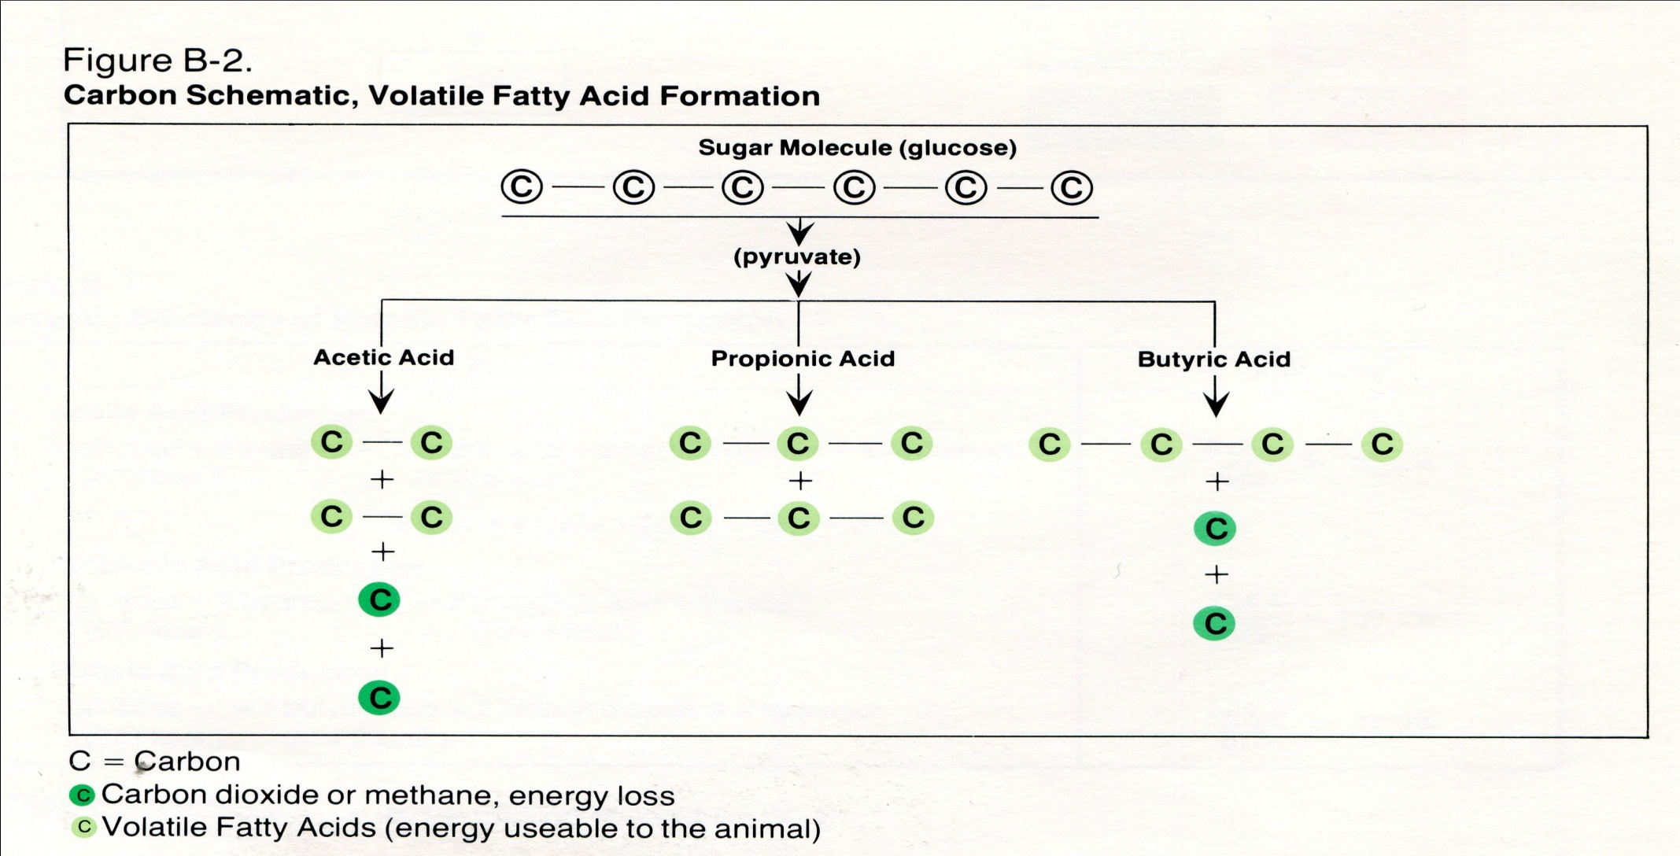
Cellulose
Starch
Cellulase enzymes
Amylase enzymes

Slide 7
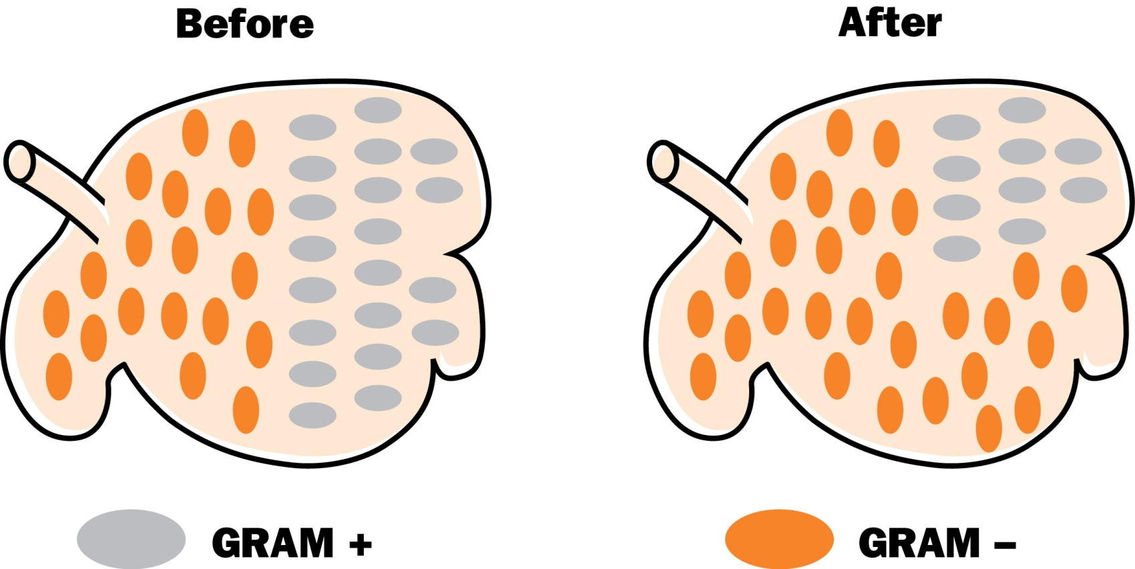
Rumen Bacterial
Population Changes¹
¹Adapted from Dawson and Boling. 1983. Appl Environ Microb 46:160.
Notes:
BEFORE: AFTER:
Rumensin Fermentation Rumensin Fermentation
sensitive products insensitive products
Ruminococcus Acetate Selenomonas Propionate
Methanobacterium Acetate, methane* Bacteroides Acetate, propionate
Lactobacillus Lactate Megasphera Propionate, acetate
Butyrivibrio Acetate, butyrate Veillonella Propionate
Lachnospira Acetate Succinimonas Succinate
Streptococcus Lactate Succinivibro Succinate
Methanosarcina Methane*
Fibrobacter Acetate
Adapted from Nagaraja, TG, CJ Newbold, CJ Van Nevel & DI Meyer. 1997. Manipulation of Rumen Fermentation. The Rumen Microbial Ecosystem, 2nd edition. Ed: Hobson & Steward. Pp. 538-548.

Slide 8


Ionophore Sensitive & Insensitive Bacteria^{1,2}
PRIMARY
FERMENTATION
PRODUCTS
PRIMARY
FERMENTATION
PRODUCTS
RUMENSIN
SENSITIVE
RUMENSIN
INSENSITIVE
Ruminococcus
Methanobacterium
Lactobacillus
Butyrivibrio
Lachnospira
Streptococcus
Methanosarcina
Fibrobacter
Acetate
Acetate, methane
Lactate
Acetate, butyrate
Acetate
Lactate
Methane
Acetate
Selenomonas
Bacteroides
Megasphera
Veillonella
Succinimonas
Succinivibro
Propionate
Acetate, propionate
Propionate, acetate
Propionate
Succinate
Succinate
¹Adapted from Dawson and Boling. 1983. Appl Environ Microbio 46:160.
²Adapted from Nagaraja, T. G., C. J. Newbold, C. J. Van Nevel & D. I. Meyer. 1997. Manipulation of Rumen. Fermentation. The Rumen Microbial Ecosystem, 2nd edition. Ed: Hobson & Stewart. pp. 538-547.

Slide 9
Effects of Rumensin on VFA Percentages in Fistulated Cattle on Pasture (Molar Percent in Rumen)¹
Acetic
Propionic
Butyric
67
63
28
60
22
10
11
21
9
0 mg 50 mg 200 mg
Monensin
0 mg 50 mg 200 mg
Monensin
0 mg 50 mg 200 mg
Monensin
¹Richardson et al., 1976. J. Anim. Sci. 43:657.

Slide 10
Effect of ionophore on ruminal fluid parameters of steers grazing winter wheat, OSU
Item | Controlª | Rumensin® | Bovatec® | SE^{b} | Control vs Ionophore^{c} |  | Rumensin® vs Bovatec®
No. of cannulated cattle | 4 | 4 | 4
 | -------Ruminal fluid analysis-------
PH | 5.62 | 5.70 | 5.64 | .037 |  | .33 | .37
NH₃, mg/100 ml | 47.90 | 51.88 | 51.24 | 2.317 |  | .23 | .85
Total VFA’s, mmol/l | 141.37 | 144.33 | 145.81 | 3.100 |  | .36 | .74
Acetate, mol/100 mol | 60.69 | 59.56 | 61.50 | .731 |  | .87 | .09
Propionate, mol/100 mol | 19.21 | 22.05 | 18.43 | .614 |  | .20 | <.01
Butyrate, mol/100 mol | 14.06 | 11.51 | 13.86 | .456 |  | .04 | <.01
A/P ratio | 3.18 | 2.73 | 3.35 | .114 |  | .32 | <.01
ª Least square means for each collection period. ^{b} Standard error of least squares means. ^{c} P-value associated with orthogonal contrasts.

Slide 11
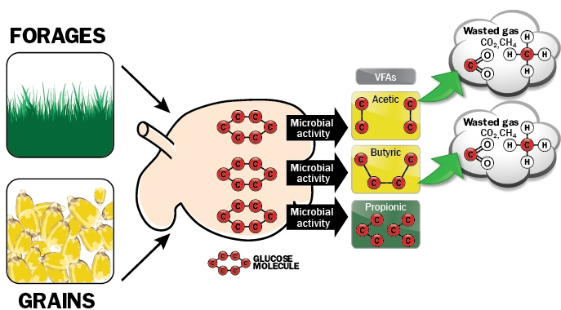
Carbohydrate Digestion by Rumen Microbes
& VFA Efficiency¹
¹Adapted from Nagaraja, T. G., C. J. Newbold, C. J. Van Nevel & D. I. Meyer. 1997. Manipulation of Rumen Fermentation. The Rumen Microbial Ecosystem, 2nd edition. Ed: Hobson & Stewart. pp. 538-547.
Notes:
Ruminal bacteria convert simple sugar (glucose) to VFAs. This diagram shows a ruminal bacteria converting a 6 C glucose ring to one of 3 VFAs, acetic, butyric, & propionic acid. In reality it is very unlikely a single specie of ruminal bacteria would not convert sugars to all all 3 VFAs so this model is for illustrative purposes only. When a bacteria (primarily G+) convert a 6 carbon sugar molecule to acetic acid, 2 molecules of acetic acid with 2 C each are produced with 2 additional carbon that are lost as by products of carbon dioxide &/or methane. When a G + rumen bacteria converts a 6 carbon sugar molecule of glucose to butyric acid, 1 molecules of butyric with 4 C is produced but again 2 additional carbons are lost as by products of carbon dioxide &/or methane. When a ruminal bacteria (primarily G-) converts the molecule of glucose to propionic acid 2 molecules of propionic acid (3 C each) are produced & there is no Cs lost as by products of CO₂ &/or CH₄ thus the improved efficiency in propionate production.

Slide 12
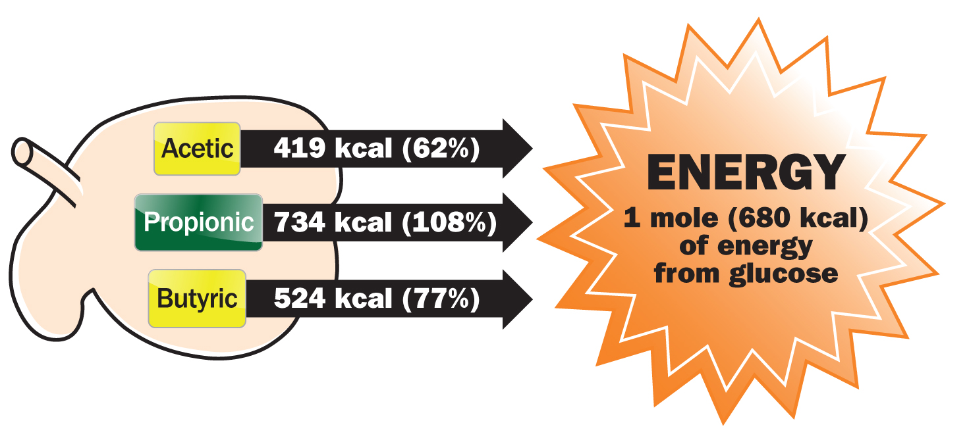
Efficiency of Energy Conversion¹
¹Adapted from Nagaraja, T. G., C. J. Newbold, C. J. Van Nevel & D. I. Meyer. 1997. Manipulation of Rumen Fermentation. The Rumen Microbial Ecosystem, 2nd edition. Ed: Hobson & Stewart. pp. 538-547.
Notes:
Further examining the efficiency of propionate production, if 1 mole of glucose containing 680 kcal is converted to acetic acid, the energy value of the acetic acid produced would be 419 kcal or approximately 62% of the original energy value from glucose. If 1 mole of glucose is converted to butyric acid, the energy value of the butyric acid produced would be 524 kcal or approximately 77% of the original energy value from glucose. Finally, if the mole of glucose is converted totally to propionic acid, the energy value of the propionic acid is 734 kcal or approximately 734 kcal or 108% of the original energy value of glucose. How could the energy value from propionate be greater than that from the mole of glucose? Not only are all Cs preserved, but additional energy is also derived from additional H bonds conserved in the propionate molecules.

Slide 13
Rumensin Mode of Action — Summary
Alters rumen microbial populations
New population produces more propionate
Propionate is a more energy- efficient fuel source for cattle

Slide 14
Ionophores - Coccidiostatic

Slide 15
Anticoccidials — Mode,
Stage of Action & Minimum Dose Requirements¹⁻⁶
Active ingredient
Trade name
Cidal/Static
Killing stages
Minimum required dose, mg/lb BW/d
Monensin
Rumensin
Cidal
3
0.14
Lasalocid
Bovatec
Cidal
3
0.455
Amproliumª
Corid®
Cidal
1
2.27
Decoquinate
Deccox®
Static
0
0.227
ªAvailable in dry & liquid formulations for use in feed or water applications for beef & dairy calves.
¹Ernst, J. V. & G. W. Benz. 1986. Intestinal Coccidiosis in Cattle. Veterinary Clinic of North America: Food Animal Practice. 2:283.
²Long, P. L . & T. K. Jeffers. 1982. Studies on the Stage of Action of Ionophorous Antibiotics against Eimeria. J Parasitol 68:363.
³Radostits, O. M. & P. H. G. Stockdale. 1980. A Brief Review of Bovine Coccidiosis in Western Canada. Can Vet J 24:227.
⁴Smith, C. K. II & R. B. Galloway. 1983. Influence of Monensin on Cation Influx and Glycolysis of Eimeria tenella Sporozoites In vitro.
J Parasitol 69:666.
⁵Smith, C. K. II, R. B. Galloway & S. L . White. 1981. Effect of Ionophores on Survival, Penetration and Development of Eimeria
tenella Sporozoites In vitro. J Parasitol pp. 67:511
⁶Smith C. K. II & R. G. Strout. 1979. Eimeria tenella: Accumulation and Retention of Anticoccidial Ionophores by Extracellular Sporozoites. Expr. Parasitol. pp. 48:325.

Slide 16
Ionophores for Growing Cattle

Slide 17
Southeast Kansas Rumensin Mineral Grazing Study¹
2-Year Average 1996/1997
Control
Rumensin
Difference
No. head
240
229
No. pastures
7
7
Initial wt, lbs
545
552
Daily gain, lbs
2.47ª
2.66^{b}
0.19
Total gain, lbs
243ª
262^{b}
19
Mineral intake, oz/d
5.0ª
3.4^{b}
1.6
Monensin intake, mg/hd/d
170
^{a,b}Means within a row without a common superscript differ (P < 0.05).
¹Brazle, F. K. & S. B. Laudert. 1998. Effects of Feeding Rumensin® in a Mineral Mixture on Steers Grazing Native Grass Pastures. 1998 Cattlemen’s Day Report of Progress 804, Kansas State University Agricultural Experiment Station and Cooperative Extension Service, p. 123-125. http://www.ksre.ksu.edu/library/lvstk2/srp804.pdf.
Notes:
Cattle:
469 English & Continental crossbred steers
548-lb initial weight
Pastures:
Southeast Kansas
Grazing started — April 1996 & 1997
Grazing periods
83 days, 2 hd/acre stocking rate
114 days, 3 hd/acre stocking rate
Mineral treatments:
Rumensin free-choice mineral, 1,620 g/ton
Control free-choice mineral (no Rumensin)
Increased gain by 0.19 lb over controls (8% improvement in ADG)
Consumed 1.6 oz less mineral per day
Cattle fed Rumensin ate less mineral, but gained more
Joint Elanco/KSU-sponsored trial

Slide 18
Oklahoma Wheat Pasture Rumensin Mineral Studies
4-Year Summary
Control
ADG, lbs
Rumensin
Improvement
lbs/hd/d (%)
OSL
Horn 1999–2000¹
1.33
1.63
0.30 (23%)
0.04
Horn 2000–2001¹
2.55
2.70
0.15 (6%)
0.03
Fieser 2004–2005²
1.21
1.58
0.37 (31%)
0.03
Fieser 2005–2006²
2.40
2.53
0.13 (5%)
0.35
4-Year Summary²
1.80
2.02
0.22 (12%)
0.01
¹Horn, G., C. Gibson, J. Kountz & C. Lundsford. 2001. Two-Year Summary: Effect of Mineral Supplementation With or Without Ionophores on Growth Performance of Wheat Pasture Stocker Cattle. Proceedings from the Wheatland Stocker Conference. pp. A1-A19. (Elanco Trial Nos. T1FB50002 & T1FB50102).
²Fieser, B. G., G. W. Horn & J. T. Edwards. 2007. Effects of energy, mineral supplementation, or both, in combination with monensin on performance of steers grazing winter wheat pasture. J. Anim. Sci. 85:3470-3480.

Slide 19

Effect of mineral medication treatments on stocker performance, KSU Stocker Unit
 | Treatment
 | Aureomycin + Bovatec | Rumensin | SEM
Mineral intake, oz/hd/d | 4.22ª | 2.39^{b} | 0.01
Feed Additive intake, mg/hd/d | 325/186 | 105
On-test stocker weight, lbs | 583 | 582 | 4.1
Off-test stocker weight, lbs | 739 | 743 | 5.3
90-day daily gain | 1.73 | 1.79 | 0.06
^{a,b} Means within a row with different superscripts differ by (P<0.01).

Slide 20

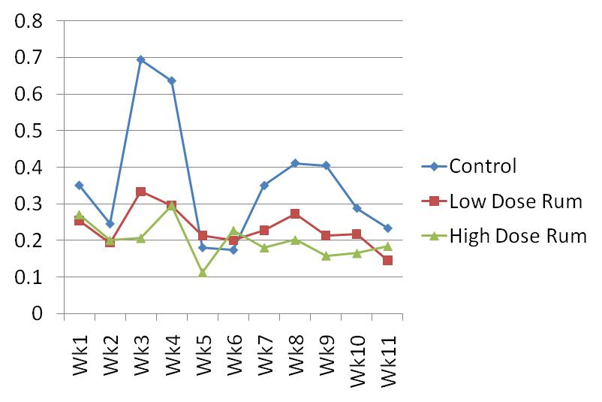
2010 results, KSU Beef Stocker Unit
Item | Control | Rumensin | Rumensin
Onwt, lbs | 657 | 659 | 660
Offwt, lbs | 823 | 842 | 863
ADG | 2.14 | 2.36 | 2.62
Intake | .36 | .23 | .20
Conc: RM | gm/ton | 400 | 800
Conc:CTC | 1400

Slide 21
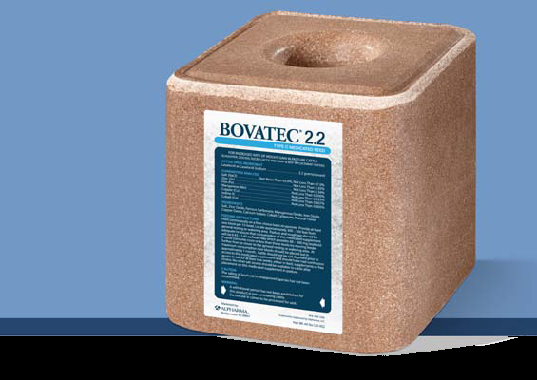
Bovatec 2.2
– 44-pound block
– Contains 2.2 grams lasalocid sodium per pound (4,400 g/ton)
– For use continuously on a free-choice basis
0.43 – 1.45 oz/head/day consumption delivers 60 – 200 mg Bovatec/head/day

Slide 22
Rumensin for Mature Beef Cows
Only ionophore approved for use in mature, reproducing beef cows
Improves feed efficiency, which helps maximize profitability
Maintains body condition on 5% to 10% less feed
Notes:
Rumensin improves feed efficiency & helps you maximize profitability because your beef cows can maintain their body condition on 5% to 10% less feed
Rumensin kills coccidia parasites at three different stages in the life cycle^{1,2} instead of merely arresting their development
¹McDougald, LR. 1980. Chemotherapy of Coccidiosis. PL Long (ed.). The Biology of the Coccidia. University Park Press, Baltimore. pp. 373-427.
²Long, PL & TK Jeffers. 1982. Studies on the Stage of Action of Ionophorous Antibiotics Against Eimeria. J Parasitology 68(3): pp. 363-371.

Slide 23
Four-trial dose titration, summary of cow weight change and feed intake data
 | Rumensin, mg/hd/d
Item | 0 | 50 | 200
Number of cows | 108 | 99 | 109
Initial wt, lbs | 1,063 | 1,050 | 1,049
Final cow wt, lbs | 1,016 | 1,006 | 1,010
Wt. change, lbs | -47 | -44 | -39
Feed intake (lbs DM/day/exp unit)
0-171 days | 164.2ª | 155.7^{b} | 146.4^{b}
Percent of control | 100 | 94.8 | 89.2
Avg days on study at calving | 124 | 123 | 125
Days from calving to conception | 93^{c} | 87^{d} | 87^{d}
Number of cows bred | 99 | 93 | 100
Number of cows conceived | 90 | 86 | 97
Percent conception | 90.9 | 92.5 | 97.0
^{a,b} Means within a row with different superscripts differ by (P<0.01). ^{c,d} Means within a row with different superscripts differ by (P<0.01).

Slide 24
Rumensin for Mature Beef Cows —
Reproductive Safety¹
2007 Trial
0
Monensin, mg/hd/d
200
No. pastures²
12
12
Conception date³
161ª
155^{b}
Calf to conception, days
90ª
85^{b}
Calving percentage⁴ (%)
80.7ª
91.9^{b}
^{a,b}Means within a row without a common superscript differ (P < 0.01).
¹Bailey et al., 2007. Can. J. Anim. Sci. 88:113.
²Pasture was the experimental unit, and each pasture contained 9 to 11 cow-calf pairs.
³Julian calendar date.
⁴Logistic regression analysis.
Notes:
A University of Arkansas 2-year study on the effects of Rumensin on beef cow reproduction demonstrated that Rumensin supplemented at 200 mg/hd/d during the first 42 days postpartum shortened calving to conception and increased calving percentage in beef cows consuming bermudagrass hay. The study consisted of crossbred Brangus cows (n=132, Year 1; n=116, Year 2)

Slide 25
Effects of Monensin on Beef Cow Performance, Oklahoma State University Study
 | Supplement¹
Item | CONT | MON | SEM² | P-value³
No. | 28 | 28
Initial BW, lbs | 1082 | 1090 | 21 | 0.79
Initial BCS | 5.15 | 5.21 | 0.10 | 0.70
Final BW, lbs | 1117 | 1153 | 23 | 0.28
Final BCS | 5.28 | 5.81 | 0.14 | 0.01
Change in BW | 35.4 | 65.1 | 10.1 | 0.04
Change in BCS | 0.13 | 0.57 | 0.12 | 0.01
ADG, lbs/day | .62 | 1.12 | .18 | 0.04
¹ CONT = 36% CP cottonseed meal based pellet with 0 mg/hd of monensin; MON = 36% CP cottonseed meal based pellet with 200 mg/head of monensin. ² SEM of the Least squares means. ³ Observed significance levels for main effects.

Slide 26
Ionophore Toxicity Symptoms
Lethargy
Cyanosis
Depression
Pulmonary edema
Myocardial degeneration
Death ….
  Especially pronounced in horses, where monensin has an LD50 1/100th that of ruminants

Slide 27
Estimated no observed effect level (NOEL), toxic and lethal dose (mg/kg BW) ranges
 |  | Toxic and lethal dose ranges, mg/kg BW
Species | Parameter | Lasalocid | Monensin
Cattle | NOEL | 1.0 | 5 - 30
 | Toxic range | 10 – 100 | 12 - 20
 | Lethal dose range | 50 – 100 | 22.4 – 39.8
 | LD₅₀ | -- | 26.0
Horses | NOEL | -- | --
 | Toxic range | 15 – 20 | --
 | Lethal dose range | > 20 | 1 - 3
 | LD₅₀ | 21.5 | 1.4
Sheep | NOEL | -- | --
 | Toxic range | 45 - 60 | --
 | Legal dose range | > 60 | --
 | LD₅₀ | -- | 11.9
Swine | NOEL | -- | --
 | Toxic range | 30 - 50 | 40 - 50
 | Legal dose range | > 50 | --
 | LD₅₀ | -- | 16.7

Slide 28
Chronic Rumensin® Toxicity – Trial VPR-255-766
 | Rumensin (grams/ton)
 | 0 | 20 | 60 | 100
Cattle per treatment
Steers | 5 | 5 | 5 | 5
Heifers | 5 | 5 | 5 | 5
Mortality (%) | 0 | 0 | 0 | 0
Lesions at Necropsy Indicative of Treatment Toxicity | None | None | None | None
Performance Data (160 days)
Average Daily Gain (lbs.) | 1.83 | 1.89 | 1.84 | 1.48
Average Daily Feed Consumption (lbs.) | 20.4 | 18.4 | 18.2 | 15.3
Feed Efficiency | 11.18 | 9.75 | 9.88 | 10.38
Mean Rumensin Intake (mg/hd/day) | 0 | 184 | 546 | 765

Slide 29
Summary
Ionophores are an effective tool for:
  Improved feed efficiency
  Improved rate of gain in stockers
  Slight improvement in ADG in feedlot cattle
  Decreased feed intake (which may enhance the carrying capacity of cattle on a given quantity of forage)
  A potential protein sparing effect
  Increased digestibility of low quality forages
  Some reduction in the incidence of coccidiosis
  A decrease in the incidence of lactic acidosis
  Some reduction in the incidence of feedlot bloat
  Partial intake regulation in self feeding supplement systems
  Some reduction in the incidence of pulmonary emphysema

Slide 30
Questions?
Dale A. Blasi dblasi@ksu.edu

