Slide 1

US & Kansas Dairy Industry Trends
Eastern KS Extension Update
November 6, 2012
Mike Brouk

Slide 2
Changes in the Number of US Dairy Cows and Total Milk Production from 1925 to 2011
2011 – 9.2 million dairy cows
196,245 million lbs of milk
21,345 pounds per cow
Compiled from: NASS Quick Stats

Slide 3
Average US Milk Production per Cow and Milk Fat Percent from 1925 to 2011
1945 - 25 million cows
119,828 million lbs
2011 - 9.2 million cows
  196,245 million lbs
36.8% of cows = 164% of milk
Compiled from: USDA Statistical Bulletin 303, 430
USDA Statistical Bulletin Entitled Milk: Final Estimates for Various Issues.

Slide 4
Changes in US Dairy Farm Numbers and Cows per Farm from 1965 to 2011
2011
60,000 dairy farms
153 cows/farm
Compiled from: NASS Quick Stats

Slide 5
Trends in Dairy Farm Size
Data Source: NASS – Quick Stats

Slide 6
Trends in Milk Production by Dairy Farm Size
Data Source: NASS – Quick Stats

Slide 7
Trends in Cattle Ownership by Dairy Farm Size
Data Source: NASS – Quick Stats

Slide 8
Summary of Operation Size
500 - 1,000 Milking Cows
  1,650 farms or 2.8% of operations
    12.3% of cattle & 12.6% of milk production
1,000 – 2,000 Milking Cows
  950 farms or 1.6% of operations
    13.7% of cattle & 15.7% of milk production
Over 2,000 Milking Cows
  800 farms or 1.3% of operations
  32.5% of cattle & 34.6% of production
5.7% of operations own 58.5% of cattle
and produce 62.9% of the milk

Slide 9
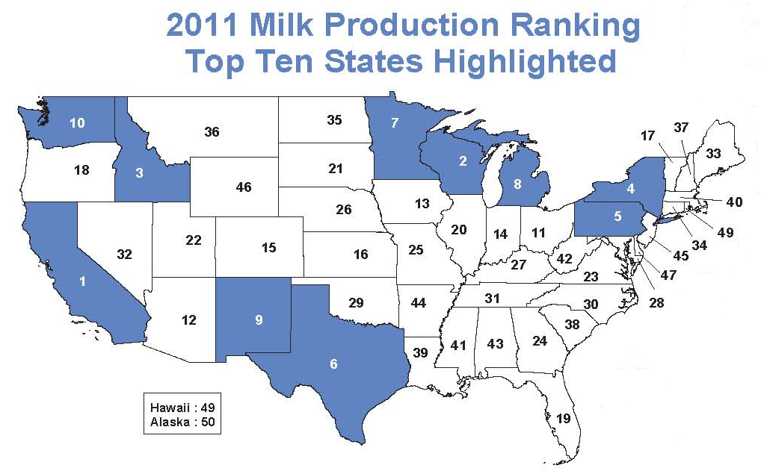
Source: Federal Milk Market Administrator – Central Order

Slide 10
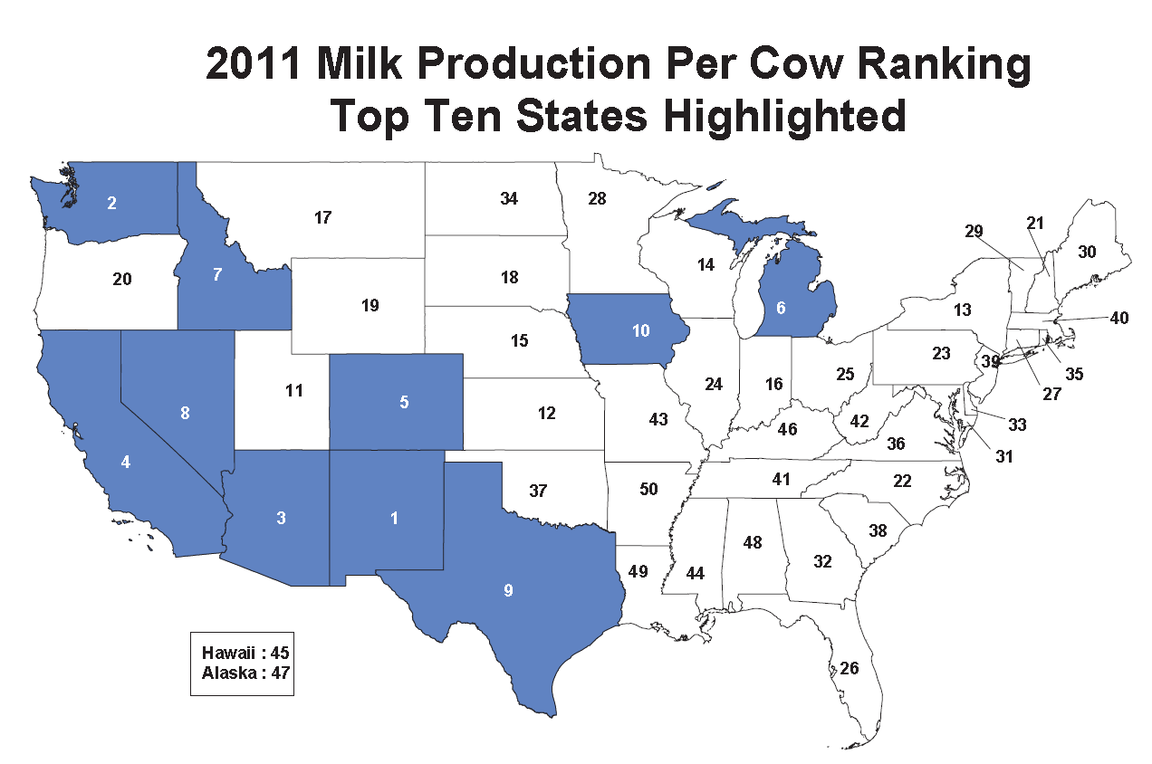
Source: Federal Milk Market Administrator – Central Order

Slide 11
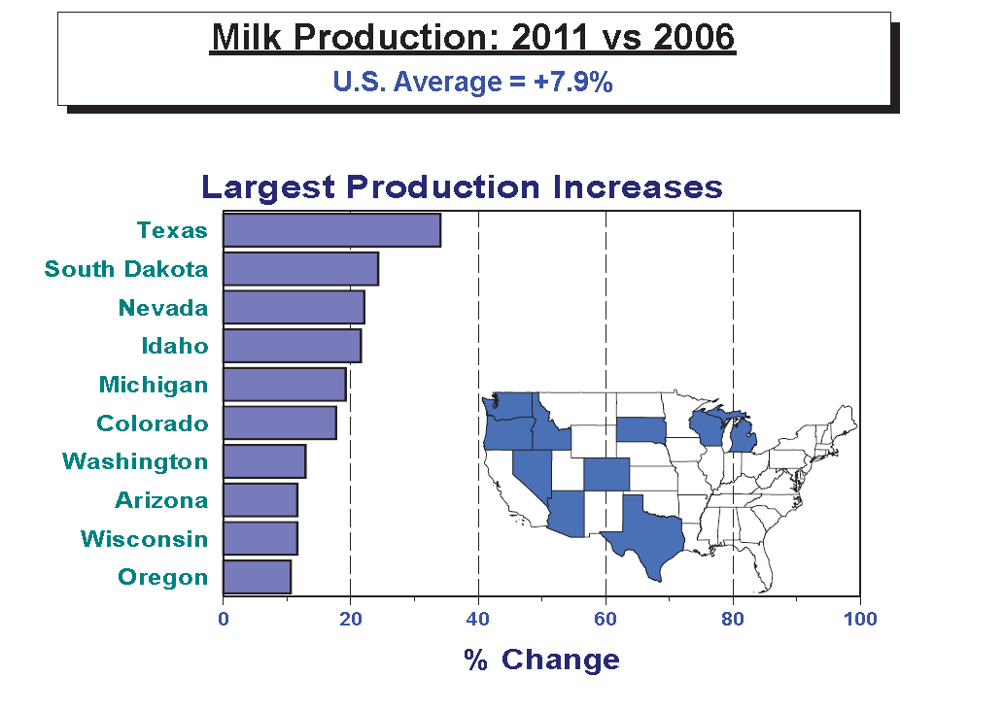
Source: Federal Milk Market Administrator – Central Order

Slide 12

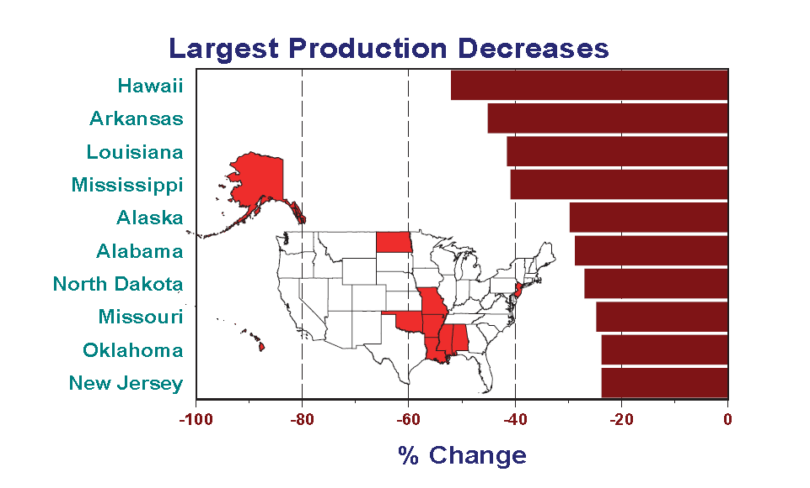
Source: Federal Milk Market Administrator – Central Order

Slide 13
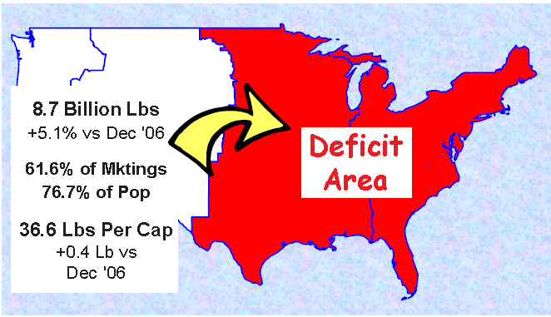

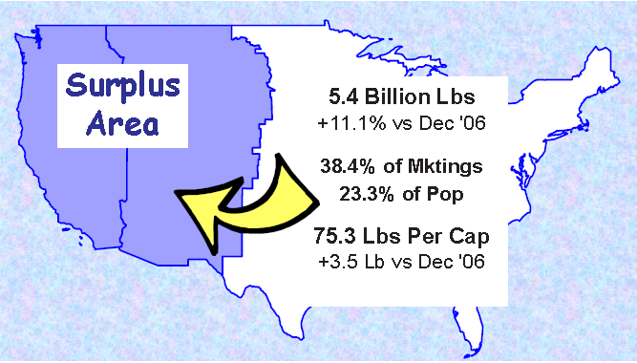
www.fmmacentral.com

Slide 14
Changes in KS Milk Cow Numbers
2011 – 123,000 cows

Slide 15
Changes in KS Milk Production
2011 - 2,590 million pounds

Slide 16
Changes in KS Milk Production per Cow
2011 – 21,057 lb per cow

Slide 17
KS Dairy Industry Trends
Data Source: NASS Quick Stats

Slide 18
KS Dairy Industry Trends
Data Source: NASS Quick Stats

Slide 19
KS Dairy Industry Trends
Data Source: NASS Quick Stats

Slide 20
KS Dairy Industry Trends
Data Source: Kansas Department of Agriculture

Slide 21
Changes in the Location of Dairy Cattle Within Kansas
Compiled from: NASS Quick Stats

Slide 22
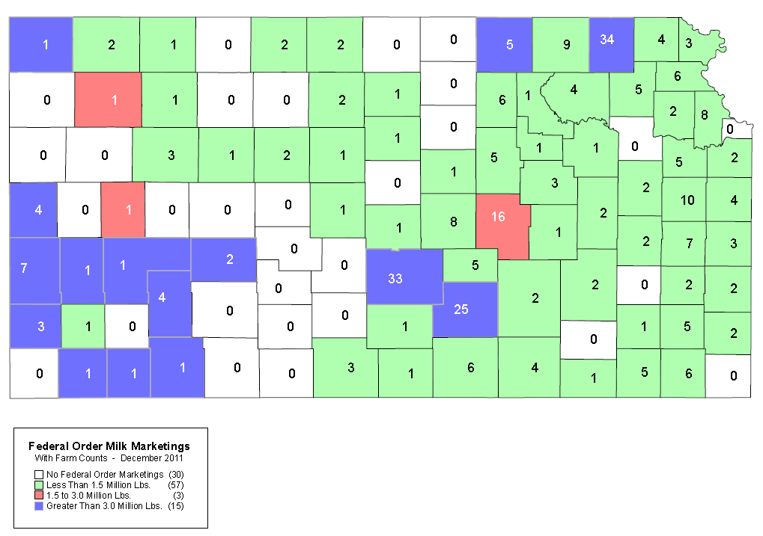
Kansas Dairy Farms by County - 2011
Chart courtesy of Federal Milk Market Administrator, Central Order 32.

Slide 23
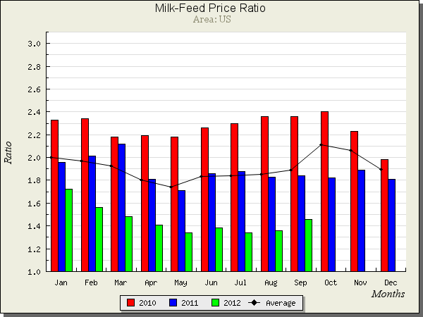
Brian Gould, Agricultural and Applied Economics, UW Madison

Slide 24
Milk-Feed Ratio
Feed Value (FV) ($/cwt) is the sum of:
  51/56 x corn price ($/bu)
  8/60 x Soybean price ($/bu)
  41/2000 x Price of Alfalfa Hay ($/ton)
Milk-feed ratio = Pmilk/FV
  Pmilk = milk price ($/cwt)

Slide 25
Current Ratio for KS
Prices
  Corn = $7.50/bu
  Soybean = $15.00
  Alfalfa Hay = $250/ton
  Milk = $20.50/cwt
Calculations
  FV = 51/56 x $7.50 + 8/60 x $15.00 + 41/2000 x $250 = $13.96/cwt
  Milk-Feed = $20.50 / $13.96 = 1.47

Slide 26
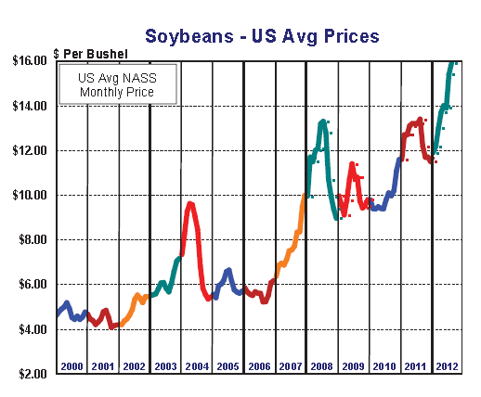
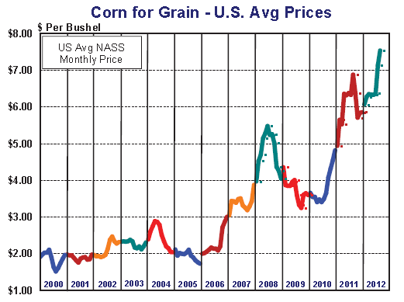
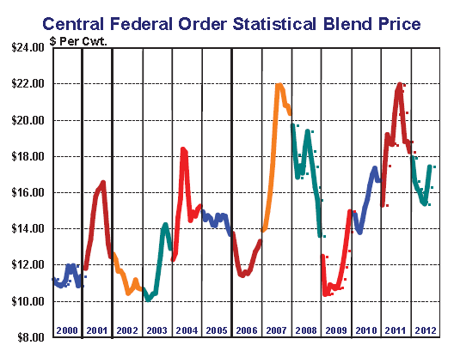
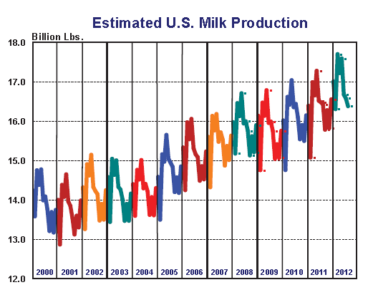
Central Order Milk Market Administrator

Slide 27
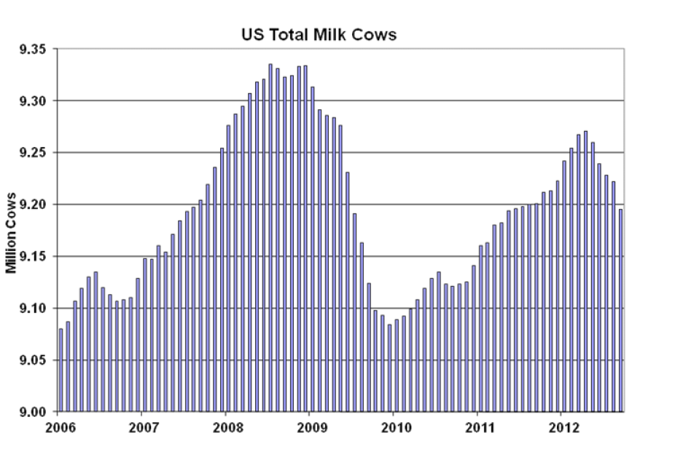
Data Source - NASS

Slide 28
Summary
Positive Growth in KS Dairy Industry
Challenges
  Labor
  Economics
  Water
  Marketing Options
  Feed/Forage
  Co-Products

Slide 29
Opportunities
Farm to Table
  Large Scale
    McCarty – Dannon
    Forget-Me-Not – Dean Foods
    Milk Concentration
  Medium Scale
    On-farm Processing
      Hildebrand, Iwig, Wiebe
  Small Scale
    Home Delivery
      Emrick

