Slide 1
Swine Industry Update
K-STATE
RESEARCH
and
EXTENSION

Slide 2
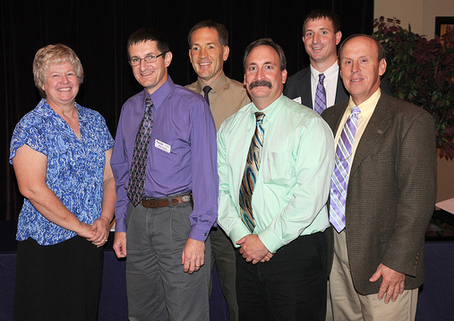
KSU Swine Extension Team
1.4 Extension tenths in Swine
  Joel DeRouchey (20%)
  Bob Goodband (20%)
  Jim Nelssen (40%)
  Mike Tokach (60%)
  Steve Dritz
  Lois Schreiner

Slide 3
Other KSU Faculty working with swine
Animal Sciences and Industry
  Duane Davis (Repro phys)
  Joe Hancock (Nutrition R-T)
  Terry Houser & John Gonzalez (meats)
Ag Econ
  Kevin Dhuyvetter, Glynn Tonser, etc.
Veterinary Medicine
  Dick Hesse, Bob Rowland, Jurgen Richt, Jerome Nietfeld, Morgan Scott, etc

Slide 4
Recent Swine Industry History
Volatility
Profit to 1998 - 30+years
LOSS to 2000
Profit to 2002
Loss to 2004
PROFIT to 2007
LOSS to 2010
Profit for 2011
Loss for 2012 and 2013?

Slide 5
Recent Ingredient Prices
 | June 2009 | June 2010 | June 2011 | June 2012 | Sept 2012
Corn, $/bu | $4.00 | $3.20 | $7.25 | $6.00 | $7.48
SBM, $/ton | $395 | $285 | $350 | $400 | $500
DDGS, $/ton | $150 | $120 | $200 | $240 | $273
CWG, $/cwt | $27 | $33 | $50 | $46 | $44
Dical, $/cwt | $23 | $26 | $28 | $33 | $33
L-lysine, $/cwt | $70 | $110 | $120 | $113 | $105
~cost/finishing pig | $64 | $57 | $90 | $87 | $104

Slide 6
Sow Production Standards
Total pigs per litter 13 to 14
Total live born per litter 12 to 13
Total pigs weaned per litter 11 to 12
Preweaning mortality 5 to 10%
Pigs weaned per sow per year 26 - 30
  mated female
Adjusted 21-d litter weights 150 to 170 lb

Slide 7
Sow Housing
Large portion of retailers and meat suppliers have indicated they will only purchase pork from pigs originating from group housed sows in approximately 8 - 10 years.
Affects virtually all commercial producers in KS.
Estimated ~ 20% of sow in US are in group housing today.

Slide 8
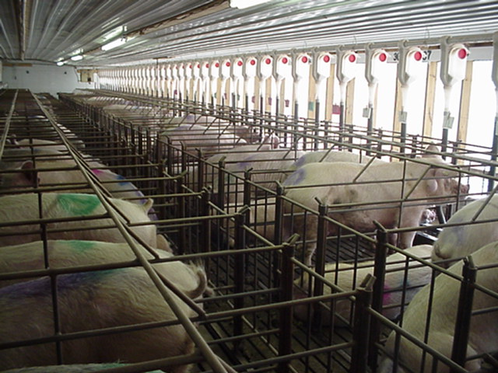

Slide 9
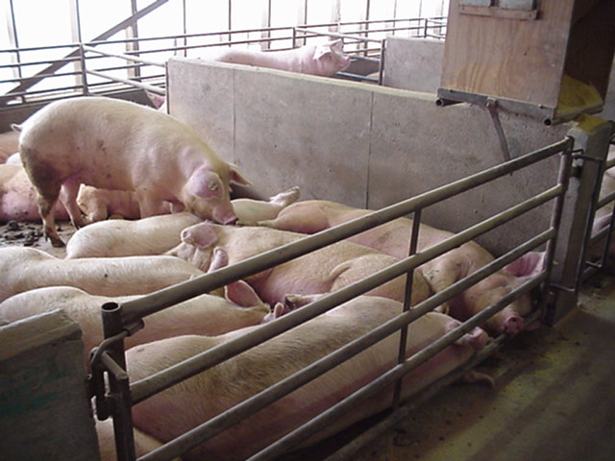
Gestation Pens

Slide 10
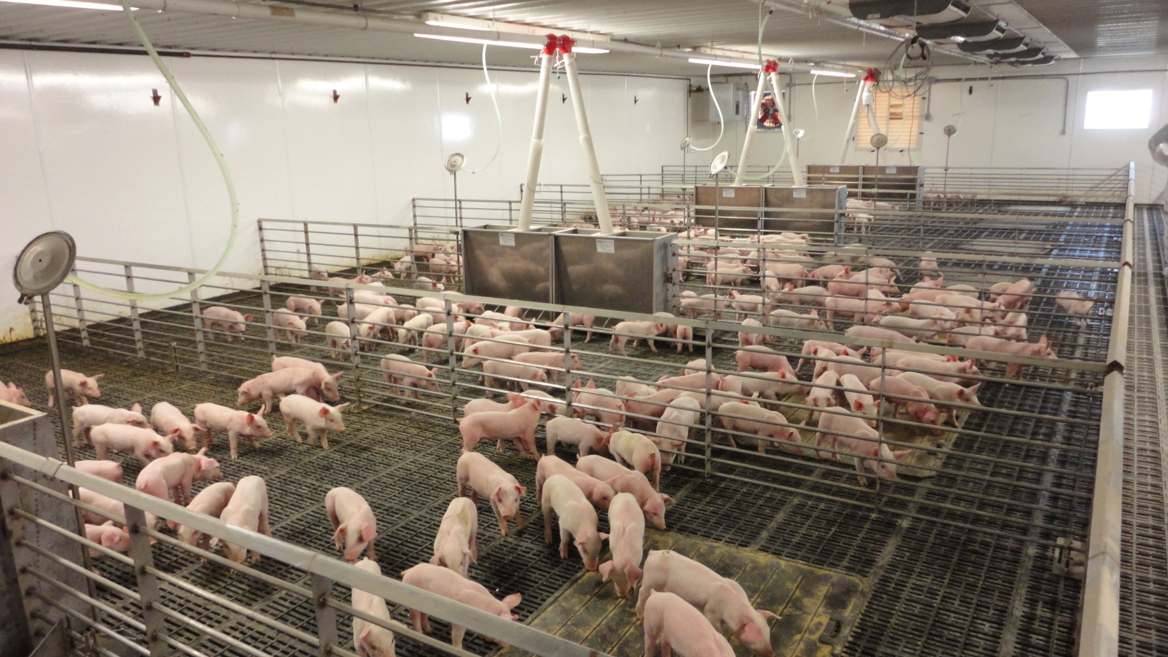

Slide 11
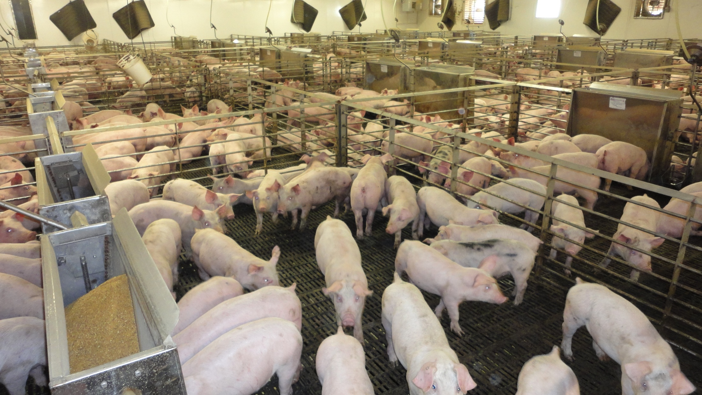

Slide 12
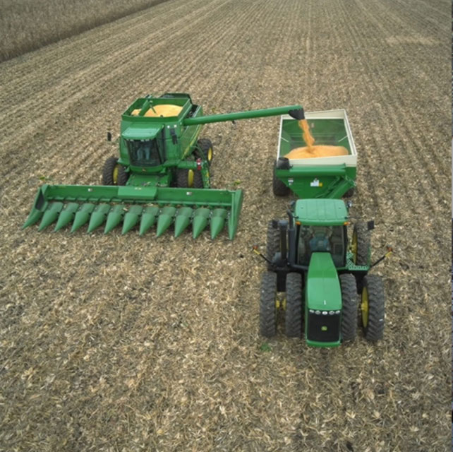
Pork and the Rural Economy
Pork Industry consumes 10% of the total
US corn crop –
1.4 billion bushels.
Pork Industry consumes roughly 10% of the US soybean crop - 283 million bushels.
Notes:
Pork production is still very important to the local economy and to corn and soybean producers. More than half of the U.S. corn crop is used as livestock feed, with pigs consuming nearly 1.4 billion bushels – or about 10 percent of the total corn crop. Pork producers purchased the equivalent of 283 million bushels of soybeans last year – or roughly 10 percent of the total U.S. soybean crop.
Source: Pork Facts 2002/2003 www.porkboard.org
Source: American Soybean Association Soystats 2004 www.soystats.com

Slide 13
KS Swine industry future
Volatility
  Good times for land-based diversified systems
    Make money on grain when pigs losing money and (hopefully) vice versa
    These farms will continually question whether they want to remain in swine industry
  Large systems must have either:
    Deep pockets (high equity and understanding banker)
    Risk management to avoid open market swings
KDA promoting swine production in KS
  Stated goal to be top 5 producer in US

Slide 14
Improvest
What is IMPROVEST® and how does it work?
IMPROVEST® (gonadotropin releasing factor analog – diphtheria toxoid conjugate) is a veterinary prescription product that is a safe and effective alternative to physical castration. It’s a protein compound that works like an immunization to protect against unpleasant aromas that can occur when cooking pork from some male pigs.
FDA-approved, IMPROVEST® is for the temporary immunological castration and reduction of boar taint in intact male pigs intended for pork. It uses the pig’s own immune system to provide the same effect as physical castration, but much later in the male pig’s life.

Slide 15
Improvest
IMPROVEST® works like an immunization
IMPROVEST® works like an immunization, using the male pig’s immune system to temporarily reduce the two major off-odor causing compounds in pork, androstenone and skatole.
IMPROVEST® is given subcutaneously behind the base of the pig’s ear in two 2-mL doses. 1st does is primer; 2nd dose causes the immune response, market pigs 3 to 10 weeks following 2nd dose.

Slide 16
Adult PQA+
Program is under revision to include more animal handling aspects
All Advisors will have to be trained in May-June 2013.
Major Change – All individuals you certify must now take and pass a test.
  Similar to the test you take to pass to become an advisor.

Slide 17

2012
Thursday, November 15, 2012
Notes:
1

Slide 18
Junior Swine Producer Day
To be held February 16, 2012
  Held every other year in Manhattan
  400 youth and adults attend (2011 - 47 counties)
Focused on the basics of swine projects
  Buying the right pig, daily care, nutrition, showing, youth PQA+ and skillathon etc..
More information to come
  We greatly appreciate your promotion and support of this event

Slide 19
Thank you!
K-STATE
RESEARCH
and
EXTENSION

