Slide 1
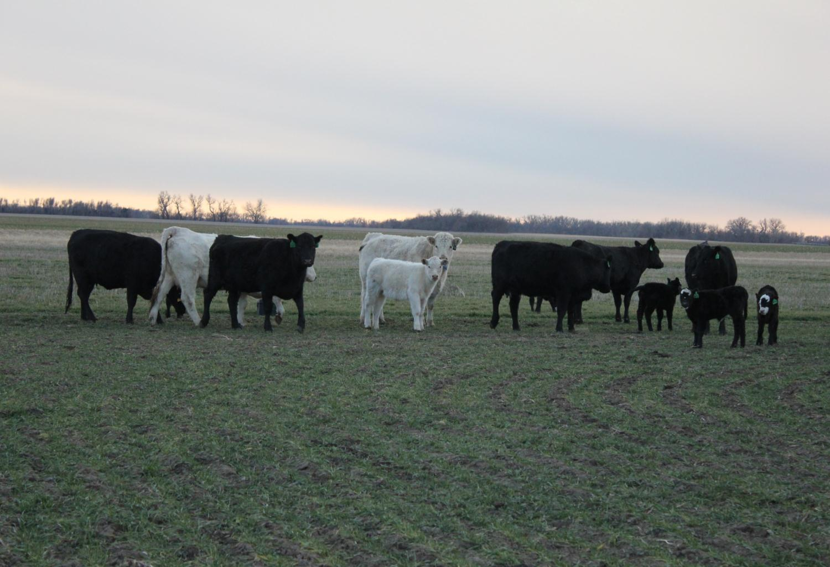
Introducing ….
Dr. Jaymelynn Farney
Southeast Beef Systems Specialist

Slide 2
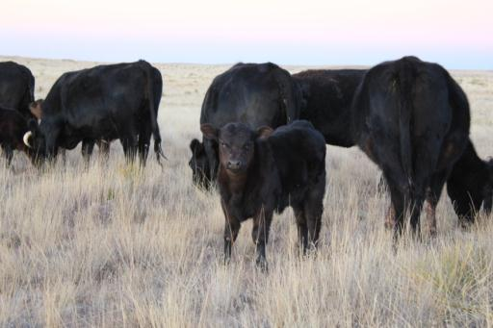
Background
Home-town: Fort Sumner, NM
  Cow-calf operation
  Experience in grazing yearling program
Angus based cow herd
  Rotational cross-breeding
Small farm
  Alfalfa, Hygari, wheat
Active in 4-H and FFA
  Leadership roles
  Showed livestock: cattle, sheep, and swine
  Judging

Slide 3




Background
Butler Community College – A.S.
  Agriculture
Kansas State University – B.S.
  Animal Science – Pre-vet option
Oklahoma State University – M.S.
  Animal Science – Ruminant Nutrition
Kansas State University – PhD
  Animal Science – Ruminant Nutrition

Slide 4
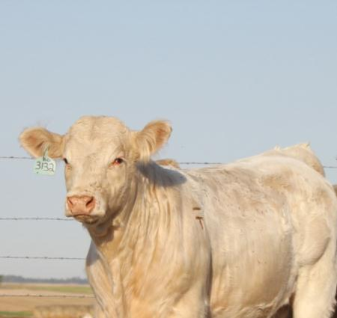
Background
Married 3 years
  Registered Charolais and Angus operation
    AI
    Embryo transfer
    Rotational grazing
  Backgrounding/stocker operation
    Pen
    Wheat pasture

Slide 5
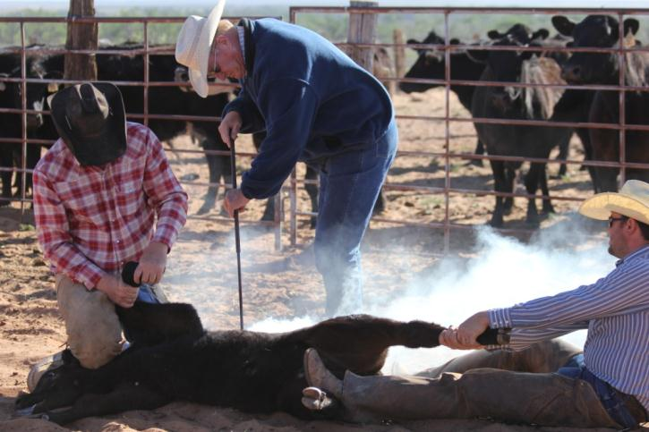
Beef Experiences
Cow-calf
Backgrounder
Stocker
Feedlot
Packing facility
  Beef
  Cullers

Slide 6
My Research Experiences
Master’s
  High-risk receiving cattle
  Gene expression changes that occur based on the number of times heifers treated for BRDC
Doctorate
  Health and metabolism interact
  Inflammation impacts on production

Slide 7
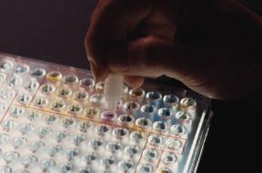
Research Experiences
Basic
  Metabolite profiles in plasma
  Gene expression in muscle, adipose, and liver
Applied
  Nutrient analysis
  Health diagnosis

Slide 8
Purposed Research
Utilizing more resources for cattle
  Corn stalk residues as a grazing substitute
    Modern corn varieties
    Advances in combines
  No till
    Cover-crop grazing
    Determine if this can release pressure on native range and/or improved pastures
Notes:
How does modern corn and combines alter the nutrients in the field that will be grazed compared to older estimates
Cover crops like legumes because the cover-crop will increase water uptake from rain and that acts like tilling to be used to help soil and water retention and

Slide 9
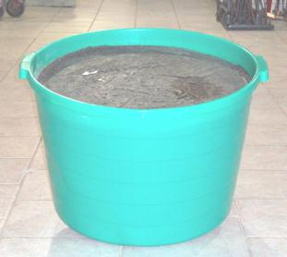
Proposed Research
“Efficiency tools”
  Ionophores
  Combination minerals
Fescue management
  Reproduction
  Counteract heat stress

Slide 10
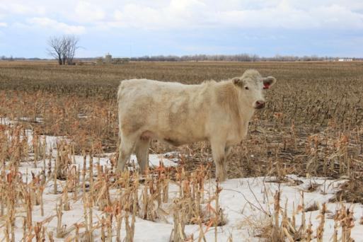
Collaborative Research
20% Research
Health component to research
Whole systems approach
Connections with feed companies in Kansas
Connections with Animal Health companies

Slide 11
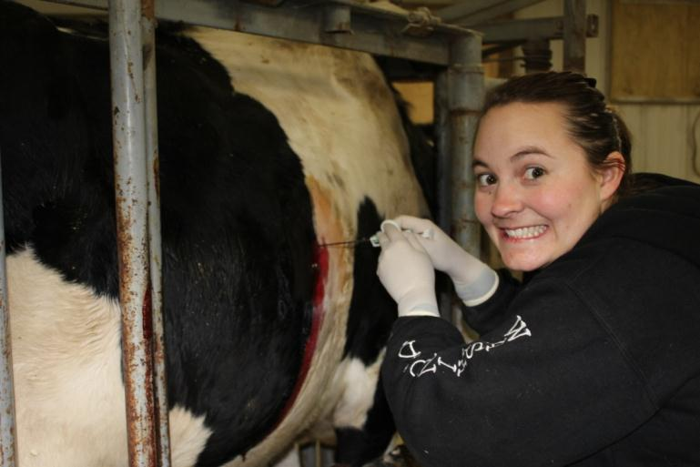
Other Pertinent Information

Slide 12
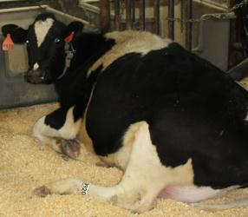
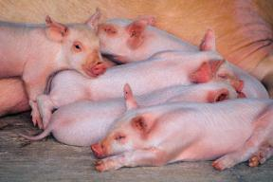
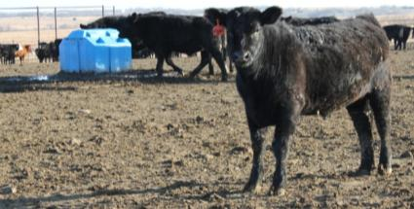
Diversity
Successful research with
  Genetics (swine)
  Behavior (swine)
  Receiving cattle
  Transition dairy cows
Taught proper data collection and interpretation
Exposure to different sectors in animal agriculture and identified the impacts all have on each other

Slide 13

Newsprint experience
Worked for a summer at the De Baca County News and Clovis Livestock Market News
  Fort Sumner, NM
Wrote news reports
Photographs
Ad-development

Slide 14
Contact information
Southeast Area Research Center
  Parsons, KS
(620) 421-4826 ext. 17
jkj@ksu.edu

Slide 15
Thanks!

