Slide 1
Application of liquid protein supplements on intake and digestibility of low quality forages
Sandy Johnson
NW ASI Update
Nov. 7, 2012

Slide 2
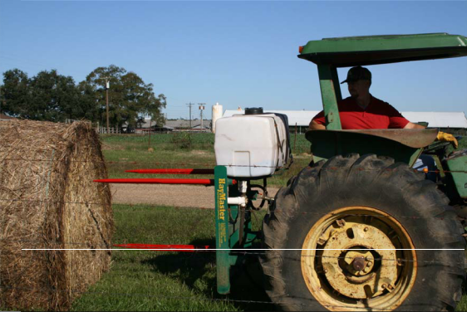

Slide 3
Nutritive changes in ammoniated or liquid protein treated wheat straw
Treatment | Dry Matter | CP | NDF | ADF
Ammoniation
Pretreatment | 94.7 | 2.8 | 77.6 | 46.7
Post-treatment | 89.8 | 9.9 | 70.8 | 41.6
Liquid Supplement
Pre-treatment | 95.4 | 2.9 | 77.8 | 46
Post-treatment | 95.2 | 3.5 | 75.7 | 42.2
Goehring et al., 1990
Notes:
no sig differences
Sprayed with 4 gallons of Loomix, turned on end for 30 minutes
3% ammonia

Slide 4
 |  | Gas Production, ml/hr | TDN Estimate
Treatment | IVDMD |  | ADF | IVDMD
Ammoniation
Pretreatment | 30.9^{d} | 9.2^{d} | 42.6 | 39.6^{d}
Post-treatment | 41.4^{f} | 12.7e | 48.5 | 47.4^{g}
Liquid Supplement
Pre-treatment | 33.3e | 9.1^{d} | 43.5 | 41.3e
Post-treatment | 35.2^{g} | 10.0^{d} | 47.8 | 42.8^{f}
34% ↑
6% ↑
^{d,e,f,g} Means with different superscripts differ. P<0.05
Goehring et al., 1990
Notes:
LS dilutes straw, composition of wheat its self is not changed
Increased gas prod, MAY indicate a higher rate of fermentation

Slide 5
 | Control | NaOH | Liquid Suppl | Ammoniated
Cow Trial
ADG, lb | .26^{b} | 0ª | .10ª | .88^{c}
Straw intake, lb | 19.3ª | 17.3ª | 17.8ª | 23.0^{b}
Sheep metabolism trial
DM digestibility,% | 53.6ª | 53.5ª | 52.4ª | 59.7ª
Intake, lb | .99ª | 1.30^{b} | 1.32^{b} | 1.43^{c}
IVDMD,% | 50.3ª | 54.2^{b} | 49.7ª | 57.7^{c}
^{a,b,c,} Unlike superscripts in a row differ (P<0.05) using orthogonal contrasts
Faulkner et al., 1981 (yr?)
Notes:
32% CP liquid ptn (urea based), to achieve 6% liquid suppl on DMB
to wheat straw, 3 reps gestating cows, free choice in round bale feeders, also fed 16.3 lbs hay (alfalfa??) M,W &F, visual estimate of hay refusal
NaOH straw was moldy

Slide 6
Cow Preference for NaOH or Liquid Supplement treated straw compared to untreated straw
 | Trial 1 |  | Trial 2
Treatment | Untrt | NaOH | Untrt | LS
Estimated intake, lb | 2.3 | 13.3 | 2.5 | 12.1
IVDMD | 37.6 | 46.7 | 37.6 | 41.1
NDF, % | 87.7 | 82.0 | 87.7 | 86
Crude Protein, % | 3.3 | 4.5 | 3.3 | 8.6
Paterson et al., 1980
Notes:
15 gestating mature cows, 1030 lbs, cow preference of each, 3 reps (3 bales of each offered)
Suppl with 7 lbs alfalfa
LS – 51% CP (urea based) sprayed on windrow, to achieve 10% CP in bale
IVDMD – NaOH 24% increase, 6.5% decrease cell walls (NDF) – LS 9.3% increase digestibility, CP increased
Uniform application of LS and NaOH a problem

Slide 7
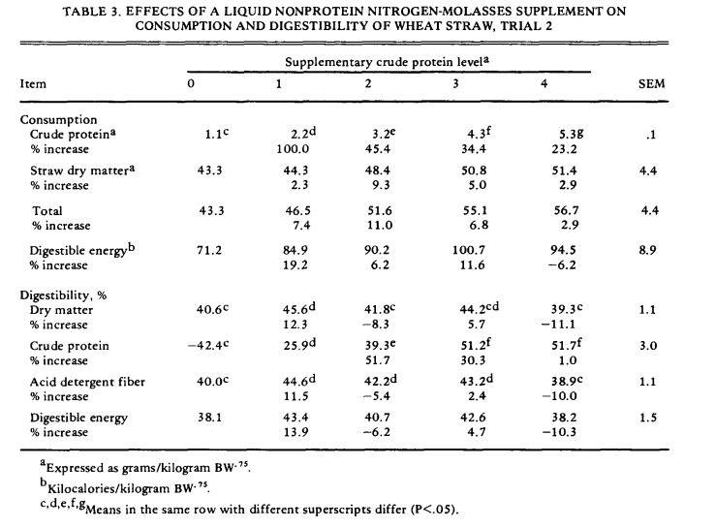
Church and Santos, 1981

Slide 8
Hay quality following injection with molasses-urea solution - LSU
 | Study 1 – Bermudagrass hay |  | Study 2 – Johnsongrass-crabgrass hay
Item (%DM) | Control | Injected | Control | Injected
CP | 12.3 | 13.2 | 7.8 | 7.5
ADF | 39.5 | 38.6 | 47.3 | 47.0
NDF | 70.7 | 70.3 | 74.7 | 73.9
TDN | 53.0 | 54.0 | 44.1 | 44.4
IVDMD | 69.8 | 71.6 | 64.3 | 64.2
McCormick et al., 2010
Notes:
www.lsuagcenter.com/NR/...CC99.../2010FieldDaysSummary.pdf
no diff nutritive values P>0.1

Slide 9
Hay palatability following injection with molasses-urea solution - LSU
 | Study 1 Hay – Bermudagrass |  | Study 2 Hay – Johnsongrass-crabgrass
Item (%DM) | Control | Injected | Control | Injected
Bales tested | 8 | 8 | 6 | 6
Bale weight | 1227 | 1282 | 1229 | 1272
Hay refusals, lb | 641ª | 343ª | 700ª | 555^{b}
Intake/period | 586ª | 939^{b} | 529ª | 717^{b}
Intake/calf/d | 5.22ª | 8.28^{b} | 5.01ª | 6.38^{b}
Hay intake, %BW | 0.75 | 1.18 | 0.71 | 0.91
^{a,b,} Study 1 means differ P<0.01; Study 2 means tend to differ P<0.10
McCormick et al., 2010
Notes:
www.lsuagcenter.com/NR/...CC99.../2010FieldDaysSummary.pdf
offered free choice to 30 yearling Holstein heifers, feeding periods per bale from 3-5 days

Slide 10
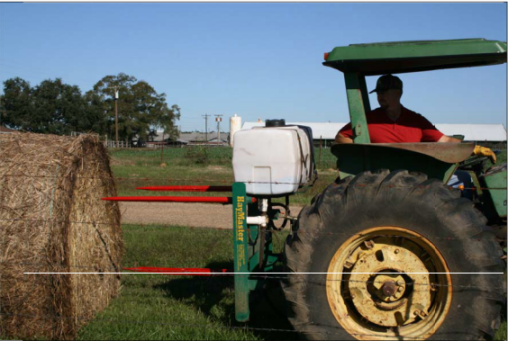
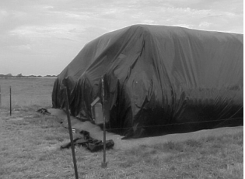
Summary
Ammoniation
Increase digestibility
Increase intake
Increase CP
treat group of bales
LS injection
Increase intake
Nutrient content function of dilution
treat individual bales

Slide 11
Ammoniation Project
Notes:
solublizes hemicellulose

Slide 12
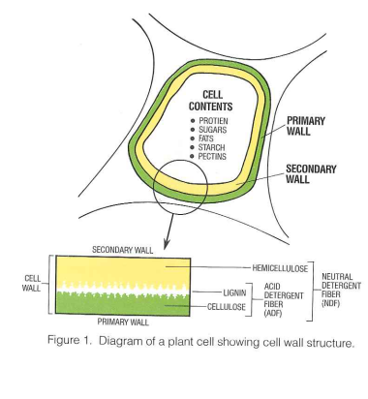

Slide 13
 |  | Gas Production, ml/hr | TDN Estimate
Treatment | IVDMD |  | ADF | IVDMD
Ammoniation
Pretreatment | 30.9^{d} | 9.2^{d} | 42.6 | 39.6^{d}
Post-treatment | 41.4^{f} | 12.7e | 48.5 | 47.4^{g}
Liquid Supplement
Pre-treatment | 33.3e | 9.1^{d} | 43.5 | 41.3e
Post-treatment | 35.2^{g} | 10.0^{d} | 47.8 | 42.8^{f}
20%
^{d,e,f,g} Means with different superscripts differ. P<0.05
Goehring et al., 1990
Notes:
LS dilutes straw, composition of wheat its self is not changed
Increased gas prod, MAY indicate a higher rate of fermentation

Slide 14
Nitrates
KPICS

Slide 15
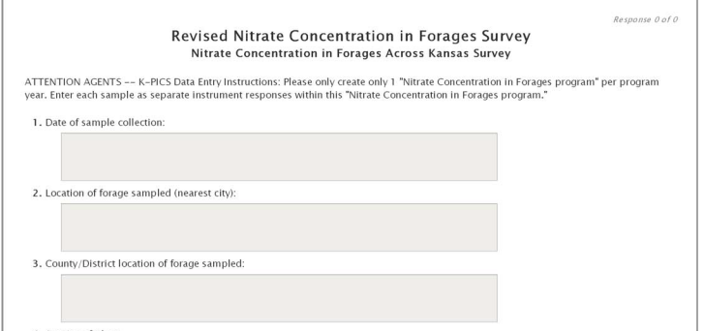
Nitrate Concentration in Forages Survey
Date
Location of forage sampled (City)
County/District of forage sampled

Slide 16
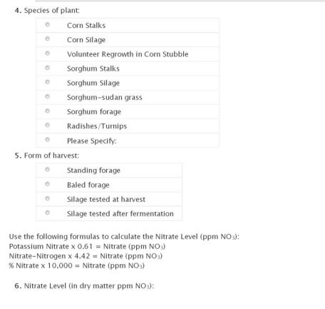

Slide 17
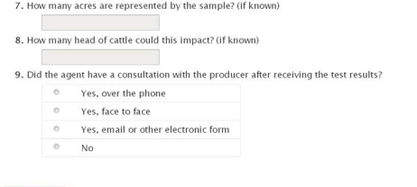

Slide 18
Nitrate tests
KPICS
Sub-samples you were asked to collect
correct sub sample procedure
2 teaspoons to ¼ cup
type of forage
actual nitrate value and associated units (copy analysis sheet)

Slide 19
Starting weight and condition
 | EW | NW
n | 18 | 18
Cow age, yr | 4.3 ± .6 | 4.6 ± .6
Julian calving date | 57 ± 3 | 60 ± 3
Calf weight, lbs. | 351 ± 13 | 367 ± 13
Cow weight, lbs. | 1023 ± 39 | 1072 ± 38
Cow body condition | 3.6 ±.2 | 3.9 ± .2
Notes:
Project at CCC on GrowSafe System some of you saw when we worked on BRANDS

Slide 20
Ending weight and condition
 | EW | NW | P
Cow weight, lbs | 1182 ± 10 | 1137 ± 10 | 0.01
Cow weight change, lbs | 137 ± 10 | 93 ± 10
Cow body condition | 4.7 ± 0.1 | 4.5 ± 0.1 | 0.08
Cow body condition change | 0.9 ± 0.1 | 0.7 ± 0.1
Dry matter intake | 20.4 ± 3 | 25.5 ± 3

Slide 21
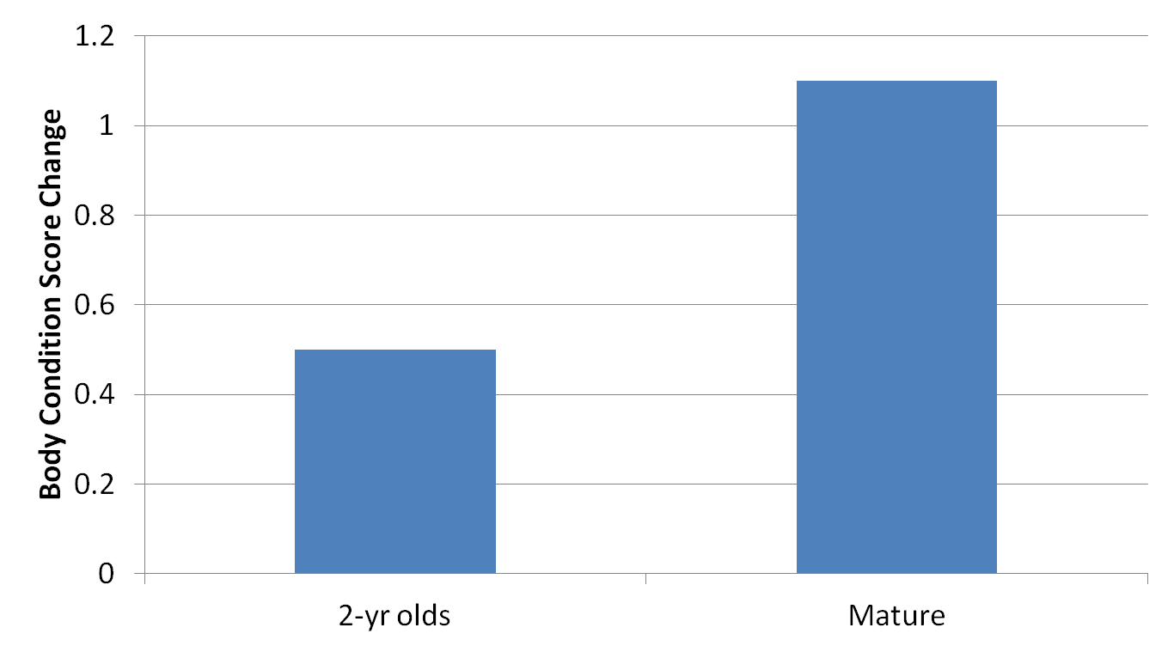
Body condition change in 2-yr old and mature cows after a 77 day re-feeding period following nutrient restriction

Slide 22
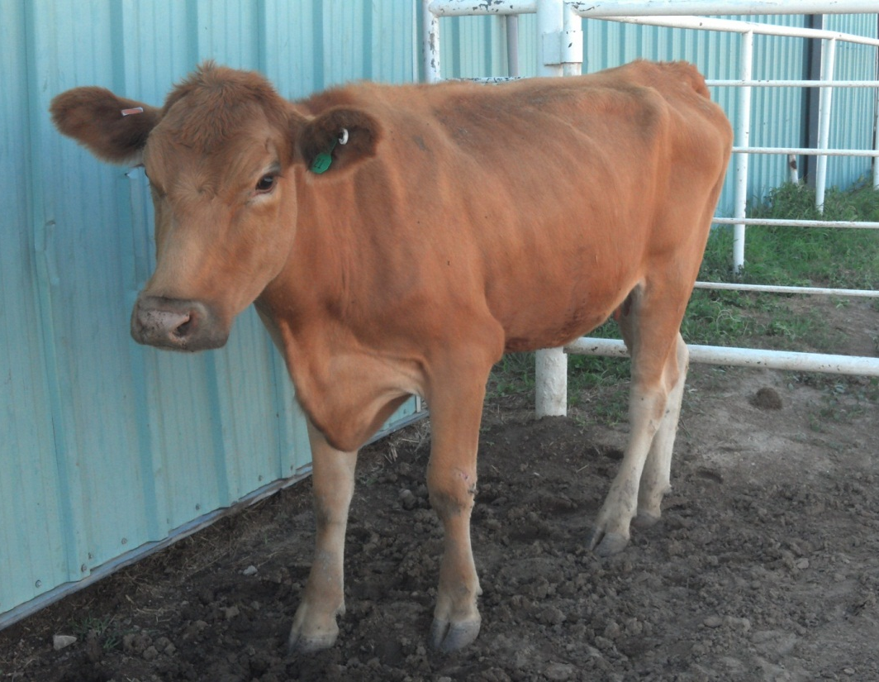
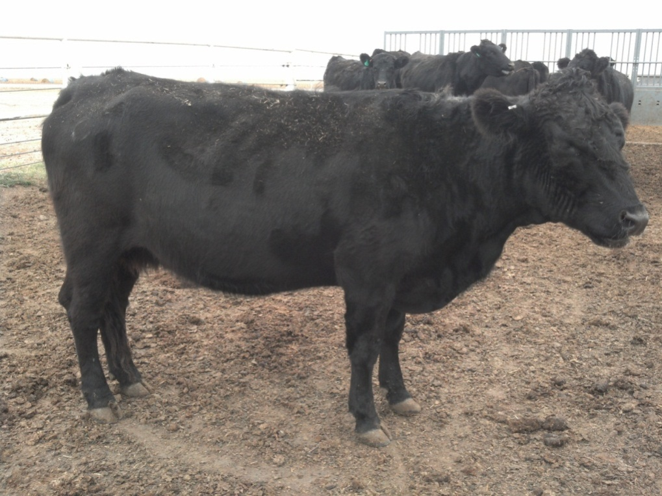
Day 0
Day 77

Slide 23
Ideas for local demonstrations
technology that isn’t being used
scales

Slide 24
Hay waste –
  Feeder type
  Access time
  Shred vs unrolling
  At current cost of hay when does it pay to buy bunks/processing ect.

Slide 25
Methods of Feeding Hay
Method Amount Wasted
Unrolled on the groundª 22%
Processed, fed on groundª 16%
Processed, fed in bunkª 11%
Hay Feeders 7-9 %
Ground Hay <5%?
ªBlasi et al., 1993 Cattlemen’s Day

Slide 26
 | Access time to hay
 | 3 hours | 6 hours | 9 hours | Free choice
Weight change, lbs ª | 119 | 161 | 191 | 207
Body condition change ª | 0.1 | 0.5 | 0.7 | 0.8
Hay disappearance, lbs DM/d ª | 17.6 | 24.4 | 29.3 | 34.1
Hay waste, lbs DM/d ^{b} | 5.9 | 5.7 | 9.2 | 13.4
Manure production, lbs DM/d ^{b} | 11.7 | 15.0 | 19.6 | 22.7
ª linear and quadratic effects (P<0.01) ^{b} linear effect (P<0.01)
Notes:
Nov. 2007 Beef Tips
University of Illinois, Miller et al., 2007; Prof. Ani. Sci. 23: 366-372.

