Slide 1
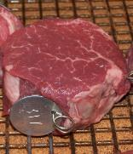
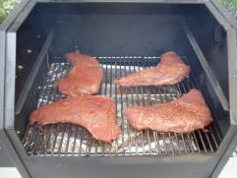
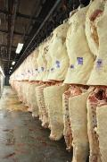
Fresh Meat Extension
Programming Opportunities
Travis O’Quinn, Ph.D.
November 2015

Slide 2

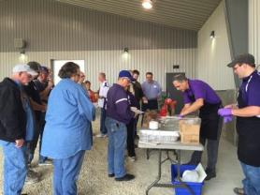

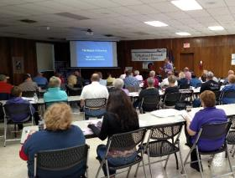
BBQ 101
BBQ 101
All day program focusing on teaching consumers about all things BBQ
Targeting consumers who have an interest in learning more about BBQ and are looking to learn different techniques, about different meats, different products etc.
Focused on how to create great backyard BBQ for friends and family
Touches on competitive BBQing, but not the major focus
Hands-on demonstrations, taste testing of different products, etc.

Slide 3
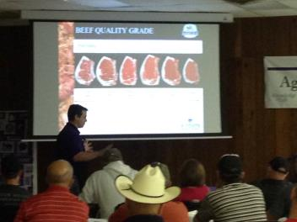
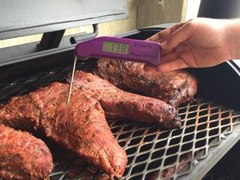
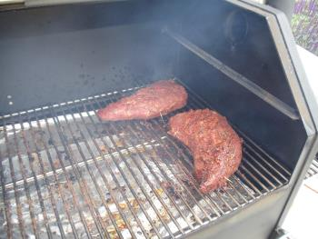
BBQ 101
Meat Cutting Basics
Food
Safety
Science of Smoking

Slide 4
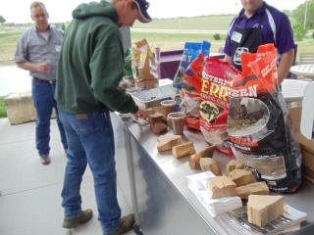
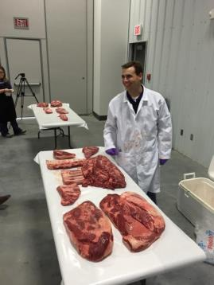
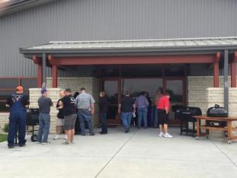
BBQ 101
Taste Testing Meats with
Different Woods
Different Meat Cuts
for BBQ
Demonstrations
of Different
Types of
Smokers

Slide 5
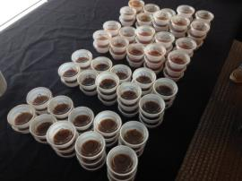
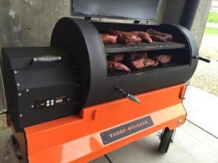
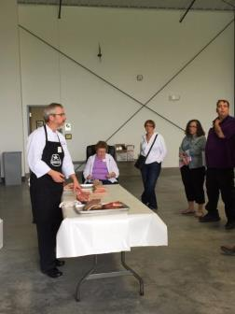
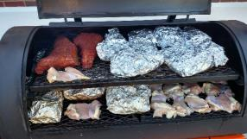
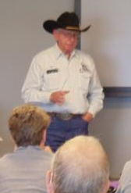
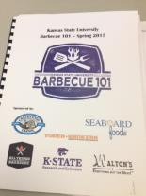
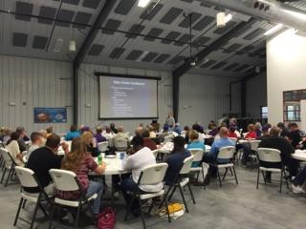
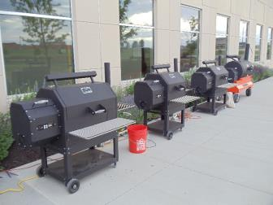
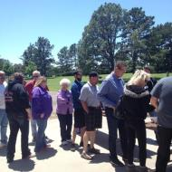
BBQ 101

Slide 6
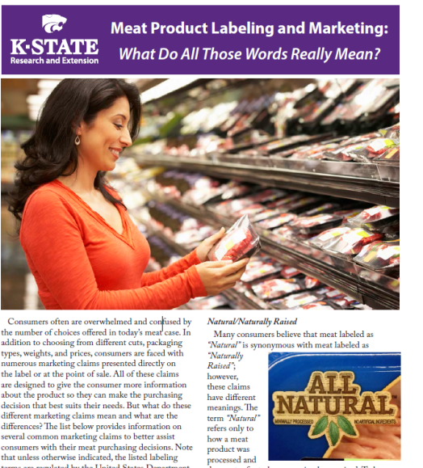
FACT SHEETS
Available through the KSRE Bookstore:
http://www.bookstore.ksre.ksu.edu/pubs/MF3209.pdf
Has an accompanying PowerPoint and Program evaluation for use in county programing

Slide 7
CONSUMER TOPICS
Fact Sheets and Programs
Current Fact Sheets to be completed and published in spring:
  Differences between Grass vs Grain Fed Beef
  What’s in a grade? – All about meat grading
  Beef, Pork and Lamb Cutout Calculator
Additional Topics to Be Developed:
New cut names with pictures and cooking information
Ground Beef 101
Right cut for the right cooking method – maximizing value and taste
Meat selection basics
How and why to use a meat thermometer when cooking meat
In addition to the fact sheet, most of these topics would have a ready made PowerPoint and evaluation for simple programing at the county level

Slide 8

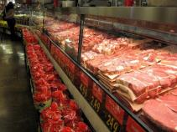
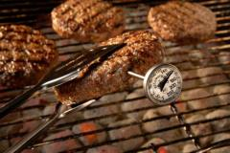
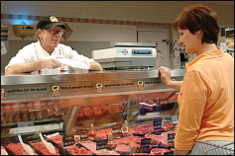
CONSUMER TOPICS
Meat 101
Focused on current consumer issues concerning meat and meat products
Focused on helping educate consumers about meat
Topics would include:
  Safe meat handling
  Meat cookery
  Meat selection and purchasing
  Meat production
  Meat labeling and marketing
  Meat nutrition
  Producer panel
  Tasting of different types of beef

Slide 9

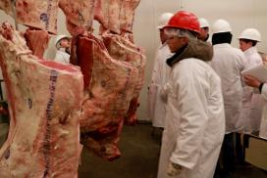
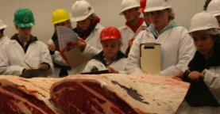
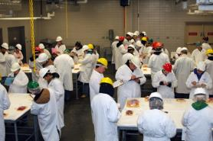
4-H MEAT JUDGING
Future Plans
Provide more resources for coaches
Provide opportunities for teams to get “cooler time”
Planning on developing a website with information and training resources for teams. Will have pictures, videos, terminology, sample classes, reasons, how-to instruction, etc.
Planning on hosting a one day meat judging clinic in the spring allowing teams to come to KSU and practice on several different classes, retail ID, instructional times from K-State meat judging team members
Potential regional meat judging workshops

Slide 10
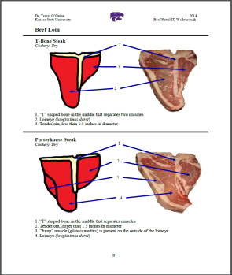
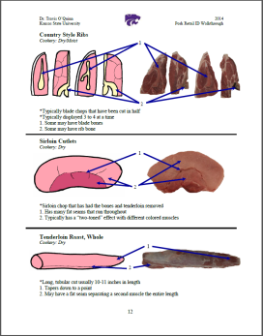
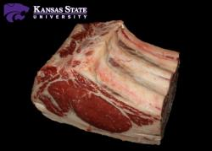
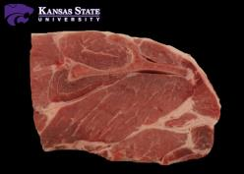
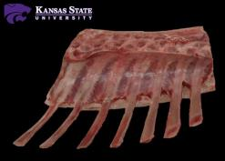
4-H MEAT JUDGING

Slide 11

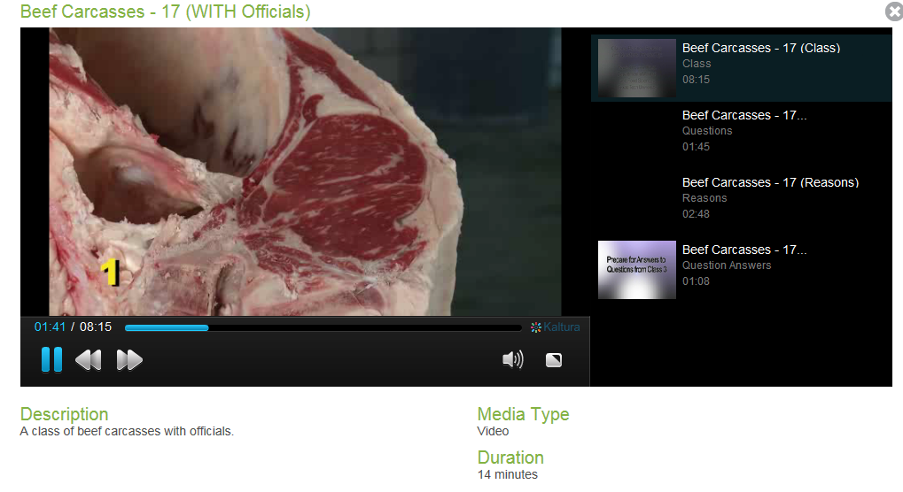
4-H MEAT JUDGING
More than 150 classes (all possible cuts) with reasons and questions
More than 30 differ ID rails
Instructional “how-to” videos for all classes and retail ID

Slide 12
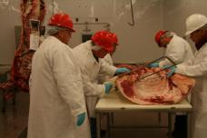
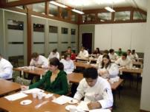
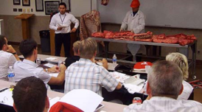
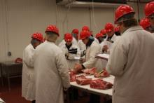
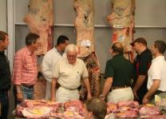
ADDITIONAL PROGRAMING
Other Possibilities and Areas of Expertise
Carcass contests associated with livestock shows
Meat cutting and processing demonstrations
Beef 706 program – producer and feeder focused
“All About Steak”, meat cookery (grilling, BBQ), selection, labeling, eating-quality, food safety, venison processing, etc.
Any meat related programing that may be needed

Slide 13
Questions?
Travis O’Quinn
travisoquinn@ksu.edu
785-532-3469

