Slide 1
Example Diets and Ionophore Use
Dale A. Blasi
Livestock Program Focus Team
Agent Professional Development Meeting
March 25 – 26, 2015

Slide 2
Canned beef diets

Slide 3
Effective Supplementation Programs
Must have an approximate idea of:
  Feed value of base forage
  Quantity of forage an animal can consume
  Nutritional needs of the animal

Slide 4
Numerous considerations
Genetics
Stage/level of production
Size of animal
Existing body condition
Desired body condition
Environment

Slide 5
Changes in Forage Intake of Cows Grazing Tall Grass Prairie
Adapted from Katz, 1980; Pruitt et al., 1980; Del Curto, 1987 and Jacques et al., 1987; KSU

Slide 6
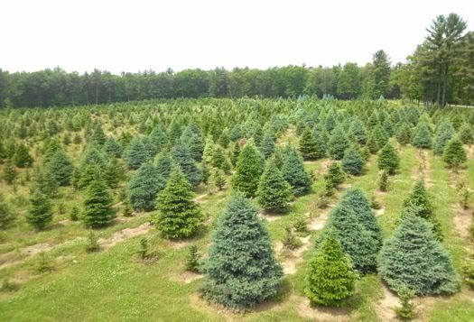


Slide 7
Forage Intake of Beef Cows as Affected by Stage of Production, Forage Quality and Supplement Typeª
Forage Quality
Stage of production &
supplementation strategy Low Medium High
Dry, pregnant cow Intake expressed on % body wt, dry matter basis
Unsupplemented 1.5 2.0 2.5
Protein supplementation 1.8 2.2 2.5
Energy supplementation 1.5 2.0 2.5
Lactating cow
Unsupplemented 2.0 2.3 2.7
Protein supplementation 2.2 2.5 2.7
Energy supplementation 2.0 2.3 2.7
ªAdapted from Hibberd and Thrift, 1992

Slide 8
Supplementation of Poor Quality Forages
Protein is first limiting nutrient
20 to 35% boost in intake with protein
Use supplements with at least 20% protein content

Slide 9
1350 lb Beef Cow, BCS = 5
 | 3rd Trimester | Early lactation
Native grass only | 24.4 lbs | 24.4 lbs
Net energy Req. | 67% | 49%
Met. Protein Req. | 65% | 39%
 |  |  |  | w/ DDGS
Native grass | 29 lbs | 33.7 lbs | 32.7 lbs | 31.8
36% Cube | 5.0 lbs | 5.0 lbs | 7.0 lbs | 7 lbs
Net energy Req. | 102% | 84% | 89% | 95%
Met. Protein Req. | 134% | 91% | 100% | 112%
Brome grass hay | 30.5 lbs | 35.5 lbs | 34.0 lbs | 32.50 lbs
36% Cube | 3.0 lbs | 3.0 lbs | 5.0 lbs | 6.0 lbs
Net energy Req. | 97% | 81% | 85% | 92%
Met. Protein Req. | 121% | 84% | 92% | 104%

Slide 10
Effect of Days to Calving on Proportions of Feedstuffs Necessary to Achieve Desired Daily Gain for an 1100 lb. Pregnant Cow
 |  |  |  |  |  | Days to calving
64.00 | 62.00 |  |  |  |  | Low quality forage | 52.00 | 47.00
 |  | 61.00 | 55.00 | 48.00 | 37.00 | Medium quality forage |  |  | 37.00 | 25.00
21.00 | 21.00 | 18.00 | 20.00 | 22.00 | 25.00 | Grain | 24.00 | 23.00 | 29.00 | 33.00 | 47.00
15.00 | 17.00 | 21.00 | 25.00 | 30.00 | 39.00 | Wheat Middlings | 24.00 | 30.00 | 34.00 | 42.00 | 53.00
0.62 | 0.71 | 0.82 | 0.98 | 1.23 | 1.63 | Desired daily gain lb/day | 1.24 | 1.40 | 1.63 | 1.96 | 2.44

Slide 11
Negative and Positive
Associative Effects:
Positive
  Increased ruminal microbe activity
  Increased ruminal retention time
Negative
  Reduced rate of fiber digestion because of the presence of starch and low ruminal pH
  Reduced ruminal retention time
  Incomplete starch digestibility

Slide 12
Positive Associative Effect
25
25
24
24
23
23
Observed
22
22
21
21
Expected
20
20
No Supplement
With Supplement
20 lbs dry grass intake plus 2 lbs high protein-containing supplement

Slide 13
Negative Associative Effect
25
25
24
24
23
23
Expected
22
22
21
21
Observed
20
20
No Supplement
With Supplement
20 lbs dry grass intake plus 5 lbs of corn

Slide 14


Slide 15
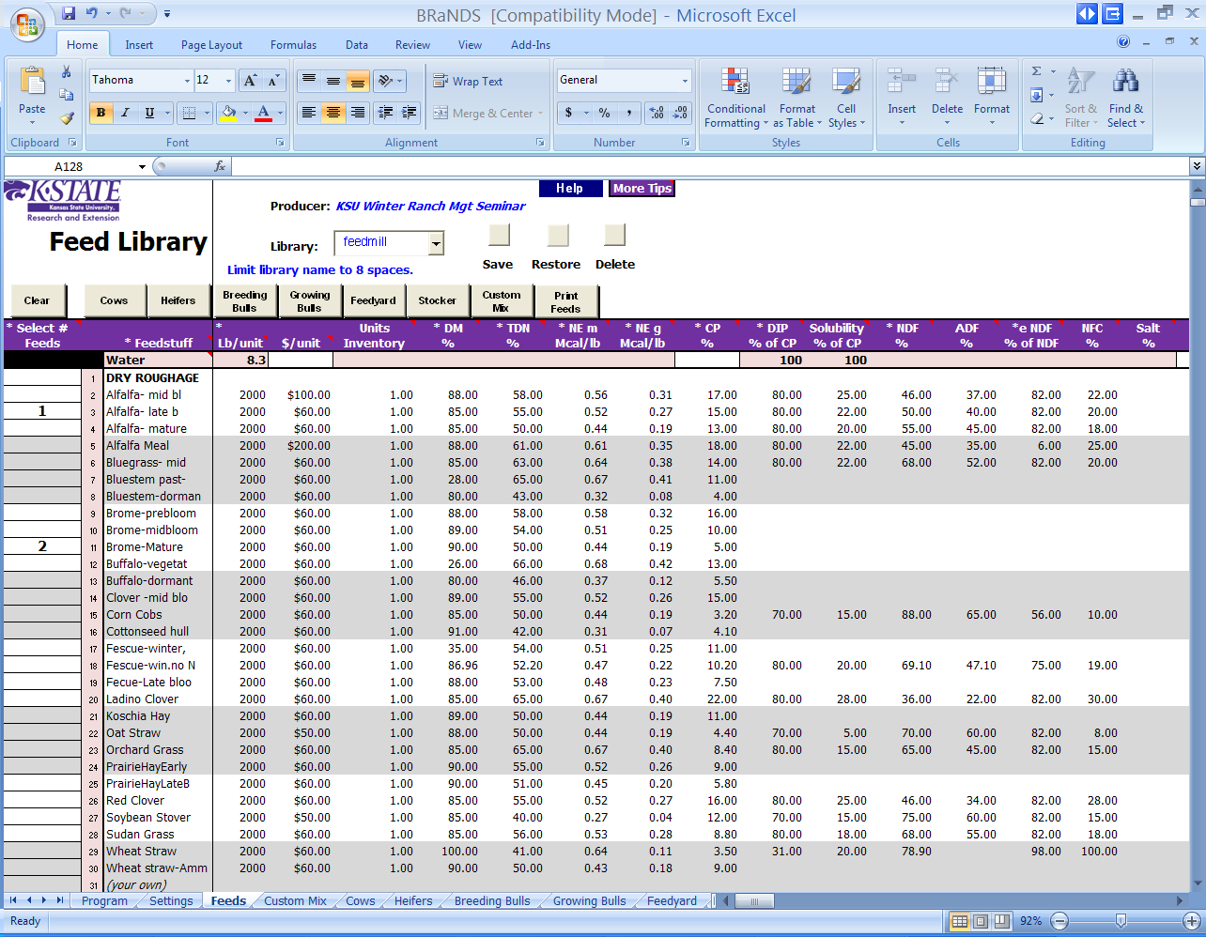

Slide 16


Slide 17


Slide 18
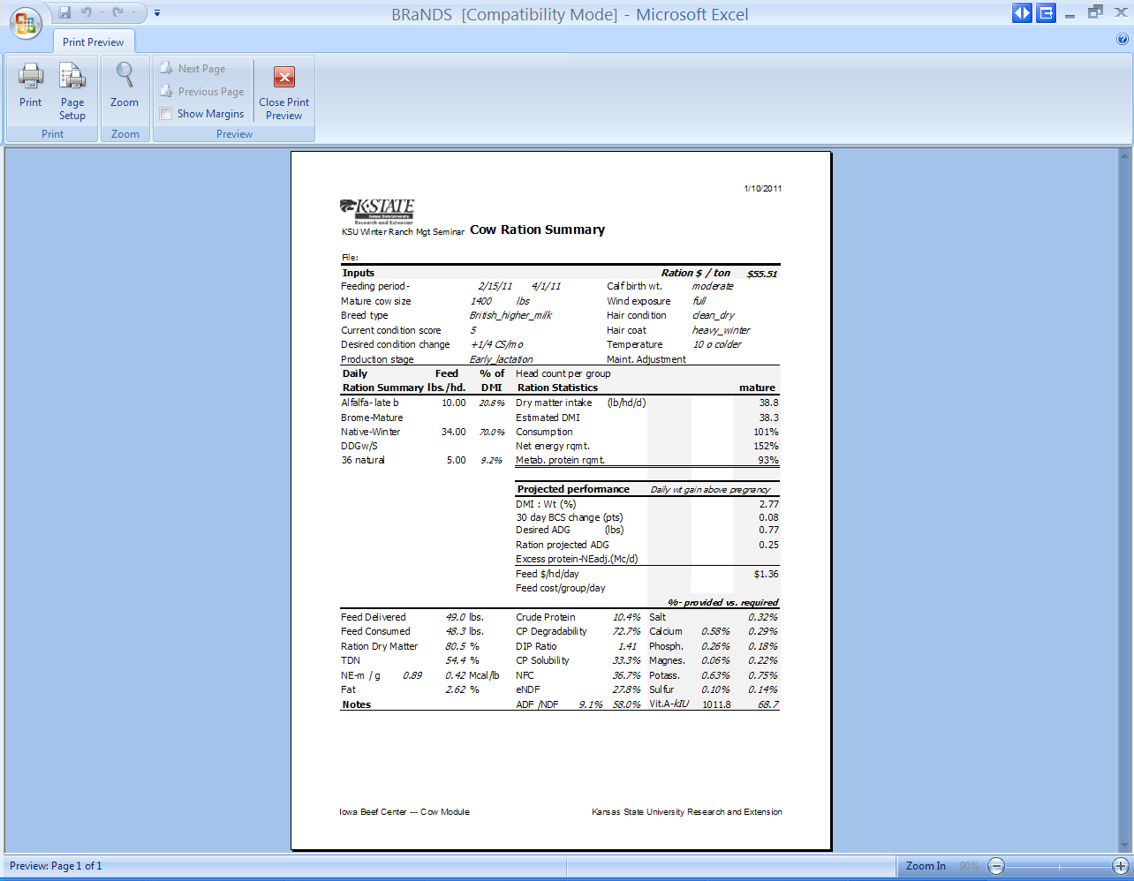

Slide 19
Growing Calves – Rules of Thumb
Keep diet moisture to not less than 20 – 25%
    Diet moisture not more than 50 - 55%
1 lb. of grain / 100 Body Weight = @ 2 lb ADG
A typical growing ration would consist of:
  1/3 roughage
    Watch alfalfa levels – degree of grind
  1/3 byproduct – Distillers grain/corn gluten feed
  1/3 Energy (corn / sorghum)

Slide 20
Calves on grass

Slide 21
Crude Protein of Native Range
Montgomery et al. (2002)

Slide 22
ADF of Native Range
Montgomery et al. (2002)

Slide 23
Minimum Crude Protein to Support a 2.0 lb ADG
Montgomery et al. (2002)

Slide 24
Net Energy of Native Range Calculated from ADF
%TDN = 88.9 - (0.779 x ADF)
ME (Mcal/kg) = (TDN% × 0.044) × 0.82
NEm (Mcal/lb) = (1.37 × ME) – (.138 × ME²) + (.0105 × ME³) – 1.12 / 2.204
NEg (Mcal/lb) = (1.42 × ME) – (.174 × ME²) + (.0122 × ME³) – 1.65 / 2.204
NRC (1996)

Slide 25
Maximum ADF to support a 2.0 lb ADG
Montgomery et al. (2002)

Slide 26
Predicted ADG based on ADF
Montgomery et al. (2002)

Slide 27

Ionophores – Mode of Action
An ionophore is a compound that makes cations lipid soluble thereby disrupting the homeostatic mechanisms responsible for maintaining intra- and extracellular ion concentrations across the cell membrane of ruminal microbe cells.
Specifically, ionophores disrupt the exchange of cations (K+ Na+ H+ Ca 2+ and Mg 2+). By doing so, bacteria that are unable to dispose of their protons by other means consequently decline in numbers.

Slide 28
Effects of Rumensin on VFA Percentages in Fistulated Cattle on Pasture (Molar Percent in Rumen)¹
Acetic
Propionic
Butyric
67
63
28
60
22
10
11
21
9
0 mg 50 mg 200 mg
Monensin
0 mg 50 mg 200 mg
Monensin
0 mg 50 mg 200 mg
Monensin
¹Richardson et al., 1976. J. Anim. Sci. 43:657.

Slide 29
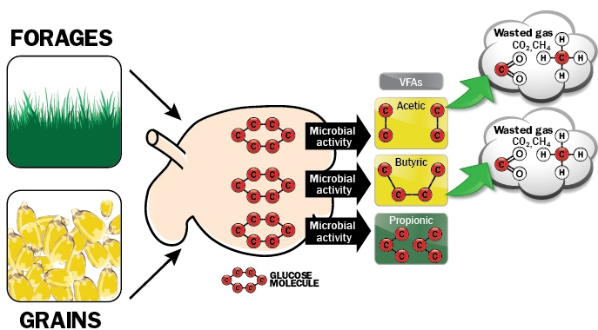
Carbohydrate Digestion by Rumen Microbes
& VFA Efficiency¹
¹Adapted from Nagaraja, T. G., C. J. Newbold, C. J. Van Nevel & D. I. Meyer. 1997. Manipulation of Rumen Fermentation. The Rumen Microbial Ecosystem, 2nd edition. Ed: Hobson & Stewart. pp. 538-547.
Notes:
Ruminal bacteria convert simple sugar (glucose) to VFAs. This diagram shows a ruminal bacteria converting a 6 C glucose ring to one of 3 VFAs, acetic, butyric, & propionic acid. In reality it is very unlikely a single specie of ruminal bacteria would not convert sugars to all all 3 VFAs so this model is for illustrative purposes only. When a bacteria (primarily G+) convert a 6 carbon sugar molecule to acetic acid, 2 molecules of acetic acid with 2 C each are produced with 2 additional carbon that are lost as by products of carbon dioxide &/or methane. When a G + rumen bacteria converts a 6 carbon sugar molecule of glucose to butyric acid, 1 molecules of butyric with 4 C is produced but again 2 additional carbons are lost as by products of carbon dioxide &/or methane. When a ruminal bacteria (primarily G-) converts the molecule of glucose to propionic acid 2 molecules of propionic acid (3 C each) are produced & there is no Cs lost as by products of CO₂ &/or CH₄ thus the improved efficiency in propionate production.

Slide 30
Oklahoma Wheat Pasture Rumensin Mineral Studies
4-Year Summary
Control
ADG, lbs
Rumensin
Improvement
lbs/hd/d (%)
OSL
Horn 1999–2000¹
1.33
1.63
0.30 (23%)
0.04
Horn 2000–2001¹
2.55
2.70
0.15 (6%)
0.03
Fieser 2004–2005²
1.21
1.58
0.37 (31%)
0.03
Fieser 2005–2006²
2.40
2.53
0.13 (5%)
0.35
4-Year Summary²
1.80
2.02
0.22 (12%)
0.01
¹Horn, G., C. Gibson, J. Kountz & C. Lundsford. 2001. Two-Year Summary: Effect of Mineral Supplementation With or Without Ionophores on Growth Performance of Wheat Pasture Stocker Cattle. Proceedings from the Wheatland Stocker Conference. pp. A1-A19. (Elanco Trial Nos. T1FB50002 & T1FB50102).
²Fieser, B. G., G. W. Horn & J. T. Edwards. 2007. Effects of energy, mineral supplementation, or both, in combination with monensin on performance of steers grazing winter wheat pasture. J. Anim. Sci. 85:3470-3480.

Slide 31
Rumensin for Mature Beef Cows
Only ionophore approved for use in mature, reproducing beef cows
Improves feed efficiency, which helps maximize profitability
Maintains body condition on 5% to 10% less feed
Notes:
Rumensin improves feed efficiency & helps you maximize profitability because your beef cows can maintain their body condition on 5% to 10% less feed
Rumensin kills coccidia parasites at three different stages in the life cycle^{1,2} instead of merely arresting their development
¹McDougald, LR. 1980. Chemotherapy of Coccidiosis. PL Long (ed.). The Biology of the Coccidia. University Park Press, Baltimore. pp. 373-427.
²Long, PL & TK Jeffers. 1982. Studies on the Stage of Action of Ionophorous Antibiotics Against Eimeria. J Parasitology 68(3): pp. 363-371.

Slide 32
Four-trial dose titration, summary of cow weight change and feed intake data
 | Rumensin, mg/hd/d
Item | 0 | 50 | 200
Number of cows | 108 | 99 | 109
Initial wt, lbs | 1,063 | 1,050 | 1,049
Final cow wt, lbs | 1,016 | 1,006 | 1,010
Wt. change, lbs | -47 | -44 | -39
Feed intake (lbs DM/day/exp unit)
0-171 days | 164.2ª | 155.7^{b} | 146.4^{b}
Percent of control | 100 | 94.8 | 89.2
Avg days on study at calving | 124 | 123 | 125
Days from calving to conception | 93^{c} | 87^{d} | 87^{d}
Number of cows bred | 99 | 93 | 100
Number of cows conceived | 90 | 86 | 97
Percent conception | 90.9 | 92.5 | 97.0
^{a,b} Means within a row with different superscripts differ by (P<0.01). ^{c,d} Means within a row with different superscripts differ by (P<0.01).

Slide 33
Rumensin Levels Based on Forage Quality
Forage Quality | TDN Value | NEm Content | NEg Content | Rumensin mg/hd/day
Poor | 40 -42% | .28 - .31 | .04 - .07 | 50
Medium | 43 – 48% | .33 - 41 | .08 -.16 | 100
High | 49% or greater | > .41 | > .18 | 150 - 200

Slide 34
Effects of Monensin on Beef Cow Performance, Oklahoma State University Study
 | Supplement¹
Item | CONT | MON | SEM² | P-value³
No. | 28 | 28
Initial BW, lbs | 1082 | 1090 | 21 | 0.79
Initial BCS | 5.15 | 5.21 | 0.10 | 0.70
Final BW, lbs | 1117 | 1153 | 23 | 0.28
Final BCS | 5.28 | 5.81 | 0.14 | 0.01
Change in BW | 35.4 | 65.1 | 10.1 | 0.04
Change in BCS | 0.13 | 0.57 | 0.12 | 0.01
ADG, lbs/day | .62 | 1.12 | .18 | 0.04
¹ CONT = 36% CP cottonseed meal based pellet with 0 mg/hd of monensin; MON = 36% CP cottonseed meal based pellet with 200 mg/head of monensin. ² SEM of the Least squares means. ³ Observed significance levels for main effects.

Slide 35
Ionophore Toxicity Symptoms
Lethargy
Cyanosis
Depression
Pulmonary edema
Myocardial degeneration
Death ….
  Especially pronounced in horses, where monensin has an LD50 1/100th that of ruminants

Slide 36
Summary
Ionophores are an effective tool for:
  Improved feed efficiency
  Improved rate of gain in stockers
  Slight improvement in ADG in feedlot cattle
  Decreased feed intake (which may enhance the carrying capacity of cattle on a given quantity of forage)
  A potential protein sparing effect
  Increased digestibility of low quality forages
  Some reduction in the incidence of coccidiosis
  A decrease in the incidence of lactic acidosis
  Some reduction in the incidence of feedlot bloat
  Partial intake regulation in self feeding supplement systems
  Some reduction in the incidence of pulmonary emphysema

Slide 37
Questions?
Dale A. Blasi dblasi@ksu.edu

