Slide 1
Growth Promotion Technology in Beef Cattle

Slide 2
What’s all the fuss?
Implants contain hormones
Hormones may contribute to cancer
…then do implants have anything to do with cancer?

Slide 3
Is Implanted Beef Safe?
3 oz serving of unimplanted beef = 1.3 ng estrogen
3 oz serving of implanted beef = 1.9 ng estrogen

Slide 4
What’s a Nanogram?
Nanogram per gram = 1 part per billion (ppb)
~1 blade of grass in a football field

Slide 5
Other Foods
3 ounces:
Unimplanted Beef 1.3 ng
Beef 1.9 ng
Milk 11 ng
Potatoes 225 ng
Peas 340 ng
Ice Cream 520 ng
Wheat Germ 3,400 ng

Slide 6
Hormones
Found in ALL animals and plants
Naturally-occurring
Growth regulators
Essential for life

Slide 7
Normal Human Estrogen Production
Pre-pubertal male 41,500 ng
Pre-pubertal female 54,000 ng
Adult male 136,000 ng
Adult female 480,000 ng
…remember…
3 oz beef 1.9 ng

Slide 8
Normal Human Estrogen Production
Pre-pubertal male 41,500 ng
Pre-pubertal female 54,000 ng
Adult male 136,000 ng
Adult female 480,000 ng
Pregnant female 3,415,000 ng
Birth control pill 35,000 ng

Slide 9
Additive Effect
Pre-pubertal male child 41,500 ng
3 oz implanted beef 1.9 ng
Total 41,501.9 ng

Slide 10
Implication of Implants
If we stopped using Implants:
  A serving of beef would not contain less hormones.
Implants reduce the cost of beef production by ~10%.
  900 lbs × $1.30 /lb = $1,170
  $1,170 × 10% = $117
    That $117 would eventually come from Every cow/calf producer in the U.S.

Slide 11
Implication of Implants
If we stopped using Implants:
  A serving of beef would not contain less hormones.
Ranchers would take $117/head less for their calves
  $117 / 5 cwts = $23 / cwt
  ~9% price reduction

Slide 12
So what’s it REALLY about?...
Is it about hormones?
  We’ll never eliminate hormones
    In our food or in our bodies

Slide 13
Implant Approvals
Ages/Production Segments:
Calves
Stockers
Feedlot cattle
Sex:
Steers
Heifers
Cull cows
Not Bulls!

Slide 14
Types of Implants
Estrogenic
  Estradiol 17-β
  Estradiol benzoate
  Zeranol
Androgenic
  Testosterone
  Trenbolone acetate (TBA)
Combination implants

Slide 15
Planning the Program:
Most combination feedlot implants last up to ~140 days

Slide 16
Planning the Program:
Weaned calf (240 days from slaughter):
  1. Low potency implant during backgrounding
  2. Medium potency implant upon feedlot arrival
  3. High potency implant ~100 days before slaughter
Backgrounded calf (180 days from slaughter):
  Medium upon arrival
  High ~100 days before slaughter
Long yearling (90-140 days from slaughter):
  High potency implant upon arrival

Slide 17
Conventional Implant Technology – Sustained release implants
Conventional Implants
Ralgro, Synovex, Revalor, and Component
Sustained release E2-TBA implant
  90-140 days
Requires a re-implant after payout
  For >140 day cattle

Slide 18
“Life” of an implant…

Slide 19
“Life” of an implant…

Slide 20
Sustained release Implant
Revalor-XS
Sustained release E2-TBA implant
  200+ days
Like Revalor-IS (medium) w/ Revalor-S (high) reimplant on d 70
Revalor-S is coated with a soluble polymer, dissolves ~d 70

Slide 21
Benefits of Implants
Estrogenic
  ADG = ~10%
  Feed Efficiency = ~10%
Combination with Androgenic (TBA)
  ~15% Feed Efficiency
  ~15% ADG

Slide 22
Implants on Grass
ADG ↑ 10%
  Lbs?
  Depends on base ADG
    2.00 × 10% = 0.20 lb/day
    0.20 × 100 days
    = +20 lbs in 100 days
  20 lbs × $1.20 = $24 / head

Slide 23
Benefits of Implants
Minimum: $10 per $ 1 spent
Typical: $20+ per $1 spent

Slide 24
TBA:E2
Hypothalamus
Anterior pituitary
Liver
IGF binding protein
Satellite cell
Muscle Cells

Slide 25
Picture this…Protein deposition
Implant
Pounds
Implant
Implant
Time

Slide 26
Picture this…Fat deposition
Implant
Implant
Implant

Slide 27
Implant growth curve
kg
Implant date
Non-implanted
Days of Life
= Fat endpoint marketing target

Slide 28
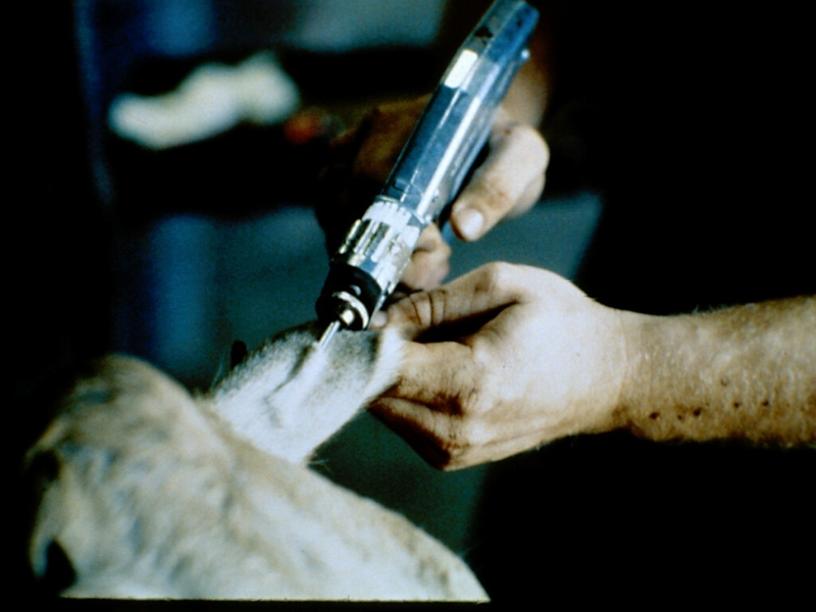
Placement of Implant
Only approved location: Middle third of the back side of the ear
Ear is removed and discarded at time of slaughter, reducing any food supply risk

Slide 29
Return from implants:
Suckling:
  10-30 lbs
Stocker / backgrounding:
  20-30 lbs
Finishing:
  40-150 lbs, depending on days on feed
    Yearlings: 40-50 lbs
    4-500 lb calves: 60-100 lbs
    Calf-fed Holsteins: 100-150 lbs

Slide 30
Take Homes:
Implants use hormones similar / identical to those already in the beef animal
Implants improve lifetime cost efficiency of beef production by ~10%
Implants act using other messenger systems in the body to affect growth

Slide 31
Take Homes:
Coated implants increase the duration of release of combination E2-TBA implants

Slide 32
Take Homes:
Hormones ARE NOT the issue!
Estrogen content of many other foods is many times higher than beef
But that’s not a problem either. Your body produces several hundred thousand or MILLION times as much every day!
The Issue is:
  Beware of Who is on the sending end of the message and always question motivations.

Slide 33

Thank You

