Slide 1
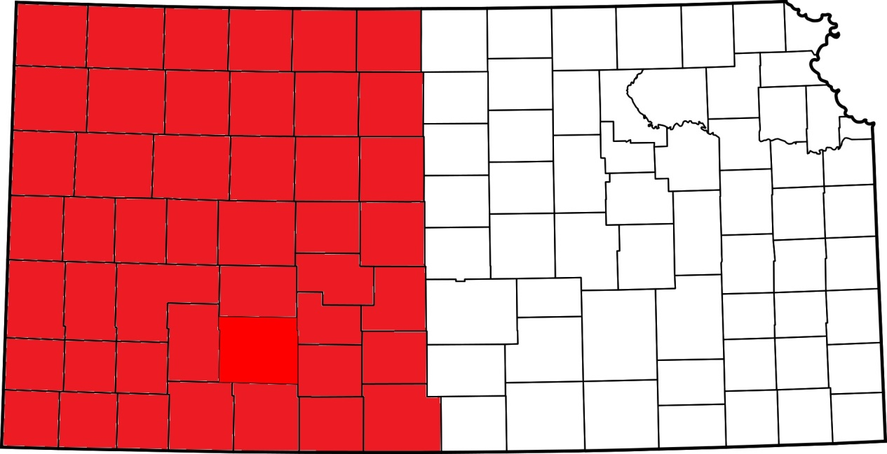
Toxic Plants of Western Kansas
Anthony Zukoff
Southwest Research and Extension Center Entomology

Slide 2
What is a toxic plant?
Death
Abortions
Decreased production
Emaciation
Birth defects
Significant cause of economic loss, impacting
3-5% of cattle grazing in western rangeland
Notes:
So lets start simple, lets define a toxic plant.
These plants are going to be those that when consumed will cause a wide variety of effects ranging from death to, etc….
Combined, these plants do end up being a significant cause of loss in western rangelands.

Slide 3
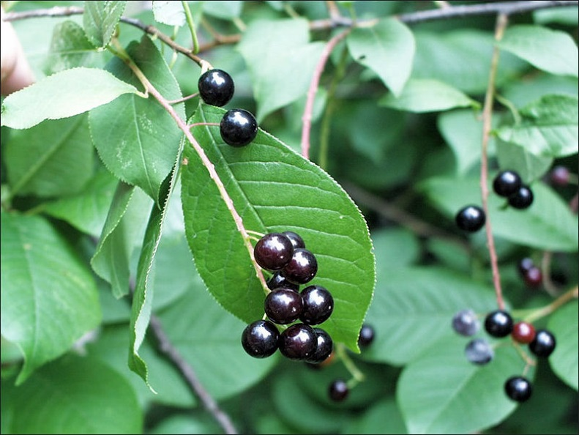
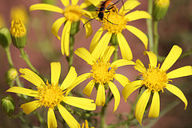
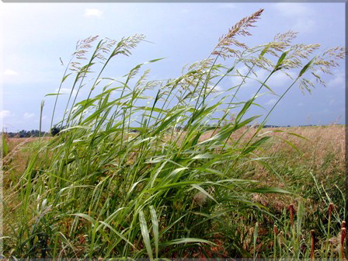
How many are out there?
~ 50 species potentially toxic to cattle in western KS
Notes:
So how many toxic plants do we need to worry about?
In western KS, there are approx 50 species possible in a rangeland setting, of course they all wont always be occuring there at once.
But they include anything from trees, many flowering plants/forbs and even grasses.

Slide 4


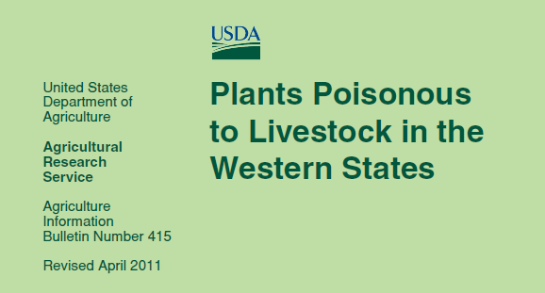
Notes:
We will not be discussing every plant, my goal is to introduce you to a couple of groups in particular I want to help you get familiar with as they are usually more talked about/more maligned plants that do have a potential for sig. loses. Under certain conditions. Bring up boxes for milkweeds locos/vetches.
And I am going to cover several that can be much more abundant/common and/or dangerously unique to hopefully give you an idea of how varied and even surprisingly common some toxic plants can be in the landscape.
So we’ll touch on nitrate accumulators, selenium accum. And a few others as time permits?
milkweeds
locoweeds
various others

Slide 5
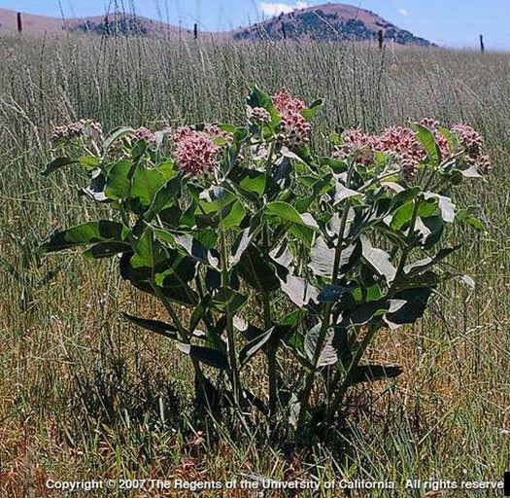
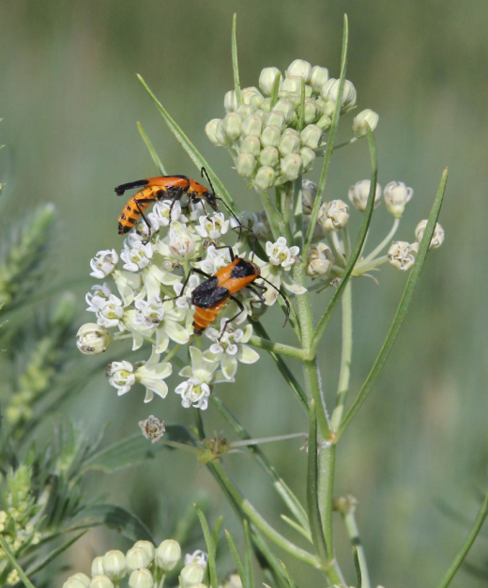
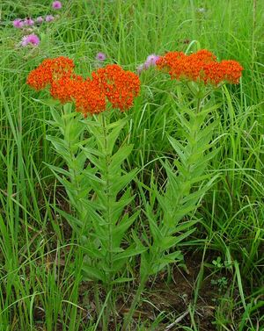
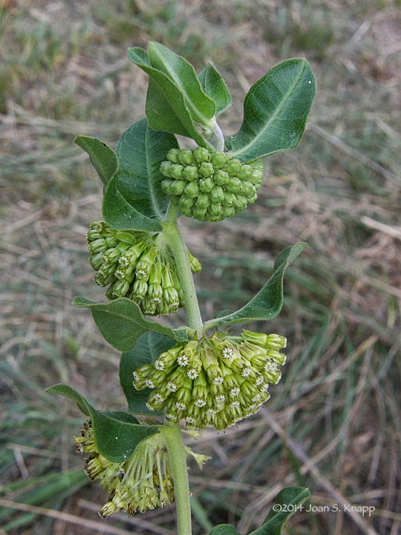
Milkweeds 15 species
One of the more maligned groups of toxic plants
SOME aggressively weedy
SOME highly toxic
ALL low forage value, low palatability
Very noticeable in landscape
Notes:
Being a plant nerd, Milkweeds are one of my favorite groups. They are really variable and unique plants and important for a variety of ento reasons but I’ve
Learned since being here a few seasons sometimes you don’t want to mention the “m word” around certain folks. Milkweeds can potentially be extremely toxic and
have definitely caused losses throughout the west. Some can be very aggressively weedy and easily noticed in the landscape. It is worthwhile to note that milkweeds in general
Are not considered to be very palatable and cattle tend to avoid their very bitter tasting foliage in most settings.
However, poisonings do occur….
Pics of flowers/pollinators? Big patches of milkweed?

Slide 6
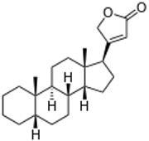
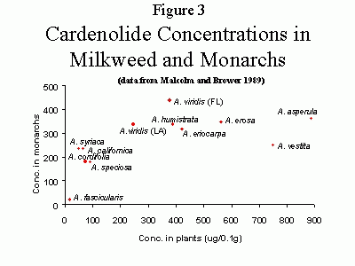
Milkweeds Toxicity
What makes milkweed toxic?
Cardenolides
• Difficulty in breathing
• Dilation of pupils
• Rapid, weak pulse
• Loss of muscular control
• Elevated temperature
• Violent spasms
• Bloating
• Respiratory paralysis
• Congestion of visceral organs
• Renal tubular necrosis
• Gastroenteritis
• Depression, weakness, staggering
< 1 %
Notes:
So how exactly is milkweed toxic to livestock?
MW plant material contains complex compounds known as cardenolides that when consumed result in a variety of symptoms
And if enough plant material is consumed, or even a small amount for the very toxic species, death results. PIC OF CARDENOLIDE?
Depression, weakness, and
staggered gait
• Difficulty in breathing with
expiratory “grunting” sounds
• Dilation of pupils
• Rapid, weak pulse
• Loss of muscular control
• Elevated temperature
• Violent spasms
• Bloating
• Respiratory paralysis
• Congestion of visceral organs
• Renal tubular degradation and
necrosis
• Gastroenteritis

Slide 7
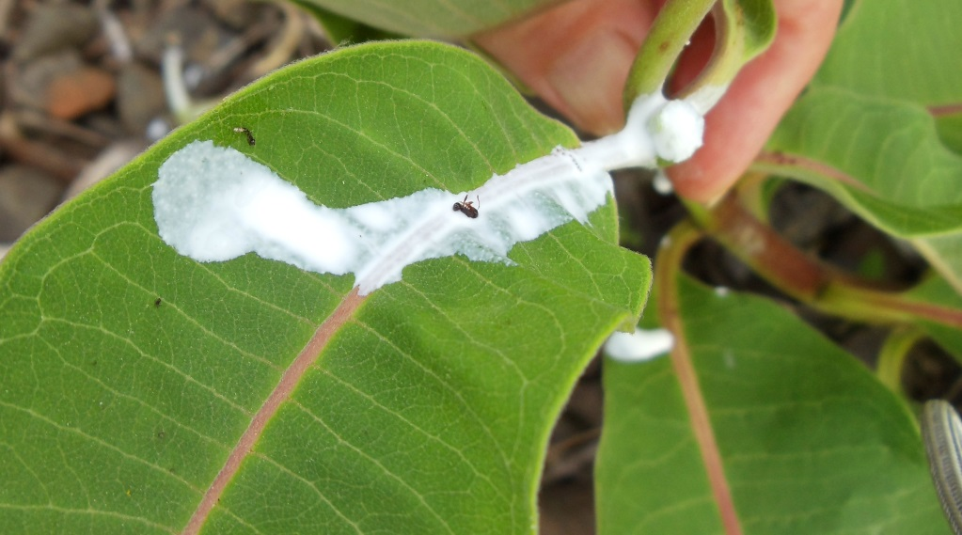
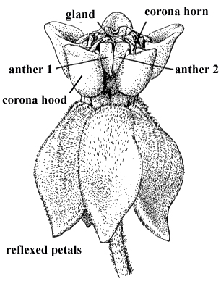
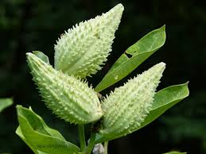
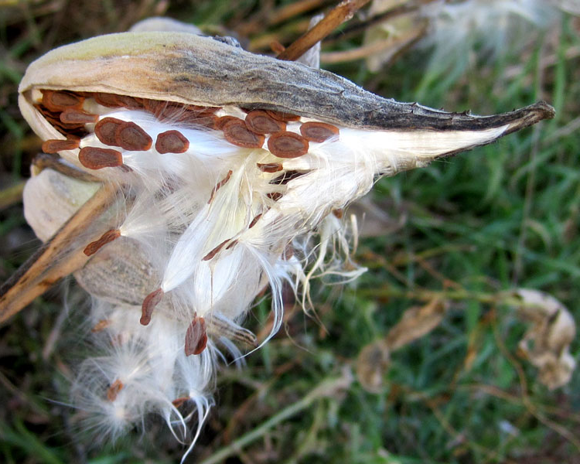
Milkweeds Identification
Notes:
There are a few easy characters to learn that will make noticing a milkweed easy. Leaf shape, arrangment and plant habit are all quite variable, but all milkweeds have
Milky sap
Distinct flower structure
And Produce a succulent pod that dries down and releases clouds of fluffy seeds.

Slide 8
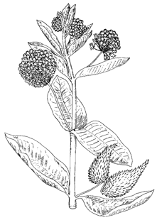
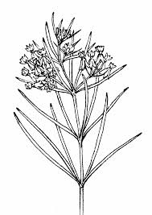
Milkweeds Species of Concern
Narrowleaf
Asclepias subverticillata
Asc. pumila
Asc. engelmaniana
Asc. stenophylla
Broadleaf
Asclepias speciosa
Asc. syriaca
Asc. latifolia
Notes:
Of the 15 species occurring in W ks, 5 are very rare or sporadic and many others simply occur in low numbers infrequently through the landscape and/or in hard to reach areas.
So that leaves us with 6 species of concern.
And an easy way to break these 6 into groups is to simply compare the broad-leaf species to the narrow leaf species. I will highlight these and then we’ll discuss a couple in more detail.
And out of these, I would really like to highlight just a couple one for reasons of high toxicity and another for reasons of abundance.

Slide 9
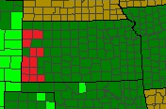
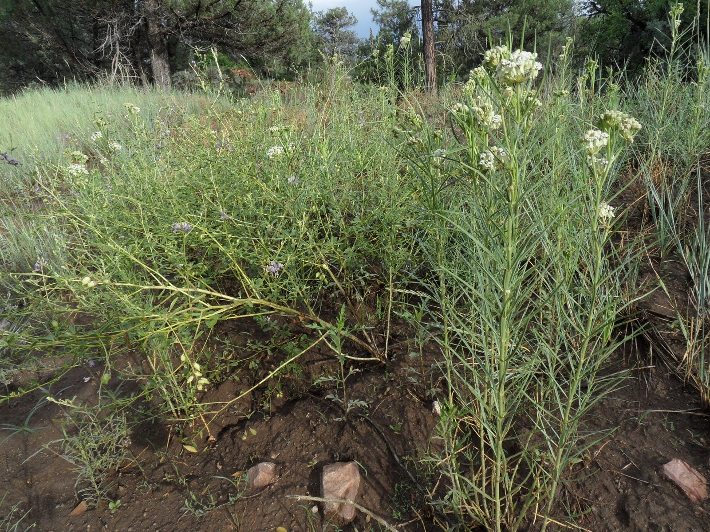
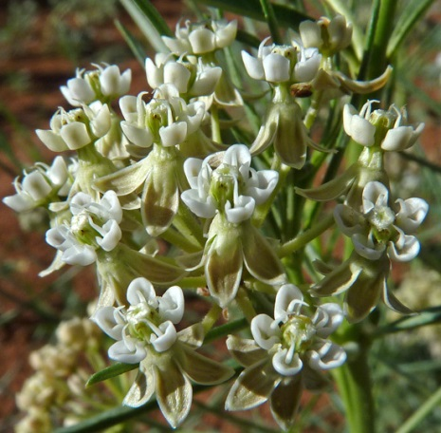
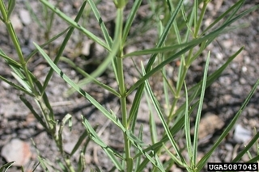
Horsetail Milkweed
Asclepias subverticillata
15 in. up to 4 ft.
Very narrow, almost whorled leaf arrangement
White blooms early to late summer
Vegetation appears mid-late spring
Key Concerns:
Most toxic species in Kansas
Performs well on poor quality sites
Forms “colonies” via spreading root system
Easily mistaken for grass
Notes:
Asclepias subverticillata
I wanted to discuss this species in particular for the main reason that it is considered one of the most toxic species of milkweed in western rangelands
In KS, the most toxic.
As you can see it is restricted to very far western KS, but where it occurs it has the potential to become very abundant
Because it can do well on disturbed, poor quality sites
It can form colonies due to the spreading nature of its root system

Slide 10
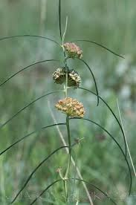
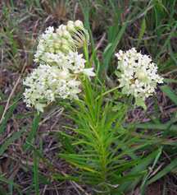
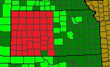
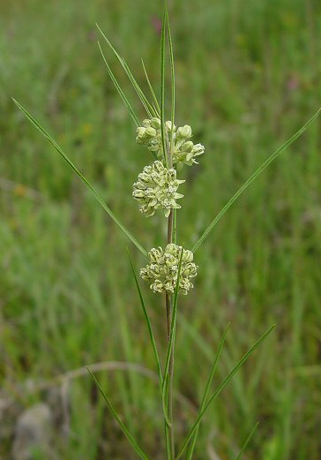
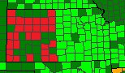
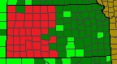
Other Narrow-leaf Milkweeds
Dwarf Milkweed
Plains
Milkweed
Engelmann’s
Milkweed

Slide 11
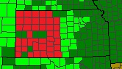
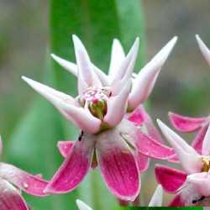
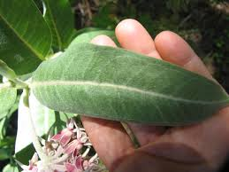
Showy Milkweed
Asclepias speciosa
2-4 ft.
Broad leaves
Pinkish blooms early to late summer
Vegetation appears late spring
Key Concerns:
Relatively low toxicity, BUT
Performs well on poor quality sites
Grows vigorously, colony forming
Notes:
Asclepias subverticillata
I wanted to discuss this species in particular for the main reason that it is considered one of the most toxic species of milkweed in western rangelands
In KS, the most toxic.
As you can see it is restricted to very far western KS, but where it occurs it has the potential to become very abundant
Because it can do well on disturbed, poor quality sites
It can form colonies due to the spreading nature of its root system

Slide 12
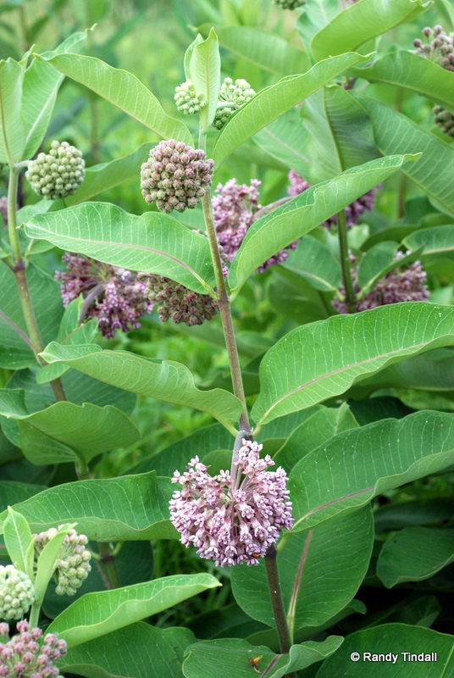
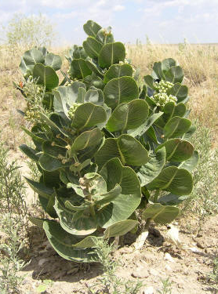
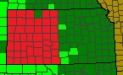
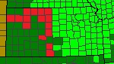
Other Broad-leaf Milkweeds
Common Milkweed
Broadleaf Milkweed

Slide 13
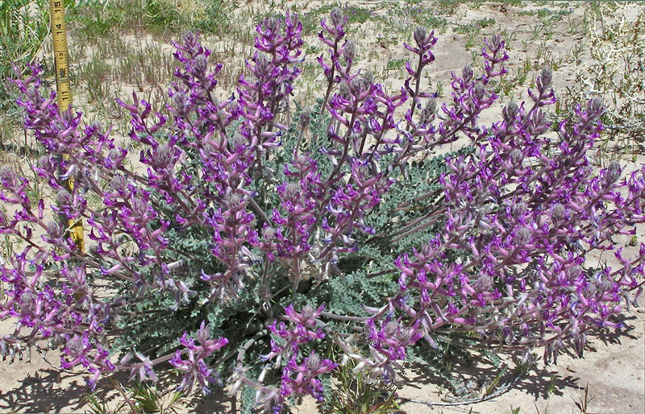
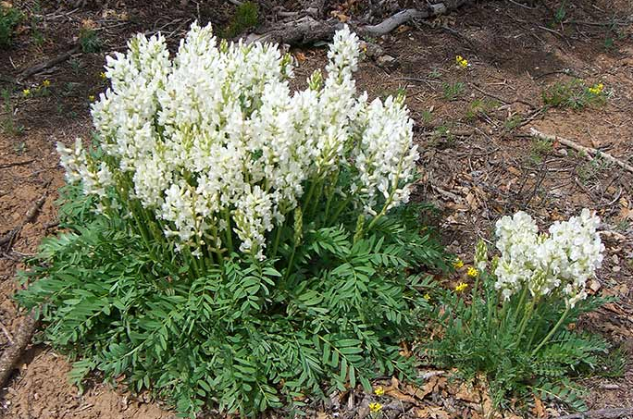
Locoweeds 15 species
Notorious for dramatic effects on livestock
Present in late fall/early spring
Relatively more palatable than other forage during certain times of the season
ALL cause “locoism”; never completely recover
Notes:
The second most notable group of toxic plants includes the “locoweeds”, particularly notorious for the dramatic effects on grazing livestock
Several characteristics make them of particular concern:

Slide 14
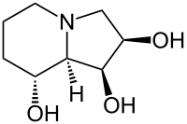
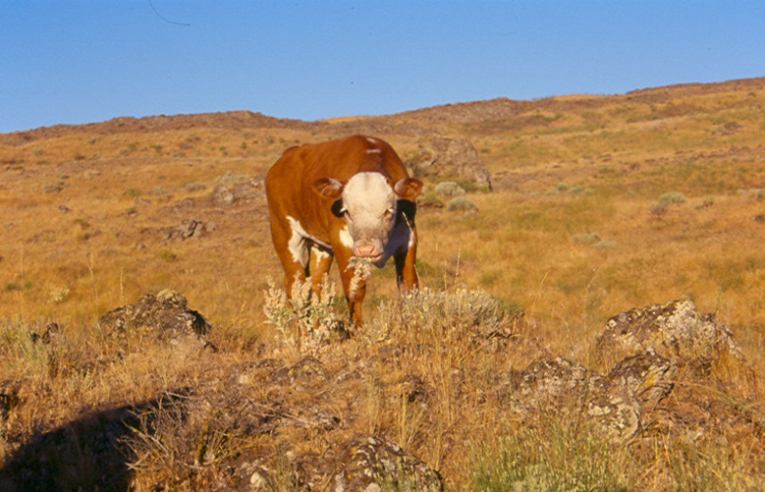
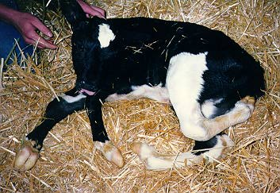
Locoweeds Toxicity
What makes locoweed toxic?
Swainsonine
Neurological damage
Emaciation
Birth Defects/Abortion
Congestive Heart Failure
May take 2-3 weeks of grazing before symptoms appear
No treatments available
Toxin excreted in milk, so calves can be poisoned
Notes:
Swainsonine makes loco toxic.
Particularly nasty because:
May take 2-3 weeks of grazing before symptoms appear
No treatments available for poisoned animals
Causes neurological damage
Emaciation
Birth defects/abortions
Congestive heart failure
Toxin excreted in milk, so calves can be poisoned.

Slide 15
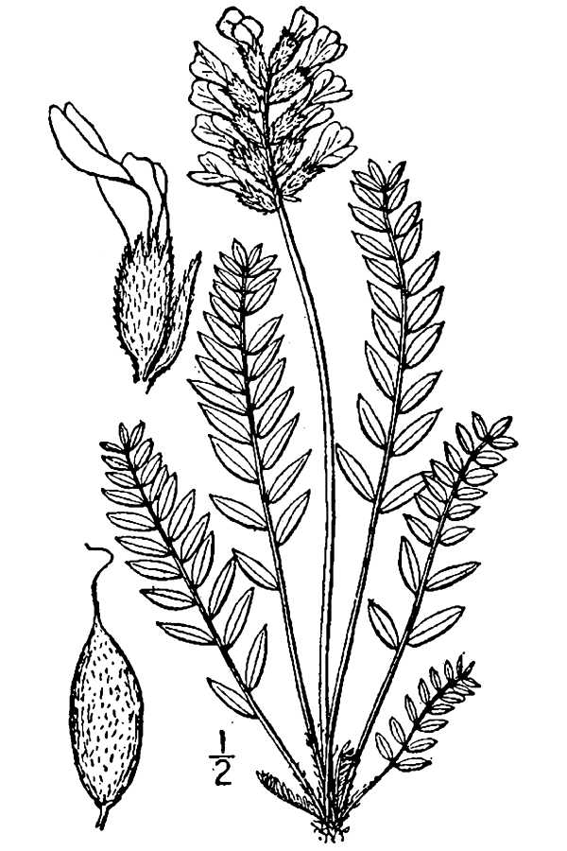
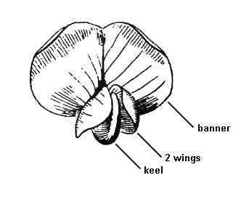
Locoweeds Identification
Compound leaves
Distinct “pea” flower structure
Pod-forming
Notes:
Many characteristics of individual species will vary but there are a few distinct characters that will help you know if you are looking at a potential locoweed.
All members of the family have compound leaves, a 3 parted flower structure and form pods.

Slide 16
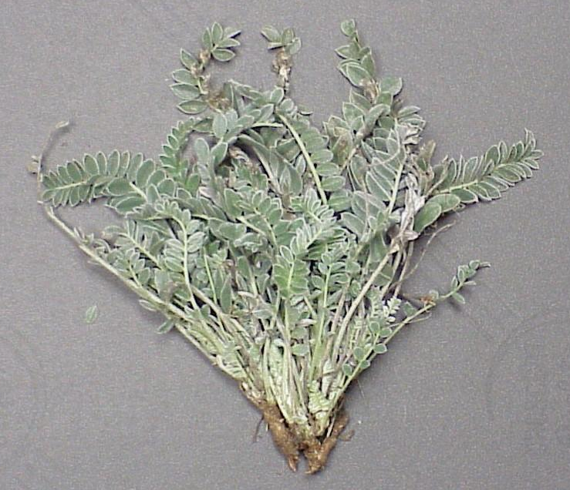
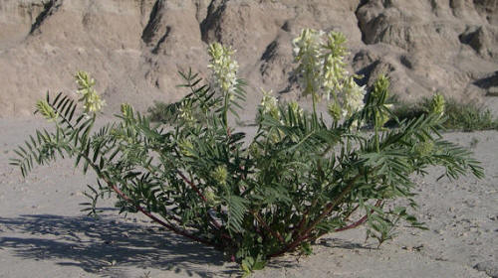
Locoweeds Species of Concern
“True Locos”
Astragalus mollisimus
Ast. missouriensis
Oxytropis lambertii
Oxy. sericea
Milkvetch
Astragauls pectinatus
Ast. racemosus
Selenium Accumulators
Notes:
Of the 15 species of loco or milkvetch occuring in west ks, only 6 are toxic and only 4 of those are “true locos” containing swainsonine
The remaining 2 are toxic due to selenium accumulation. Of the true locos, it would be worthwhile to discuss a few. Mo milkvetch ususally very small statured and at least I think likely not as noticeable to cattle.

Slide 17
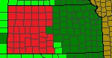
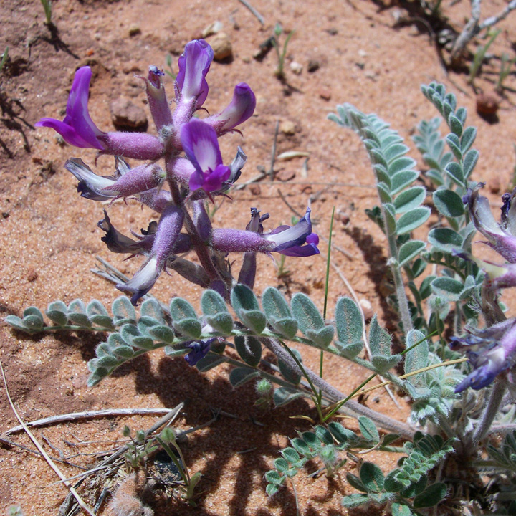
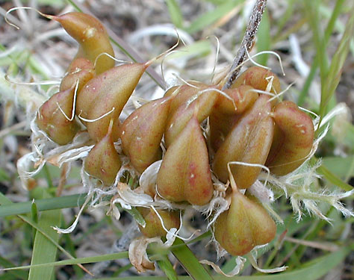
Wooly Loco
Astragalus mollisimus
4-16 inches
Densely fuzzy, compound leaves
Purple blooms early summer
Vegetation early spring, late fall
Key Concerns:
Performs well on poor quality sites
Tends to be abundant
Sprawling nature = ample biomass
Foliage present early and late season

Slide 18
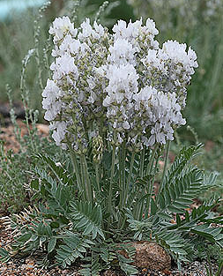
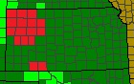
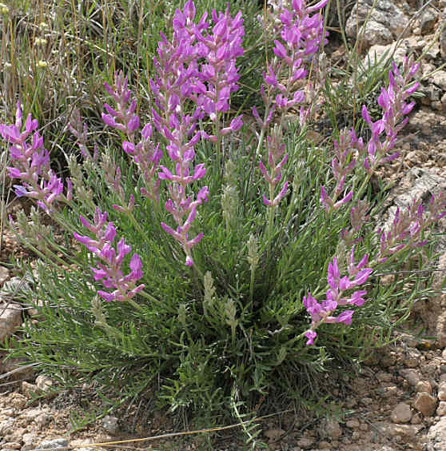
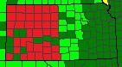
White Loco
Oxytropis sericea
Small-statured locoweed
More upright habit
Pure white flowers
Lambert’s Loco
Oxytropis lambertii
Similar to Wooly Loco
More upright habit
Leaflets narrower

Slide 19
Notes:
Now that we’ve covered a couple of the more known groups of toxic plants, I want to go over a couple more groups and a few indidivuals that are possible here.
While the previous two groups can potentially cause significant losses under certain circumstances, there are quite a few other plants that can be just as problematic in the landscape. Some much more common and abundant than milkweeds and locos.

Slide 20

Nitrate Accumulators
Sublethal Effects
Lethal Effects
.5% - 1.5%
>1.5%
Unhealthy appearance
Reduced weight gain
Abortion/infertility
Cyanosis
Breathing problems
Staggering gait
Chocolate-brown blood
Death
.05% of an animal’s weight is a lethal dose
Notes:
Many factors influence nitrogen content: plant itself, soil, weather conditions and even herbicide use
Livestock may be poisoned by harvest or nonharvested plant material/feed high in nitrogen
Plants containing more than 1.5 % nitrates by weight can be lethal to livestock
.5 % can cause sublethal effects
Amount of plant material needed to poison varies by plant/concentration but .05% of an animals weight in nitrates is a lethal dose.

Slide 21







Nitrate Accumulators
Who are they?
Many common crops and weeds!
Notes:
Its not necessarily all of the non-forage, naturally occurring plants in a landscape that will be problems for livestock.
Many plants, both crops and weeds, can accumulate dangerous amounts of nitrogen!
These plants and many others can cause poisonings under the right circumstances.

Slide 22


Selenium Accumulators
Regionally widespread group
Mainly forbs
Variable accumulation depending on species
Toxic only on selenium rich soil!
Notes:
Selenium Accumulating plants are quite a varied group and can be locally abundant in certain areas and is comprised mostly of forbs however some common grasses like western wheatgrass are included as well as some cultivated crops like alfalfa
As you can see, this group of plants can be found throughout western KS, but I’ve noticed them most in the NW portion of the state, Scott Co. and up.
Accumulation ability of plants in this group are highly variable, primary vs. secondary accumulators vs nonaccumulators
While these plants can be widespread regionally, they are only toxic if they are growing in areas where the soil is high in selenium.

Slide 23
Selenium Accumulators
Chronic Poisoning
Acute Poisoning
Dullness
Lack of vitality
Emaciation
Overgrown hooves
Loss of long hair
Abnormal posture
Unsteady gait
Diarrhea
Internal hemorrhage
Death
Fine line between amount needed for good nutrition and amount that is toxic
Notes:
So what does selenium do?
Selenium intox can be chronic or acute
It appears the tricky thing about selenium is the fact that there is a fine line between the amount needed for good nut. Vs the amount that can cause toxicity

Slide 24







Selenium Accumulators
Only 5ppm required to be toxic
Non-accumulators
Secondary
Primary
5-12 ppm
>50mm rarely
100’s ppm
1000’s ppm
Notes:
So what are the selenium accumulators?
They can be split into 3 different groups based on accumulation ability.
Non acumm
Secondary-quite a few forbs naturally occurring in western shortgrass prairie/rangeland settings, a few more noticeable forbs include
Primary, aka indicator plants, definite indicators of selenium heavy soil includes some pretty noticeable forbs including princes plume and the two astragalus species we discussed earlier
So as you can see this group is very diverse and potentially very problematic, and as opposed to the nitrate accum, this group includes a lot more classic prairie-land forbs as opposed to aggressive weeds found in an ag setting.

Slide 25


But wait, there's more!
Tansy Mustard
Cocklebur
Toxic as seedlings
Blindness, tongue paralysis
Notes:
So those are four pretty sig groups of plants when it comes to toxic plants in our region, but there are quite a few others that do not fit neatly into a group per se.
Without getting to detailed about how they are toxic I just want to quickly go over a handful of additional species, some toxic all the time, some only under certain conditions.
Some might be surprising.

Slide 26


But wait, there's more!
Sweet Clovers
Nightshades
Severe hemorrhagic disease caused by mold
Nervous system effects, paralysis
Notes:
So those are four pretty sig groups of plants when it comes to toxic plants in our region, but there are quite a few others that do not fit neatly into a group per se.
Without getting to detailed about how they are toxic I just want to quickly go over a handful of additional species, some toxic all the time, some only under certain conditions.
Some might be surprising.

Slide 27



But wait, there's more!
Chokecherry
Larkspur
Respiratory failure, death
Paralysis, respiratory/heart failure
Notes:
So those are four pretty sig groups of plants when it comes to toxic plants in our region, but there are quite a few others that do not fit neatly into a group per se.
Without getting to detailed about how they are toxic I just want to quickly go over a handful of additional species, some toxic all the time, some only under certain conditions.
Some might be surprising.

Slide 28


But wait, there's more!
Ponderosa Pine
Shinnery Oak
Causes abortions w/in 48 hours
50-75% of diet can cause sickness - death

Slide 29


Remember…
With such a wide variety of toxic plants, important to take the entire landscape into consideration
Info not meant to demonize certain groups of plants; quite a few play important roles in healthy ecosystem functioning!
Notes:
Hopefully this gives you an idea of how diverse the toxic plant scene is in western kansas rangeland. Important to consider the entire landscape when investigating a loss as it might not always be the most obvious culprit all of the time.

Slide 30



Resources

