Slide 1
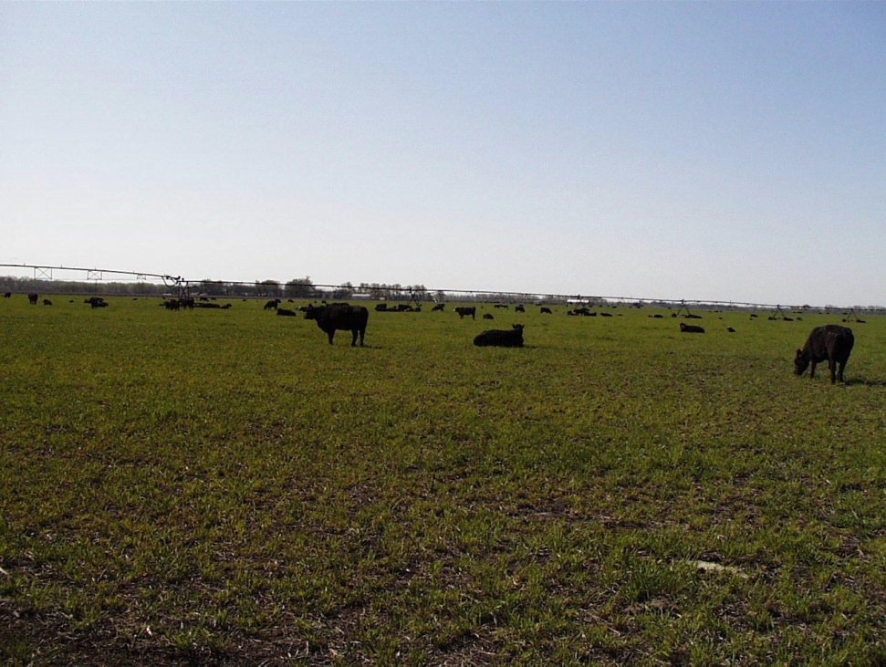
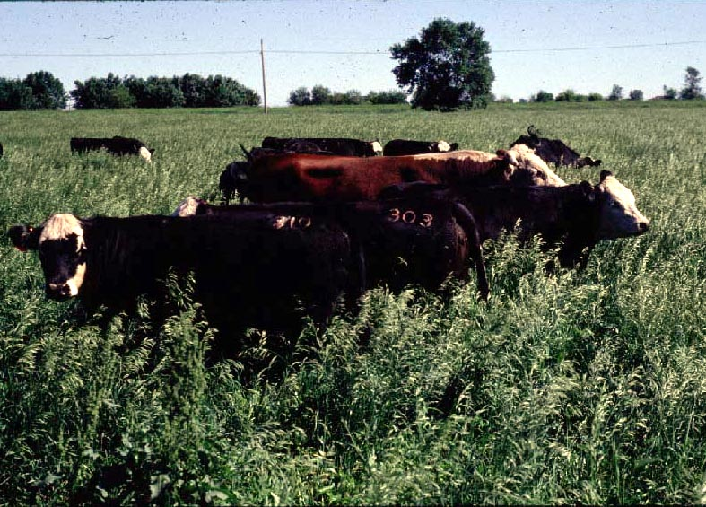
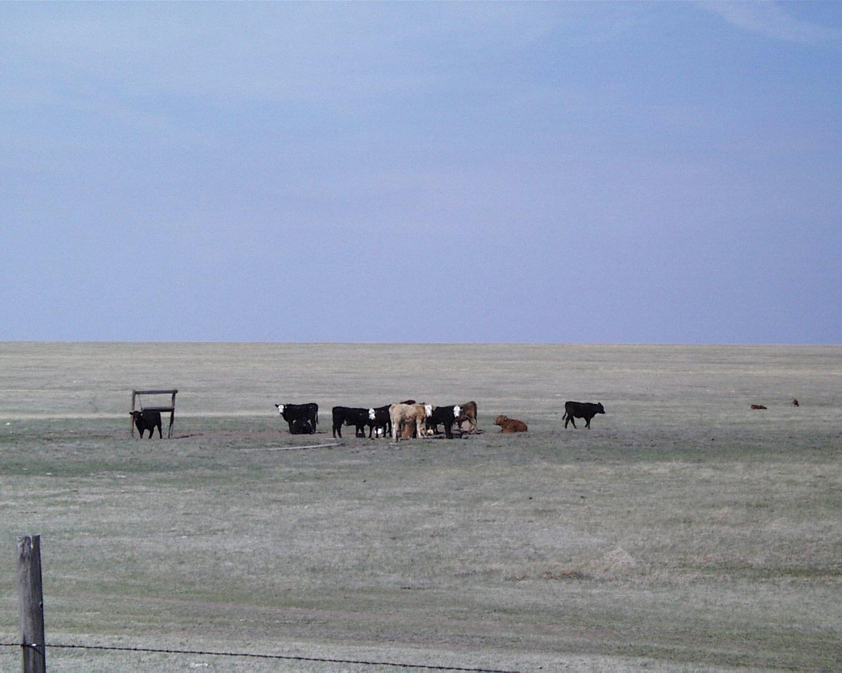
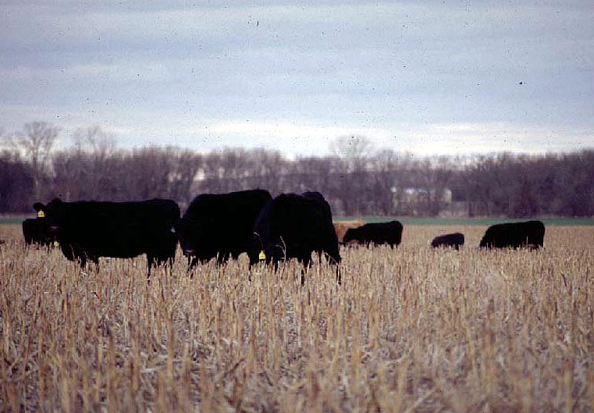

Slide 2
The Environment: Its impact on forage quality and grazing performance
Animal Science Extension Agent Update
Eastern Kansas
Dale A. Blasi
11/10/2015

Slide 3
Forage plants are the product of their environment
Soil
Weather
Animals
Disease

Slide 4
Growth vs. Quality
Digestibility
Lignin/Fiber
Nutrient
Content
Spring
Summer
Fall

Slide 6
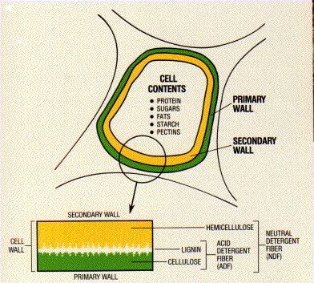
The Van Soest Hotel Theory

Slide 7
Nutrient Availability of Forage Components (Van Soest, 1983)
Forage Fraction
Component
Nutrient Availability
Cell Contents
Soluble sugars
Complete
Pectin
Complete
Soluble Protein
High
Lipids
High
Cell Wall Elements
Hemicellulose
Partial
Cellulose
Partial
Lignin
Indigestible
Silica
Indigestible

Slide 8
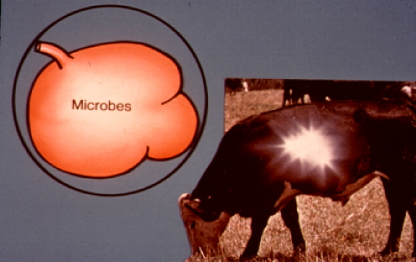

Slide 9
Forage Dry Matter Intake
Function of:
Fermentation rate
Rate of particle size reduction
Rate of particle passage rate

Slide 10
Forage Quality and Cattle Intake
Dry Matter Intake
Forage Quality (% of body weight)
High 2.5 to 3.0%
Medium 2.0%
Poor 1.0 to 1.5%

Slide 11
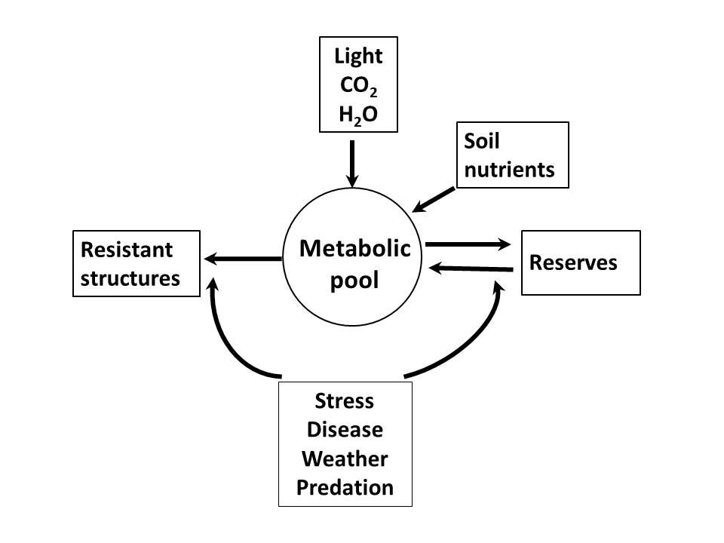
Relationship of environmental factors to plant metabolic components

Slide 12
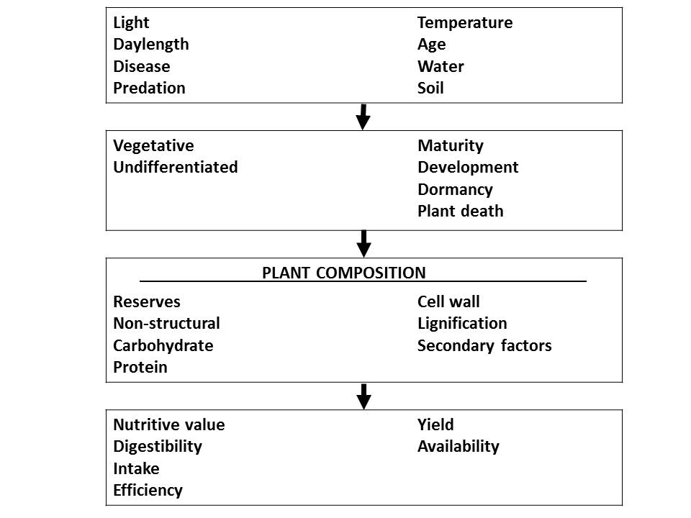
The sequence of cause-effect relationships between environmental factors and nutritive value
Positive Negative

Slide 13
Factors that accelerate the maturation process
Temperature
Light
Water

Slide 14
Factors that minimize maturation process
Clipping
Grazing
Disease

Slide 15
Temperature and forage quality
Lower digestibilities at higher temps are the result of the combination of two main effects
Increased lignification of plant cell wall
Increased temperature decreases the pool size in the cell contents
Enzymatic activities associated with lignin biosynthesis are enhanced by increased temps

Slide 16
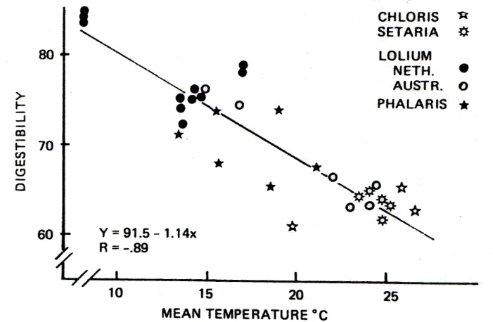

Slide 17
Influence of Water
A water deficiency minimizes the development of the plant, thereby retarding maturity.
Therefore:
This equals increased digestibility while DM yields are reduced.

Slide 18
Leaf and Stem
Aging is frequently associated with a decline in leafiness and an increase in the stem:leaf ratio.

Slide 19
Influence of Environmental Factors Upon Composition and Digestibility of Forageª
Item | Temp. | Light | Nitrogen | Water | Predation
Yield | + | + | + | + | -
Nitrate | - | - | + | + | +
Cell Wall | + | - | ± | + | -
Lignin | + | - | + | + | -
Digestibility | - | + | ± | - | +
ª Val Soest et al., 1978.

