Slide 1
Wildlife Update
Lease hunting rates
Endangered species
WOTUS
Mountain lions

Slide 2
Hunting lease rates
Lots of variability on private lands
  $2-$10/acre
KDWPT
  WIHA varies based on E vs W and parcel size
  FISH
    $500 -$1000/mile for streams
    $1200/mile for access to navigable stream
    ponds

Slide 3
WIHA rates in 2015
Acres | April-May (W/E) | Nov-Jan | Sept-Jan/Mar | Sept/May
150-200 | $250/$375 | $350/$525 | $450/$675 | $700/$1050
501-650 | $800/$1200 | $900/$1350 | $1000/$1500 | $1800/$2700
801-1000 | $1200/$1800 | $1300/$1950 | $1500/$2250 | $2700/$4050

Slide 4
Liability: KSA 58-3201-3207
… an owner of land who either directly or indirectly invites or permits any person to use such property, or any part of such property, for recreational purposes or an owner of nonagricultural land who either directly or indirectly invites or permits without charge any person to use such property, or any part of such property, for recreational purposes does not thereby:
(a) Extend any assurance that the premises are safe for any purpose.
(b) Confer upon such person the legal status of an invitee or licensee to whom a duty of care is owed.
(c) Assume responsibility for or incur liability for any injury to person or property caused by an act or omission of such persons.

Slide 5
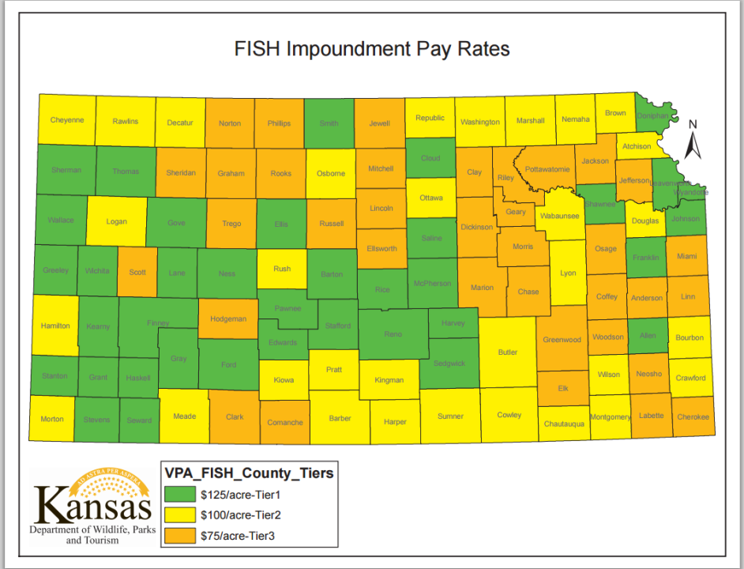
$500-1000 /mile for stream fishing
$1200/mile access to navigable waters

Slide 6
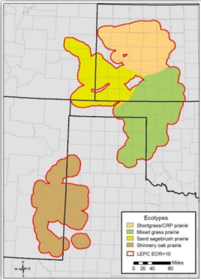
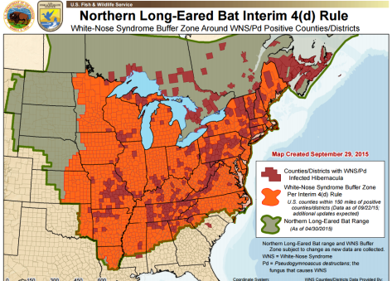
Endangered species
2246 species as of Nov 9, 2015
  Lesser prairie chicken: 96,000 acres enrolled, 180 oil, wind and gas companies committed $47.5 M
Northern long-eared bat

Slide 7
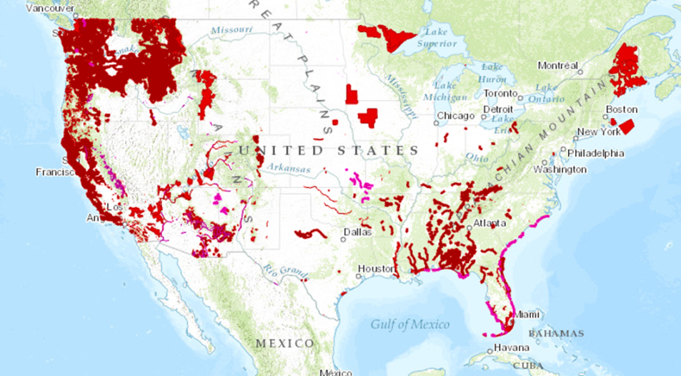
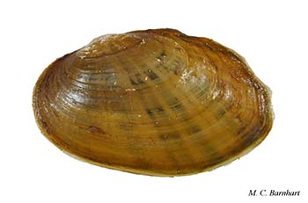
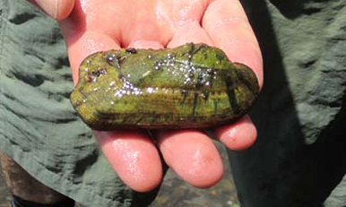
Critical Habitat

Slide 8
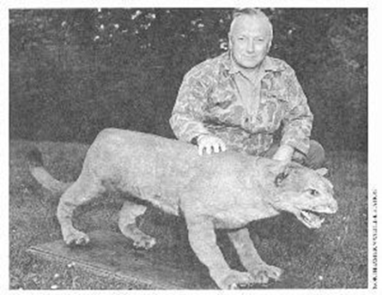
Downlisting?
Last known Eastern cougar trapped in 1938 in Maine
? Florida population
Recent genetic work supports only one subspecies

Slide 9
WOTUS
EPA and COE wanted a codified definition of WOTUS under the Clean Water Act
  Controversial for years
  Rapanos v. U.S. Supreme Court Case resulted in a 4-1-4 decision
  “a wetland is jurisdictional only if there is a surface connection between the wetland and a jurisdictional waterbody”
  Justice Kennedy’s “significant nexus” It is jurisdictional if it significantly affects the chemical, physical and biological integrity of a navigable waterway.
Fourteen lawsuits just after “Clean Water Rule” June 27, 2015
Effective August 28, 2015
  Judge Erickson in ND : injunction only applies in the 13 states that filed for it: Alaska, Arizona, Arkansas, Colorado, Idaho, Missouri, Montana, Nebraska, Nevada, New Mexico, North Dakota, South Dakota and Wyoming.
  U.S. Circuit Court issued a stay for all of U.S. (October 9, 2015)
  Question is whether EPA had the authority to issue the regulation.

Slide 10
Likely provide a nexus
Any other wetlands, lakes, ponds or ephemerally ponded areas within 4,000 feet (about ¾ mile) of any river, stream, creek, ephemeral drain, WOTUS ditch or impoundment.
Any other wetlands, lakes, ponds or ephemerally ponded areas at least partially within the 100-year floodplain of any interstate or navigable waters.

Slide 11
Clean Water Act
Some “normal” farming exemptions
Would likely prevent without a permit
  Farming without a permit land broke out after 1977
  Deposit of pollutants including herbicides
  No discharge or fill material
  Wetland draining or improved site drainage
  Constructing or maintaining ponds across ephemeral streams
> 6,000 NPDES in Kansas in FY2015

Slide 12
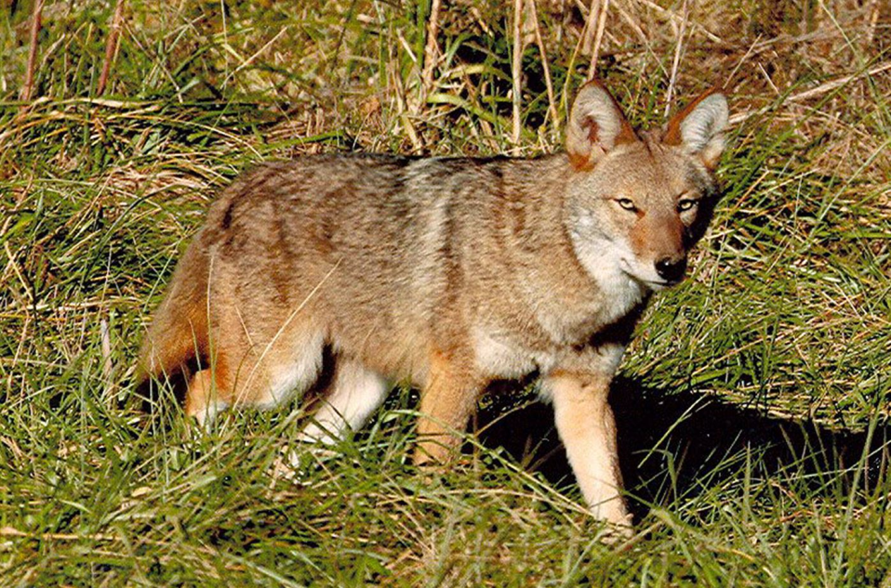

Slide 13
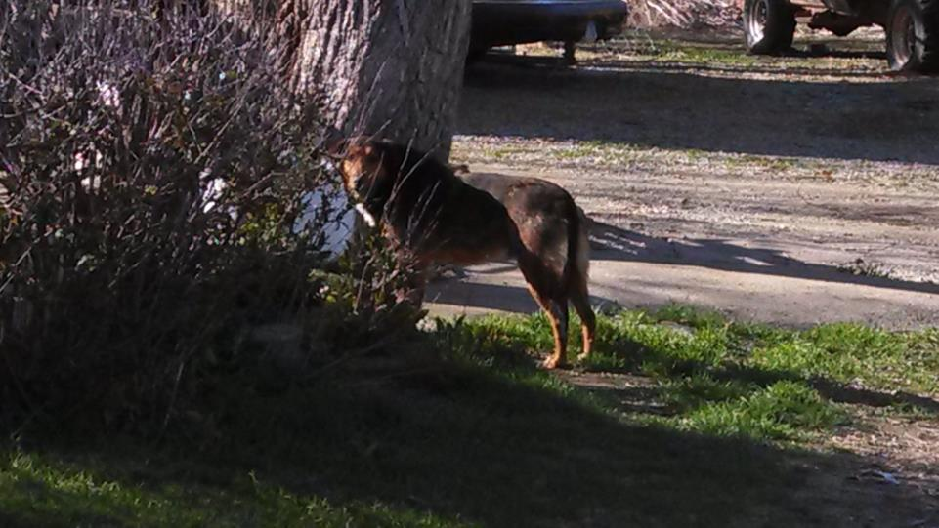

Slide 14

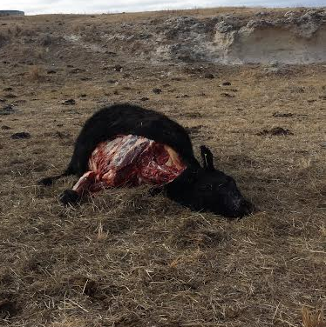

Slide 15

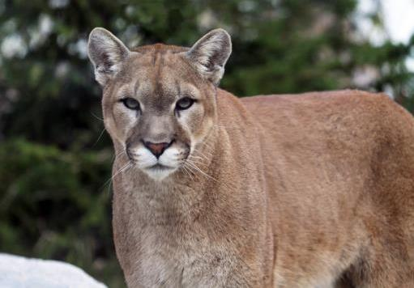
How many of you have seen a cougar?

Slide 16
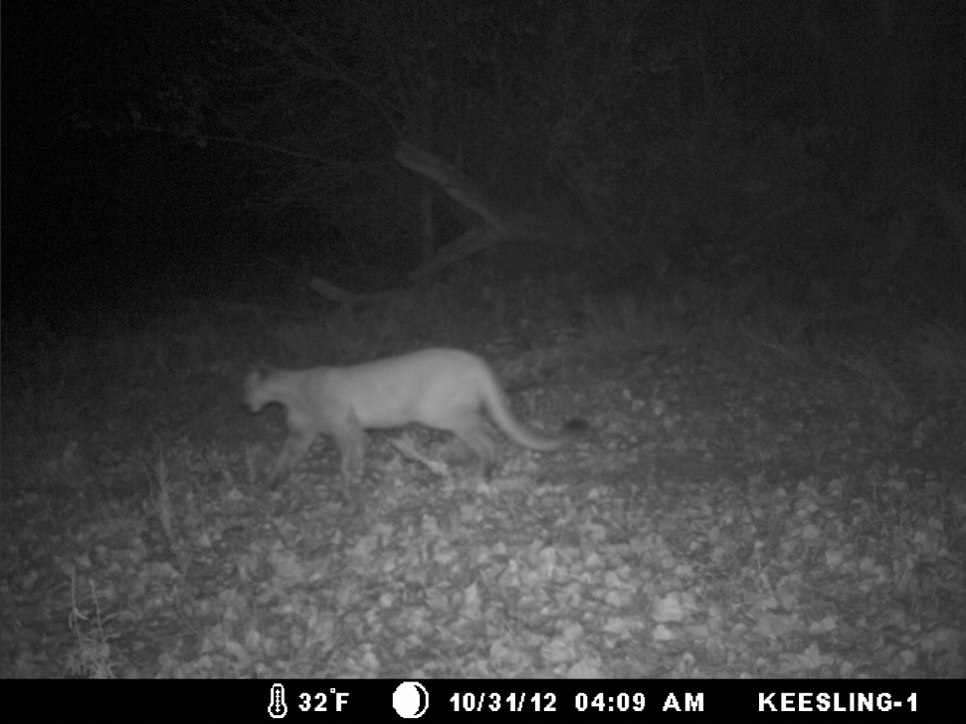
Stafford Co.
#9

Slide 17
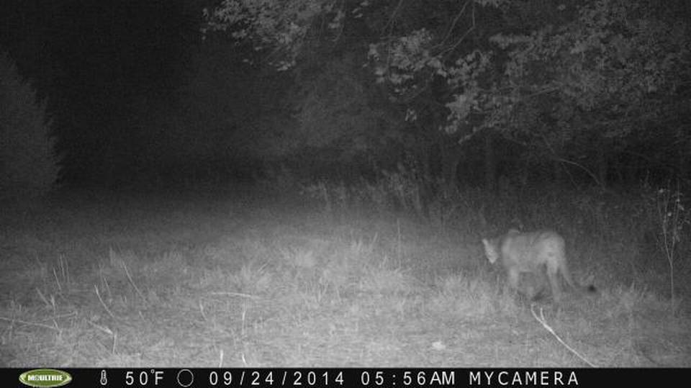
#10
Labette County 9/24/14

Slide 18
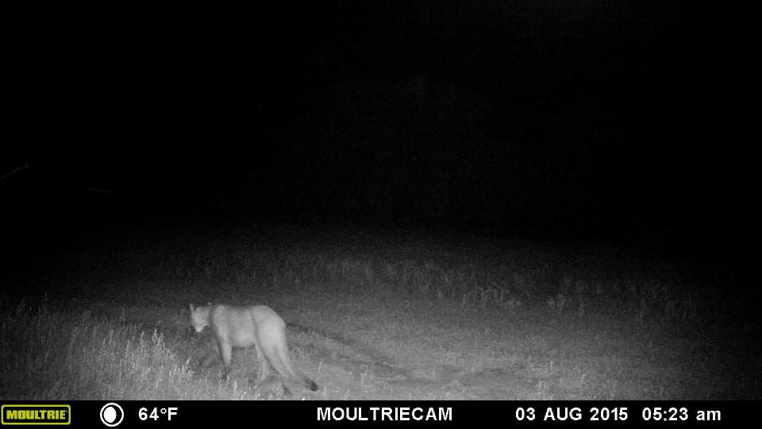
#11
Rooks County 8/3/2015

Slide 19
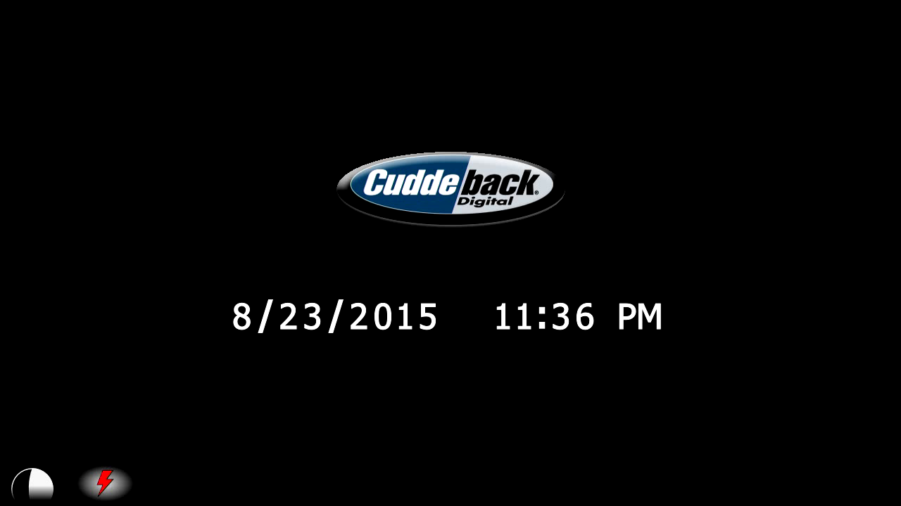
#11
Hoisington
David Paden Sheriffs office Great Bend

Slide 20
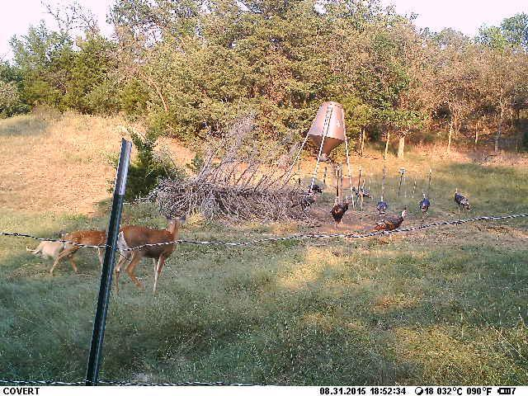
Bunker Hill area Not confirmed

Slide 21
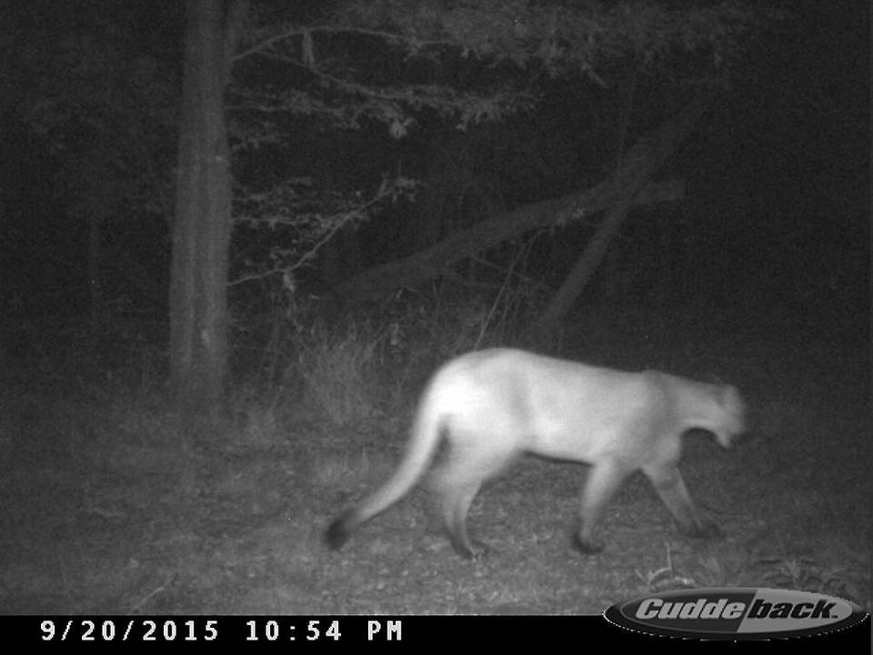
Danny Holden Argonia 2015

Slide 22
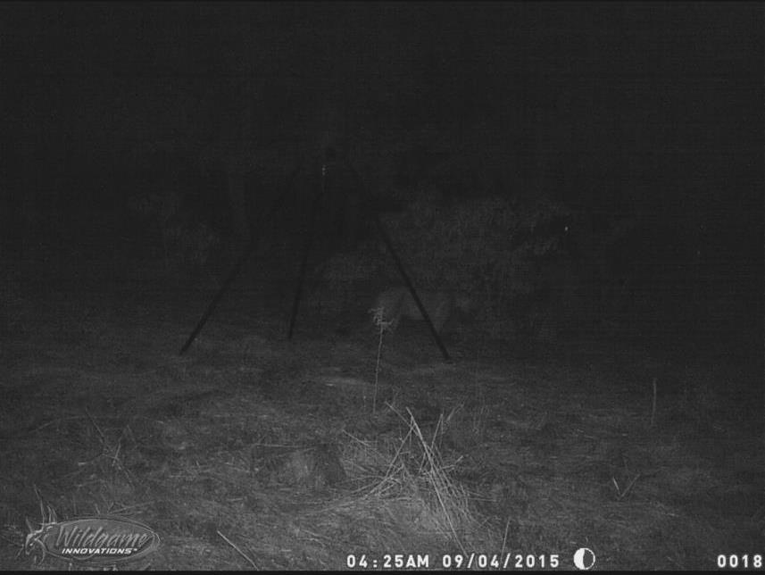
Not confirmed

Slide 23
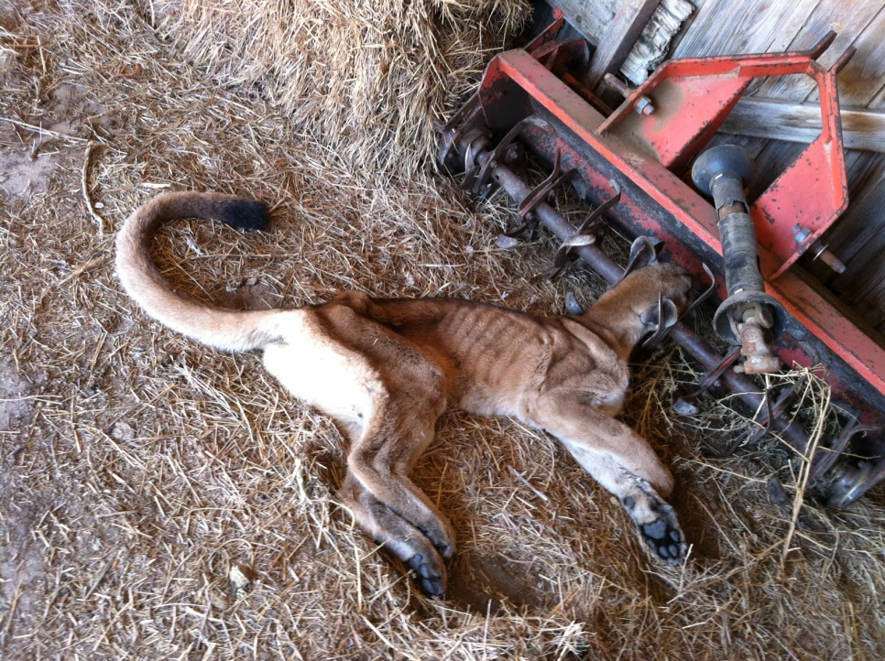
Dodge City Oct 23, 2015

Slide 25
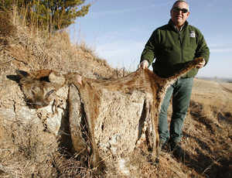
2007 Barber Co.
# 1

Slide 26
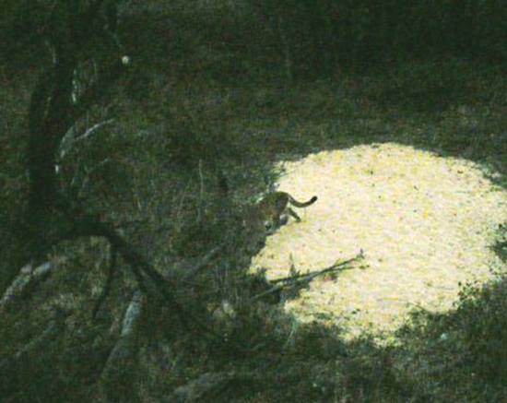
# 2
10/12/2009 Trego county

Slide 27
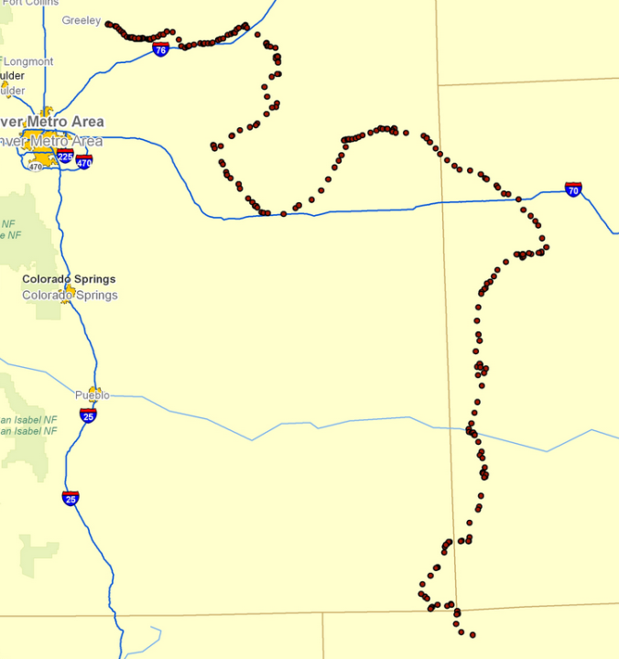
# 3

Slide 28
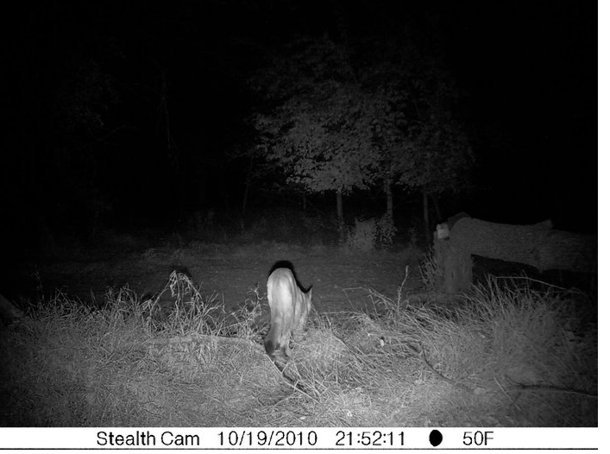
Near Courtland 10/16/2010
# 4

Slide 29
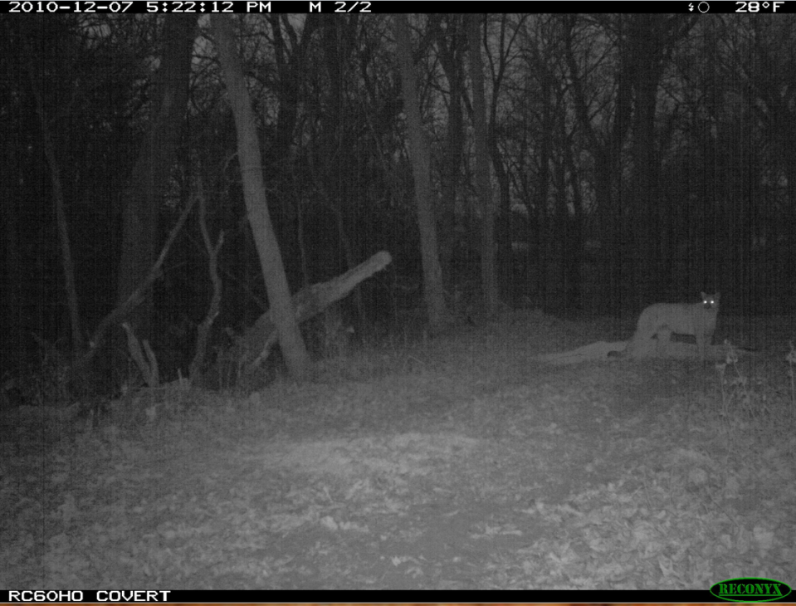
# 5
Nemaha Co.

Slide 30
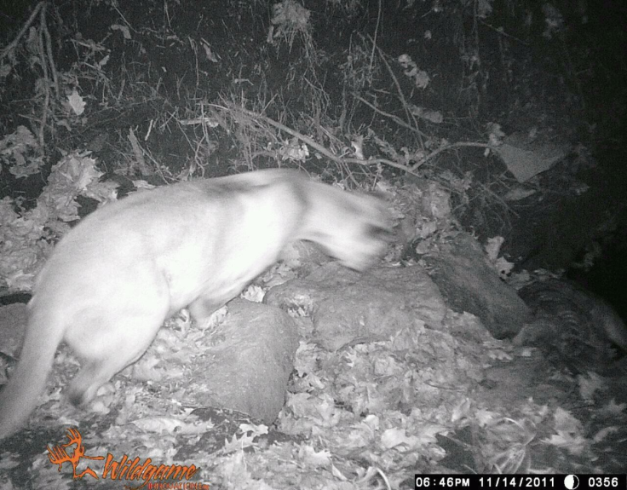
11/14/2011 Atchison Co.
# 6

Slide 31
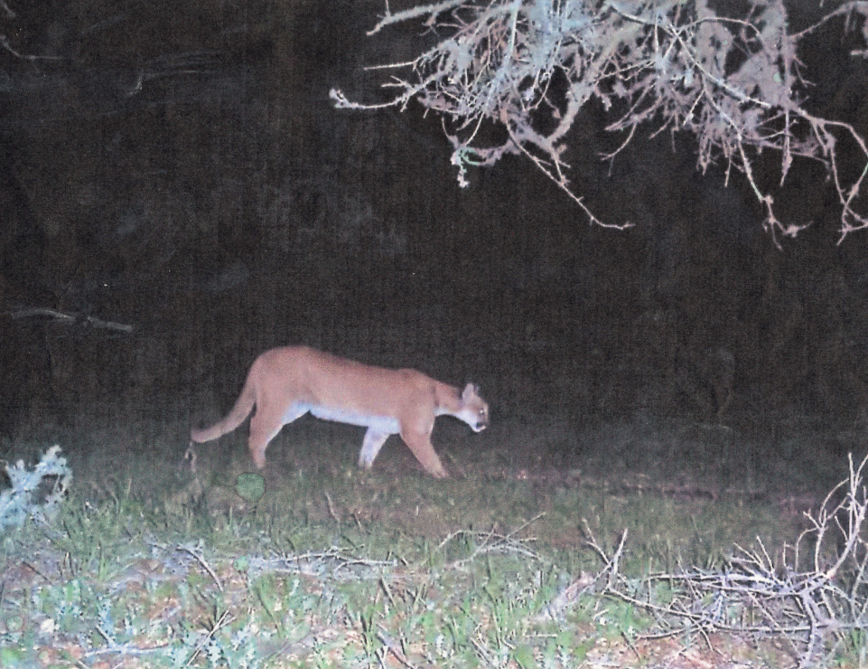
11/26/11 near Derby KS
# 7

Slide 32
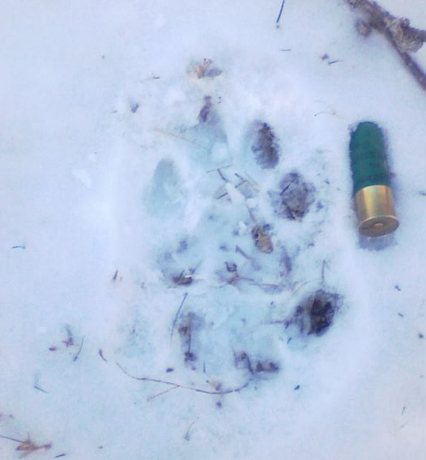
1/18/2012 Washington Co.
#8

