Slide 1
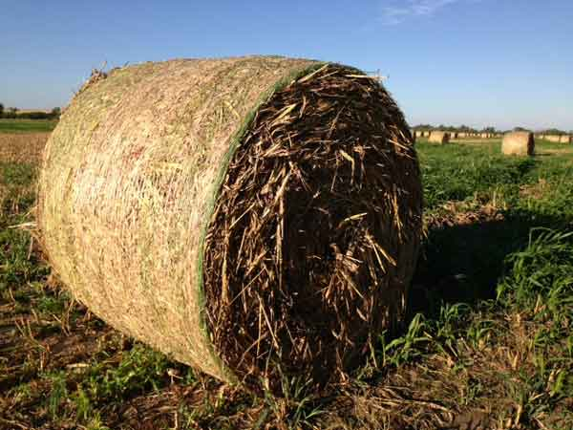
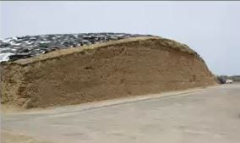
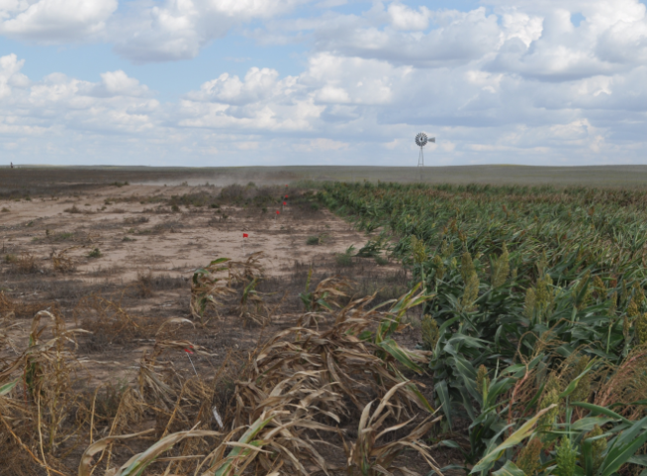
How to Sample Forages for Nutrient Analysis
Bales…Bags…Bunkers…Standing

Slide 2
Collect a Representative Sample of the Forage being Tested
Objective
Representative sample of the forage or feed
Tons to lbs., lbs. to grams, (grams) to ppm
Sampling error
Taking the sample
Handling the sample prior to analysis
Notes:
Collecting a representative forage or feed sample is important towards building a ration that accurately can project performance and illustrate cost.

Slide 3
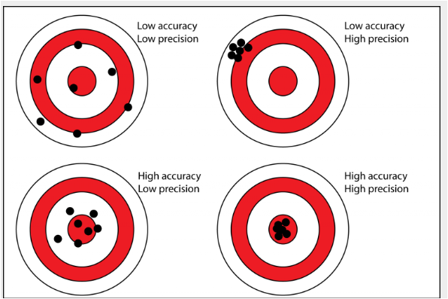
Accuracy and Precision
Notes:
Acccuracy refers to the closeness of a measured value to a standard or known value… Precision refers to the closeness of two or more measurements to each oher.

Slide 4
What is a forage lot ?
A forage lot consists of forage harvested from one field:
at the same cutting and maturity within a 48-hour period
Usually contains fewer than 100 tons of hay.
A forage lot should be similar for forage type, field (soil type), cutting date, maturity, variety, weed infestation, type of harvest equipment, weather during growth and harvest and storage conditions.
Notes:
A forage lot represents the sample size from which the forage sample will be collected from.

Slide 5
Select Uniform Lots of Hay
 | Hay field 1st cut |  |  | Hay field 2nd cut
 | Grass infested | Pure |  | Grass infested | Pure Rain Damage | Pure No Rain
Lot # | 1 | 2 |  | 3 | 4 | 5
Notes:
This slide represents that 5 different forage samples should be collected to accurately portray a representative sample source.

Slide 6
Sampling Bales
Group bales
Field, source, forage type, Quality
Risk management (nitrates)
Sort and store bales such that group/lots of hay can be identified and maintained during feeding
Notes:
Group bales according to field source, environmental conditions during harvest and cutting. It is important to maintain identity of the bales’ source as feeding time approaches in order to match the quality attributes of each source according to the needs of the various livestock classes being fed.

Slide 7
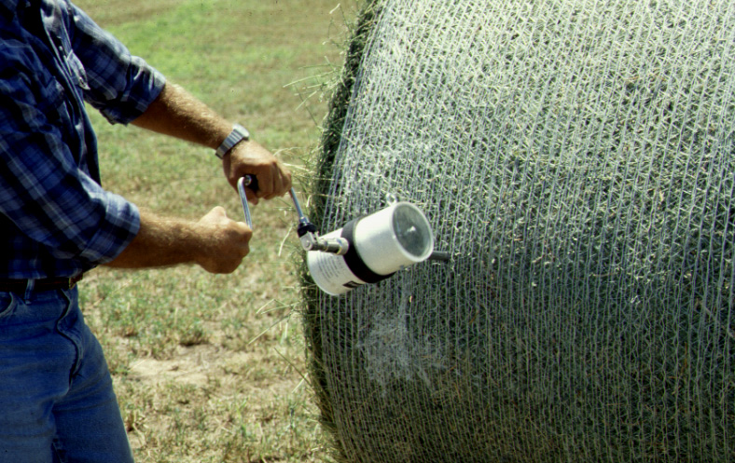

Slide 8
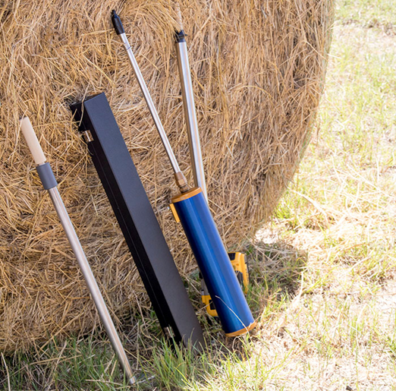
Sampling bales
Sample as close to feeding as possible
Rule of thumb: Sample 10-20% of bales in lot
Randomly selected bales
Use an approved sampling device
Many options available
Ensures consistent stem/leaf ratio
Notes:
Sample as close to the feeding period as possible to obtain a more accurate estimate of what is present. Moreover, a good rule of thumb is to sample @ 10% of the bales from a forage lot. So, if 100 bales were swathed and baled at the same time one would randomly select 10 bales to collect 3 core samples from each side of each bale.

Slide 9
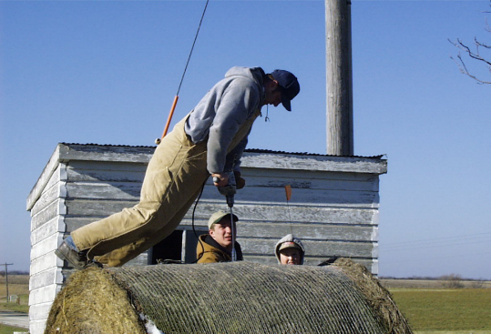
Weathering Damage of Large Round Bales
Most damage occurs in the outer 12 inches of the bale
50% of the hay in a bale with a radius of 30 inches is in the outer 9 inches of the bale
Proper core-sampling procedures must be adjusted to consider this change
Notes:
Weather damage on the outer portion of big round bales in particular can be extensive.

Slide 10
Six Foot Diameter Round Bale
Outer 4″ =
25% of the bale
Outer 12″ =
50% of the bale
Inner 3' =
25% of the bale
Outer 6″ =
33% of the bale
Outer 18″ =
75% of the bale
Notes:
This slide merely illustrates the proportion of the hay bale impacted by potential weathering of the outer area.

Slide 11
Hay Composition in Different Depths of Unprotected Large Round Bales
% of DM
Sampling depth
interval, inches DM,% IVDDM NDF ADF
0-3 56.4 43.0 59.5 46.7
3-6 75.5 50.2 58.1 45.1
6-9 81.0 52.1 58.0 45.2
9-12 82.4 53.0 56.2 43.3
12-30 83.9 55.0 53.5 41.5
Notes:
Research from Iowa State shows the impact of weathering on quality attributes.

Slide 12
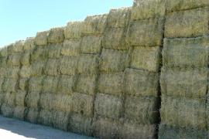
Sampling Big Squares
Stem/Leaf ratio most consistent on ends
Sample from ends with probe at 90°
Drill style work well…
Safety
Bales fall…it happens
Notes:
With respect to square bales, sample from the ends with a probe at a 90° angle.

Slide 13
Sampling Silage
During harvest
Dry matter/moisture
30-40% dry matter or 60-70% moisture
Koster tester, microwave
Post-ensiling
Ensiling process takes 21 days
Usually sample at 28 days
Notes:
Dry matter determination is critical to know during silage production. There are numerous ways to determine an “on the fly” estimation of DM. As the ensiling process normally takes approximately 21 days, it is advisable to delay forage sampling until day 28 or as close to feeding as possible.

Slide 14
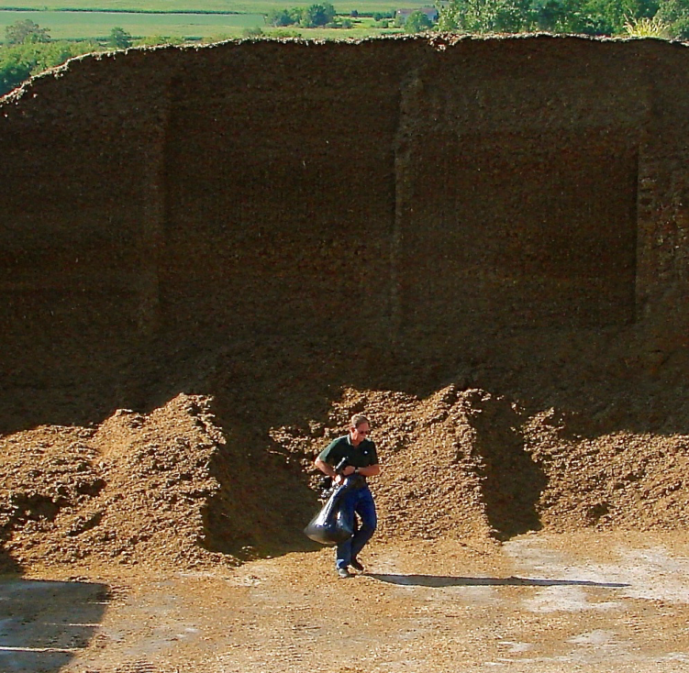
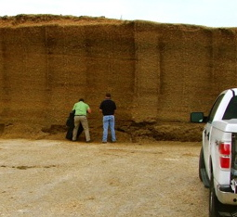
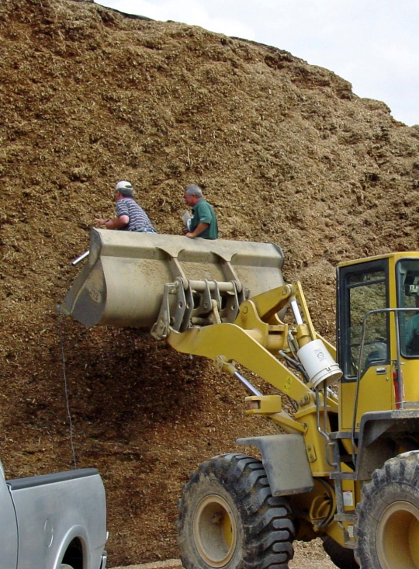
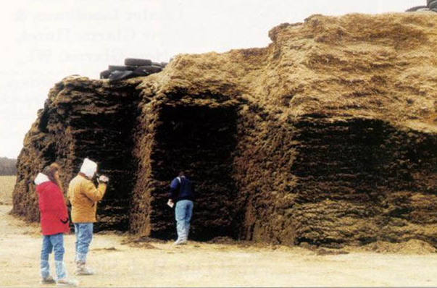
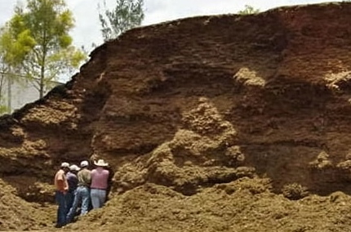
Don’t be these guys!
Notes:
How many people in the audience have heard about a “near miss”??

Slide 15
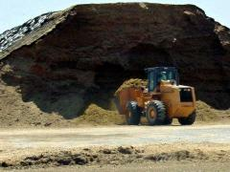
Sampling Silage
Bunkers
Use loader or rake to collect silage from entire silage face
Collect grab (3-4) samples from bucket
May need multiple loader trips on a large bunker
Silage is delivered on some operations
Sample from middle of truck or wagon
Notes:
Be mindful to collect silage for forage analysis across the entire “face of the bunker.

Slide 16
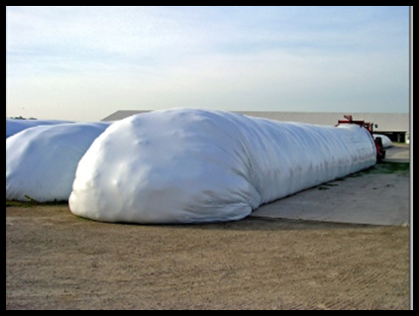
Silage Bags
Multiple bags
Different days, different conditions, who knows?
Sampling methods
Grab sample from face (8-10 locations)
Only represents small amount of silage
Sample multiple times during day
Probe along sides
Both sides…challenge
Need to patch holes with bag tape
Notes:
Be mindful to patch holes when probing along the sides of the bag.

Slide 17
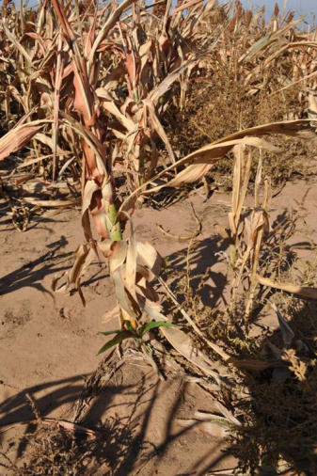
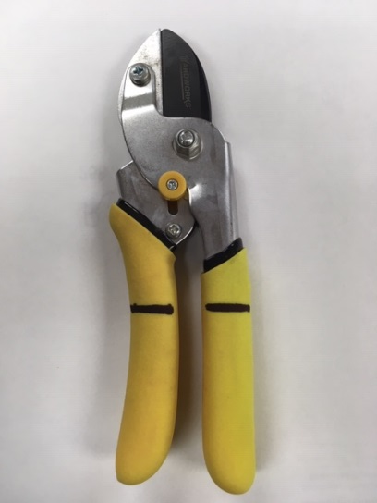
Sampling Standing Forage (crop residues, forage sorghum)
Representative sample of the forage
Not easy
Difficult to determine what livestock will eat
Whole plant samples
Pulling plants = soil contamination
clipped at the same height
Mark clippers
Notes:
The sampling of standing forages is a challenging task. It is important to ensure that a representative sample is collected to truly estimate what is consumed. With respect to crop residues, it is recommended to sample a 8 to 12 foot row length in 4 different locations.

Slide 18
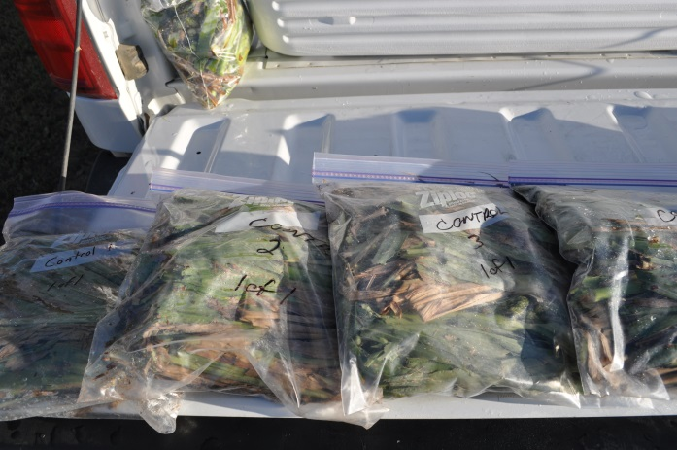
Standing forage
Protocols
Walk diagonal line sample 1 plant every 50-100 steps
4 corners and the center
Chop whole plant in 1-3 inch pieces and place in clean bucket
Mix and then subsample in gallon bag
Notes:
Standing forages such as native grass and other forages can be sampled with the use of a quadrat.

Slide 19
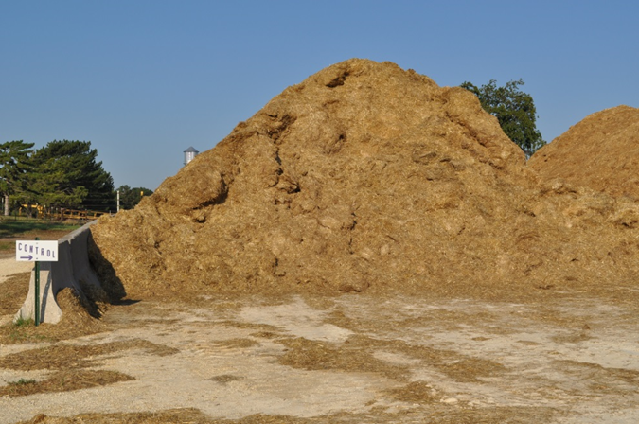
How do we sample this?
Notes:
Collect a sample at several locations during the process of feeding to ensure a representative sample is collected.

Slide 20
Composite sampling
Take similar weight/or volume of sample on different days/times
Place in refrigerator (3-5 days)
Place an equal amount (weight or volume) of each sample in a clean container
Mix slightly
Then fill a 1 gallon zipper bag for analysis
Notes:
Once silage samples are collected, it is important to composite the numerous samples collected over different days/times into one final sample that is submitted for analysis.

Slide 21
Final Thoughts
Forage analysis is often overlooked as a management tool
Feedstuffs variation can be potentially be huge
Poor sampling technique or protocols create more problems than producers think
Notes:
Reemphasize the importance of forage analysis as a management tool. Given the tremendously high potential for variability, it is critical to collect representative forage samples before submitting to a commercial laboratory.

