Slide 1
Understanding Forage Analysis

Slide 2
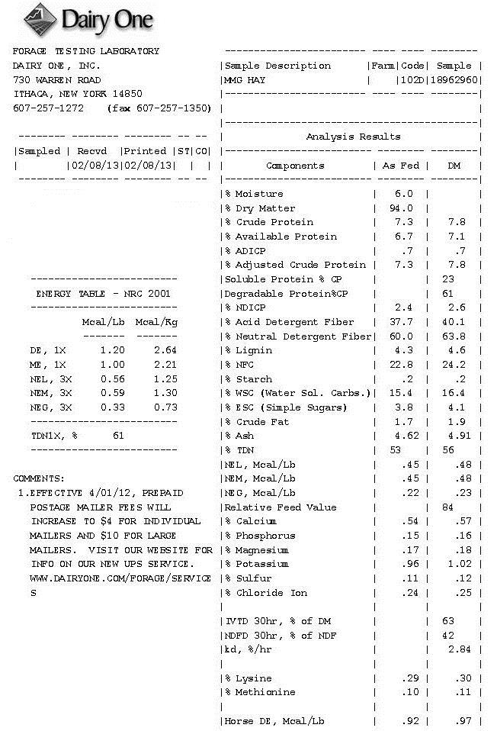
Notes:
An analytical report from a laboratory can be overwhelming. With terms like as fed, dry matter, Acid detergent fiber, and many other terms that most people are not familiar with.
The presentation discusses the basic analytical procedures and define some of the common terms associated with forage analysis.

Slide 3
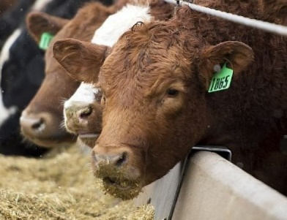
Evaluating Forage Quality
The best method of evaluating a feed/forage is animal performance
Feed and record performance
Intake (palatability), digestibility, efficiency
Time consuming, expensive
Laboratory analysis is an economical means of gathering data which may be used to reliably predict animal performance
Notes:
It is often overlooked.. the reason we analyze feedstuffs is animal performance.
The absolute best method of evaluating the quality of any feedstuff is to simply feed it to an animal or group of animals maintained in a controlled environment and record the performance of those animals.
This would take a tremendous amount of time and would be very expensive.
Analyzing feedstuffs/forages in a lab and determine the chemical composition of the feed provides a rapid, relatively economic means of gathering information about a feedstuff that may be used to predict animal performance.

Slide 4
Evaluating Forage Quality
Qualitative
Color, leafiness, smell, texture,
Dust, mold, foreign material (wire, cans etc.)
Quantitative
Analysis conducted in the laboratory
Chemical composition
Direct
Indirect (NIR…Near infrared reflectance spectroscopy)

Slide 5
Basic Components of Nutrient Analysis
Moisture
Dry Matter
As Received
Total Nitrogen
Crude Protein
Acid Detergent Fiber (ADF)
Total Digestible Nutrients
Metabolizable Energy
Net Energy Maintenance
Net Energy Production
Neutral Detergent Fiber (NDF)
Relative Feed Value
Mineral Analysis
Notes:
There are 4 basic components of a nutrient analysis of feedstuffs plus the analysis of minerals
Moisture
Total Nitrogen, which is used to calculate crude protein
Acid Detergent fiber which is used to calculated the various estimates of energy commonly used (TDN, Net Energy for Maintenance)
Neutral Detergent fiber which is used with ADF to calculate RFV

Slide 6
Moisture or Dry Matter
Simple, but important analysis
Removing water allows us to compare straw to silage
Removing the water within the sample
Dry forages (hay)
Forced air oven at 100-105°C for 24 hours
Wet forages (fresh clipped, silage)
2 stage drying process
Forced air oven at 55°C followed by 105°C
Notes:
Moisture or Dry matter determination is the most simple analytical procedures, but it is the most important because all other nutrients are reported on dry matter basis so the dry matter is used to calculate all the other values on an analysis.
Secondly this is the analysis that allows us to compare very different feeds such as silage and straw.
The procedure is relatively simple for dry forages. The sample is sampling placed in an oven at 100-105 degrees for 24 hours
Wet forages are typically subjected to a 2 stage process by first drying at a lower temperature and then the 100-105. This minimizes the amount of nutrients that could be lost in the drying process.

Slide 7
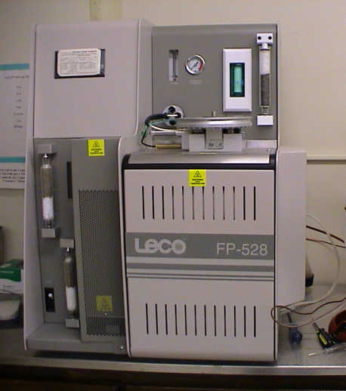
Crude Protein
Nitrogen content is measured
Kjeldahl analysis (Johan Kjeldahl, 1880’s)
Uses strong acids to digest sample
Total combustion is commonly used today
Sample is burned and nitrogen is captured and measured
Nitrogen * 6.25 = crude protein content
Most proteins contain ~ 16% Nitrogen
Conversion factor of 6.25 (100/16 =6.25)
Notes:
Crude protein is determined by measuring the amount of Nitrogen within a sample.
There are 2 methods used the Kjeldahl analysis which originated in Germany and goes back well over 100 years.
The second method is total combustion where a small sample (less than 250 mg) of the feedstuff is placed in a machine and burned. The gases produced are collected and the amount of Nitrogen produce is evaluated. This is a very rapid approximately 4 minutes per sample
Crude protein is calculated by multiplying nitrogen by 6.25

Slide 8
Detergent Fiber Analysis (NDF and ADF)
Developed by P.J. Van Soest (1960’s) to partition plant samples into 2 fractions
Plant cell contents (highly digestible)
Plant cell wall (vary in digestibility)
Developed to replaced crude fiber (1860’s)
Crude fiber tends to underestimate cell wall content
Still used today…on feed tags as legal standard
Notes:
The abbreviations NDF and ADF stand for neutral detergent fiber and acid detergent fiber, they are 2 of the components of the detergent fiber system.
This system developed by Dr. PJ Van Soest partitions plant samples into 2 fractions the cell contents, which are highly digestible and the plant cell wall, which vary in digestibility.
The system was developed to replace crude fiber, which underestimates the cell wall components. However, crude fiber remains the legal standard of reporting fiber content of bagged feeds and is reported on feed tags.

Slide 9
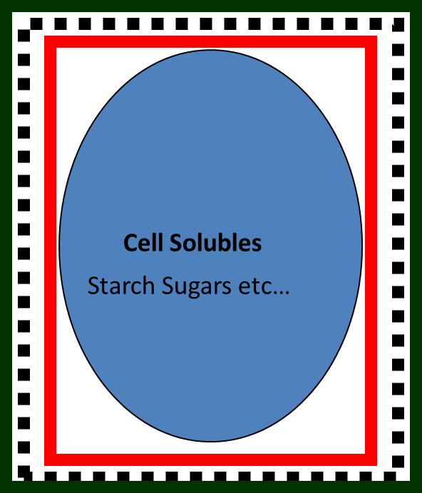
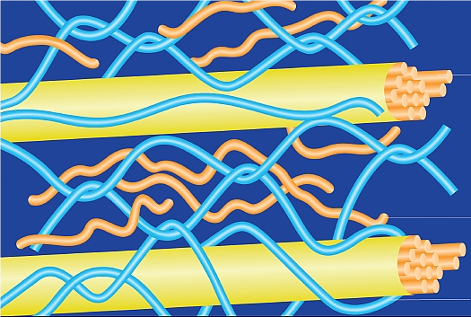
Plant Cell Wall Components and the Detergent Fiber System
Cellulose
Hemicellulose
Lignin
http://www.scidacreview.org
Neutral Detergent Fiber (NDF)
Cell contents are removed
Measures amount of hemicellulos, cellulose, and lignin
Correlated with animal intake
Acid Detergent Fiber (ADF)
Removes Hemicellulose
Measures amount of cellulose and lignin
Correlated with digestibility
Van Soest, 1984
Notes:
This slide shows an illustration of the plant cell. The plant cell contents or solubles consist of the starches, sugars etc. the plant cell wall is made up primarily of hemicellulose, cellulose and lignin.
The plant cell wall components vary in digestibility, lignin is the least digestible and is nearly indigestible.
In the process of NDF the cell contents or cell solubles are removed by washing the sample in a detergent solution at neutral pH. The remaining residue or NDF represents the plant cell wall components, Hemicellulose, Cellulose, and lignin. The NDF fraction is correlated with intake.
The ADF fraction the sample is washed in detergent solution that is acidic. This causes the hemicellulose to disassociate from the plant cell wall contents. This leaves behind cellulose and lignin in the remaining residue. Since lignin is essentially indigestible as the ADF of sample increases the digestiblity decreases.

Slide 10
Energy Estimates
Total Digestible Nutrient (TDN)
Net Energy
Net energy maintenance (NEm or NE maint.)
Net energy production
Gain, Lactation (NEg, NEl)
These are calculated from ADF due to its correlation with digestibility of the forage
Notes:
There are several different terms that may be used to express the energy content of a feedstuff. The 2 most common are TDN and the Net Energy system which is further divided into Net energy for Maintenance and Net Energy Production

Slide 11
Total Digestible Nutrients
Oldest estimate of energy availability (1860’s)
Widely accepted most recognized
Sum of the digestible protein, carbohydrates and fat (multiplied by 2.25)
Only accounts for fecal losses, so tends to overestimate value of forages
Notes:
TDN has been around for well over 100 years, and is the most common term that most are familiar. It is a calculated value that is essentially the sum of digestible protein carbohydrates and fat. The fat content is multiplied by 2.25, because fat contains 2.25 the amount of energy as carbohydrates. As the name implies it only accounts for fecal losses, so it often overestimates the value of forages.

Slide 12
Net Energy System
Takes into the energy associated with feces, urine, gas, and heat produced and the purpose for which the feed is used (maintenance and production)
Gain
Lactation
Production
Maintenance
Feed Intake
Lofgreen and Garrett, 1968
Notes:
More reliably predicts the feeding value of feedstuffs as it accounts for the energy associated with feces, urine, gas, heat production by the animal and the purpose for which the feed is being used by the animal.
An animal fed at maintenance, uses the energy within a feedstuff very efficiently, thus the slope of the line is steeper. An animal being fed to gain weight or produce milk, uses energy with a different level of efficiently, typically less, so the line is flatter.
This systems takes those efficiencies into account and does a very good job of predicting animal performance.

Slide 13
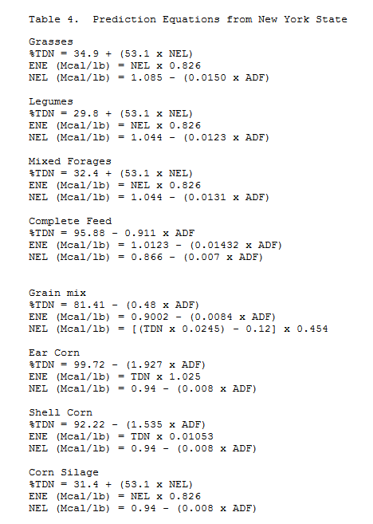
Energy Estimate Equations
National forage testing assoc. http://www.foragetesting.org
Notes:
This is a sample of some of the many equations that are used by labs to calculate energy estimates.
Notice that there are equations for different types of forages and feedstuffs. This is one of the reasons that labelling a sample is important, so the lab uses the most appropriate equation.

Slide 14
Relative Feed Value (RFV)
Essentially ranks forages by potential digestible dry matter intake relative to full bloom alfalfa (RFV = 100)
Digestible dry matter (DDM) = 88.9- (0.779 x ADF%)
Dry matter intake (DMI) = 120/ %NDF
Relative Forage Value = DDM x DMI/1.29
RFV has no specific meaning it is purely a means of ranking forages
National forage testing assoc. http://www.foragetesting.org
Notes:
Relative feed value is not an energy estimate it is essentially an index created to rank alfalfa and has no specific units or meaning associated with the term.

Slide 15
Relative effect of alfalfa maturity on CP, ADF, NDF, TDN, and RFV
Stage of Maturity | CP% | ADF% | NDF% | *TDN% | RFV
Bud | 25 | 28 | 38 | 67.1 | 164
Early Bloom | 23 | 30 | 40 | 65.5 | 125
Mid Bloom | 19 | 35 | 46 | 61.6 | 125
Full Bloom | 16 | 41 | 53 | 57.0 | 100
* Calculated
TDN% = 88.9 – (0.779 * ADF%)
Adapted from: http://facts.okstate.edu/docushare/dsweb/Get/Document-2557/PSS-2117web.pdf
Notes:
This table illustrates the relative changes that occur in CP, ADF, NDF, TDN, and RFV that occur as maturity of alfalfa advances.
Note that as the plant matures, CP goes down, ADF goes up, TDN and RFV go down.

Slide 16
Relative Forage Quality (RFQ)
Developed as an improvement over RFV, as it uses TDN rather than digestible dry matter
Maybe used on both legumes and grasses
RFQ also has no specific meaning, as it as index that may be used to compare forages.
Jeranyama and Garcia, 2004 SDSU bulletin 8149

Slide 17
NIRS Analysis
Near Infrared Reflectance Spectroscopy
First used to predict forage quality in 1976
Rapid and requires minimal sample preparation relative to traditional chemistry
Less expensive than traditional methods
Notes:
NIRS Analysis is rapid analytical procedure that is offered by many commercial labs. It is often the cheapest analytical package.

Slide 18
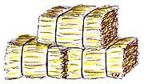
NIRS: Basic Principle
Hay Sample
Infrared light
Reflected Light
Detector Cell
Relationship between the amount of reflected light and analyte (i.e. CP) is used to determine concentration of analyte in sample
Y=mx +b
Notes:
The basic concept of an NIR analysis is illustrated.
The data used to generate the equation is typically generated from values obtained via wet traditional chemistry methods of analysis.

Slide 19
NIRS: General Comments
NIRS is an excellent analytical tool when used properly
Instrument is calibrated using wet chemistry values
Good method works well with common forages
Lower cost, so more samples may be submitted
Notes:
NIR is an good analytical method, it works well with common forages such as alfalfa, and has the advantage of being lower cost. However, NIR may not be the best analytical method for trouble-shooting problems or bunk samples that may have many different ingredients.

Slide 20
Other Terms
Amylase Neutral Detergent Fiber (a NDF)
The enzyme amylase is added to the NDF solution to help breakdown starch
Acid Detergent Insoluble Nitrogen (ADIN)
Nitrogen bound within the ADF fraction
Indication of heat damage in feeds
In-vitro Dry Matter Digestibility (IVDMD)
Sample undergoes simulated ruminal digestion
Correlated with TDN

Slide 21
The Value of Forage Testing
1400 lb, 3rd trimester cow
Consumes 2% bodyweight = 28 lbs
7% CP forage * 28 lbs = 1.96 lbs CP/d
6% CP forage * 28 lbs = 1.68 lbs CP/d
1.4 lbs of 20% supplement/d (0.28/0.20)
1.4 lbs * 60 days = 84 lbs supplement
84 lbs ($400/ton) = $16.80/cow
0.28 lbs CP/d
Notes:
This slide attempts to put a value on forage testing, in terms of the amount of supplement required to supply the amount of protein supplied by a 1% different in crude protein content of a forage.
Please note the Value of the supplement may need to be changed, based on current prices.

Slide 22
Agent Contact Information

