Slide 1
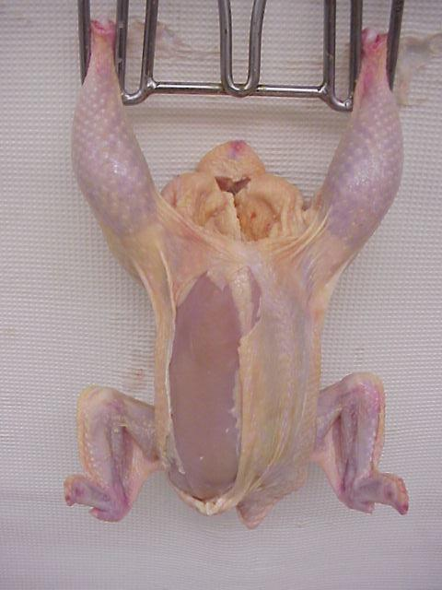
Indicate the
USDA grade for this ready-to-cook broiler.
1

Slide 2
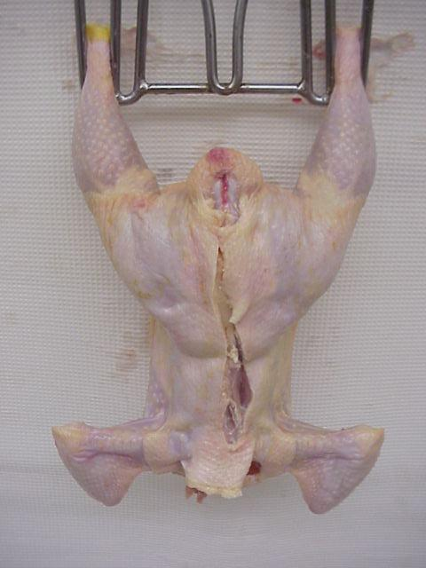
Indicate the
USDA grade for this ready-to-cook broiler.
2

Slide 3
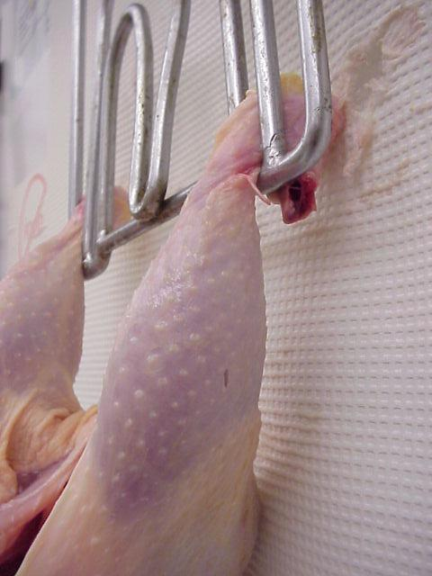
Indicate the
USDA grade for this ready-to-cook broiler.
3

Slide 4
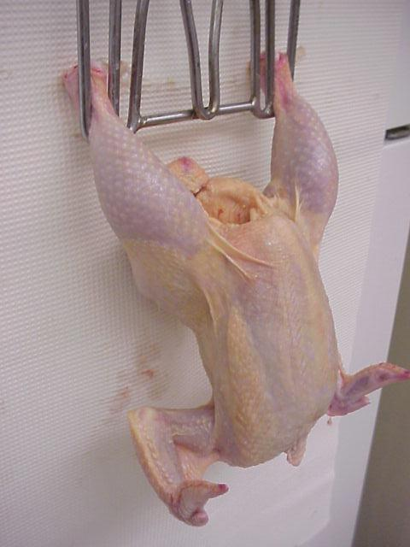
Indicate the
USDA grade for this ready-to-cook broiler.
4

Slide 5
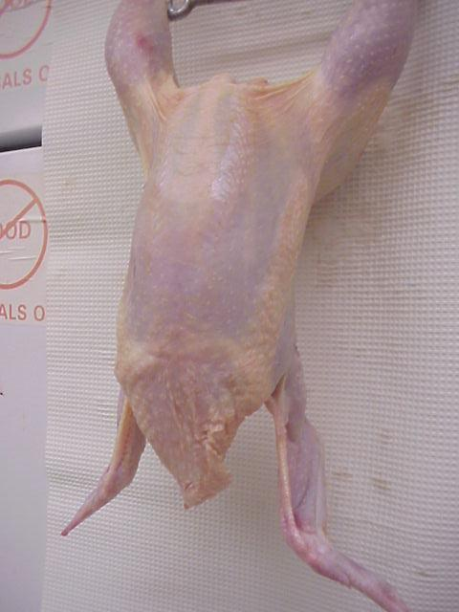
Indicate the
USDA grade for this ready-to-cook broiler.
5

Slide 6
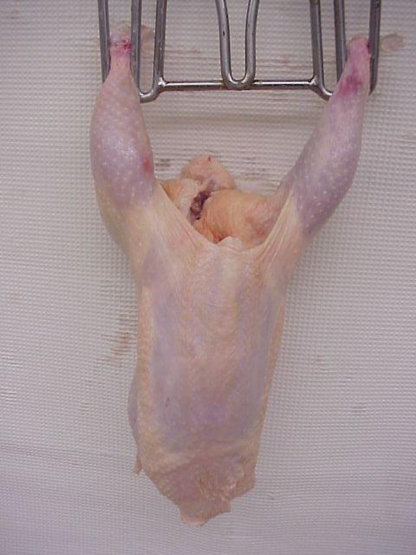
Indicate the
USDA grade for this ready-to-cook broiler.
6

Slide 7
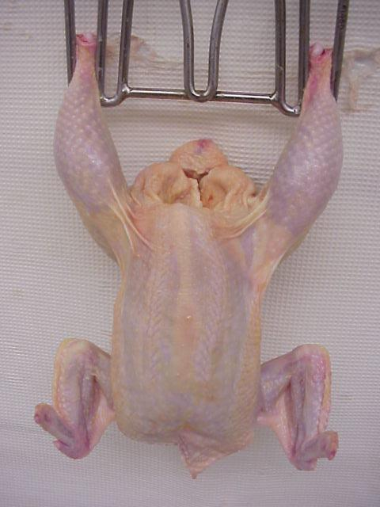
Indicate the
USDA grade for this ready-to-cook broiler.
7

Slide 8
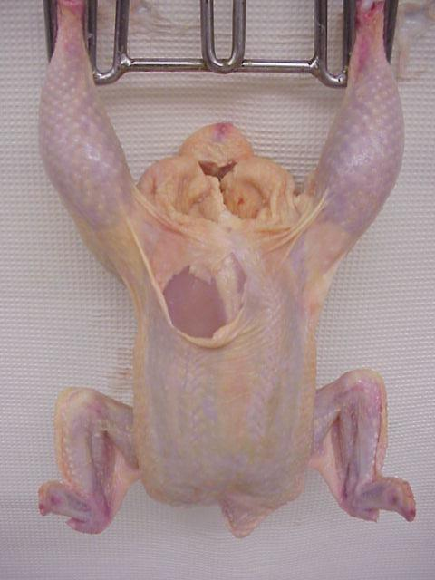
Indicate the
USDA grade for this ready-to-cook broiler.
8

Slide 9
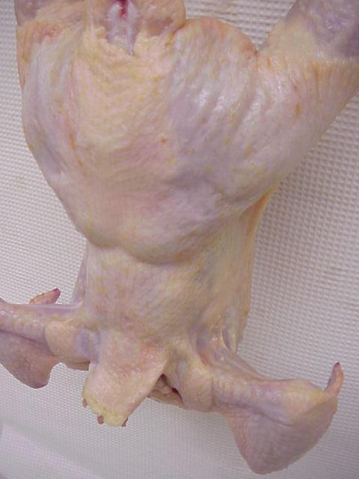
Indicate the
USDA grade for this ready-to-cook broiler.
9

Slide 10
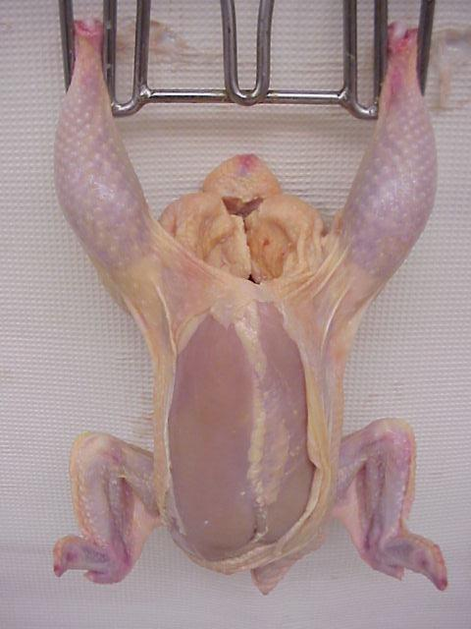
Indicate the
USDA grade for this ready-to-cook broiler.
10

Slide 11
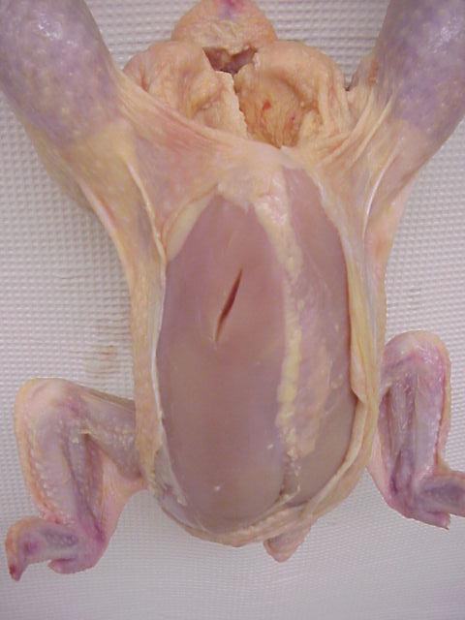
Indicate the
USDA grade for this ready-to-cook broiler.
11

Slide 12
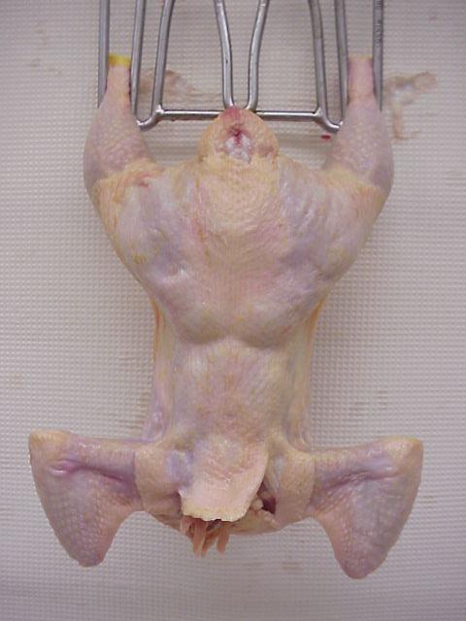
Indicate the
USDA grade for this ready-to-cook broiler.
12

Slide 13
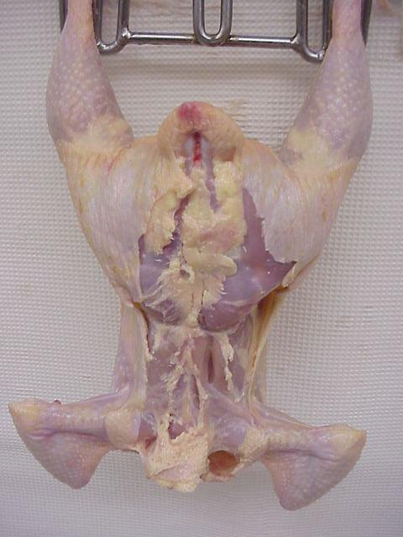
Indicate the
USDA grade for this ready-to-cook broiler.
13

Slide 14
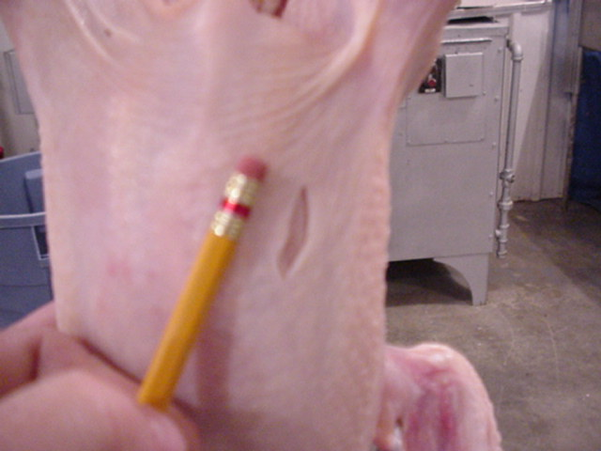
Indicate the
USDA grade for this ready-to-cook broiler.
14

Slide 15
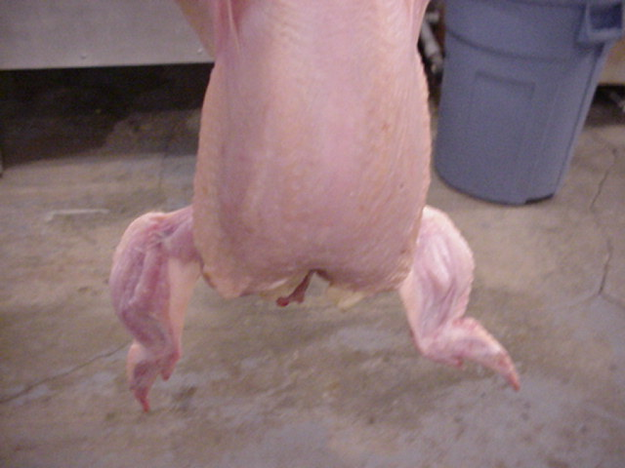
Indicate the
USDA grade for this ready-to-cook broiler.
15

