Slide 1
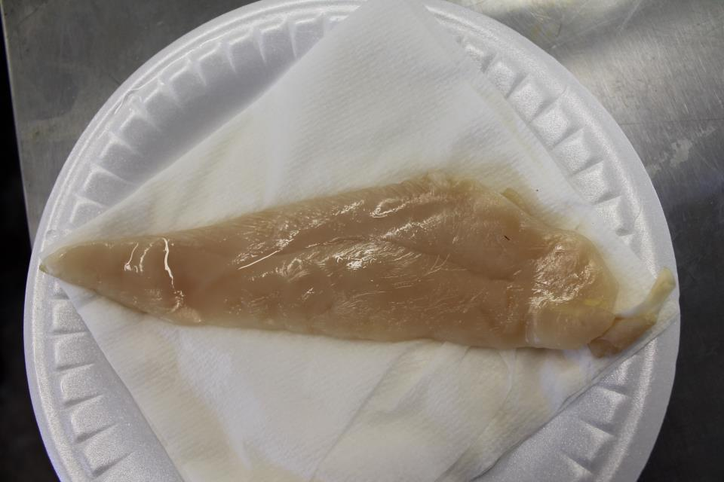
Identify this
broiler part.
1

Slide 2
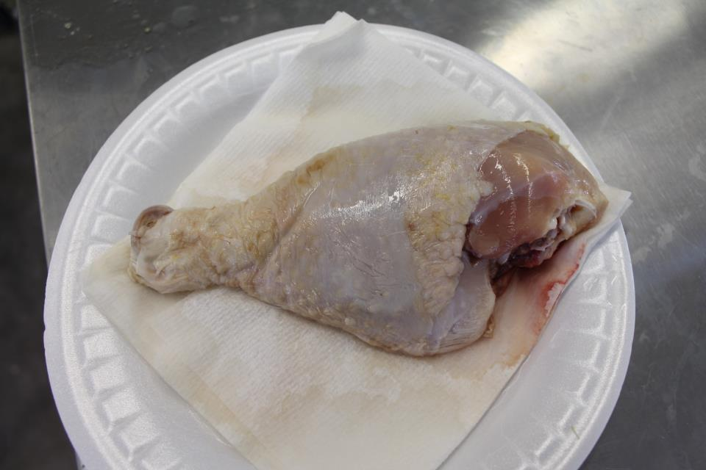
Identify this
broiler part.
2

Slide 3
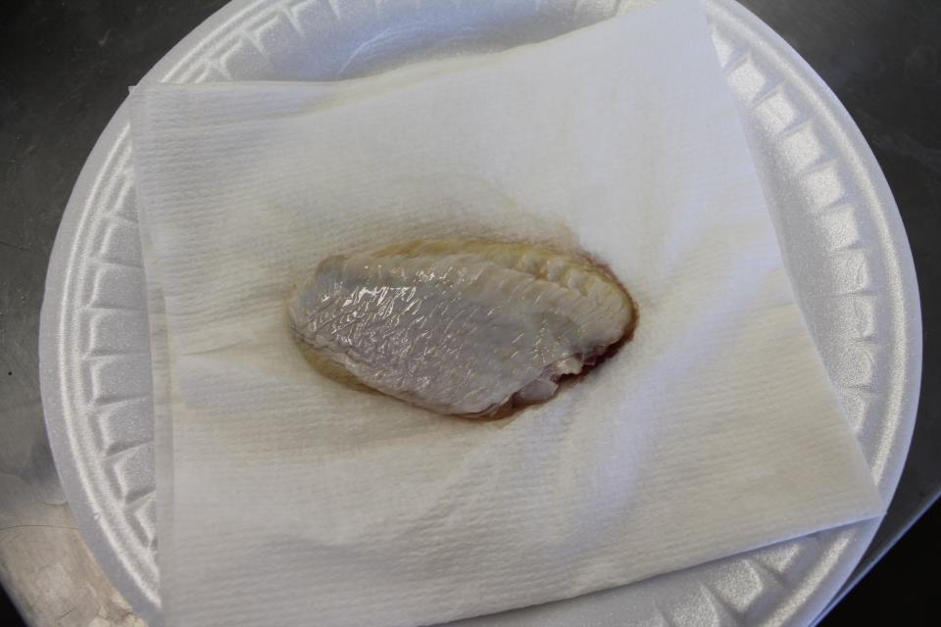
Identify this
broiler part.
3

Slide 4
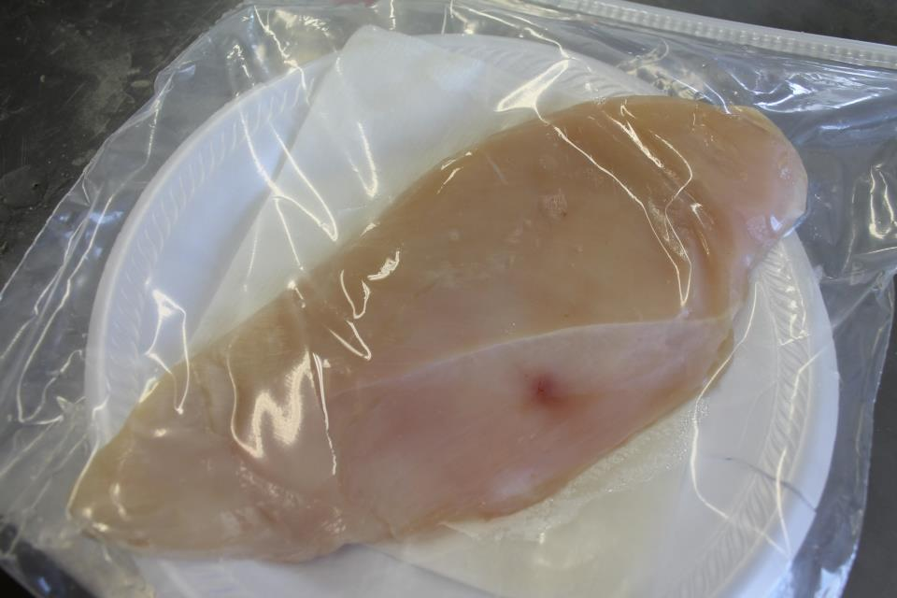
Identify this
broiler part.
4

Slide 5
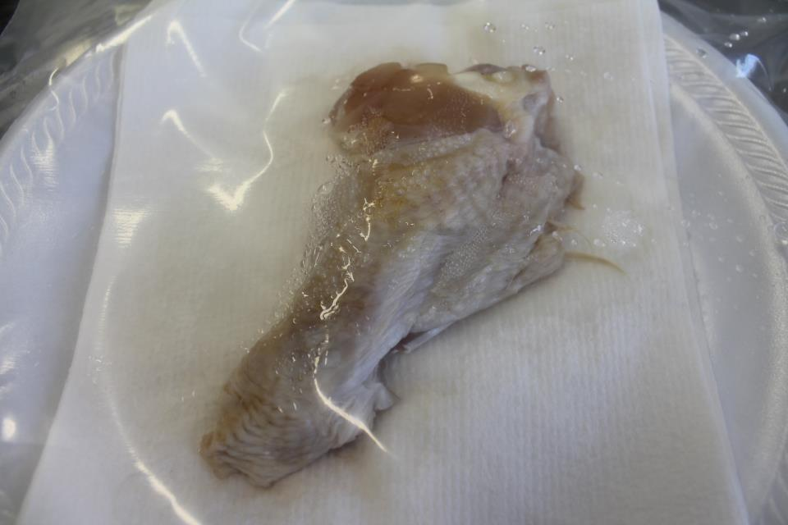
Identify this
broiler part.
5

Slide 6
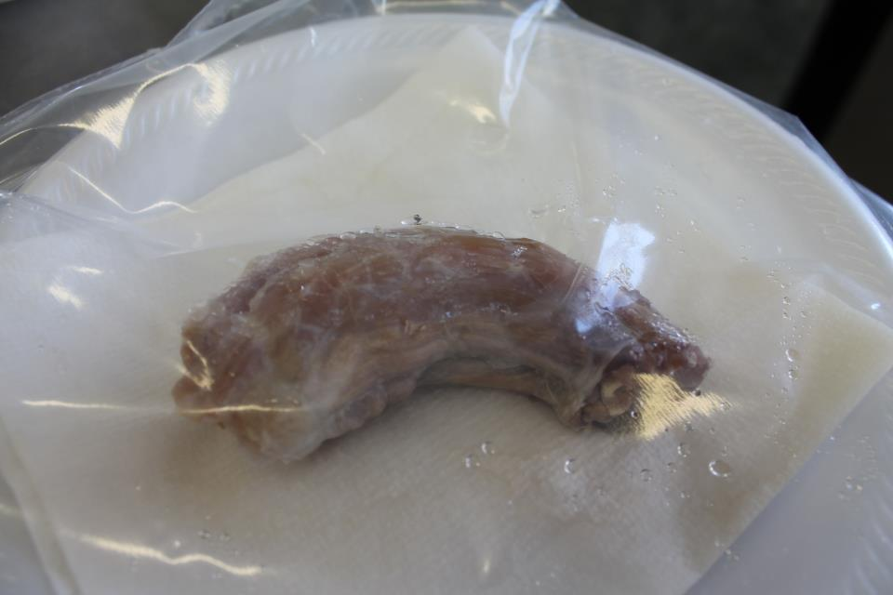
Identify this
broiler part.
6

Slide 7
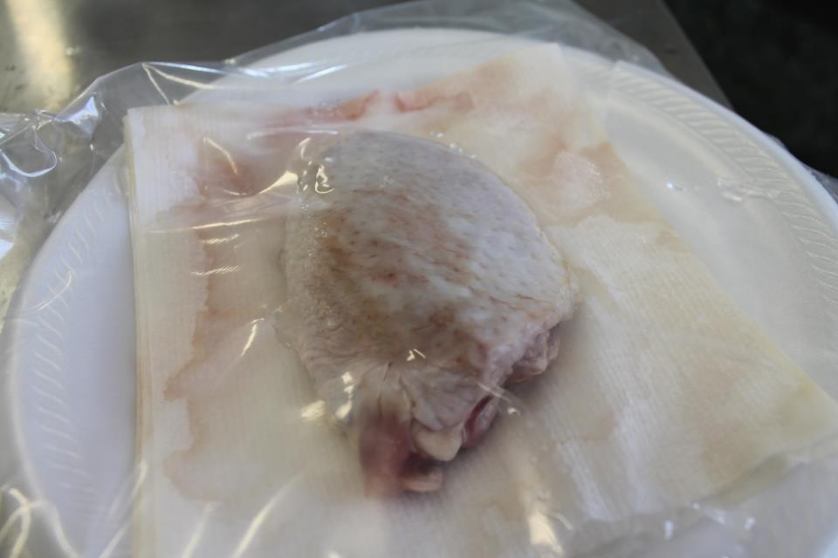
Identify this
broiler part.
7

Slide 8
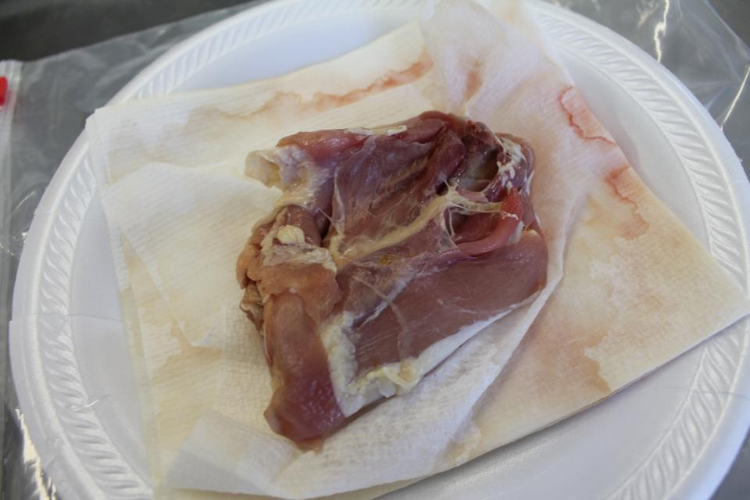
Identify this
broiler part.
8

Slide 9
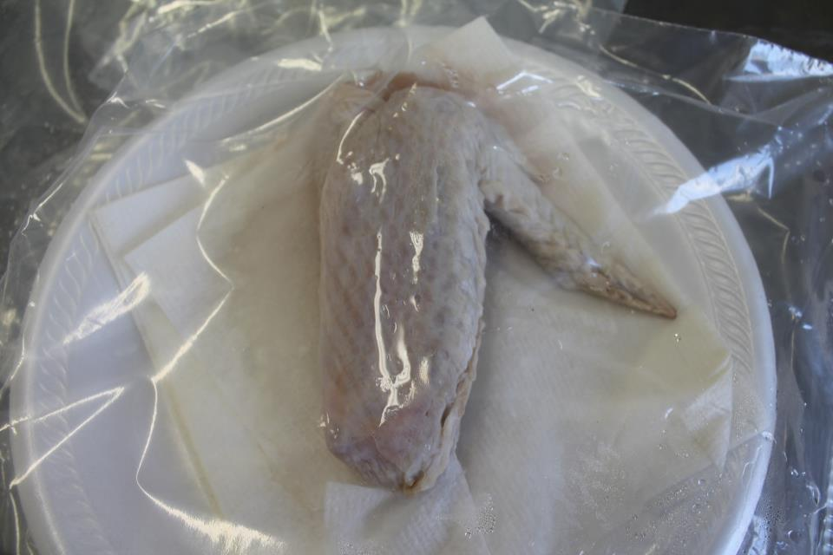
Identify this
broiler part.
9

Slide 10
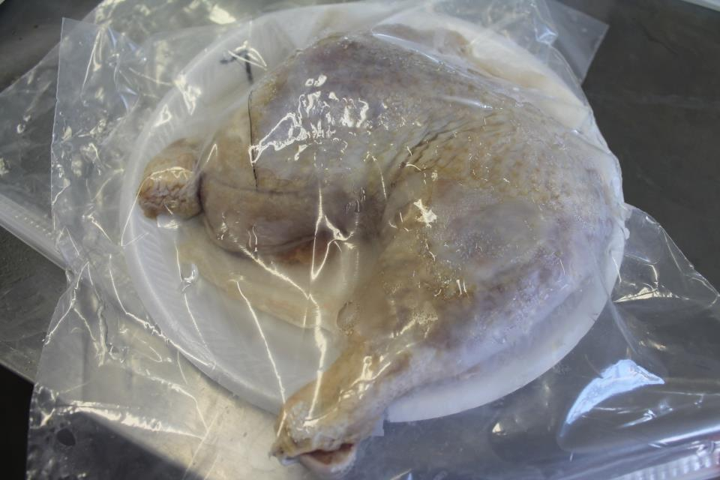
Identify this
broiler part.
10

Slide 11
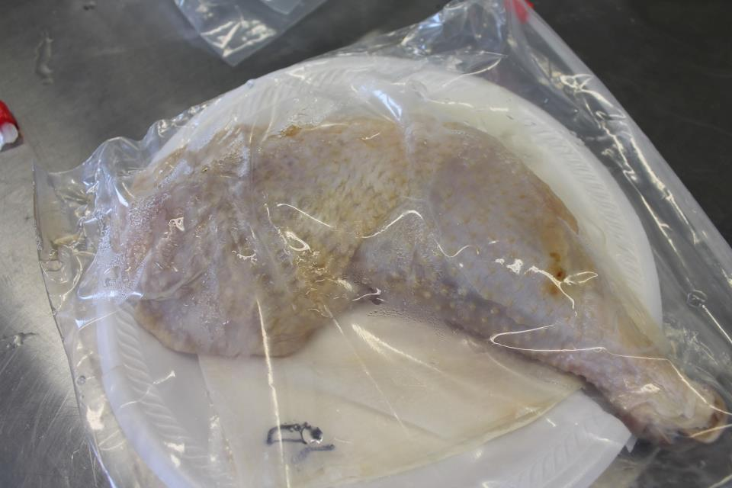
Identify this
broiler part.
11

Slide 12
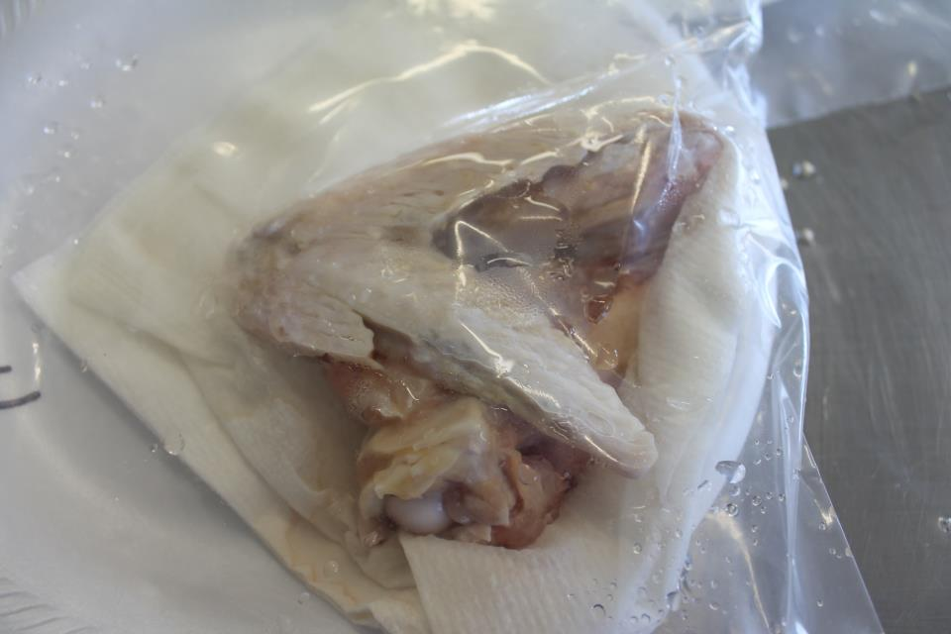
Identify this
broiler part.
12

