Slide 1
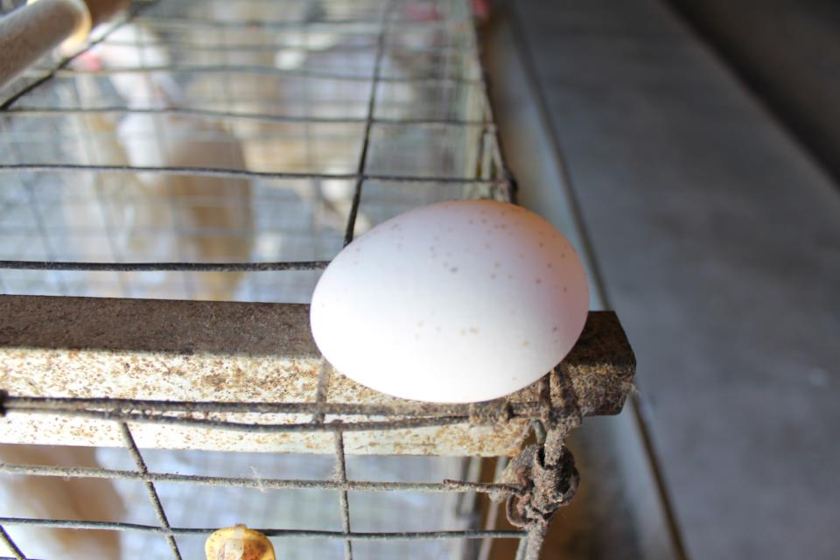
Place the USDA grade for the exterior egg shell quality of each egg.
1

Slide 2
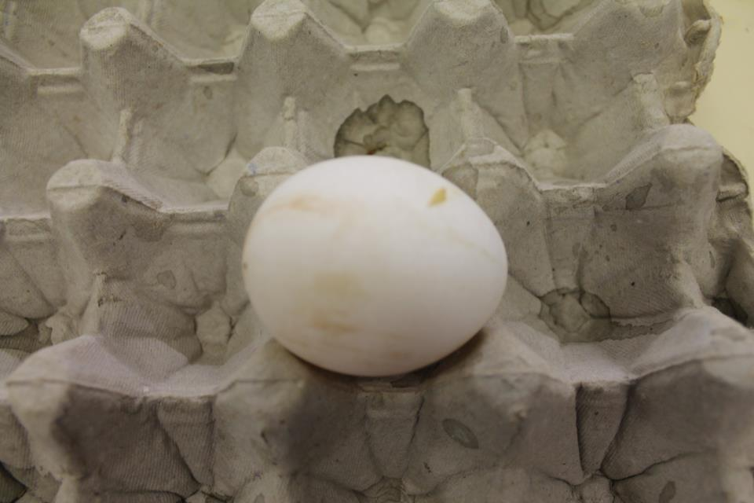
Place the USDA grade for the exterior egg shell quality of each egg.
2

Slide 3
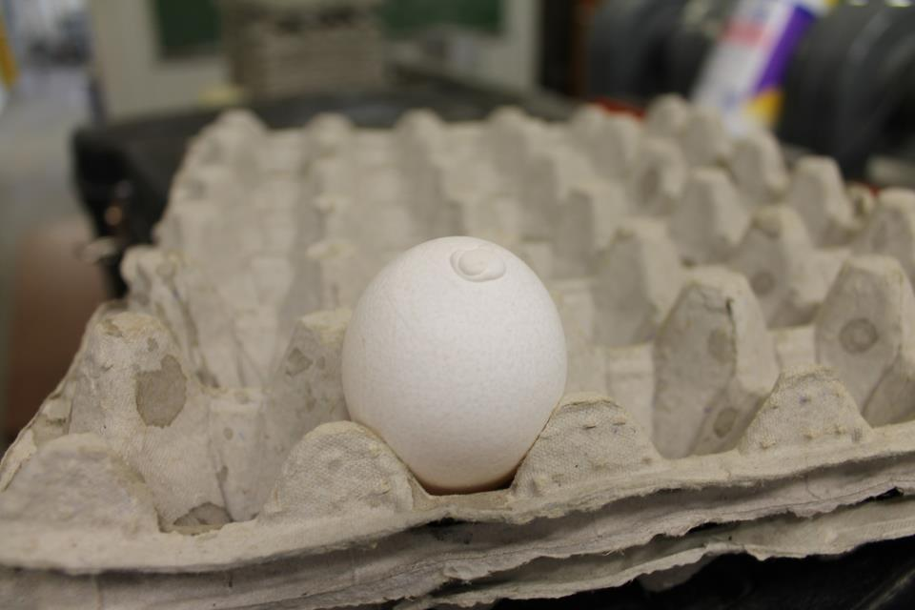
Place the USDA grade for the exterior egg shell quality of each egg.
3

Slide 4
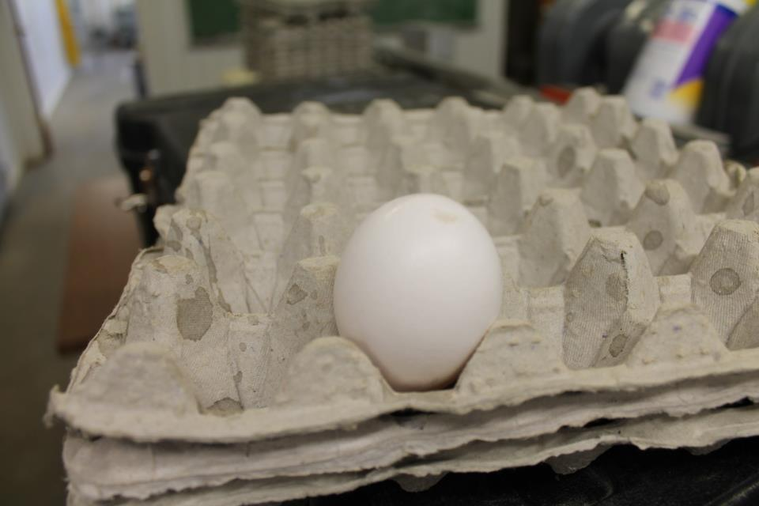
Place the USDA grade for the exterior egg shell quality of each egg.
4

Slide 5
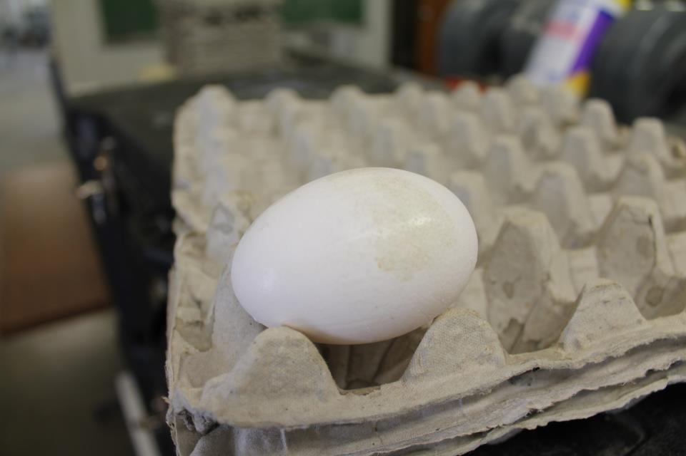
Place the USDA grade for the exterior egg shell quality of each egg.
5

Slide 6
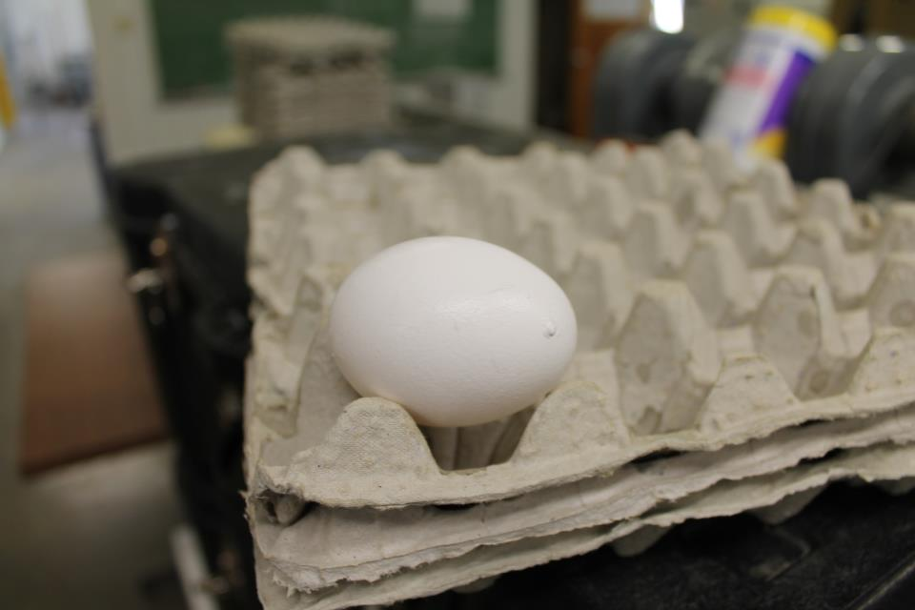
Place the USDA grade for the exterior egg shell quality of each egg.
6

Slide 7
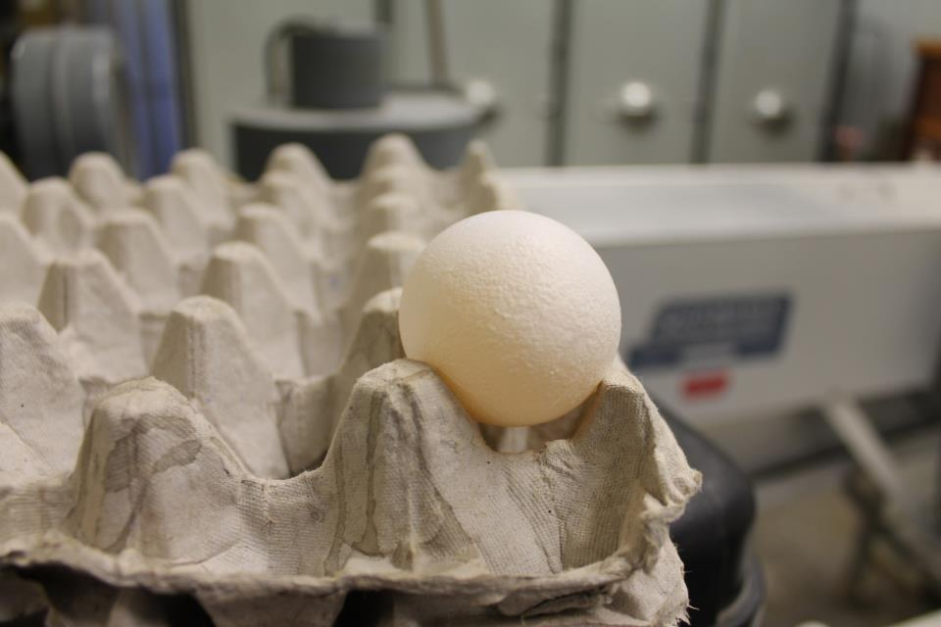
Place the USDA grade for the exterior egg shell quality of each egg.
7

Slide 8
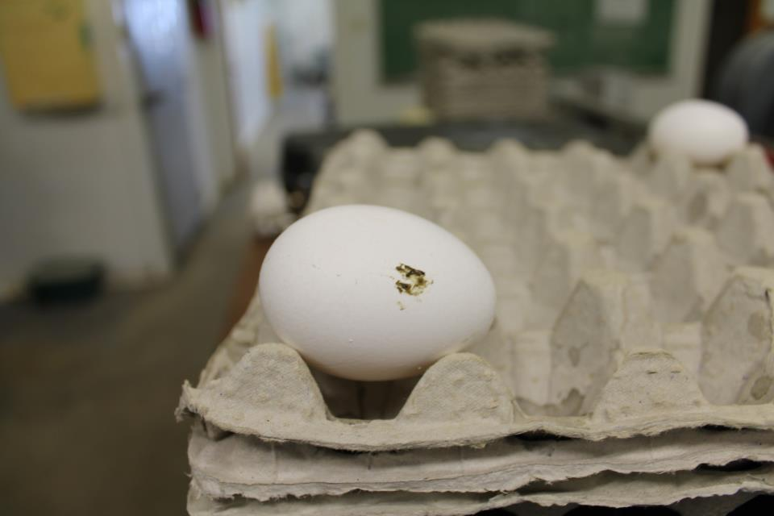
Place the USDA grade for the exterior egg shell quality of each egg.
8

Slide 9
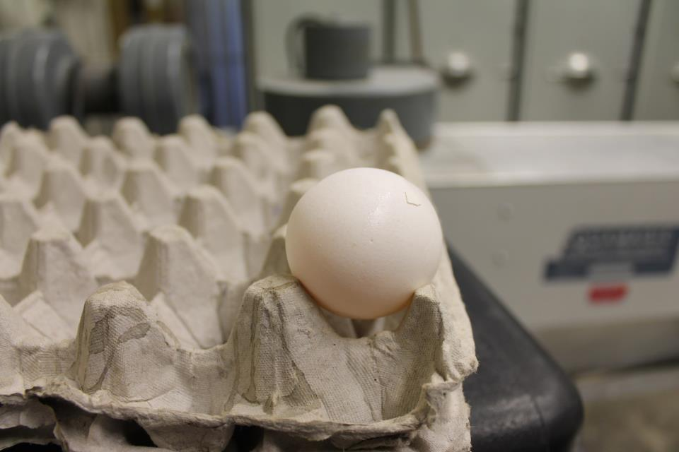
Place the USDA grade for the exterior egg shell quality of each egg.
9

Slide 10
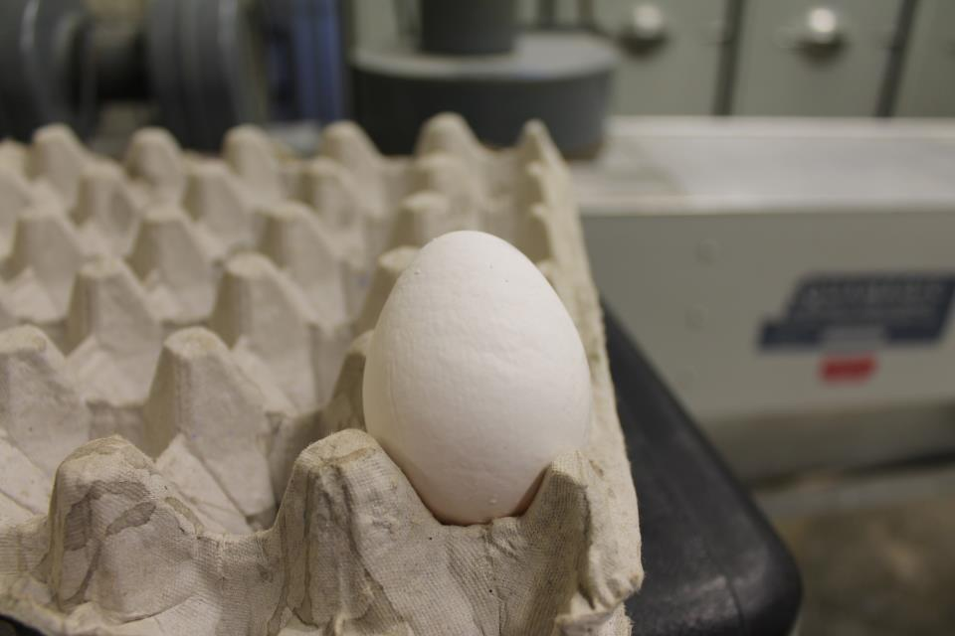
Place the USDA grade for the exterior egg shell quality of each egg.
10

Slide 11
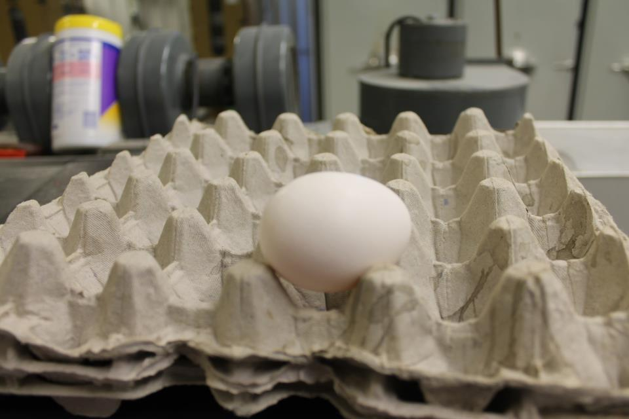
Place the USDA grade for the exterior egg shell quality of each egg.
11

Slide 12
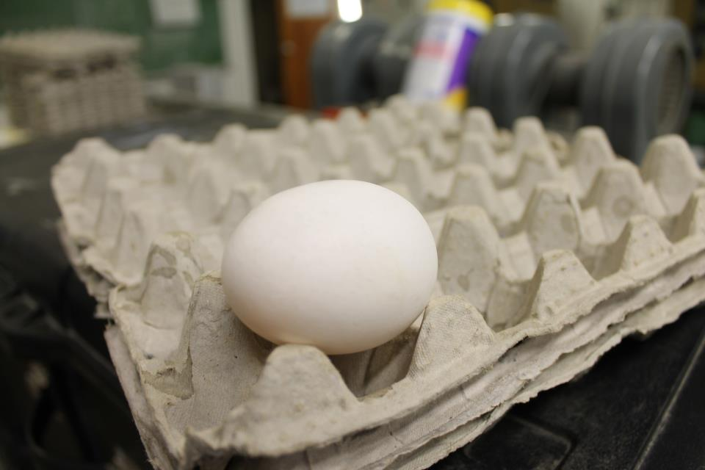
Place the USDA grade for the exterior egg shell quality of each egg.
12

Slide 13
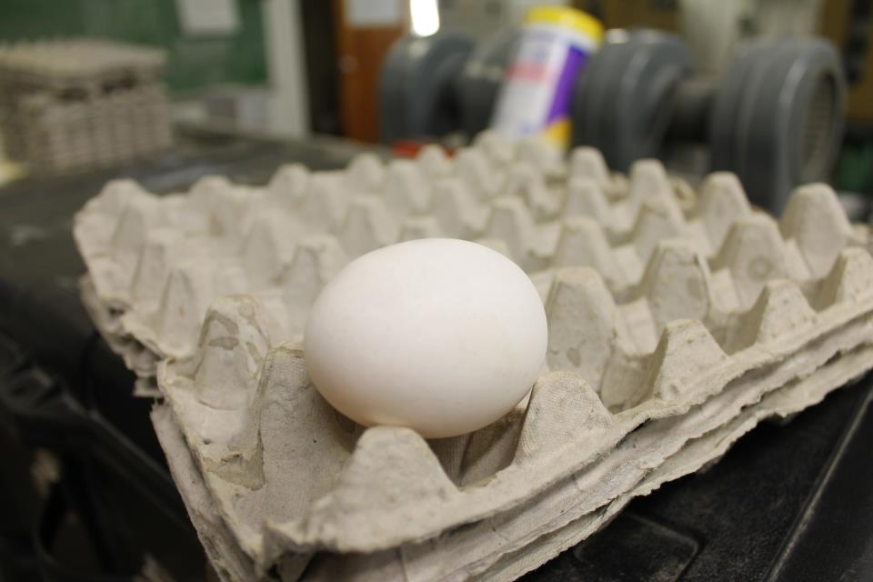
Place the USDA grade for the exterior egg shell quality of each egg.
13

Slide 14
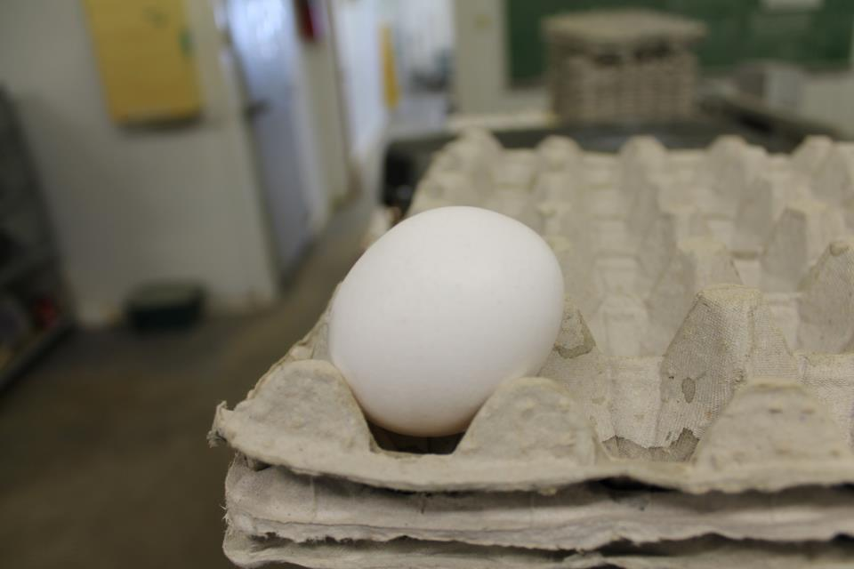
Place the USDA grade for the exterior egg shell quality of each egg.
14

Slide 15
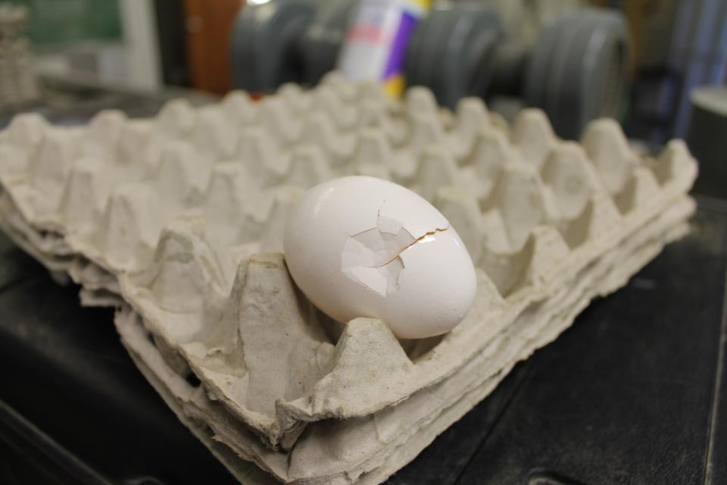
Place the USDA grade for the exterior egg shell quality of each egg.
15

