Slide 1


Evaluation of cellulose in diets with and without added ZnO on nursery pig performance
Jenna A. Chance*, Mike D. Tokach, Hilda I. Calderón, Jason C. Woodworth, Joel M. DeRouchey, and Robert D. Goodband
Kansas State University, Manhattan
Abstract # 245

Slide 2
Introduction
Adding pharmacological levels of Zn from ZnO to nursery pig diets has been widely accepted to help control diarrhea and subsequently improve growth performance post-weaning.
Alternatives to pharmacological additions of Zn in the early nursery are being explored due to environmental and antimicrobial resistance concerns.

Slide 3
Introduction
High insoluble fiber sources are of interest as they function to improve gut microflora and enzymatic activity, minimize stool looseness, reduce the instances of antibiotic injections, and improve growth performance.
  Flis et al., 2017
Cereal grains high in insoluble fiber can be expensive if not available locally and can pose risk from mycotoxins or other components that can hinder pig growth.
Concentrated cellulose products can mitigate some of these risks while providing insoluble fiber to the diet.

Slide 4
Objective
Determine the effect of adding cellulose in combination with pharmacological levels of Zn, provided by ZnO, on nursery pig growth performance.

Slide 5
Materials & Methods
A total of 1,296 weaned pigs (PIC L337×1050; initially 4.8 kg)
27 pigs/pen and 12 pens/treatment were filled over two days
Pigs were randomly assigned to pens at weaning and allotted to 1 of 4 dietary treatments.
Dietary treatments were set up as a 2×2 factorial with main effects of:
  Cellulose (0 vs 1% in phase 1 and 2)
    J. Rettenmaier USA LP, Schoolcraft, MI
  Zn from ZnO (200 vs 3,000 mg/kg in phase 1 diets and 110 vs 2,000 mg/kg in phase 2 diets)

Slide 6
Materials & Methods
The experimental period was fed in two phases:
  Phase 1: 1.8 kg/pig (d 0 to ~d 7)
  Phase 2: ~d 7 to d 21
A common phase 3 diet, without added cellulose or ZnO, was fed from d 21-42.
Phase 1 diets were manufactured by Hubbard feeds (Worthington, MN) and fed in a pellet form.
Phase 2 and 3 diets were manufactured by New Horizon Farms (Pipestone, MN) and fed as a meal.

Slide 7
Composition of nursery diets (as-fed basis)
Ingredient, % | Phase 1 (d 0 to ~7) | Phase 2 (d ~7 to 21) | Phase 3 (d 21 to 42)
Corn | 40.35 | 54.22 | 65.19
Soybean meal, 46.5% CP | 27.37 | 31.82 | 29.81
Blood plasma | 2.50 | --- | ---
Whey powder | 12.50 | --- | ---
Whey permeate, 80% lactose | 11.25 | 9.00 | ---
Fat | 3.00 | 1.00 | 1.00
Amino acids | 0.85 | 1.17 | 1.13
Vitamins and minerals | 2.20 | 2.80 | 2.88
Zinc oxide | +/- | +/- | ---
Cellulose | +/- | +/- | ---
Total | 100 | 100 | 100
Notes:
Diets either contained ZnO or cellulose alone or in combination at the expense of corn.

Slide 8
Calculated analysis of nursery diets
 | Phase 1 (d 0 to ~7) | Phase 2 (d ~7 to 21) | Phase 3 (d 21 to 42)
SID lysine | 1.35 | 1.35 | 1.30
NE, kcal/kg | 2,635 | 2,489 | 2,476
SID lysine: NE, g/Mcal | 5.12 | 5.42 | 5.25
Crude protein, % | 20.8 | 20.8 | 20.5
Calcium, % | 0.69 | 0.69 | 0.71
STTD P, % | 0.56 | 0.52 | 0.46
NDF, % | 5.8 vs 6.8 | 7.5 vs 8.4 | 8.4
Zinc, mg/kg | 200 vs 3,224 | 110 vs 2,018 | 110
Notes:
Formulated to 1.35 SID Lys in P1 & P2 and 1.3 SID Lys in P3 then other nutrients were formulated to meet or exceed the NRC requirement estimates for nursery pigs. If we look at our neutral detergent fiber %, we can see that when cellulose was included it raised NDF by ~1% in both phases 1 and 2. In regards to our calculated analysis of Zn, we either had the basal TM level vs. 3,224 mg/kg Zn in P1 and 2,018 mg/kg in P2.

Slide 9

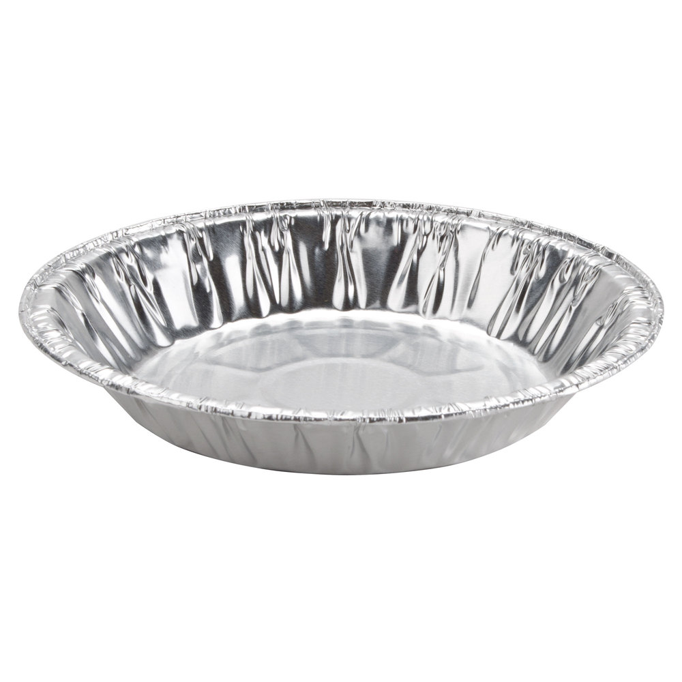



Materials & Methods
Fecal samples were taken from 3 randomly selected pigs/pen on d 16/17.
Fecal DM % = (dried sample weight at 48 h – pan weight) / (initial wet sample weight – pan weight) × 100
48 hours in 55°C forced air oven
Notes:
Scale: c9d2994d7d483002ef057556c691e383.jpg (450×450) (pinimg.com)
Pan: 377631.jpg (1000×1000) (webstaurantstore.com)
Feces: realistic-turd-brown-feces-cartoon-shit-defecation-poop-vector-poopn-95955802.jpg (800×800) (dreamstime.com)
Oven: clipart-kitchen-animated-18.png (2400×1374) (webstockreview.net)

Slide 10
Materials & Methods
Visual fecal scores were taken on d 16/17 using a 1-5 scale.
  Hard, pellet-like feces
  Firm, formed feces
  Soft, moist feces
  Soft, unformed feces
  Watery feces

Slide 11
Materials & Methods
The experiment was conducted at New Horizon Farms research facility (Pipestone, MN) which has mechanical ventilation and plastic slated flooring.
Each pen was equipped with a six-hole stainless steel dry feeder and pan waterer to provide ad libitum access to feed and water.
Pigs were weighed weekly to determine ADG, ADFI, and G:F.

Slide 12
Materials & Methods
Growth performance and fecal dry matter data were analyzed as a RCBD with treatments arranged in a 2×2 factorial using the nlme package of R (Version 4.0.0, R Foundation for Statistical Computing, Vienna, Austria) with pen as the experimental unit.
Fecal score data were analyzed using the ordinal package of R (Version 4.0.0, R Foundation for Statistical Computing, Vienna, Austria).
The main effects of cellulose and added ZnO, as well as their interactions, were tested.
Differences between treatments were considered significant at P ≤ 0.05 and marginally significant at 0.05 < P ≤ 0.10.

Slide 13
Experimental ADG, d 0 to 21
Cellulose × ZnO, P = 0.715
Cellulose, P = 0.011
ZnO, P < 0.001
SEM = 5.3
Chance et al., 2021

Slide 14
Experimental ADFI, d 0 to 21
Cellulose × ZnO, P = 0.490
Cellulose, P = 0.161
ZnO, P = 0.002
SEM = 6.5
Chance et al., 2021

Slide 15
Experimental G:F, d 0 to 21
Cellulose × ZnO, P = 0.493
Cellulose, P = 0.117
ZnO, P < 0.001
SEM = 0.01
Chance et al., 2021

Slide 16
Body weight, d 21
Cellulose × ZnO, P = 0.890
Cellulose, P = 0.125
ZnO, P < 0.001
SEM = 0.13
Chance et al., 2021

Slide 17
Common period, d 21 to 42
 | No zinc oxide |  | With zinc oxide |  |  | Probability, P =
Cellulose: | Without | With | Without | With | SEM | Cellulose × ZnO | Cellulose | ZnO
ADG, g | 508 | 495 | 523 | 523 | 6.5 | 0.269 | 0.297 | 0.001
ADFI, g | 704 | 690 | 733 | 734 | 11.2 | 0.452 | 0.481 | <0.001
G:F, g/kg | 723 | 717 | 714 | 714 | 0.01 | 0.459 | 0.518 | 0.155
Chance et al., 2021

Slide 18
Overall ADG, d 0 to 42
Cellulose × ZnO, P = 0.622
Cellulose, P = 0.023
ZnO, P < 0.001
SEM = 5.4
Chance et al., 2021

Slide 19
Overall ADFI, d 0 to 42
Cellulose × ZnO, P = 0.412
Cellulose, P = 0.138
ZnO, P < 0.001
SEM = 7.9
Chance et al., 2021

Slide 20
Overall G:F, d 0 to 42
Cellulose × ZnO, P = 0.493
Cellulose, P = 0.117
ZnO, P < 0.001
SEM = 0.01
Chance et al., 2021

Slide 21
Body weight, d 42
Cellulose × ZnO, P = 0.510
Cellulose, P = 0.155
ZnO, P < 0.001
SEM = 0.26
Chance et al., 2021

Slide 22
Fecal Dry Matter, d 16/17
Cellulose × ZnO, P = 0.426
Cellulose, P = 0.883
ZnO, P = 0.316
SEM = 0.951
Chance et al., 2021

Slide 23
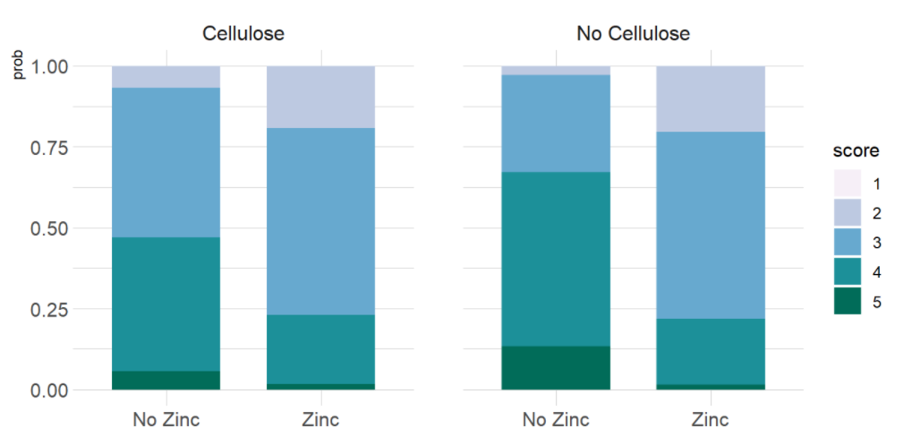
Fecal Scores, d 16/17
- Hard feces
- Firm, formed feces
- Soft, moist feces
- Soft, unformed feces
- Watery feces
Cellulose × ZnO, P = 0.192
Cellulose, P = 0.268
ZnO, P < 0.001
SEM = 0.149
Chance et al., 2021

Slide 24
Conclusions
Pharmacological levels of added Zn improves growth performance of nursery pigs.
  Increased ADG, ADFI, G:F, and BW
Cellulose had a negative impact on ADG.
No difference in fecal DM for any dietary treatment.
  Pigs fed ZnO had visually firmer feces.

Slide 25

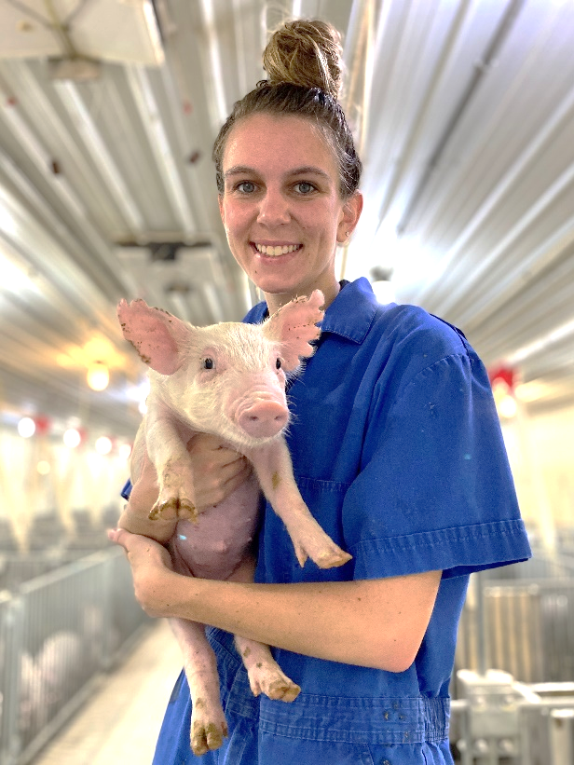


Thank you!
www.ksuswine.org
Notes:
Thanks to J. Rettenmaier USA LP for the supply of the cellulose product and for financial support ad NHF for hosting this study.

