Slide 1
OPTIMIZING THE USE OF ON-FARM FORAGE RESOURCES
Chris Reinhardt, Ph.D.
Extension Beef Specialist
Kansas State University

Slide 2
QUIZ:
Is Nitrate toxic to cattle?
Yes and No
What is the REAL problem compound?
Nitrite is 10x as toxic as NO₃

Slide 3
Nitrate Poisoning
NO₂ → RBCs
→ combines w hemoglobin
→ methemoglobin
Methemoglobin cannot transport O₂ vs. hemoglobin
↑ Heart rate / respiration \
Blood / tissues → BLUE to CHOCOLATE BROWN
muscle tremors, staggering, eventual suffocation
Abortion

Slide 4
QUIZ:
WHICH IS MORE EFFECTIVE:
Prevention
vs
Treatment?

Slide 5
QUIZ:
WHICH IS MORE EFFECTIVE:
PREVENTION
vs
Treatment?

Slide 6
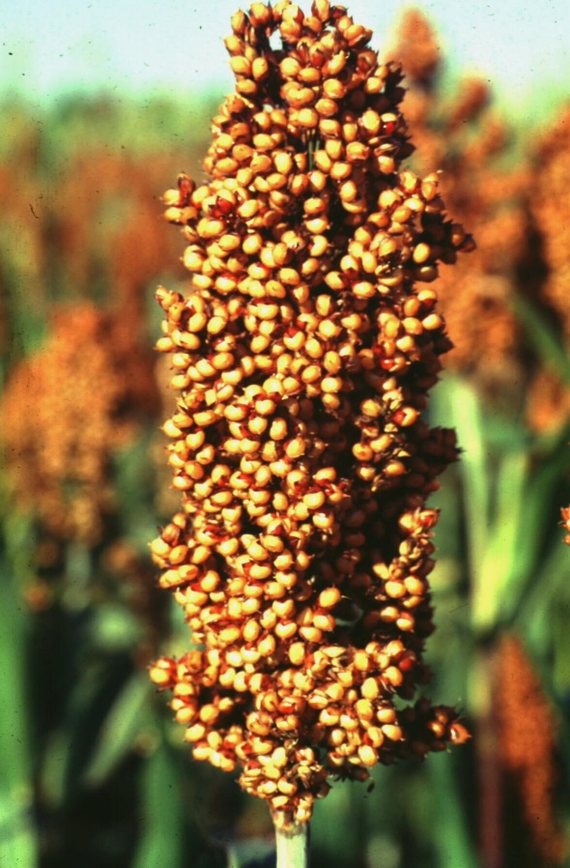
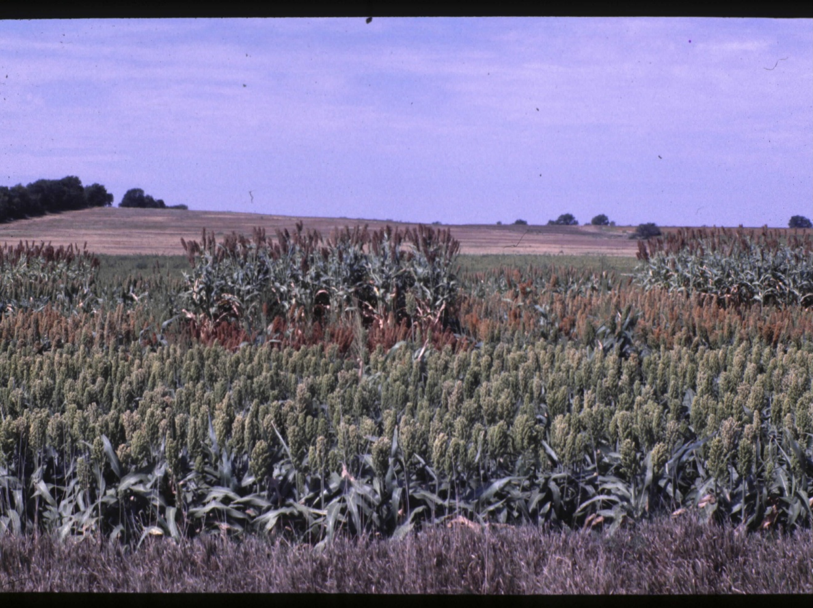
Testing forages…

Slide 7
Common plants known to accumulate nitrate:
Crops Weeds
Barley Canada Thistle
Corn Dock
Flax Jimsonweed
Millet Johnson Grass
Oats Kochia
Rape Lambsquarter
Rye Nightshade
Soybean Pigweed
Sorghum Russian Thistle
Sudangrass Smartweed
Sugar beets Wild Sunflower
Sweetclover
Wheat

Slide 8
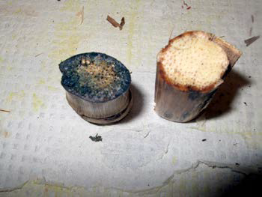
Diphenylamine Test http://www.asi.ksu.edu/doc6194.ashx
Intense BLUE color = forage contains potentially dangerous nitrate levels
If POSITIVE send the forage for analysis prior to feeding.
L. Hollis – Vet Quarterly, Fall 2012

Slide 9
QUIZ:
Why am I up here talking about Nitrate toxicity THIS year?

Slide 10
Current situation…
Drought
Rain → Regrowth = LOADED!
Harvested forage tests from eastern KS
Wheat, triticale
≥ 7,000 ppm – 18,000 (!)
Volunteer corn, Sorghum tillers
Turnips, Radishes
15,000 – 31,000 (!!!)
East > West
Fertilization rates…

Slide 11
QUIZ:
What is considered the “toxic” level of NO₃ in forages?
3,000 ppm NO₃
4,400 ppm NO₃
6,500 ppm NO₃

Slide 12
Prevention:
Test
If droughthy, test and confirm
If droughthy and fertilized, likely HIGH
Safe: ≤ 3,000 ppm
Nitrate! (not NO₃-N)
If NO₃-N then ≤ 1,000 ppm (or 1,500 ppm)
Safe to Blend: 3,000-20,000
Blend down to “safe” level
>20,000: DO NOT FEED
Let it go…too risky…cover crop

Slide 13
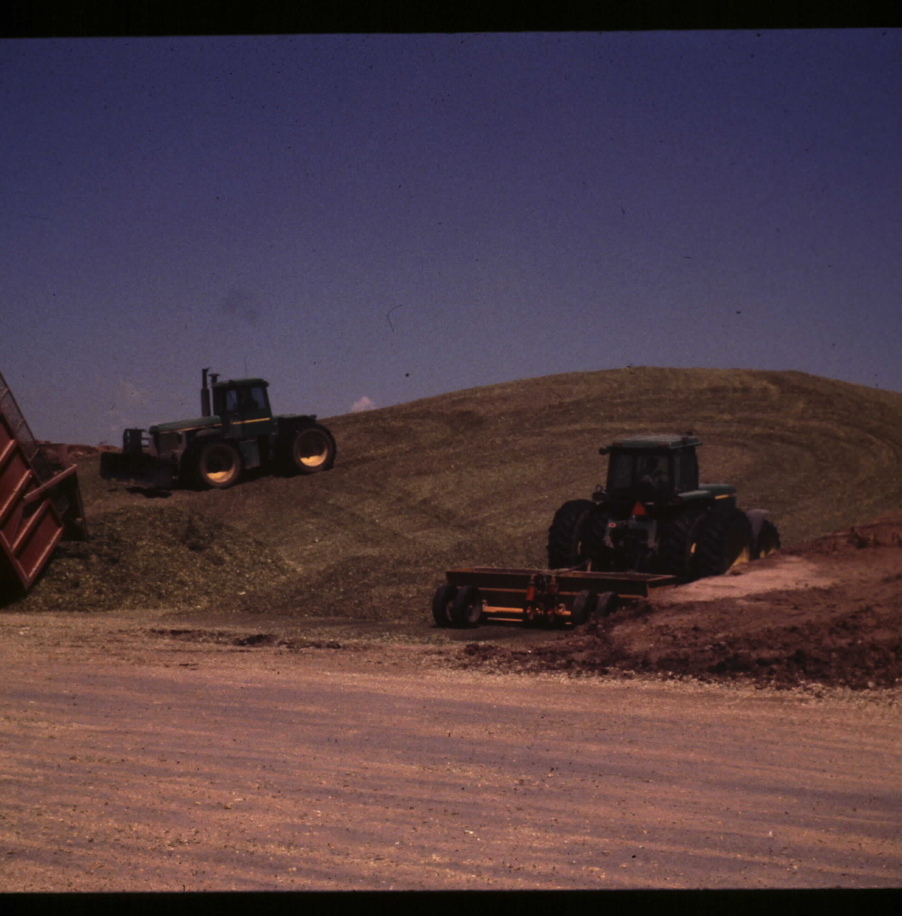
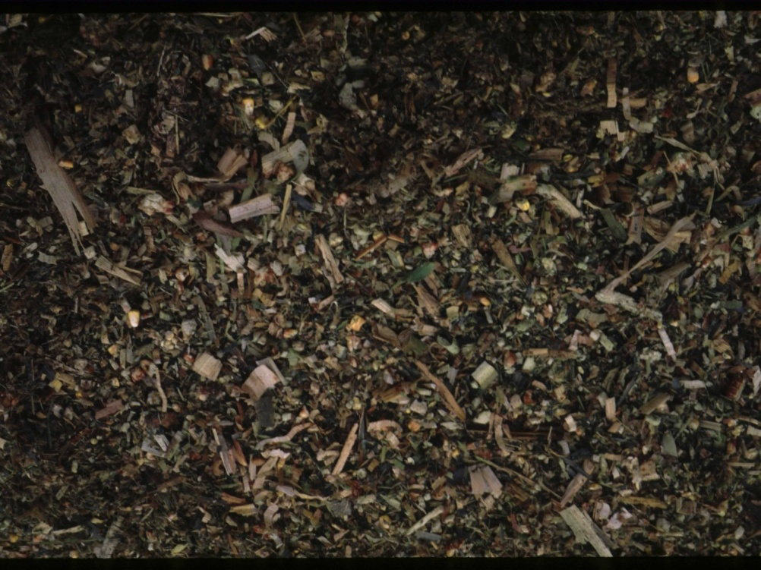
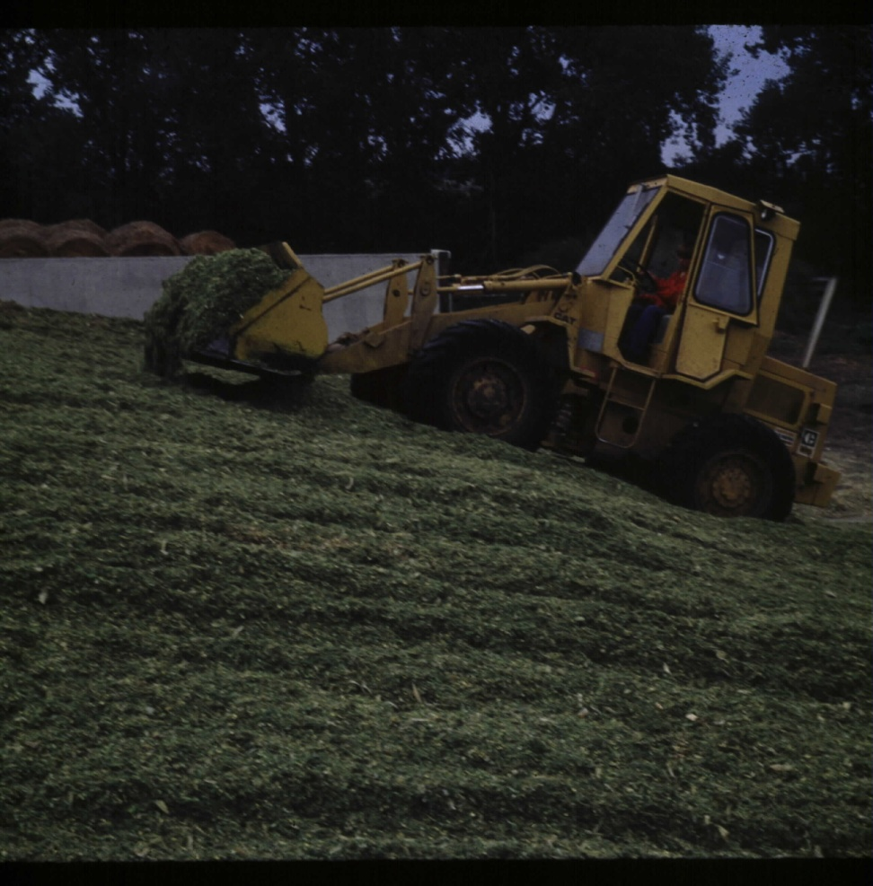
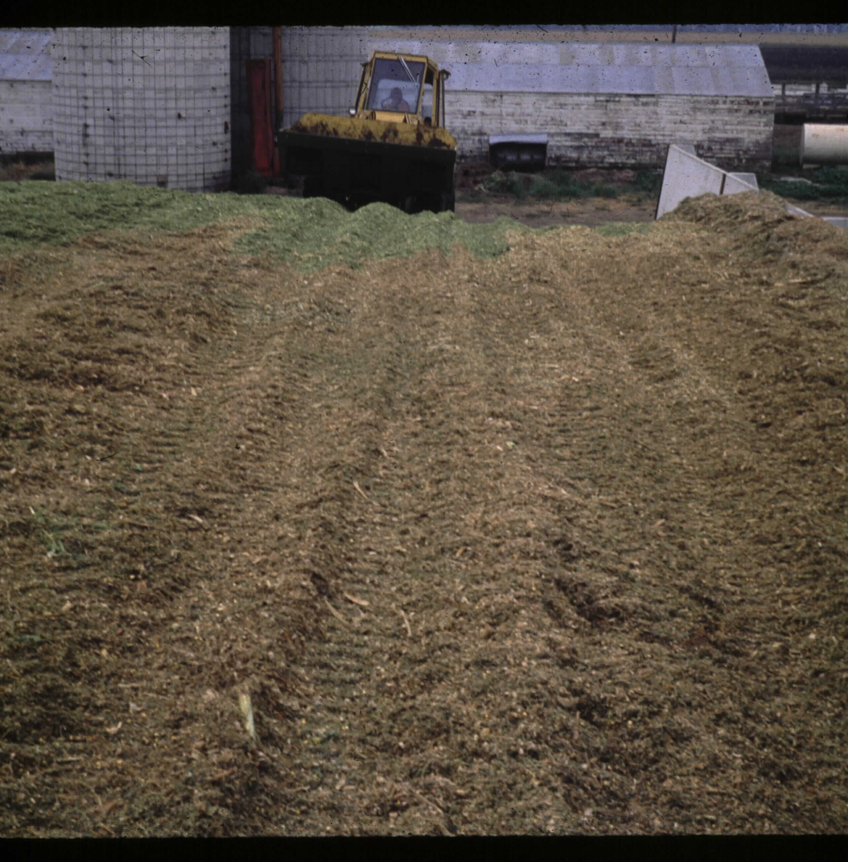
QUIZ:
Does ensiling affect NO₃ levels in forages?
How much?

Slide 14
Mitigating factors:
Ensiling reduces nitrate content 30-70%
About half…

Slide 15
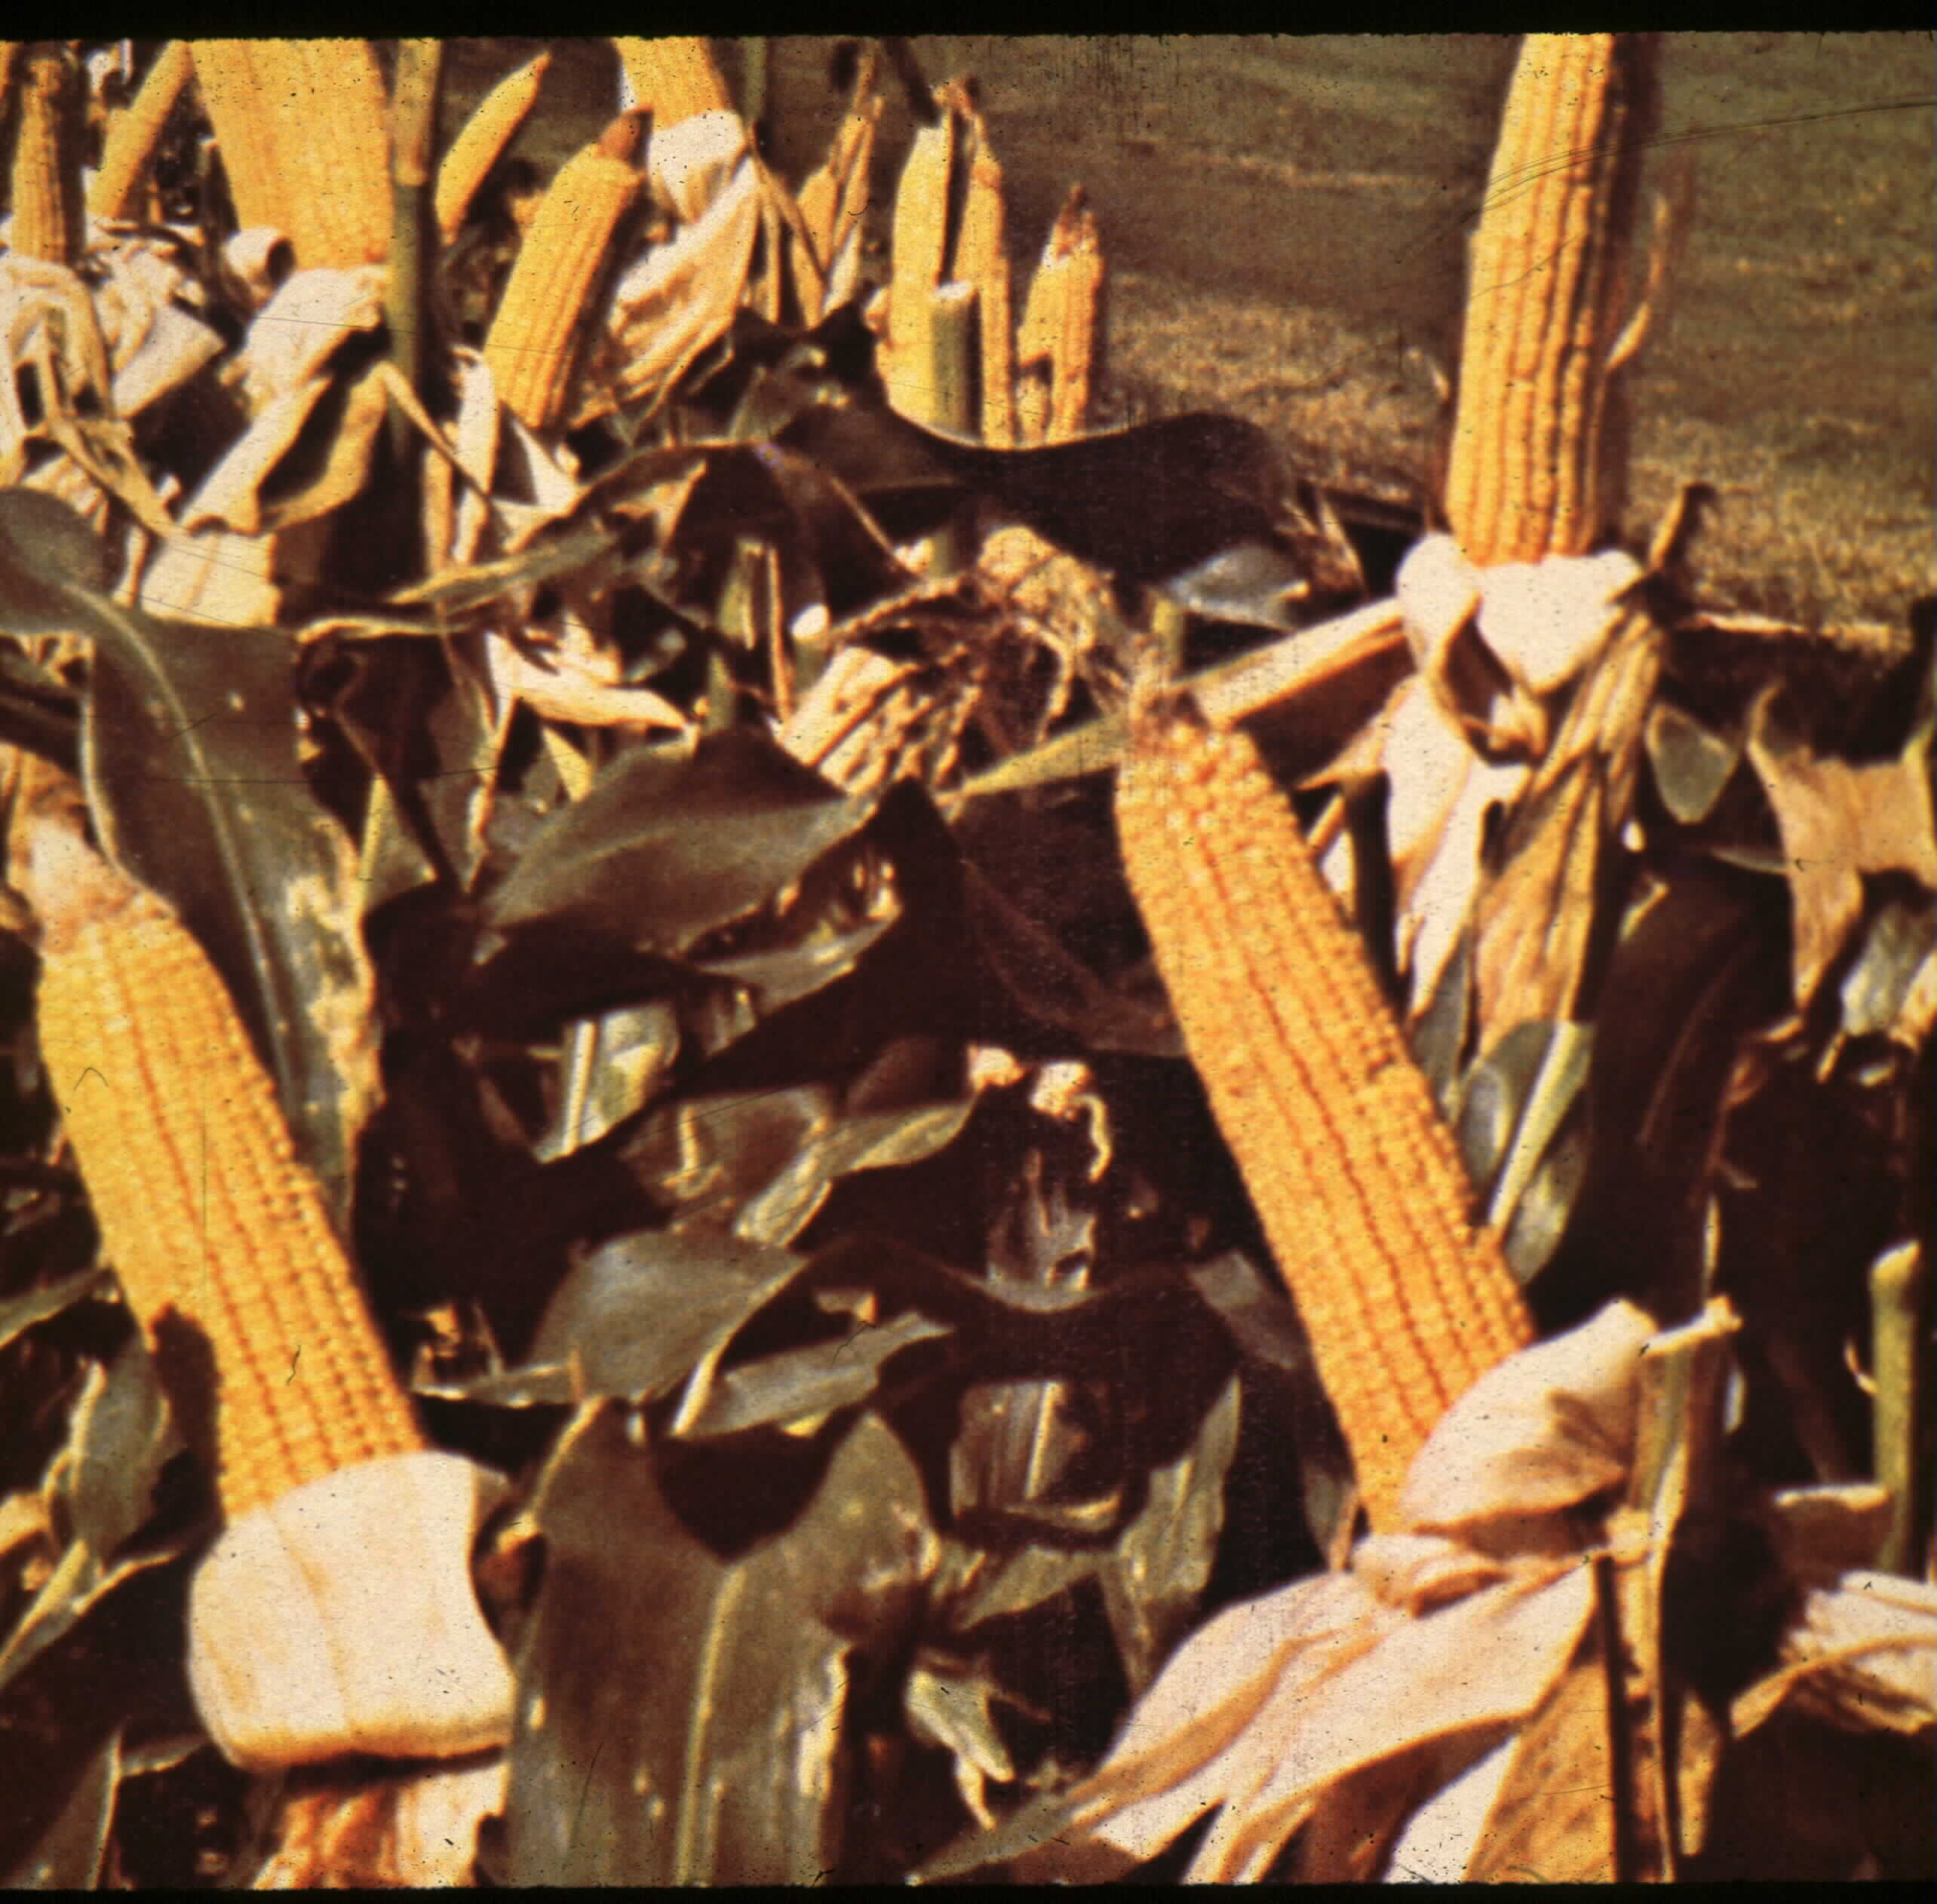
Does grain feeding affect NO3 toxicity?
How / Why?

Slide 16
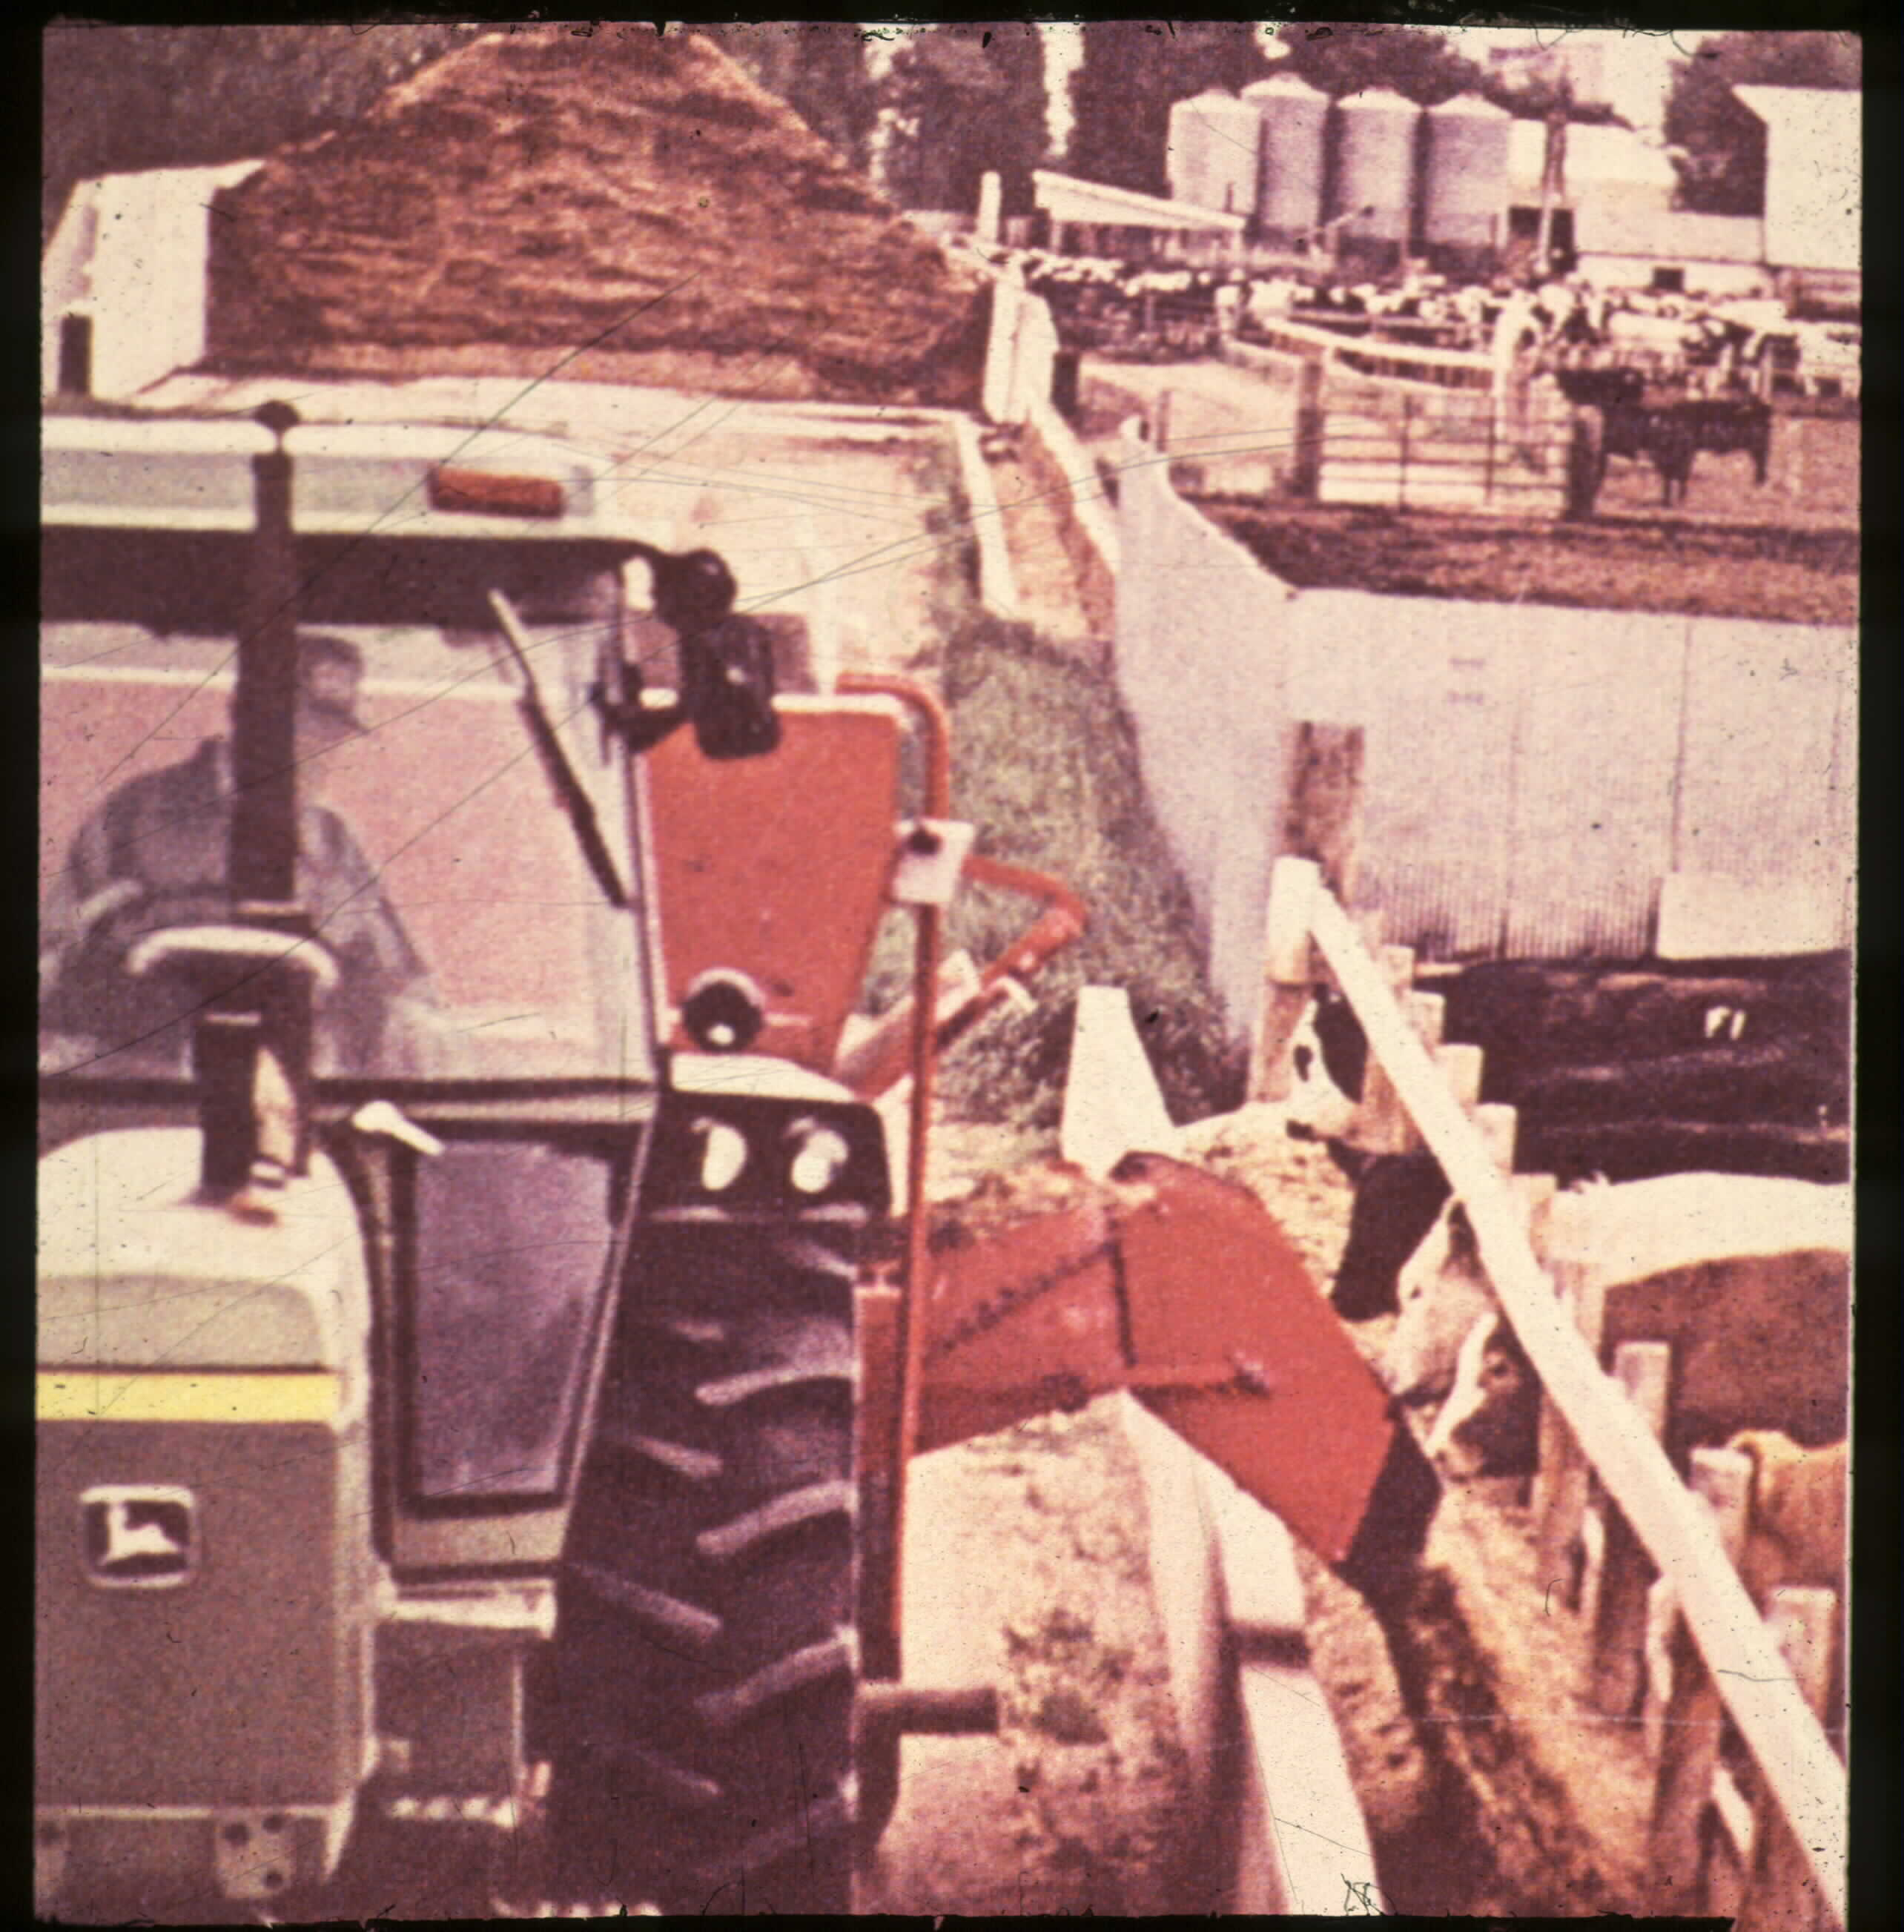
Grain feeding reduces “toxicity”
↓ rumen pH speeds transition from
NO₃ → NO₂ → NH₃

Slide 17
Avoiding Toxicity
Testing forages
Standing
Harvested
Cut corn for silage 12-18” from ground
More NO₃ nearer ground
Stalk > leaf > grain
Blend down “hot” feeds
Feed grain / DG / etc.
Don’t turn HUNGRY cattle into suspect forages

Slide 18
Treatment:
Methylene blue:
Compliance Policy Guidelines (CPG) Sec. 608.400,
Compounding of Drugs for Use in Animals
possible carcinogen
180-d withdrawal
L. Hollis – Vet Quarterly, Fall 2012

Slide 19
EVERYTHING HAS A VALUE…
…almost anyway.
Extension has never had more value than during the present situation.
This is why we exist:
Toxicity
Nutrition
Value

Slide 20
EVERYTHING (nearly) HAS A VALUE…
“Trust but verify…”
Test everything before you feed it.
Some forage may not work for cows but may work in the feedlot

Slide 21
Nutrition 101
Low quality forages:
Corn stalks
Wheat straw
Soybean stubble
Milo stalks
Dormant grass
1st limiting nutrient???
Protein…

Slide 22
Nutrition 101
Protein response???
↑ Intake
Why???
Feed the bugs…
…bugs digest the forage and they feed the cow

Slide 23
Supplementation w DG?
start
“SBM/CSM”
“DG”
No “supplement”
Bandyk et al. (1998) casein infusion

Slide 24
ADG on Grass w/ DG
Klopfenstein et al. (2007)

Slide 25
F:G of supplementation on Grass w/ DG
Klopfenstein et al. (2007)

Slide 26
DG Substitution for Grass
Klopfenstein et al. (2007)

Slide 27
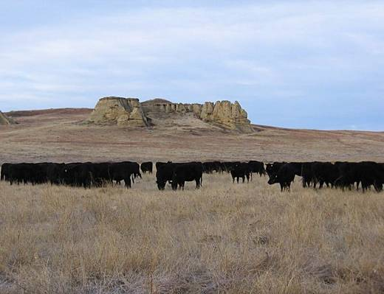
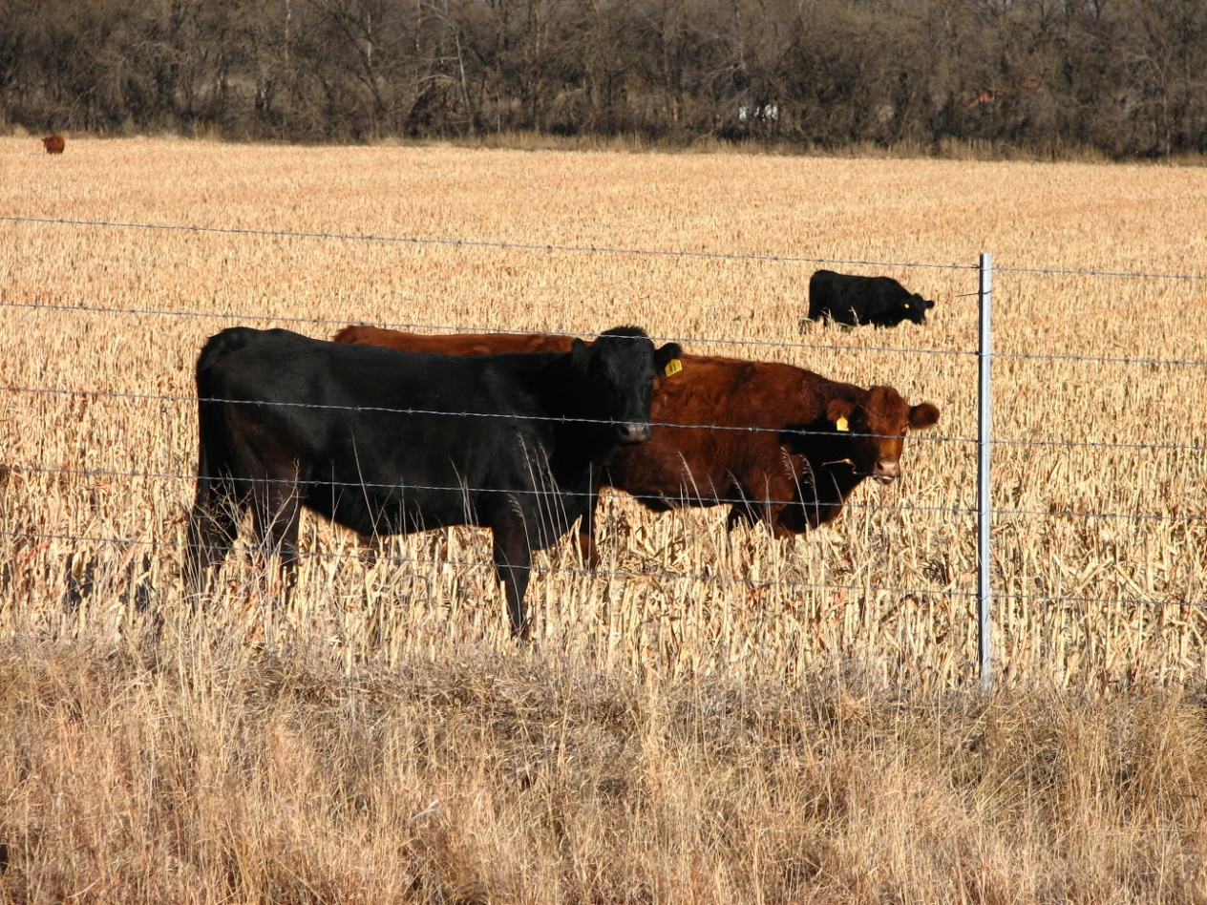
Examples
Cows on dormant range/crop residue
Low energy
4-6% Crude Protein
DG (~30% CP) = 68% of SBM
$330 vs $480 SBM
DG @ ~$260
Mid-gestation
6 lbs DG Dry basis +19 lb straw
Late-gestation
8 lbs DG +9 lb straw + 10 lb grass hay

Slide 28
Examples
Lactation
10 lb DG
16 lb grass hay
5 lb straw

Slide 29
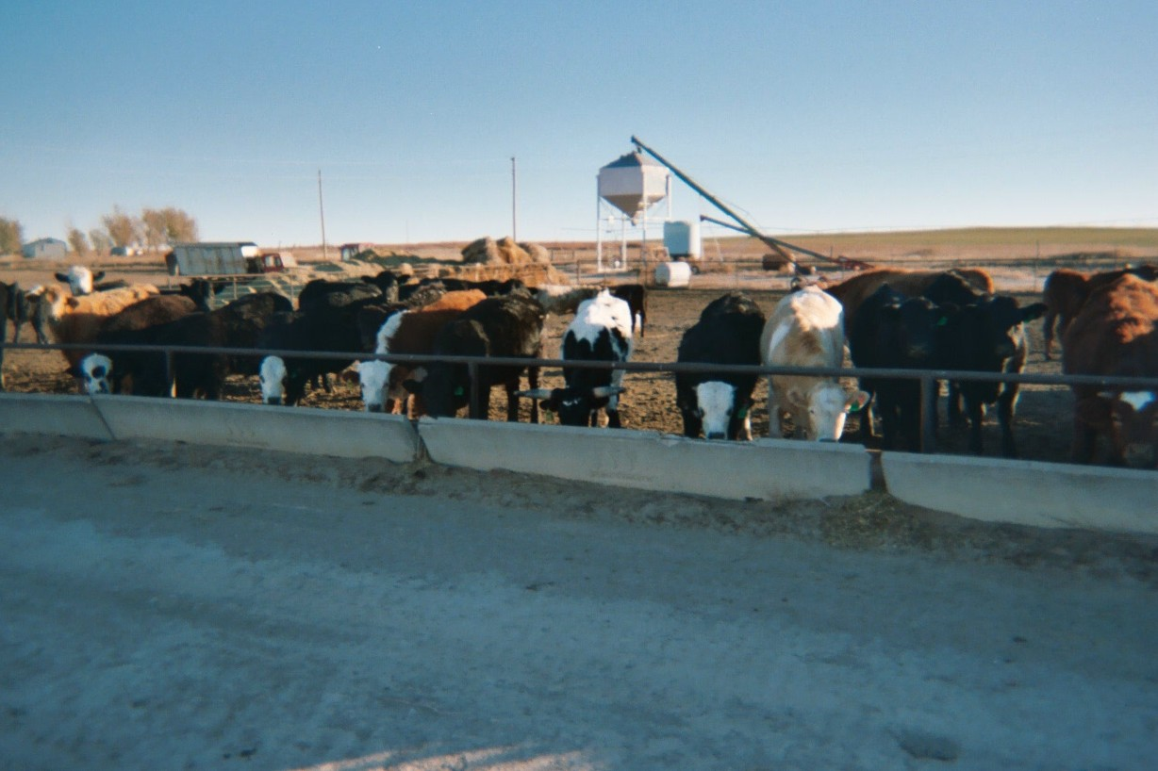
Examples - Receiving calves
15% Crude Protein
Moderate energy (forage-based diet)
DG has energy value 115-130% of corn
6 lbs Dry basis

Slide 30
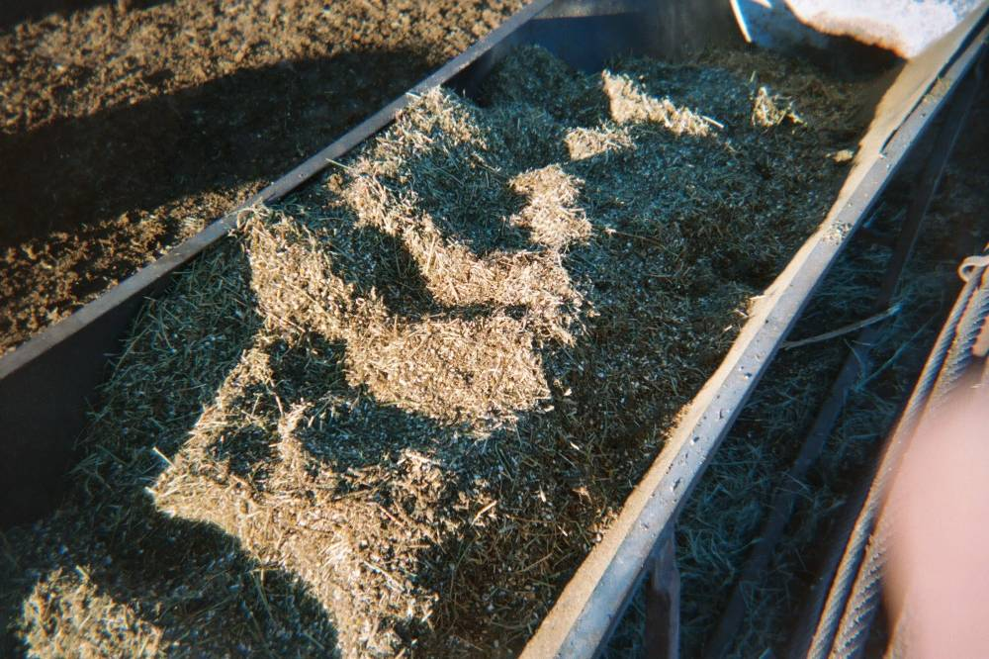
Examples
Growing calves
12% Crude Protein
Moderate energy (forage-based diet)
DG has energy value ~115% of corn
5-8 lbs Dry basis

Slide 31
Waste?
Is it ONLY about cost?

Slide 32
